Slide 1
First Order Logic
8/31/21

Slide 2
Learning Objectives
Differentiate among various logics
Express first order logic (FOL) expressions
Differentiate syntax vs. semantics of FOL
Assess challenges of inference

Slide 3
Agenda: First Order Logic
Logics
Syntax of First Order Logic
Semantics of FOL
Inference

Slide 4
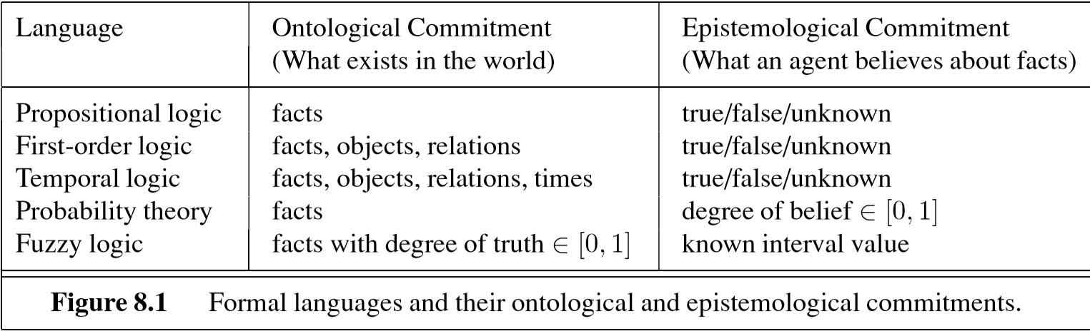
Various Logics
Example:
p = A helicopter has flown on Mars
Russell & Norvig
Notes:
Propositional logic is the simplest. It states facts—statements with one of three values: True, False, and Unknown (or “Neither”).
Despite its simplicity, this introduces an AI concept that is sometimes used: the Closed World Assumption, which states that if a statement is unknown, then it is assumed to be false.

Slide 5
Various Logics
Russell & Norvig
Notes:
The most common logic is First-order logic, in which we reason at the lowest meaningful level. Temporal logic accounts for time, as in I used to distrust every authority and I have recently changed my attitude towards authority—from which we can conclude I don’t distrust every authority. We will discuss fuzzy logic later in this module.

Slide 6
Agenda: First Order Logic
Logics
Syntax of First Order Logic
Semantics of FOL
Inference
Notes:
First Order Logic is the simplest level of logic that allows reasoning. First we discuss its syntax.

Slide 7
Elements of FOL
Constants JaneRMuldoon7, Denver, 345643, …
Predicates IsProgrammer(), LivesInBoston(), …
Variables x, y, …
Connectives ∧, ∨, ¬… ∧ is and; ∨ is or; ¬ is not
Equality = means is equivalent to
Quantifiers ∀, ∃, … ∀ is for every; ∃ is there exists
Notes:
FOL is a symbolic system that mirrors aspects of the real world. It consists of the symbols shown. Predicates take on the values true or false. They may have parameters. Think of them as you would in conversation rather than as in a programming language; for example you might say I’m at the beach (which is either true or false) or AtBeach(), a predicate with parameter—so AtBeach(Eric) is again true or false.

Slide 8
Example
English:
“Not every Amazon customer has written a review”
FOL:
∃x ∋ [Customer(x, Amazon) ∧
…
A predicate with 2 parameters
Notes:
The figure shows the beginning of a FOL representation of a real-world predicate (a statement with true/false value). It says something exists which is a customer of Amazon and … .
There may be several ways to say the same thing, such as ACustomer(y, AmazonCo) … but the important thing is to be consistent.

Slide 9
Example
English:
“Not every Amazon customer has written a review”
FOL:
∃x ∋ [ [Customer(x, Amazon) ∧
[∀p SoldBy(p, Amazon): ! HasReviewed(x, p)]
“such that”
Notes:
This completes the FOL representation as an x exists which is an Amazon customer and which is such that, for every p sold by Amazon, x has not reviewed p.

Slide 10
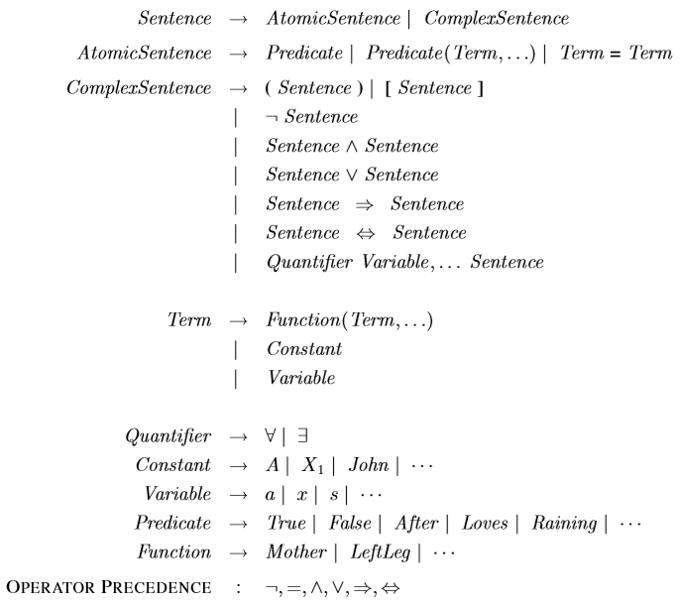
Syntax of First Order Logic
Russell & Norvig
Notes:
The figure begins to specify the form of FOL statements (“sentences”). It says that “every FOL sentence is either an AtomicSentence or a ComplexSentence; AtomicSentence’s are ether …”

Slide 11
Syntax of First Order Logic
Russell & Norvig
Notes:
The figure shows the entire syntax (although there are variations). The success of FOL in accomplishing useful tasks is analogous to that of mathematics, and the types of logics are analogous to the types of mathematics.

Slide 12
Example
¬Brother(Tom,John)
Brother(Richard,John) ∧ Brother(John,Richard)
King(Richard) ∨ King(John)
¬King(Richard) ⇒ King(John)
Russell & Norvig
Notes:
The first example in the figure says that Tomis not John’s brother. This assumes that we interpret the predicates in the self-evident manner. For example, in FOL, “Brother” is just a string: it is up to us to interpret it in the real world. We do in a consistent manner, throughout the problem we are dealing with.

Slide 13
More Realistic Example
Next step in my continuing education.
Constants BU, Northeastern, Harvard, JohnDoe …
Predicates LikesTo(…), Pays(…), Advancement(…)
Variables student, job, university, program, …
Rules (using quantifiers etc.) …
Procedure: Plug in a “world” (set of values)
Notes:
Logic is applicable to a very wide range of problems, such as the one in the figure.

Slide 14
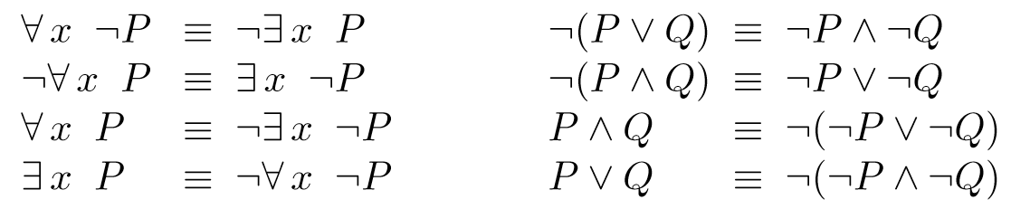
Some Relationships Between ∀ and ∃
Russell & Norvig
Notes:
There is an algebra (set of rules for FOL), which includes the above, and which reflect the real world. For example, at the bottom left, saying
some x satisfies property P
is the same as saying
it is not true that (every x satisfies P false).

Slide 15
Agenda: First Order Logic
Logics
Syntax of First Order Logic
Semantics of FOL
Inference

Slide 16
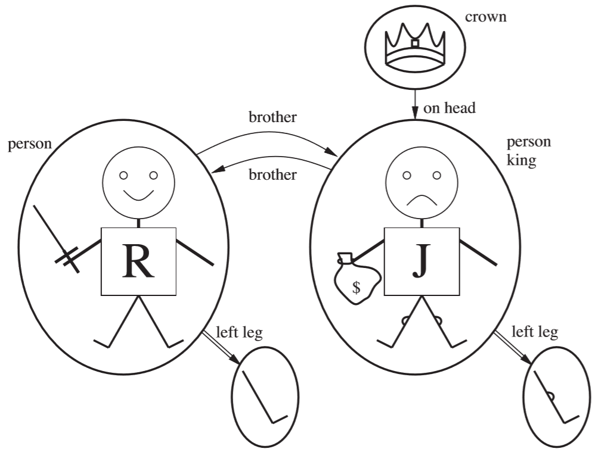
Models
Each “model” links the vocabulary of the logical sentences to elements of the possible world.
The domain of a model is the set of objects or domain elements it contains.
Adapted from Russell & Norvig p290
Notes:
Models are the link between (the symbolic) FOL and the situation (the possible “world”) that you want to apply it to.

Slide 17
Semantics of FOL
Predicates are true or false in a world (“model”).
e.g., FOL:
∃x ∋ [Customer(x, y) ∧
[∃y, p ∋ [HasReviewed(x, p) ∧ SoldBy(p, y)]]
--is true in the world where y is Amazon or WalMart

Slide 18
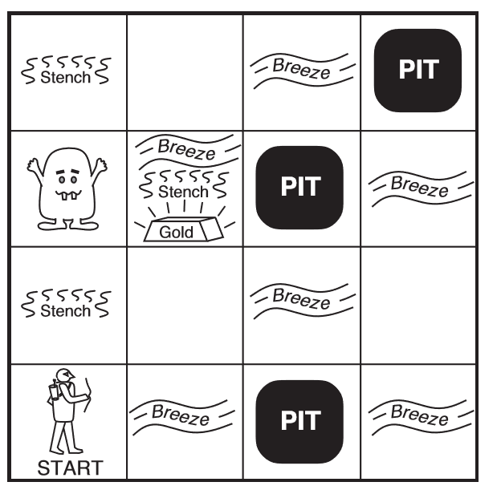
Toy Agent and FOL: WumpusWorld (R&N)
Can we express rules in FOL?
Russell & Norvig
Notes:
To exercise first order logic, Russell and Norvig developed a simplified world in which an agent moves so as to land on gold. The agent uses FOL to make decisions about movement. AI is needed when movements are not deterministic (e.g., always continue the direction you were following).
There is a stationary, agent-destroying wumpus. Its stench can be sensed immediately to its north, south, east and west. There is an unknown number of “pits”, which emit a breeze similarly.
We’ll express the WumpusWorld rules in FOL.

Slide 19
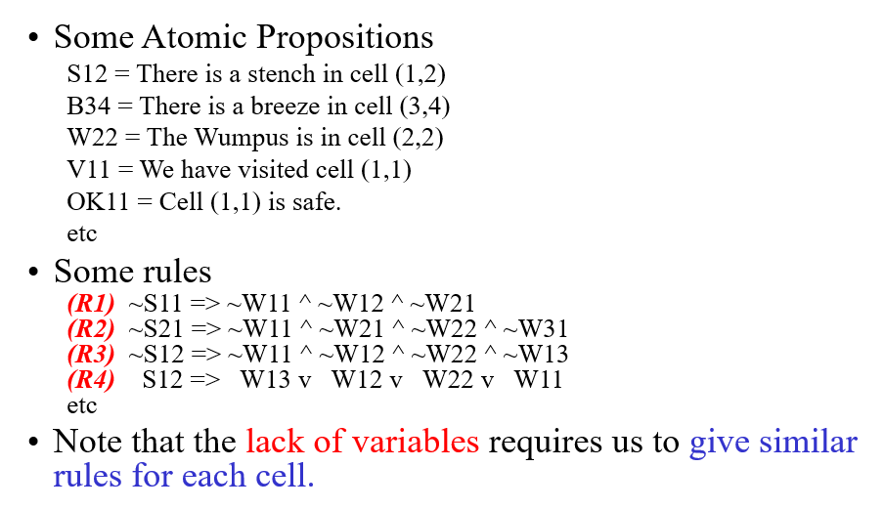
WupusWorld Rules (Tim Finin)
Notes:
First, we’ll use propositional logic (not FOL).
Rule R1 means, for example,
If there is no stench in cell (1,1), then the Wumpus is not in cells (1,1), (1,2), or (2,1).

Slide 20
Application of FOL to Programming: Dafny
AUTOMATICALLY VERIFYING SOURCE CODE
method MultipleReturns(x: int, y: int) returns (more: int, less: int) requires 0 < y ensures less < x < more { … }
https://rise4fun.com/dafny/tutorialcontent/guide
Notes:
FOL is being applied in to many domains. One is to programming itself—to verify that function code is correct. This is the field of program correctness, whose importance is recognized every time a company like Boeing loses billions due to incorrect programs.
To carry this out, the preconditions (“requires”) and postconditions (“ensures”) must be precisely specified in FOL, using Dafny syntax.

Slide 21
Application of FOL to Programming: Dafny
AUTOMATICALLY VERIFYING SOURCE CODE
method MultipleReturns(x: int, y: int) returns (more: int, less: int) requires 0 < y ensures less < x < more { more := x + y; less := x - y; }
https://rise4fun.com/dafny/tutorialcontent/guide
Notes:
The figure shows a code example that can be submitted to Dafny.

Slide 22
Quantifiers … What does this express?
method Find(a: array<int>, key: int) returns (index: int)
ensures 0 <= index ==> index < a.Length && a[index] == key
ensures index < 0 ==> forall k :: 0 <= k < a.Length ==> a[k] != key
{
….
}
https://rise4fun.com/dafny/tutorialcontent/guide
Notes:
The figure specifies a “find in an array” function. The second ensures specifies that a negative value of index is returned if key is not present in a.

Slide 23
What is this Saying … ?
method Find(a: array<int>, key: int) returns (index: int)
ensures 0 <= index ==> index < a.Length && a[index] == key
ensures index < 0 ==> forall k :: 0 <= k < a.Length ==> a[k] != key
{
index := 0; while index < a.Length invariant 0 <= index <= a.Length invariant forall k :: 0 <= k < index ==> a[k] != key { if a[index] == key { return; } index := index + 1; }
index := -1;
}
https://rise4fun.com/dafny/tutorialcontent/guide
Notes:
Dafny is not completely hands-off: it requires an invariant for every loop: predicates stating what each iteration of the loop does not change. The while loop shown in the figure has two invariants.

Slide 24
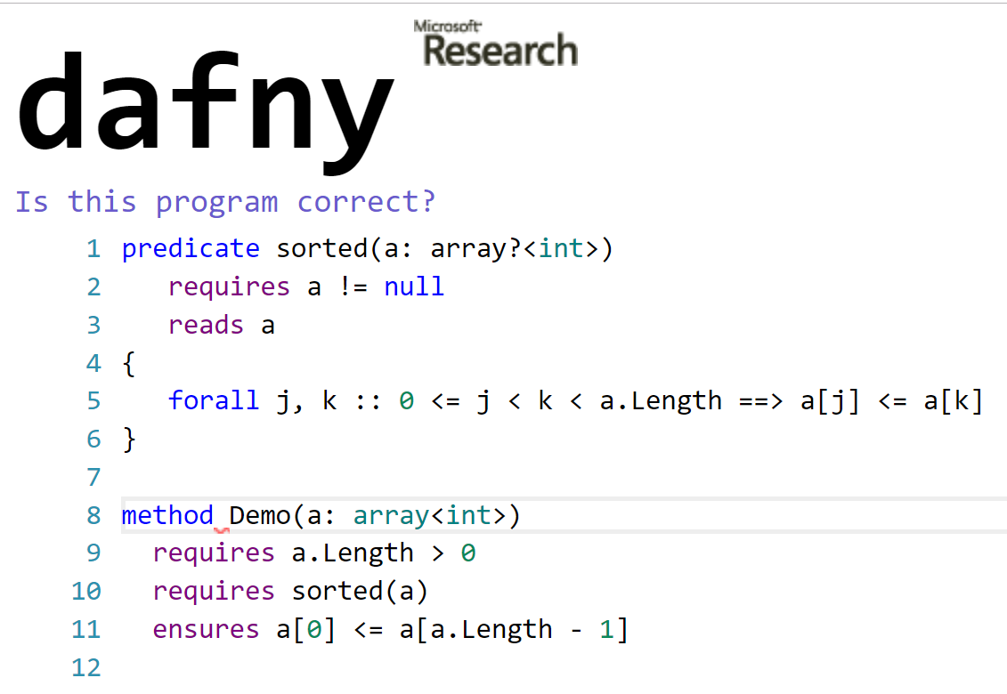
Expressing Predicates in Dafny
https://rise4fun.com/Dafny/SKw6
Notes:
It is possible to name predicats in Dafny (such as sorted) and then refer to them (such as in method Demo).

Slide 25
Agenda: First Order Logic
Logics
Syntax of First Order Logic
Semantics of FOL
Inference

Slide 26
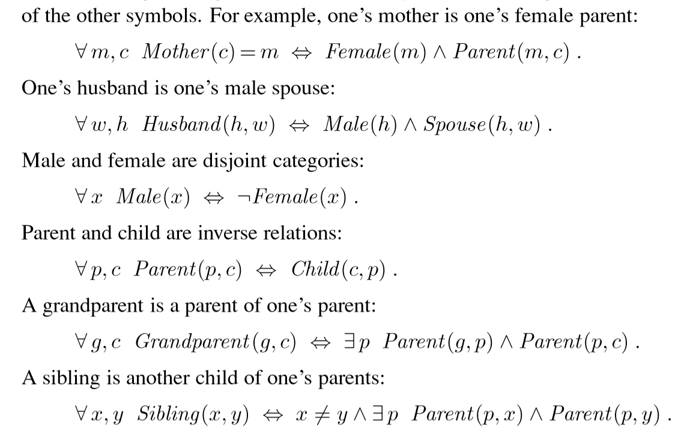
Everything Non-imply-able Must Be Supplied
Russell & Norvig
Notes:
Everything in a FOL system that does not follow from a set of existing propositions must be supplied. This can be laborious, as we have seen in Dafny, but the idea is to supply it once and use many times.

Slide 27
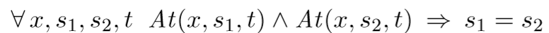
Selected FOL Statements
Notes:
A FOL system must be provided with a basis for operation. The figure shows selected FOL statements that we would have to provide to WumpusWorld (more later):
the definitions of the Adjacent predicate,
“objects can only be at one location at a time,” and
“a breeze is experiences at a cell if, and only if it is adjacent to a cell containing a pit.”

Slide 28
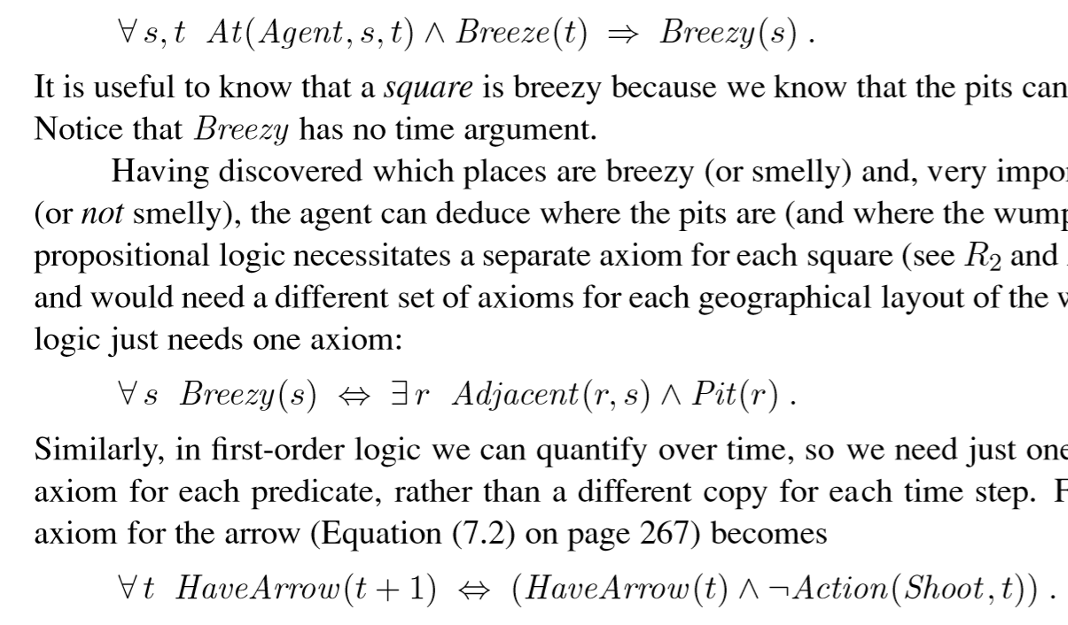
Everything Non-imply-able To Be Supplied e.g., WumpusWorld
Russell & Norvig
Notes:
The figure shown additional statements, including one about arrows(?) Two issues appear (1) when do we have enough? And (2) can contradictory facts be deduced? These are the kinds of theoretical questions that mathematical logic investigatges.

Slide 29
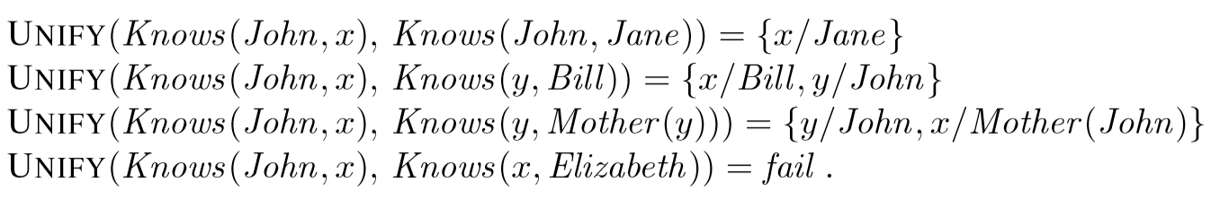
Applying Quantifiers: Unification
Russell & Norvig
Notes:
The UNIFY quantifier in logic creates all solutions to a subset of propositions, within a set of propositions. The result of the first unification is (trivially) x = Jane. The solution to the third is y = John and x = the Mother of John. There is no solution to the fourth.

Slide 30
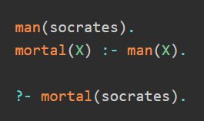
Prolog Logic Programming
https://www.matchilling.com/introduction-to-logic-programming-with-prolog/
Notes:
The Prolog (“programming in Logic”) language was developed decades ago as a programming language based on first-order logic. It has been used, especially in Europe, as an AI language, and even as a general purpose language.
In the example shown, :- means “is implied by” or ⇐.
The last line is a query: asking for solutions to a statement based on a set of FOL statements.

Slide 31
Prolog Examples
likes(mary,food). likes(mary,wine). likes(john,wine). likes(john,mary).
The following queries yield the specified answers.
| ?- likes(mary,food). yes.
| ?- likes(john,wine). yes.
| ?- likes(john,food). no.
John likes anything that Mary likes
John likes anyone who likes wine
John likes anyone who likes themselves
http://www.cs.toronto.edu/~sheila/384/w11/simple-prolog-examples.html
Notes:
The figure shows a set of propositions (using the propositional subset of Prolog).
The second paragfraph shown three queries.
The last paragraph shows what Prolog is capable of doing, even with this small set of statements.

Slide 32
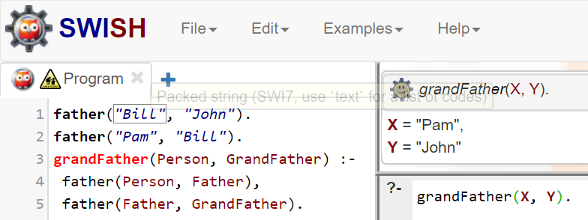
More Prolog https://swish.swi-prolog.org/
Notes:
There are many prolog systems, some cloud-based as shown in the figure.
Here is an interesting nontrivial example:
https://swish.swi-prolog.org/example/houses_puzzle.pl

Slide 33
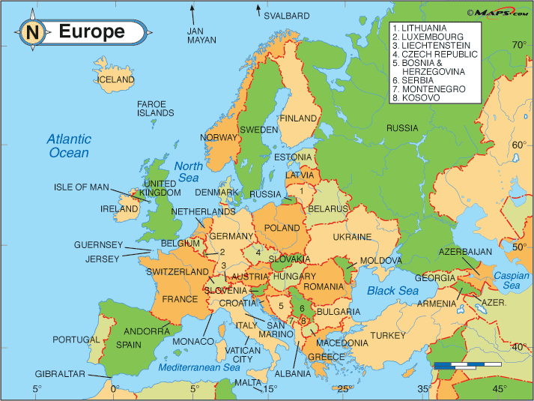
Color Europe
Notes:
Prolog is good at constraint-base search. For example, it can be used to color maps (i.e., such that adjacent countries are colored differently). Prolog does its best but is potentially inefficient.

Slide 34
Prolog Example: Map Coloring
Example of desired output: ?- colour_countries(Map).
Map = [austria/yellow, belgium/purple, bulgaria/yellow, croatia/yellow, cyprus/yellow, czech_republic/purple, denmark/yellow, estonia/red, finland/yellow, france/yellow, germany/red, greece/green, hungary/red, ireland/yellow, italy/red, latvia/green, luxemburg/green, malta/green, netherlands/yellow, poland/yellow, portugal/yellow, romania/green, slovakia/green, slovenia/green, spain/green, sweden/green, united_kingdom/green]
https://www.matchilling.com/introduction-to-logic-programming-with-prolog/
https://swish.swi-prolog.org/p/Map%20Coloring%20from%20Web.pl
Notes:
The figure shows a start to the coloring implementation and a reference if you are interested.

Slide 35
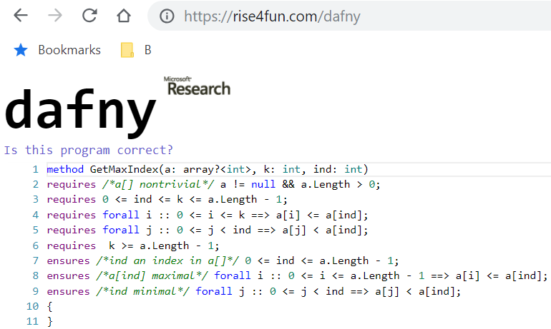
FOL In Program Construction
R
E
Notes:
You can use Dafny to check your FOL alone (i.e., with no programming involved). For example, if you want to verify the that the statements marked R in the figure imply the statements marked E, then you can ask, in effect, if I execute no code, do the postconditions follow from the preconditions?

Slide 36
Summary
First order logic often captures essentials
Syntax: universal
Semantics: link to real world
Inference mechanics has advanced
Notes:
We have seen that first-order logic captures the kind of reasoning we normally think of. Logic engines have become increasingly efficient.

