Slide 1
Planning
Notes:
To exhibit intelligent (rather than random or else rigid) behavior, agents must plan.

Slide 2
Examples: Plan …
… a wedding
… a trip
… a project
… a move
between apartments
between houses
from one business location to another
… a robot’s course of action
Notes:
Robots, and agents in general, are much more effective if they have a plan rather that following a purely greedy algorithm.

Slide 3
Planning: Learning Objectives
Recognize actions applicable in states
Plan forward or backward
Apply to programming
Notes:
By the end of this module, you will be able to observe states as the mode for a plan, distinguish the creation of a plan by beginning with the initial state, or else with a final desired state.
The ideas are applicable to programs, which are a kind of plan.

Slide 4
Planning
Introduction
Forward vs. Backward Planning
Heuristics and Plan Graphs
Conclusion
Notes:
In this section we discover what’s involved in planning.

Slide 5
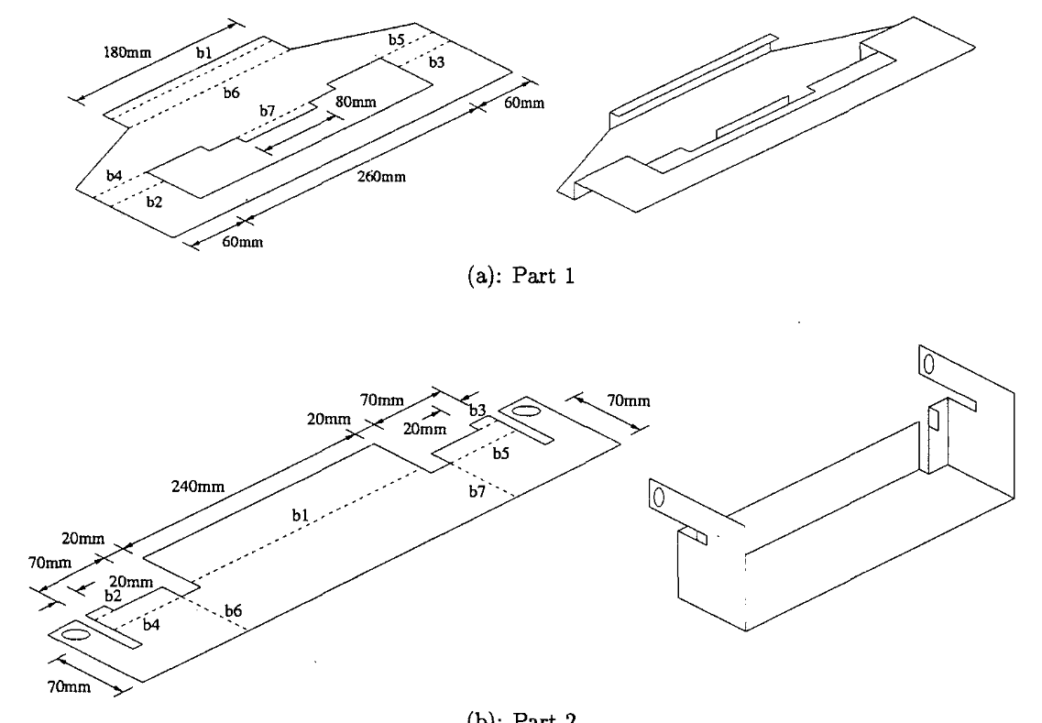
Example: Outcome
Notes:
Consider the problem of finding a way to manufacture an item, such as the one shown made from a single flat piece of metal. This is backward planning.
The problem of assembling items (creating molecules, packing a box etc.) is similar.

Slide 6
Example: Plan Folding Operations
Notes:
The figure shows a way to do this. The question is: can this plan be arrived at through an (AI planning) algorithm. The advantages include faster manufacturing, less waste, and labor saving.

Slide 7
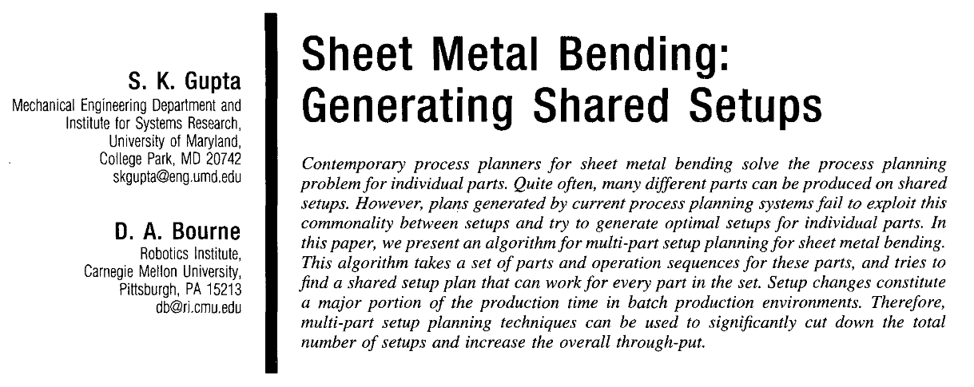
Example Source
Notes:
The figure shows an abstract of this particular paper.

Slide 8
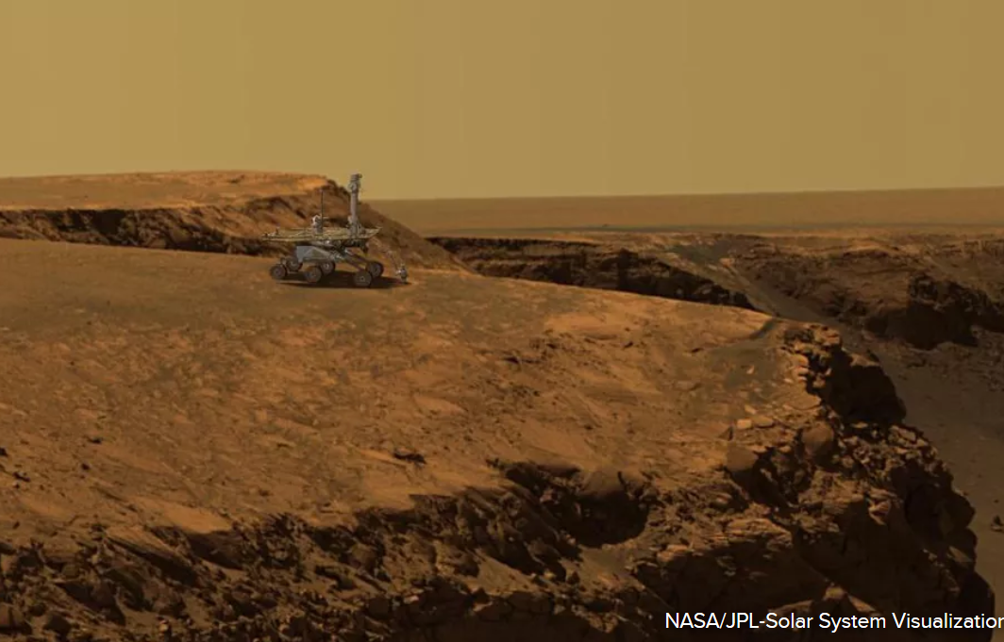
Planning for Extraterrestrials
Notes:
Planning is also required for the increasing autonomy of vehicles, just as humans exercise as much foresight as they can in operating them. This is especially true of extraterrestrial vehicles, which cannot be controlled in real time.

Slide 9
What is a Plan?
A sequence of actions.
e.g., to get to NYC
Obtain from action inventory indexed by state.
the initial state
e.g., (agent is) in JP, Boston or agent1 in …. and agent2 in …
…
Notes:
A plan, formally speaking, is a sequence of actions that accomplish a goal. Each action changes the state of the agent, agents, or system. The set of available actions depends on the state.

Slide 10
What is a Plan?
A sequence of actions.
e.g., to get to NYC
Obtain from action inventory indexed by state.
the initial state
e.g., (agent is) in JP, Boston or agent1 in …. and agent2 in …
the actions available in a state
the result of applying an action
the goal test
(agent is) in NYC?
Notes:
A plan, formally speaking, is a sequence of actions that accomplish a goal. Each action changes the state of the agent, agents, or system. The set of available actions depends on the state.

Slide 11
States
Each state is represented as a conjunction of “ﬂuents”: ground, functionless atoms.
For example,
Poor ∧ Unknown,
In_JP ∧ Have_car
Source: Russell and Norvig
Notes:
In general, a state is defined by values of variables. For example, the state “Late for Work” is defined by t > K where t is the variable time to get to work and K is minimum time to get to work without being late. In this example, the variable (t) is continuous.
Russell and Norvig simplify this by considering only a discrete variable (sometimes called state)—that can only take a set of values from a finite set. These values are called fluents, and are given names. An example is
state = {Poor, Unknown}

Slide 12
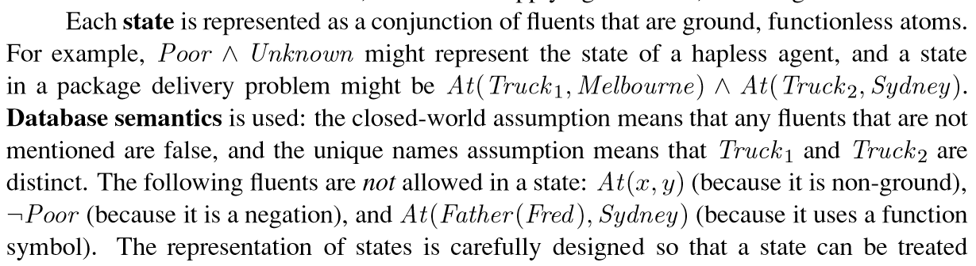
A State Example …
Source: Russell and Norvig
Notes:
The simplified version of states are often expressed in planning as predicates, such as those in the figure. This is like a variable At, whose values are pairs.

Slide 13
Closed World Assumption
Anything not provable is assumed to be false.
Example…
Notes:
In AI, we often choose to make the closed world assumption. Think of it as ultra-science-based: assume that anything unprovbable within a system is actually false within that system.

Slide 14
Apply Closed World Assumption
Anything not provable is assumed to be false.
Example: Plan a driving vacation between Denver and LA.
If steep roads are en route can’t be established from the given environments,
assume that there are none.
Notes:
The CWA is by no means foolproof, as the example in the figure suggests.

Slide 15
Action Schemas
A set of actions may be represented by a single action schema.
…
Source: Russell and Norvig
Notes:
So far, our discussion of planning has involved simple states (e.g., At(Truck, Melbourne)) and actions. This is addressed with schemas—set of actions.

Slide 16
Action Schemas
A set of actions may be represented by a single action schema.
Lifts level of reasoning from propositional logic to ﬁrst-order logic.
For example, …
Source: Russell and Norvig
Notes:
So far, our discussion of planning has involved simple states (e.g., At(Truck, Melbourne)) and actions. This is addressed with schemas—set of actions.

Slide 17
Action Schemas
A set of actions may be represented by a single action schema.
Lifts level of reasoning from propositional logic to ﬁrst-order logic.
For example, an action schema for ﬂying a plane from one location to another:
Action(
Fly(p, from, to),
PRECOND: At(p, from) ∧ Plane(p) ∧ Airport(from) ∧ Airport(to)
EFFECT: ¬At(p, from) ∧ At(p, to)
)
Source: Russell and Norvig
Notes:
Schemas tell what the effects (the postconditions) are for an action—under what preconditions.

Slide 18
Recall a Plan
A sequence of actions, given …
the initial state
the actions available in a state
the result of applying an action
the goal test
Notes:
A plan, formally speaking, is a sequence of actions that accomplish a goal. Each action changes the state of the agent, agents, or system. The set of available actions depends on the state.

Slide 19
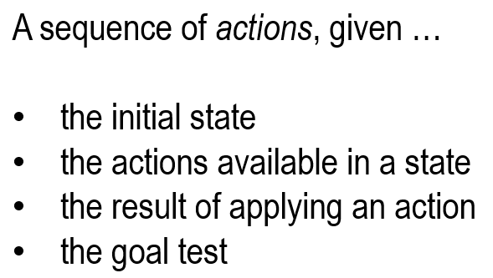
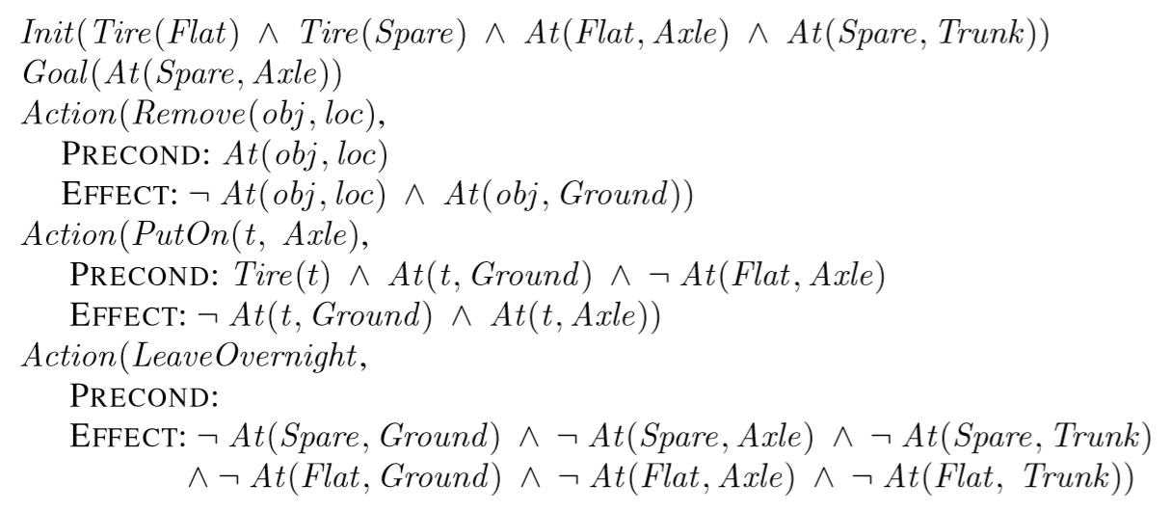
Plan Example: Spare Tire
Schemas
Source: Russell and Norvig
Notes:
Consider the goal At(Spare, Axle) (the spare tire is installed), given Tire(Flat) (the regular tire is flat) etc. What plan (sequence of schemas) accomplishes this?
We show the beginning of the first schema of such as sequence: Action(PutOn(t, Axle) …

Slide 20
Plan Example: Spare Tire
Source: Russell and Norvig
Notes:
The sequence of actions is Remove(Tire, Axle), PutOn(Spare, Axle), LeaveOvernight, and each is defined above with their pre- and postconditions. Notice that we can’t assume any common sense: for example, the logic has to be explicit, in the last Action, that the Spare is not at specific locations—other than the axle.

Slide 21
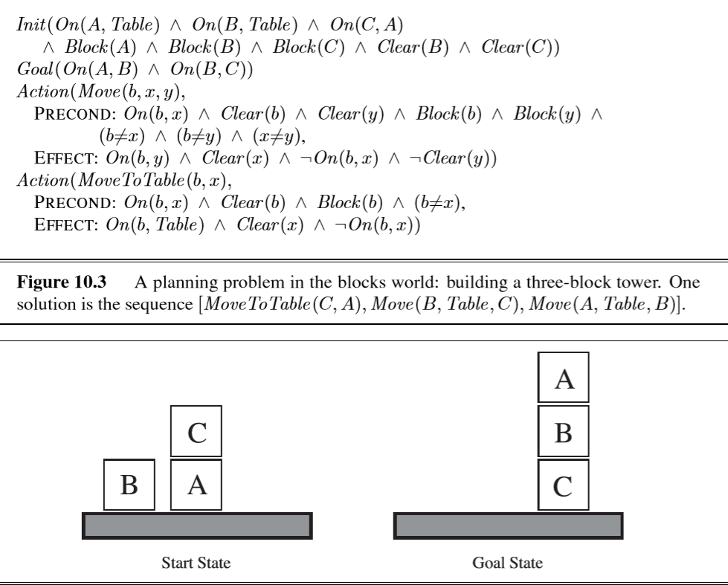
(Classical) Blocks World
Source: Russell and Norvig
Notes:
A simple example shows the principles: such is the purpose of the blocks shown in the figure.

Slide 22
Blocks World
Source: Russell and Norvig
Notes:
The figure shows the totality of initial conditions.

Slide 23
Blocks World
Source: Russell and Norvig
Notes:
The Action needed to accomplish the goal are instances of Move, as defined in the figure.

Slide 24
Plan Example
There is cargo at San Francisco, which we want at JFK.
There is cargo at JFK which we want at San Francisco.
We have a plane at San Francisco and one at JFK.
Develop a plan (at the level of load/unload/fly).
WHAT PDDL* INPUT DOES THIS TRANSLATE TO?
* Planning Domain Definition Language
Notes:
The figure poses a practical planning example. It refers to PDDL (the Planning Domain Definition Language), which Russell and Norvig translate into logic notation as in the figures.

Slide 25
PDDL
“The Planning Domain Definition Language (PDDL) is an attempt to standardize Artificial Intelligence (AI) planning languages.” (Wikipedia)
Can specify
the initial state
the actions available in a state
the result of applying an action
the goal test
https://github.com/pellierd/pddl4j/wiki/A-tutorial-to-start-with-PDDL

Slide 26
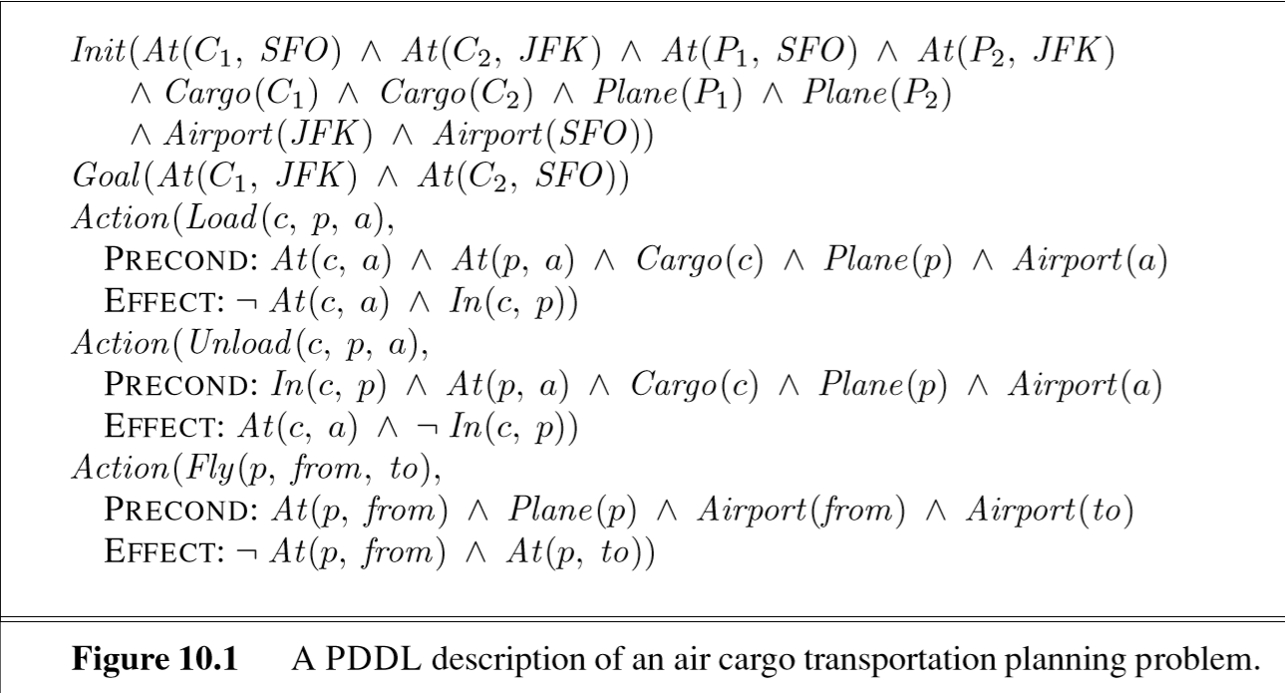
An available action schema
Notes:
The figure specifies the initial conditions, the goal, and the first action of the plan.

Slide 27
Notes:
The plan is completed in this figure.

Slide 28
PDDL (Code) Examples
http://kcl-planning.github.io/ROSPlan//demos/robot_pages/squirrel.html
(demo)
https://github.com/pellierd/pddl4j/wiki/Logistics:-a-simple-running-example
(code but no demo)
https://github.com/pellierd/pddl4j/wiki/Logistics:-a-simple-running-example
(logistic application)
Notes:
The figure lists a PDDL de mo, code base, and (essentially) a marketing example. The syntax of PDDL is rooted in LISP.

Slide 29
Planning
Introduction
Forward vs. Backward Planning
Heuristics and Plan Graphs
Conclusion
Notes:
In this section we compare the two principal poles of planning: forwards from the initial conditions, and backward from the goal.

Slide 30
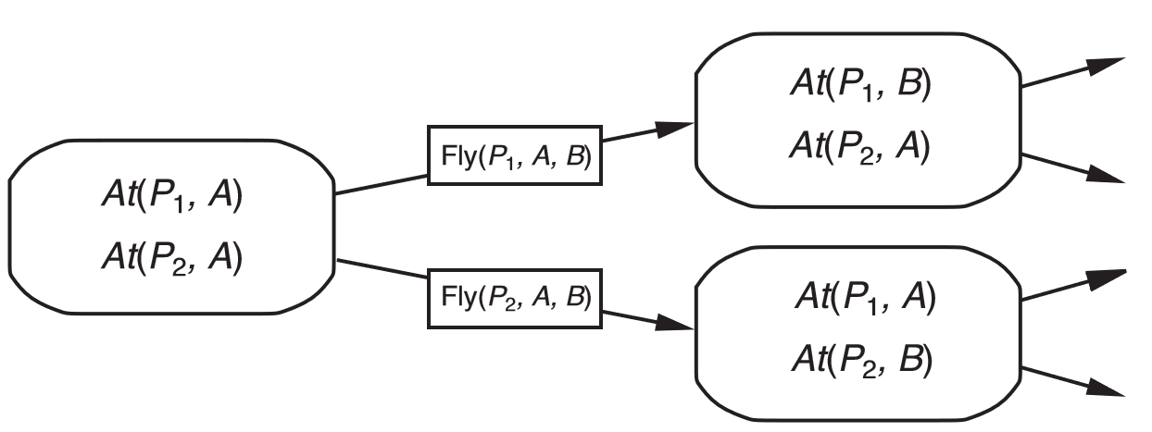
Forward Planning
Start with initial state
Source: Russell and Norvig
Notes:
In (pure, un-pruned) forward planning, we generate all possible permissible actions until the goal is encountered. A beginning is shown in the figure.

Slide 31
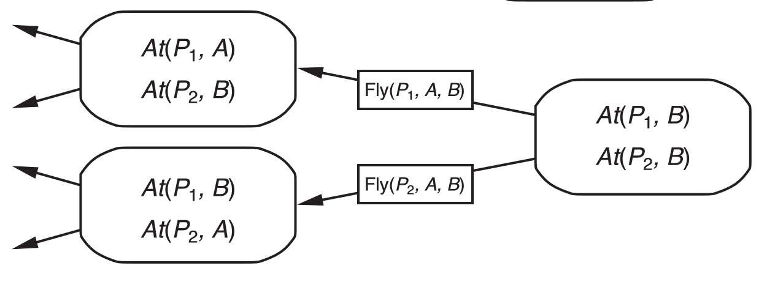
Backwards Planning
Start with goal state
Source: Russell and Norvig
Notes:
In backward planning, we begin with the goal, and generate all actions that result in that goal, noting their preconditions, which become a new set of goals on which to (recursively) apply the same process. In principle, this is performed until the given initial conditions are obtained.

Slide 32
Cumulative Fulfillment*
1. Start with overall goals OG₁, OG₂, ... , OG_{n}
2. Identify a sufficient sequence of outcomes CG₁, CG₂, ... ,CG_{n} i.e., such that CG₁∧CG₂∧ ... ∧CG_{n} ⇒ OG₁∧OG₂∧ ... ∧Og_{n}
--which …
(Often … CG₁ = OG₁, CG₂ = OG₂, ..., CG_{n} = Og_{n})
* Weakest Preconditions and Cumulative Subgoal Fulfillment by Eric J. Braude, Science of Computer Programming Volume 89, Part C, 1 September 2014, Pages 223-234
Notes:
A computer program is analogous to a plan. In the Cumulative Goal Fulfillment approach to programming, we fulfill a set of goals (CG₁, CG₁₂, … CG_{n}, say) which are at least as strong as the set of postconditions. We write code that fulfills the first goal; then code that fulfills the second, but which maintains the validity of the first etc.).

Slide 33
Cumulative Fulfillment*
1. Start with overall goals OG₁, OG₂, ... , OG_{n}
2. Identify a sufficient sequence of outcomes CG₁, CG₂, ... ,CG_{n} i.e., such that CG₁∧CG₂∧ ... ∧CG_{n} ⇒ OG₁∧OG₂∧ ... ∧Og_{n}
--which are cumulative i.e.,
fulfilling CG_{i} maintains CG₁∧CG₂∧ ... ∧CG_{i-1}
Example: Towers of Hanoi: CG₁ = “??”
Example: Repair flat: CG₁ = “??”
* Weakest preconditions and cumulative subgoal fulfillment by Eric J.Braude, Science of Computer Programming Volume 89, Part C, 1 September 2014, Pages 223-234
Notes:
The property of fulfilling goals while maintaining prior ones is “cumulative.” Cumulative goals are helpful in being specific about the purpose of each block of code.

Slide 34
Cumulative Fulfillment*
1. Start with overall goals OG₁, OG₂, ... , OG_{n}
2. Identify a sufficient sequence of outcomes CG₁, CG₂, ... ,CG_{n} i.e., such that CG₁∧CG₂∧ ... ∧CG_{n} ⇒ OG₁∧OG₂∧ ... ∧Og_{n}
--which are cumulative i.e.,
fulfilling CG_{i} maintains CG₁∧CG₂∧ ... ∧CG_{i-1}
Example: Towers of Hanoi: CG₁ = “Largest on target”
Example: Repair flat: CG₁ = “New inner tube on rim”
* Weakest preconditions and cumulative subgoal fulfillment by Eric J.Braude, Science of Computer Programming Volume 89, Part C, 1 September 2014, Pages 223-234
Notes:
There are techniques for identifying goals, and the code (the actions in planning lingo) that fulfills them. But they are arrived at by practice, and selected from a very wide set of legal programming constructs whereas in planning, the set of actions is very limited, and we can often use heuristics to identify potentially successful ones.

Slide 35
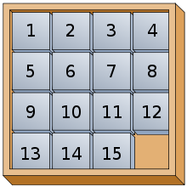
15-Puzzle Postcondition(s)
A conjunction of fluents (maybe location_of_1, location_of_2, …
Which selection is useful?
Notes:
To solve the famous Fifteen Puzzle, for example, what would be a useful cumulative goal for the plan? What fluents or predicates?

Slide 36
15-Puzzle Cumulative Goal # 1
A useful fluent to take as a goal:
Eric J. Braude “Dijkstra’s Counting Arguments, Puzzles, and Cumulative Subgoal Fulfillment”, Computer Science and Education in Computer Science 9/2013 Issue No: 1 pp 41-45 https://www.ceeol.com/search/article-detail?id=465085
Notes:
A useful—and, it turns out—practical goal is to have the required outer ring in its required order. The point here is that there is apparently no limit on how imaginative useful goal fluents and predicates can be.

Slide 37
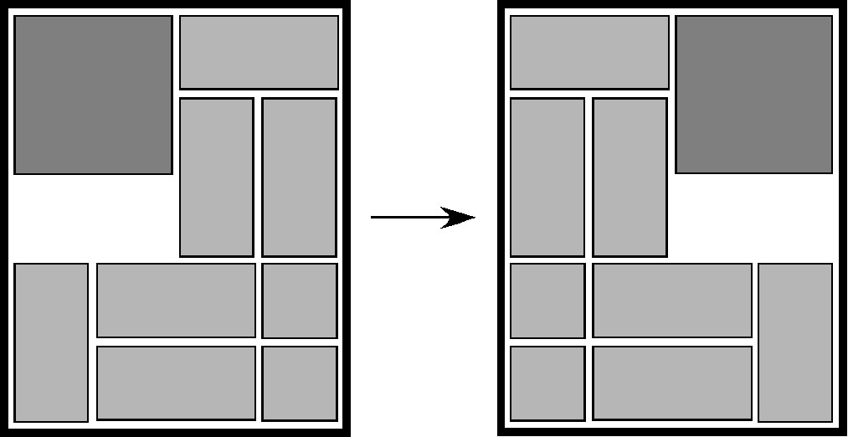
Unsolved … (non-final) Goal: Dad’s Puzzle
from the start position shown on the left, slide pieces (without picking them up) to form the end position shown on the right. *
https://www.youtube.com/watch?v=bzgYMIJQiE8
* http://www.cs.brandeis.edu/~storer/JimPuzzles/ZPAGES/zzzQuzzle.html
Notes:
A more difficult problem is Dad’s Puzzle, shown in the figure. Goal predicates can be identified such as Square One Move From Destination, but not very useful ones.

Slide 38
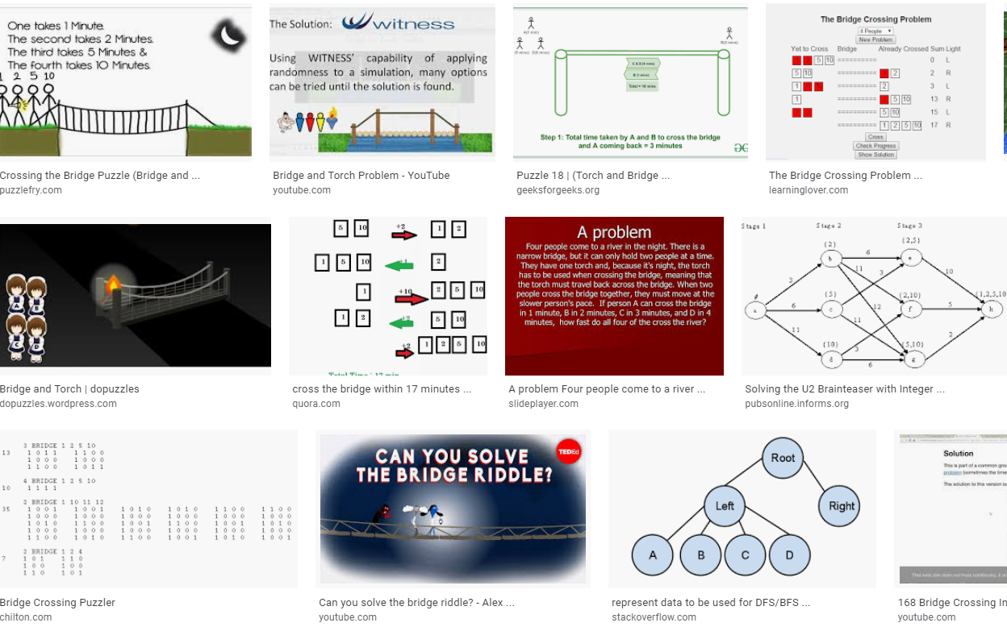
Bridge-Torch Problem
Notes:
Puzzles provide a fertile ground for planning methods. An example is the Bridge-Torch problem in which a group of people, each with their own bridge-crossing time, must cross a bridge at night. The bridge can hold at most two people. A flashlight is necessary for each crossing. There is only one.

Slide 39
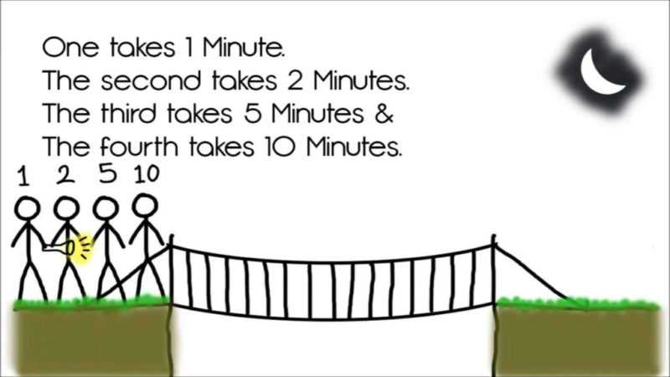
Bridge-Torch Problem
Notes:
The figure shows a particular instance of the problem. See me for a solution.

Slide 40
Planning
Introduction
Forward vs. Backward Planning
Heuristics and Plan Graphs
Conclusion
Notes:
In this section we consider how to use heuristics to develop a plan.

Slide 41
Heuristics to Prune the Plan Tree
Ignore preconditions
e.g., in 15-puzzle: ignore “must be a blank”
Ignore “delete lists”
remove negative literals from effects
no action undoes progress made by another action
e.g., Take car does not remove bus available
…
Adapted from Russell and Norvig
Notes:
Viewing the possible courses of action as a tree of actions, the task of finding a good plan amounts to either generating all possible plans—which is typically impractical—or else pruning the tree using heuristics.
The figure lists two heuristics. Ignore preconditions loosens the circumstances of the problem, allowing for more flexibility in finding a plan. For the 15-puzzle, we could ignore the need to move only to a blank position. The idea is to develop a plan with this omission, swapping tiles, and then use the (illegal) result to create a legal plan. The delete lists heuristic is similar in that it ignores ill effects of actions.
In everyday life, we plan like this all the time. For example, in planning a celebrations, we may first ignore preconditions such as venue availability, then use the resulting rough plan as the basis to move forward, modifying it as realistic venue availability is applied.

Slide 42
Heuristics to Prune the Tree
Ignore preconditions
e.g., in 15-puzzle: ignore “must be a blank”
Ignore “delete lists”
remove negative literals from effects
no action undoes progress made by another action
e.g., Take car does not remove bus available
Make states more abstract
e.g., Instead of “Cargo at Atlanta Airport”, use “Cargo at Airport”
e.g., Instead of “Place dining table”, use “Sketch dining space”
Decompose goal (artificially?)
e.g., At Waldorf Astoria → At a NYC hotel ∧ On Park Avenue
Adapted from Russell and Norvig
Notes:
Abstract states means to replace concrete courses of actions with general ones, e.g., replace Select hotel with Select venue. This makes it easier make progress with the plan. You then flesh out the resulting rough plan. Decompose goal is similar in that it abstracts aspect of a goal as shown in the figure.

Slide 43
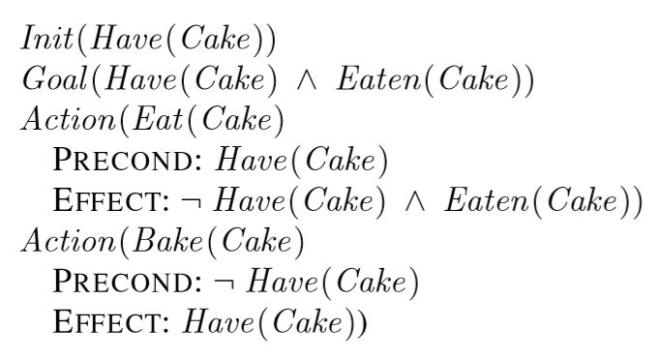
Plan Graph Example: Have your cake & …
Source: Russell and Norvig
Notes:
Consider the problem with the initial condition, goal, and allowable actions shown in the figure. We’ll generate a plan—a sequence of actions that, assuming Init, accomplish Goal.

Slide 44
Basic Planning Graph Technique
Organize as …
Possible fluents →
possible actions →
new possible fluents
(2) Group actions together that can be taken in any order
Notes:
To solve the problem, we think in terms of fluent sets that actions transform into new fluent sets. When a set of actions are such as to not affect each other, we note that because it makes matters easier. For example, the actions selectVenue and selectWeddingDress can be grouped.

Slide 45
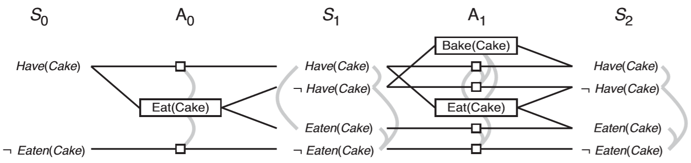
(Exhaustive) Planning Graph
Begin
End
State
Action
State
Action
State
(and)
To include action sequences
(otherwise draw serial planning graph)
End state is a subset of these fluents
Source: Russell and Norvig
Notes:
The figure shows a framework for carrying this out.

Slide 46
Planning Graph
(no action)
A possible action
Based on Russell and Norvig
Notes:
We then list all possible first actions (A₀) i.e., whose preconditions are included in the initial conditions. This would be No action (as we often say, doing nothing is a real choice) and Eat(Cake). No action activates on any precondition; Eat(Cake) is possible only when Have(Cake).
Note that Bake(Cake) is not an option because its precondition is not valid.

Slide 47
Planning Graph
(no action)
1. Have(Cake) and ¬Have(Cake)
can‘t both be true.
A mutex (mutually exclusive) relation holds between two actions at a given level if any of the following is true:
• Inconsistent effects
• Interference: one of the effects of one action is the negation of a precondition of the other. For example Eat(Cake) interferes with the persistence of Have(Cake) by negating its precondition.
• …
Based on Russell and Norvig
Notes:
Now we collect all the possible states resulting from all possible actions, on all applicable precondition sets. The gray arcs at right (mutex’s) denote mutually exclusivity (you can’t have both X and ¬X).

Slide 48
Planning Graph
(no action)
1. Have(Cake) and ¬Have(Cake)
can‘t both be true.
2. Thus, not both of these actions
are possible at the same time
(mutually exclusive--mutex).
Based on Russell and Norvig
Notes:
The process shows that no action and Eat(Cake) cannot be executed in any order here because their effects are not consistent (contain contradictions). Hence the first set of gray arcs (from the left).
In total, there are 2 possible resulting subsets—{Have(Cake), ¬Eaten(Cake)}, from executing no action—and {¬Have(Cake), Eaten(Cake)}, from executing Eat(Cake). These define the possible states S₁

Slide 49
Planning Graph
A mutex relation holds between two actions at a given level if any of the following is true:
• Inconsistent effects
• Interference: one of the effects of one action is the negation of a precondition of the other. For example, Eat(Cake) interferes with the persistence (no action”) of Have(Cake) by negating its precondition.
• …
Continue until S unchanged.
Source: Russell and Norvig
Notes:
We continue the process for the next possible actions. Instead of the preconditions, we consider the (2) possible states S₁. This time, the action Bake(Cake) is an option as well.

Slide 50
Planning Graph
A mutex relation holds between two actions at a given level if any of:
• Inconsistent effects
• Interference: one of the effects of one action is the negation of a precondition of the other. For example, Eat(Cake) interferes with the persistence of Have(Cake) by negating its precondition.
• Competing needs: one of the preconditions of one action is mutually exclusive with a precondition of the other. For example, Bake(Cake) and Eat(Cake) are mutex because they compete on the value of the Have(Cake) precondition.
Source: Russell and Norvig

Slide 51
Use a Planning Graph
-- to extract a plan
-- to estimate the number of actions required to get from a state to a goal
Several variations (see p 382 of R&N)
-- to assess whether there is a plan that accomplishes desired goals
Source: Russell and Norvig

Slide 52
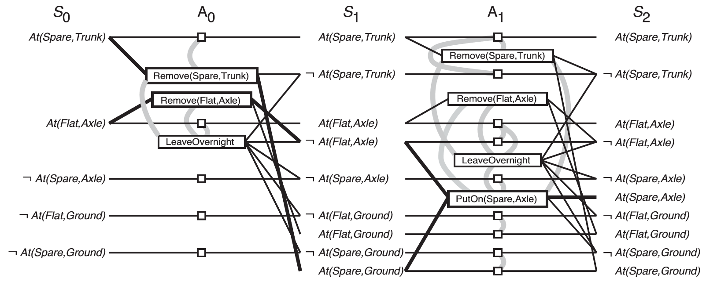
Spare Tire Example
Notes:
The figure shows the result of installing a spare tire (from Russell and Norvig). The process does not use any heuristics—which are needed because the exponential nature of its growth. However, many planning problems require a manageable number of steps, and may not require pruning.

Slide 53
Planning
Introduction
Forward vs. Backward Planning
Heuristics and Plan Graphs
Conclusion

Slide 54
Summary of Planning
Specified by actions applicable in some states
Forward and backward
Serious pruning needed for forward
PDDL facilitates applications

