Slide 1
Wrath
Git Gud Games

Slide 2
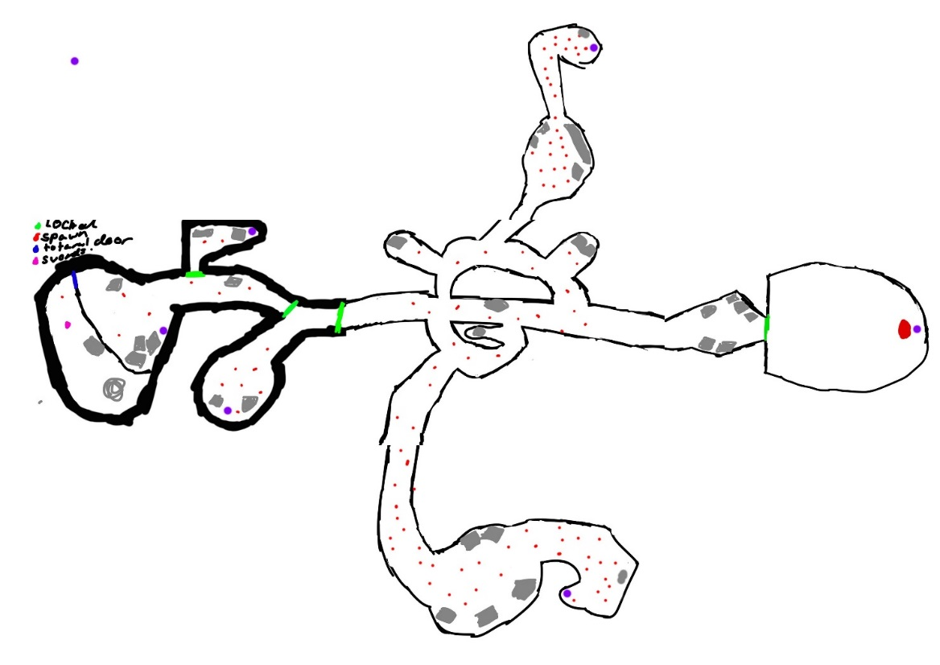
DESIGN
Level design
Main mechanics
Hack ‘n’ Slash
Story

Slide 3
PROGRAMMING
Necessary mechanics:
Character movement
Combat attacks, dodge roll, Camera lock-on
Enemies with simple AI
Final Boss
Navmeshing

Slide 4
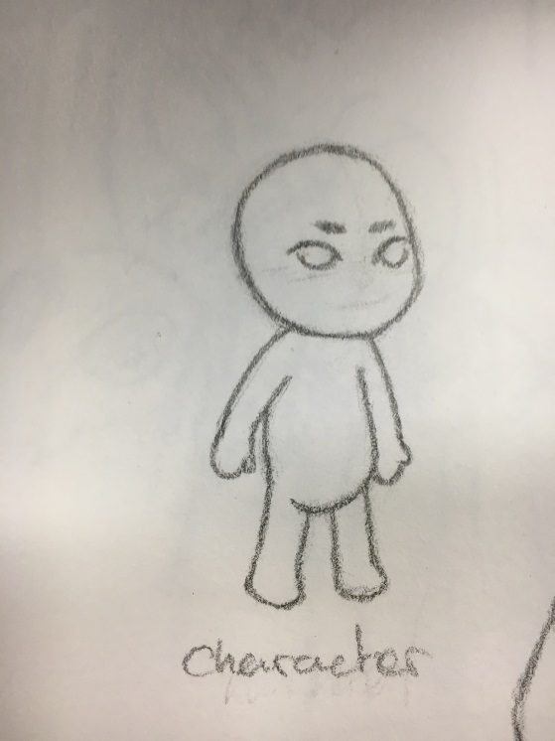
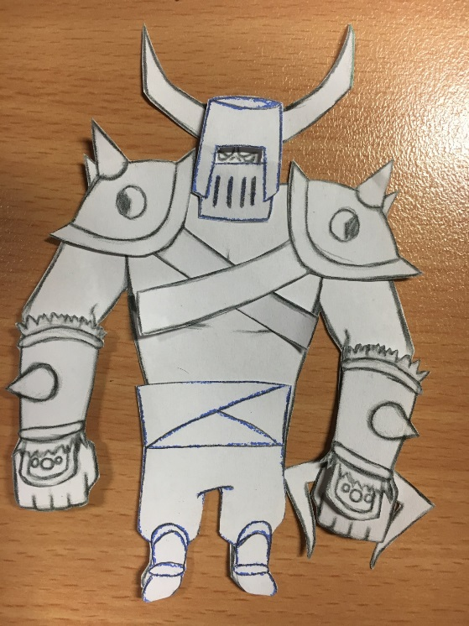
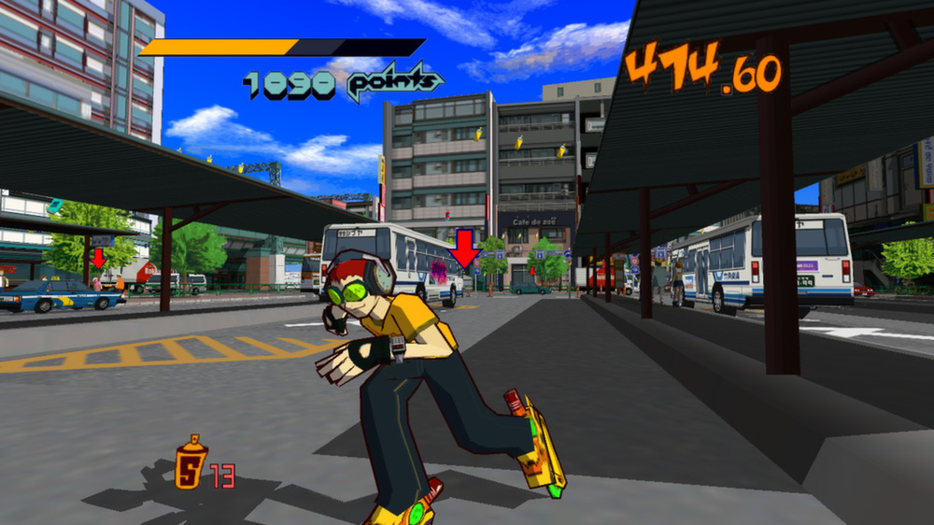
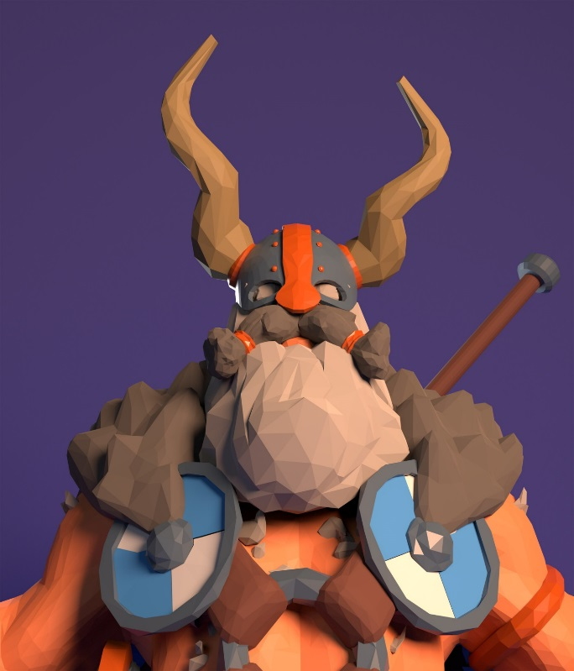
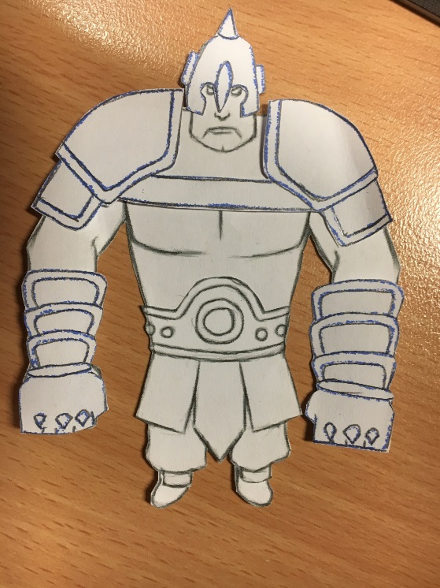
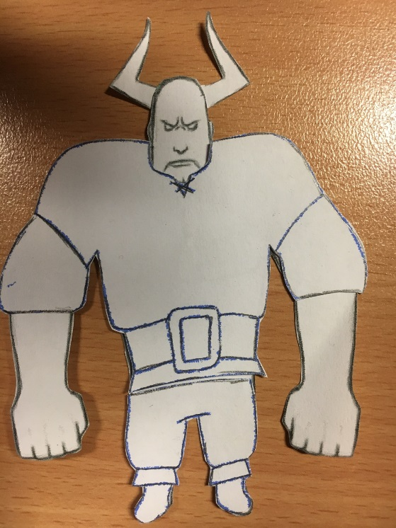
ART

Slide 5
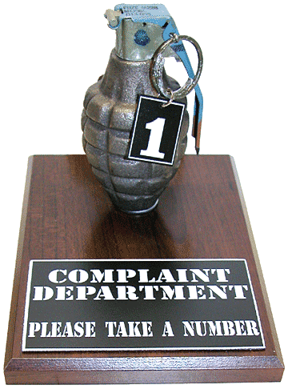
Questions

