Slide 1
Predicting Mortality
CS 513 - B - Knowledge Discovery & Data Mining
Group 9: Aidan Giordano, Tyler Sconing, Orlando Osorio Garcia

Slide 2

Overview
Objective
Dataset Description
Data Cleaning
Exploratory Data Analysis
Classification Models
Conclusion

Slide 3

Objective
Purpose
Focusing on employing classification models to predict mortality among patients with heart diseases.
Goal
Improve prediction accuracy and identify key risk factors contributing to mortality.

Slide 4

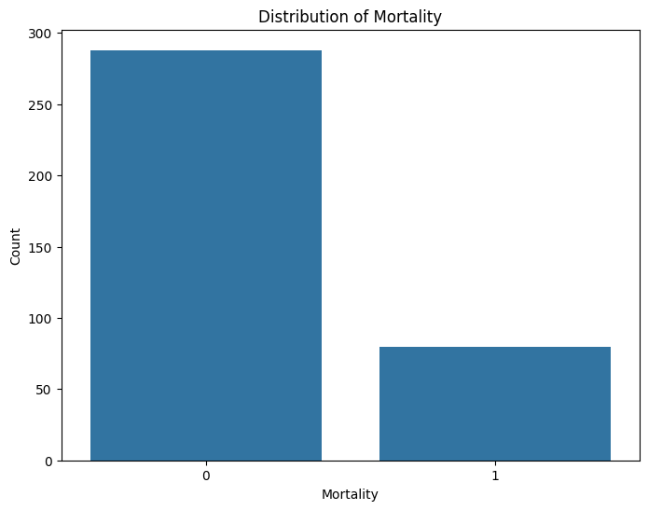
Description of The Dataset
The Dataset chosen is ‘The Heart Failure Prediction Dataset’
Source: Kaggle
Contains comprehensive medical history of heart patients
Collected from the Institute of Cardiology, Faisalabad, Pakistan
The Dataset has a total of 60 columns and 368 observations.
Our goal is to find whether a patient died or survived.
Target variable: Mortality
0: Patient died
1: Patient survived
Link to dataset
https://www.kaggle.com/datasets/asgharalikhan/mortality-rate-heart-patient-pakistan-hospital

Slide 5
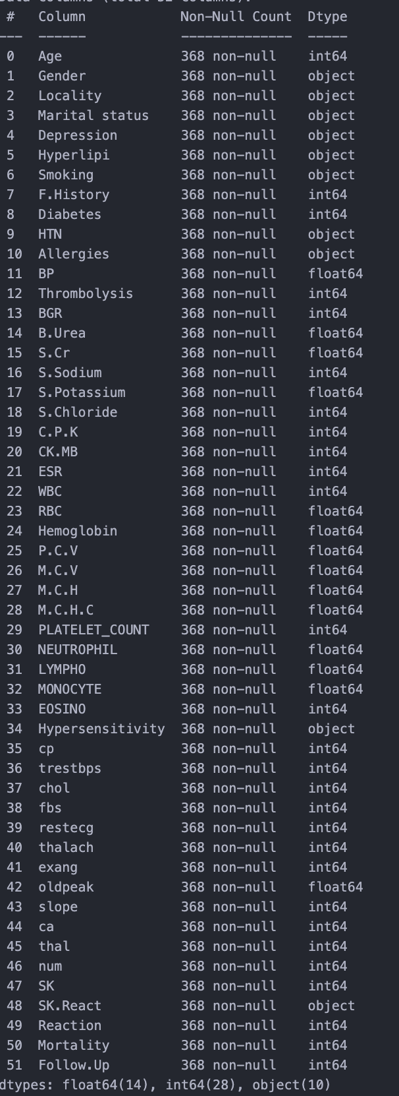
Preprocessing the Data
Dropped irrelevant or redundant columns:
8 features dropped due to redundancy or lack of description
'Others', 'Family.History', 'CO', 'Diagnosis', 'Life.Style', 'Sleep', 'Category', 'Age.Group'
Handled categorical variables:
Applied one-hot encoding to convert categorical features to numerical
Feature scaling:
Standardized features using StandardScaler for improved model performance
Addressed missing values and formatting issues:
There were no missing values
Stripped white space from column names

Slide 6
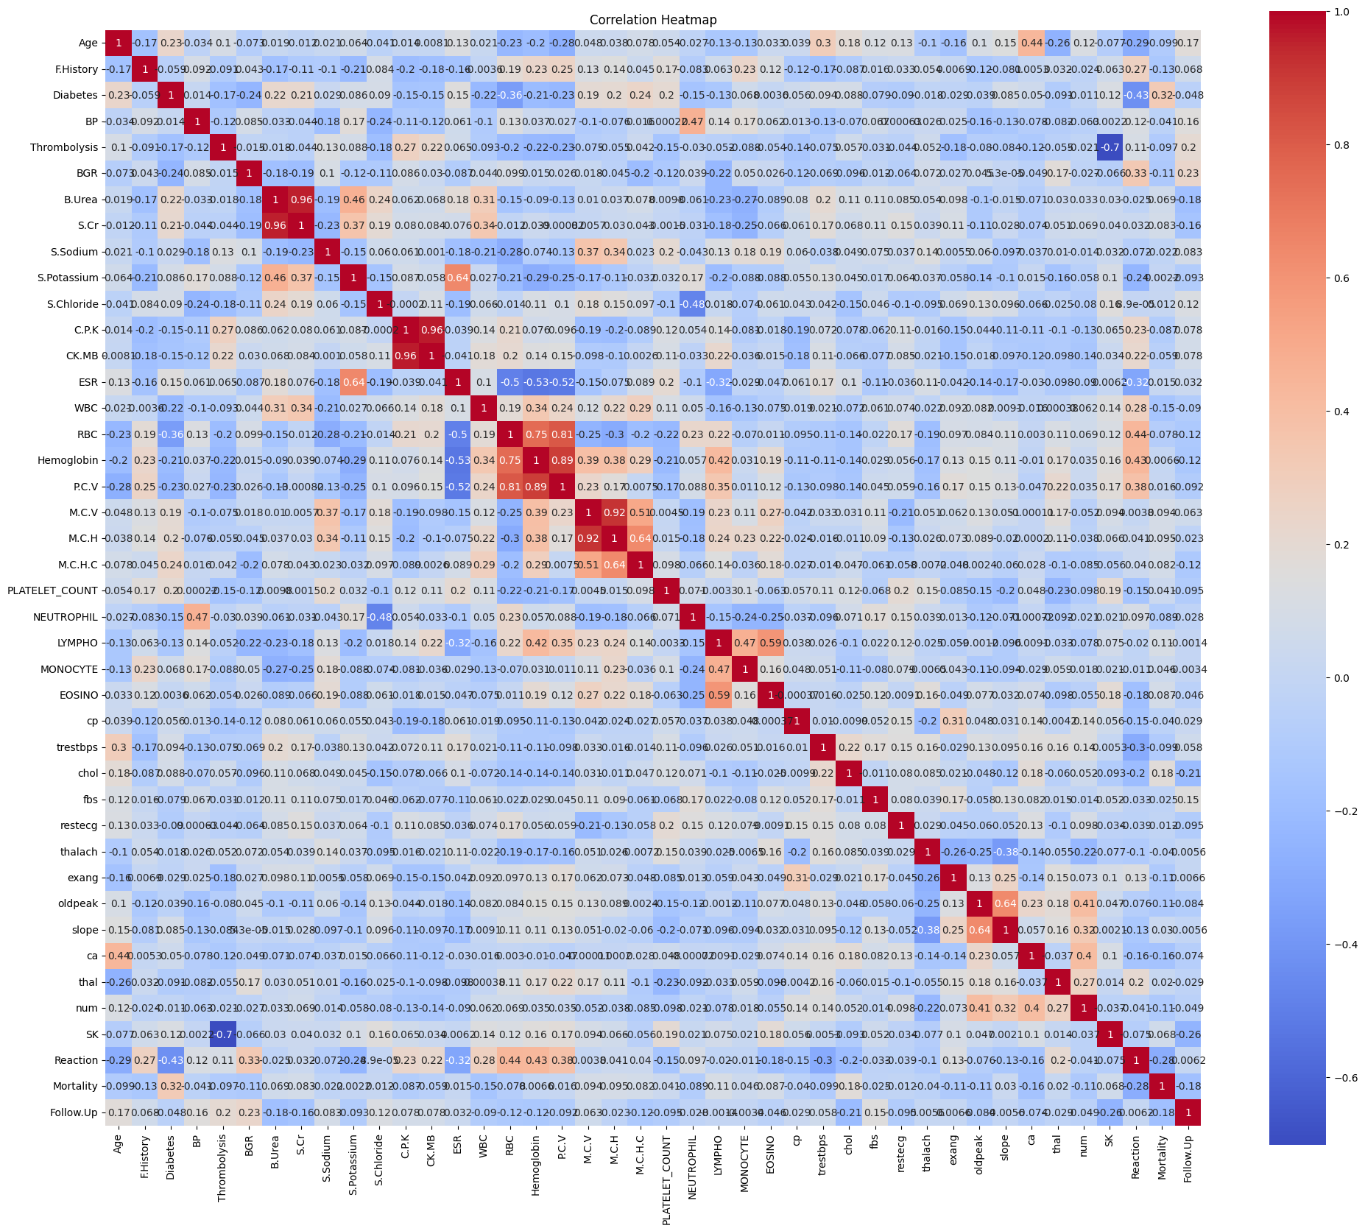
Exploratory Data Analysis
Data Overview
Statistics and data types summary
Correlation Analysis
Created a correlation matrix and heatmap to identify correlations between variables
Target variable distribution
Plotted the distribution of the Mortality variable
Continuous variable analysis
Created box plots to compare the distribution of continuous variables across Mortality groups
Categorical variable analysis
Created bar plots to compare the counts of categorical variables across Mortality groups
[Include the correlation heatmap image]
[Include the Mortality distribution plot]
[Include a selection of relevant box plots]
[Include a selection of relevant bar plots]

Slide 7
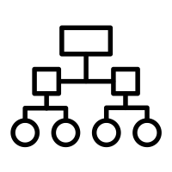
Classification Models
K-nearest Neighbors
Naïve Bayes
Random Forest
Support Vector Machine
CART
Agglomerative Clustering
K Means Clustering

Slide 8
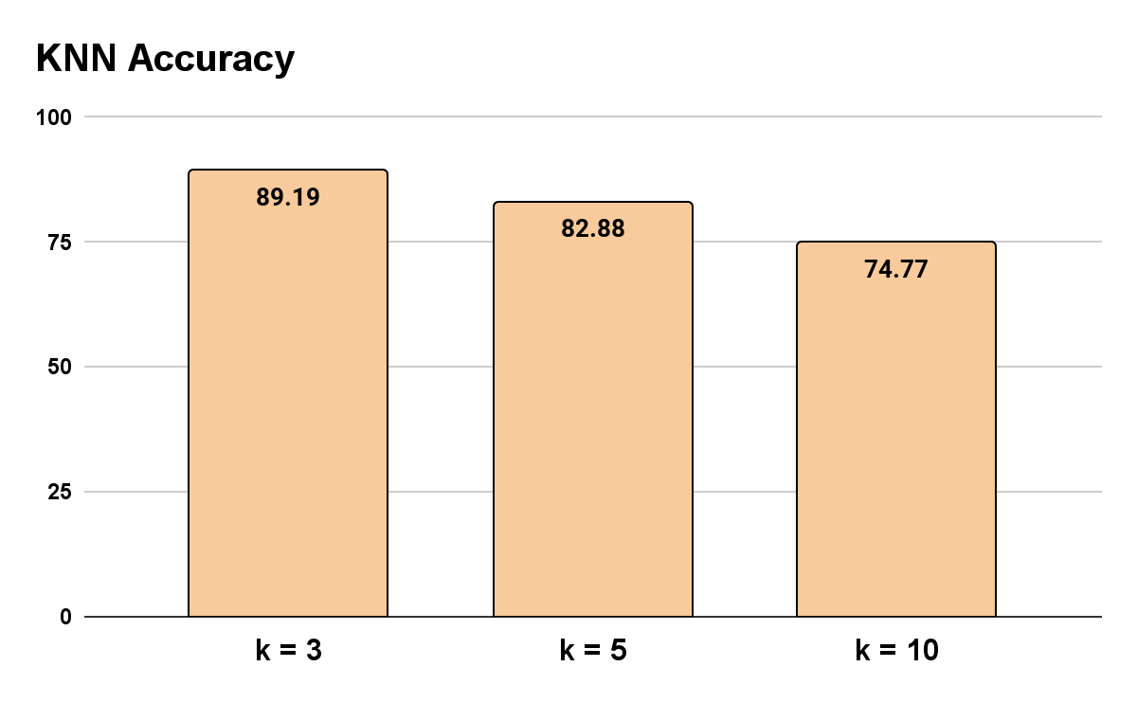



K-nearest Neighbors - Orlando
Model: K-Nearest Neighbors (KNN)
Number of Neighbors (k): Evaluated with k = 3, 5, 10
Distance Metric:
Euclidean (from ‘class’ package)
Data Preprocessing:
One-hot encoding for categorical variables
StandardScaler used to normalize features
 | K = 3 | K = 5 | K = 10
Precision | 94.25% | 88.04% | 80.80%
Recall | 92.13% | 91.01% | 89.88%
F1-Score | 93.18% | 89.50% | 85.10%

Slide 9

Naïve Bayes - Orlando
Model: Naive Bayes Classifier
Data Preprocessing:
One-hot encoding for categorical variables
StandardScaler used to normalize features
Model Performance:
Accuracy: 27.92%
Precision: 100%
Recall: 3.61%
F1-Score: 6.97%
Why the low accuracy?
Class imbalance
Significantly more ‘Dead’ than ‘Alive’
Naive Bayes assumes independence among predictors
Variables in dataset are dependent of each other
Blood pressure, cholesterol
Naive Bayes assumes predictors to follow a normal distribution
Significant skewness or outliers in data

Slide 10
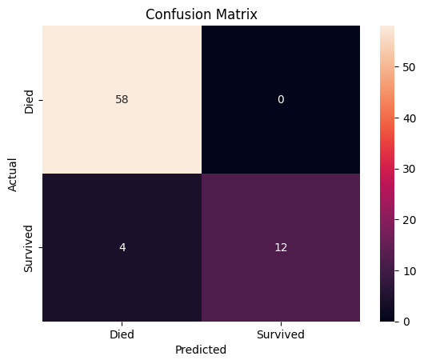
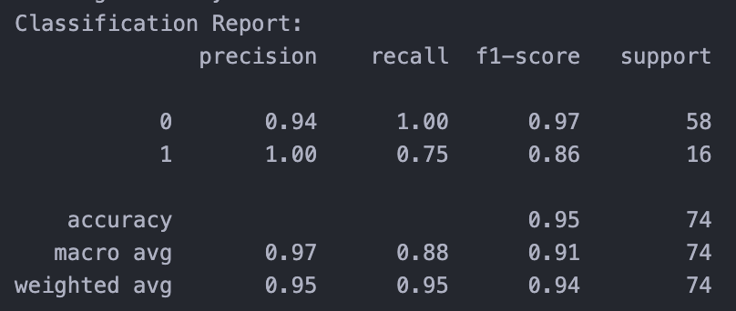
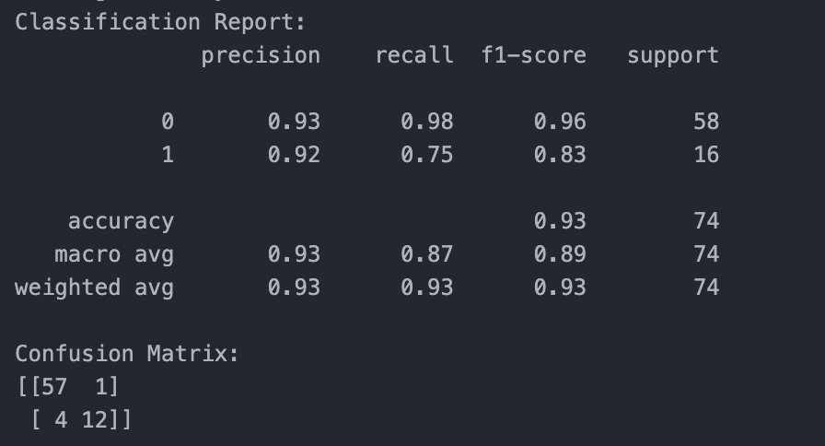
Random Forest - Aidan
Model: Random Forest classifier
Data preprocessing:
One-hot encoding for categorical variables
Feature scaling using StandardScaler
Evaluation metrics:
Testing accuracy: 0.9459
Precision: 0.94 (class 0), 1.00 (class 1)
Recall: 1.00 (class 0), 0.75 (class 1)
F1-score: 0.97 (class 0), 0.86 (class 1)
Key Takeaways:
RF has an overall very high accuracy
Accuracy at predicting death is perfect, although this is likely due to an imbalance in data
When retrying using SMOTE to balance the dataset, it had a recall of .98 for predicting death
Accuracy at predicting survival is worse but still has a good success rate
RF with SMOTE

Slide 11
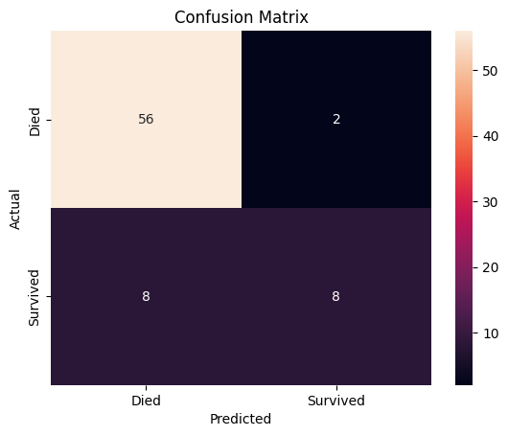
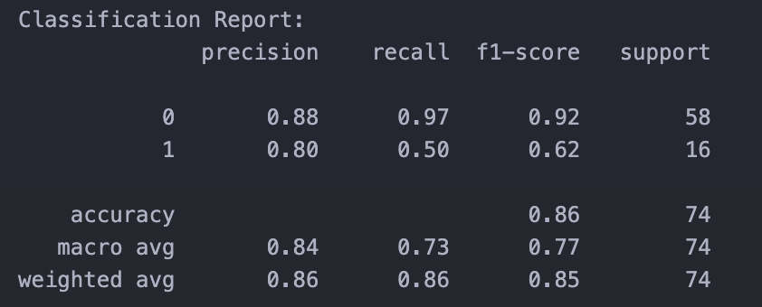
Support Vector Machine - Aidan
Model: Support Vector Machine (SVM) classifier
Kernel: Radial Basis Function (RBF)
Data preprocessing:
One-hot encoding for categorical variables
Feature scaling using StandardScaler
Evaluation metrics:
Testing accuracy: 0.8649
Precision: 0.88 (class 0), 0.80 (class 1)
Recall: 0.97 (class 0), 0.50 (class 1)
F1-score: 0.92 (class 0), 0.62 (class 1)
Key Takeaways:
Overall high accuracy
Highly accurate at predicting death but somewhat poor results at predicting survival at just 50%
[insert matrix and report]

Slide 12
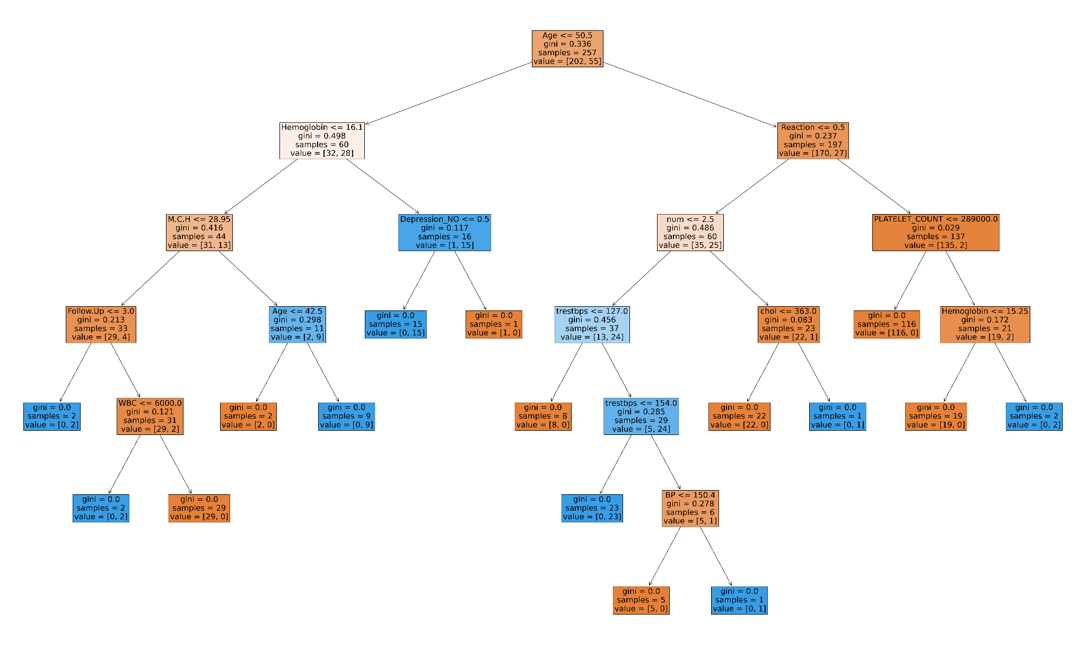
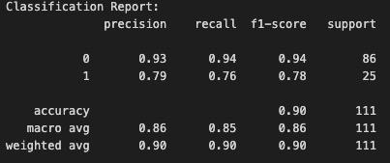
CART - Tyler
Model: Decision Tree Classifier
Data preprocessing:
One-hot encoding for categorical variables
Model performance:
Accuracy: 90%
Evaluation metrics:
Precision: 0.93 (class 0), 0.79 (class 1)
Recall: 0.94 (class 0), 0.76 (class 1)
F1-score: 0.94 (class 0), 0.78 (class 1)

Slide 13
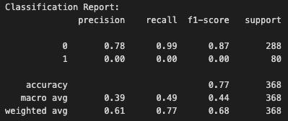
Agglomerative Clustering- Tyler
Model: Agglomerative Clustering (Euclidean/Manhattan)
Data preprocessing:
One-hot encoding for categorical variables
Feature Scaling using StandardScaler
Model performance:
Accuracy: 77%
Evaluation metrics:
Key Takeaways:
Regardless of method of normalization of data(MinMaxScalar, StandardScaler), clustering could not accurately classify patients in Class 1
Very good at clustering patients in Class 0
Both Agglomerative Clustering methods, Euclidean and Manhattan, provided the same results
Cluster | 0 | 1
Actual
0 | 285 | 3
1 | 80 | 0

Slide 14
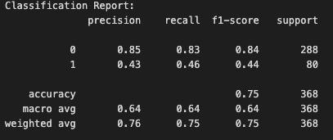
K Means Clustering- Tyler
Model: K Means Clustering
Data preprocessing:
One-hot encoding for categorical variables
Feature Scaling using MinMaxScaler
Model performance:
Accuracy: 75%
Evaluation metrics:
Key Takeaways:
Use of MinMaxScaler instead of StandardScaler
StandardScaler produced accuracy of 25%
Much more effective at classifying patients in class 1, when compared to Agglomerative Clustering
Cluster | 0 | 1
Actual
0 | 238 | 50
1 | 43 | 37

Slide 15
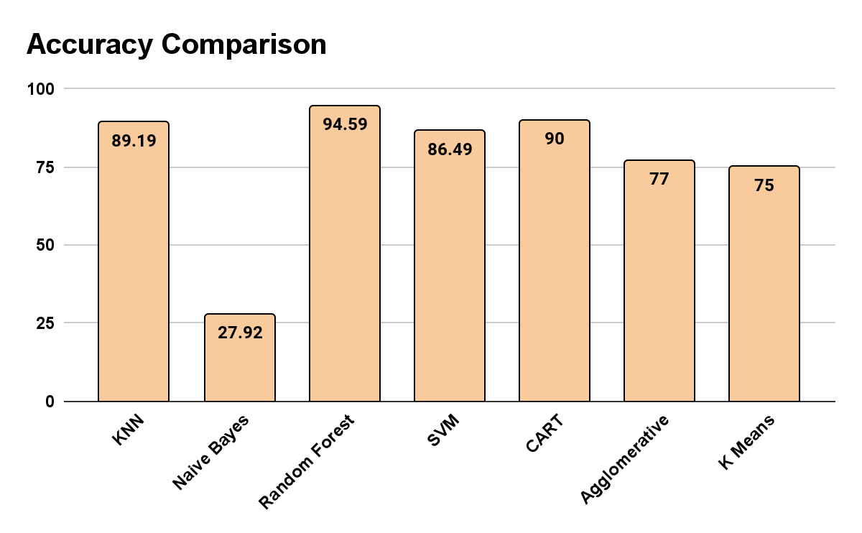
Model Comparison

Slide 16
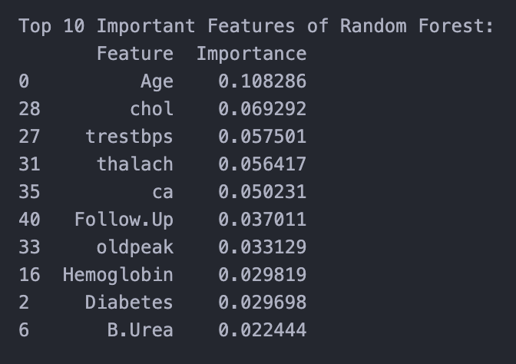
Conclusion
Random Forest and CART Outperform Other Models
Random Forest and CART achieved the highest accuracy scores of 94.59% and 90%, respectively
These tree-based models excel at handling complex, non-linear relationships in the data
These models identified important predictors of mortality in patients
This analysis could be improved with a larger and more diverse dataset along with more advanced machine learning models
It would be beneficial to conduct this analysis on a random population since a large portion of patients in this dataset died
Continued research within this field could help healthcare professionals identify high risk patients earlier and develop better treatment plans

