Slide 1
How to Get Millennials Investing
in Fidelity Mutual Funds & ETFs
New Era Consultants

Slide 2





Overview
The Problem
The Solution
Mobile App
Marketing Plan

Slide 3
Problem
Millennials are not investing – why?
Only ⅖ Millennials are invested in the stock market
Financial advisors are inconvenient and time consuming
4
Millennials do not want to invest
1
Millennials are less wealthy than past generations
3
Lack of general Financial knowledge
2
Advisors don’t want to invest with them
Notes:
85% of millennials say they "play it safe" with their day-to-day investments and would rather rely on their Savings account
They don’t want to take on risk after seeing their parents struggle through the 2008 financial crisis
NEED STAT ON MILLENNIALS BEING TOO POOR
https://www.stlouisfed.org/open-vault/2018/march/millennials-not-investing-stock-market

Slide 4
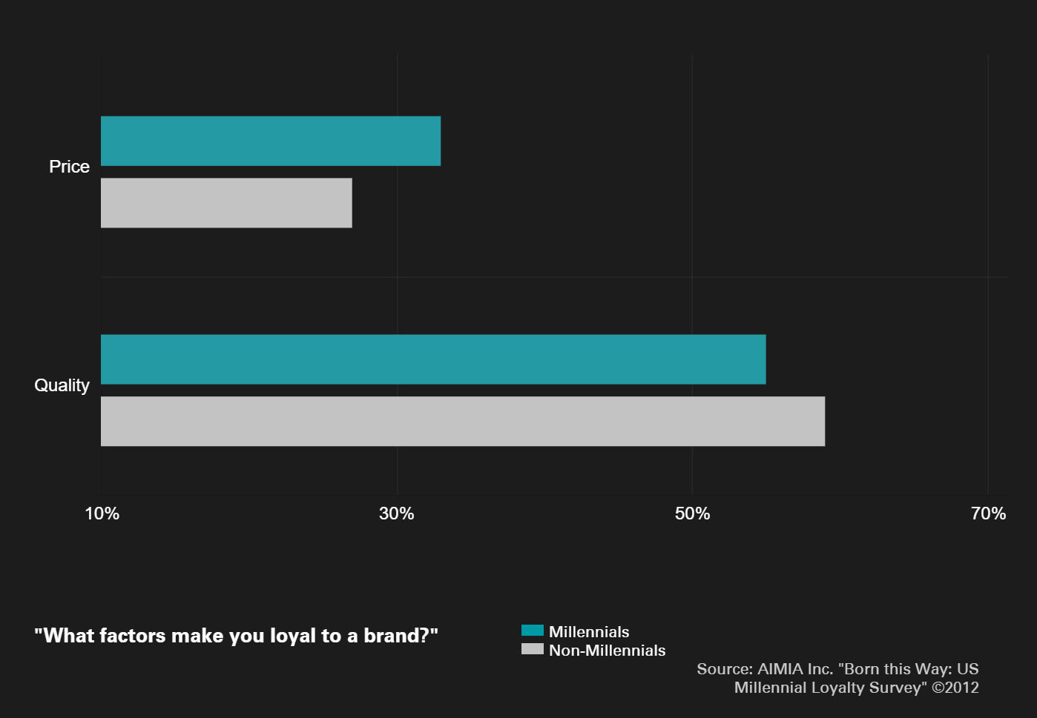
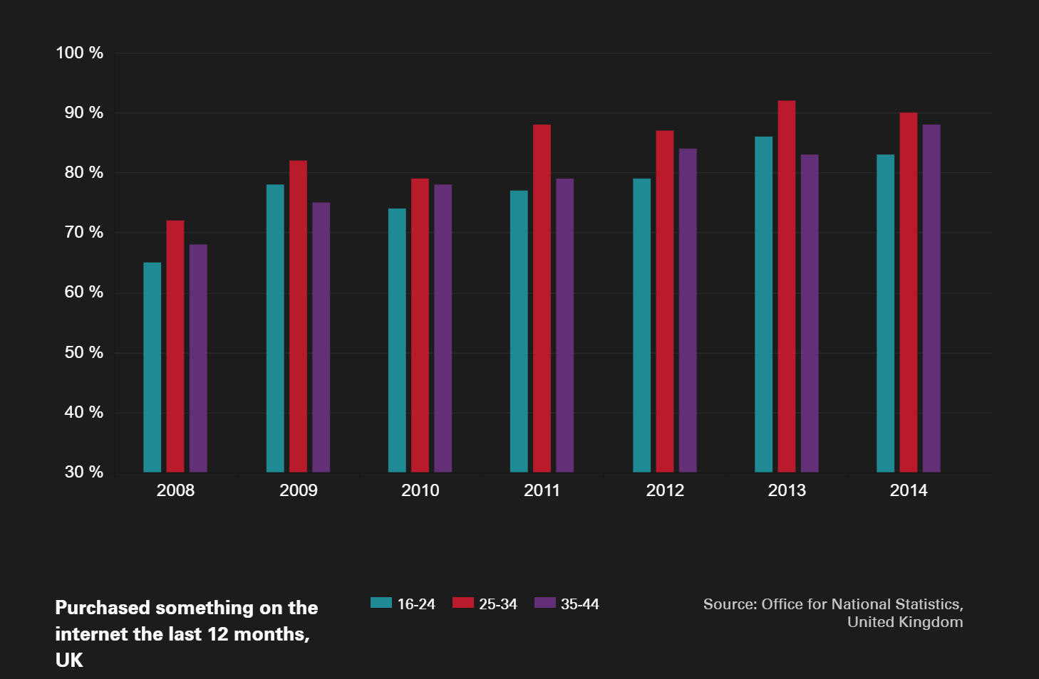
Trends
Power of Price
A strong brand is simply not enough
Price vs Quality
Digital Natives
Live online, shop online
Notes:
Power of Price – people bought it just based off of the brand but now price is way more of a factor because everything is online – can compare prices quickly
Digital Natives – tech savy

Slide 5
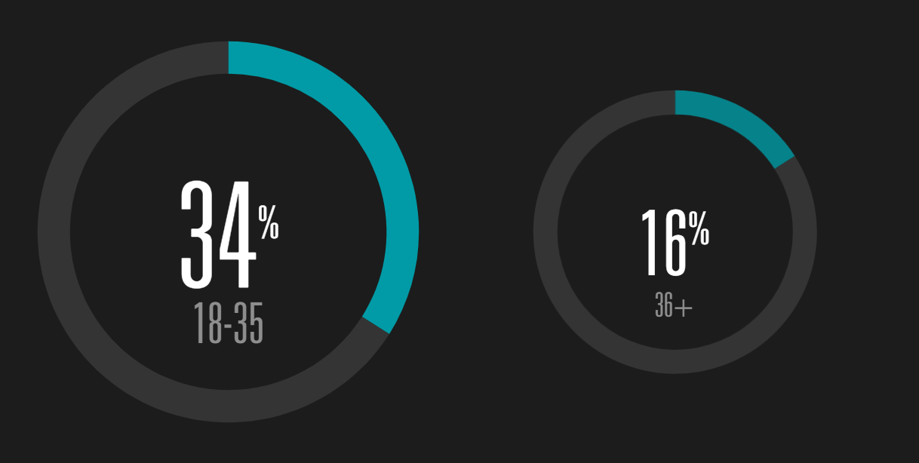
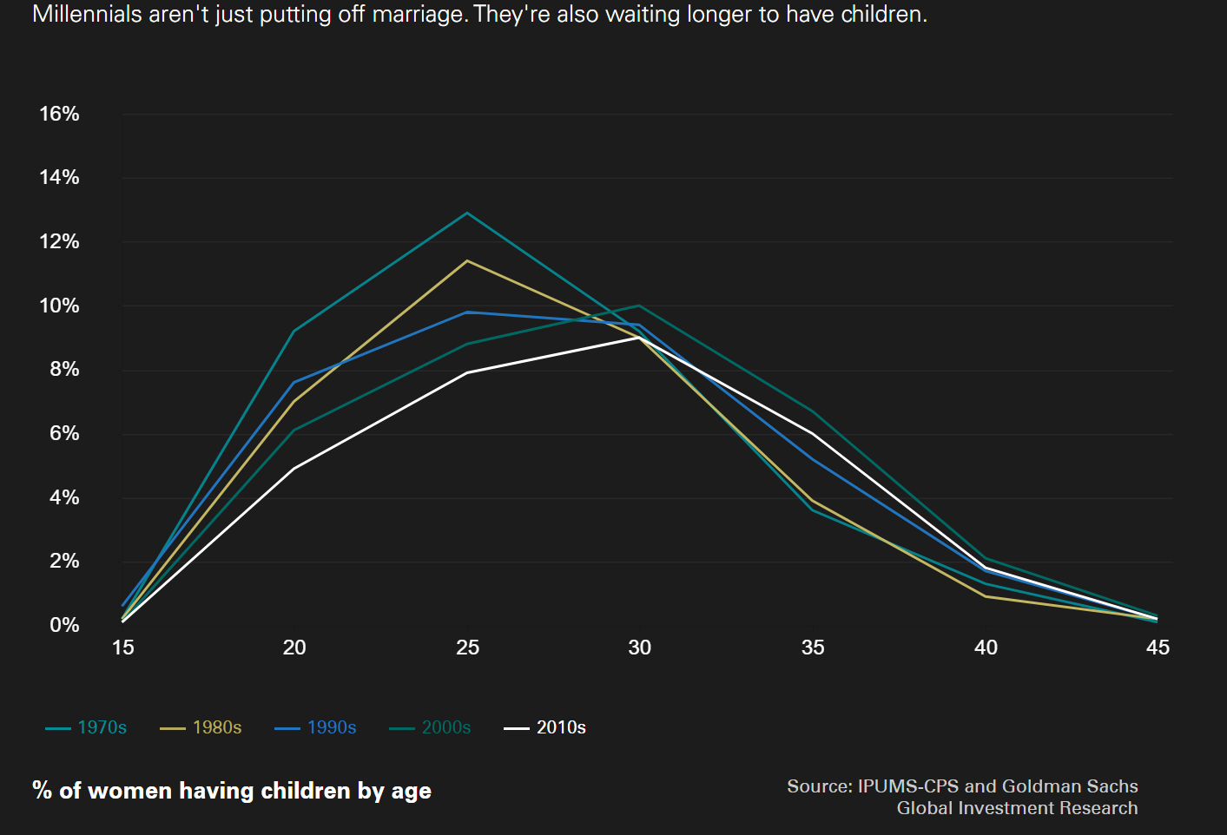
Trends
Social Media
Preference for companies active on Social Media
Different Priorities
Living at home for longer than past generations
Delaying having children and getting married

Slide 6



Opportunity
Millennials are worth Fidelity’s Time & Money!
11.1M of 36.7M Canadians are Millennials
Relevant Credible Add Value
Only 39% of Millennials are serviced by a financial advisor
Entering our formative earning, borrowing, saving years
Notes:
All of them are up for grabs bc Millennials aren’t loyal to brands. They prefer the cheapest most convenient solution … And that’s what we’re going to offer.
ANALOGY
If we lure them in while they’re minoes we have a better chance than when they become 500lbs tuna
Transition to Solution

Slide 7
Overview
The Problem
The Solution
Mobile App
Marketing Plan

Slide 8


Solution
Online Discount Brokerage
Direct Investing → convenient
Increased online presence
Selling 3rd party funds and Fidelity ETFs
→ 91% of millennials said ETFs are their investment vehicle of choice
Robo Advice
DISCOUNT BROKERAGE
Notes:
https://www.cnbc.com/2018/06/12/millennials-are-dumping-their-individual-stocks-and-flocking-to-etfs-schwab-survey-shows.html
Online Discount Brokerage
-
How big of a boost it will be to Fidelity
Direct investing through ETFs only
Robo Advice

Slide 9
Feasibility
How do we make money?
Charge to sell ETFs
Competitive Fidelity Pricing → MER around the same as competitor discount brokerages
Capabilities
FCC has compliance and trading capabilities
Notes:
Fidelity actively managed ETFs, free to buy, charging to sell, MER around the same as other discount brokerages
91% of millennials said ETFs are their investment vehicle of choice
Brand awareness – going on a Fidelity app and seeing Fidelity funds even though we’re selling other funds as well, Fidelity will be the most prominent brand
Data – we will be able to collect users data by seeing the funds they are looking into, location, gender, and what funds people are searching for we
Targeted funds - if we see millenials searching for specific types of funds then we should create a fund like it if Fidelity does not have it
Competitive advantage
https://www.investors.com/news/best-online-brokers/millennial-investors-blaze-new-trail-to-online-brokers/

Slide 10

Fidelity Advantage
What will we get?
Competitive Advantage
Brand Awareness
Access to Data
Targeted advertising
Targeted funds
Notes:
Blackrock
iShares
Questrade – Doesn’t have their own products, charge a fee to sell
- Can offer Fidelity funds cheaply on our platform, all these brokerages are doing it so we need to as well
Weathsimple – Roboadvice like us but don’t have their own products, can meet with a human advisor for a portfolio review, 0.5% fee on your invetsment + 0.2% average annually
Fidelity has our own products, we would be getting the MER fee as well as the % fee on the investment
We would be offering the advice for free

Slide 11
Overview
The Problem
The Solution
Mobile App
Marketing Plan

Slide 12

Mobile App
Quick access
Robo Advice
Purchase power
26%
of all apps downloaded are Finance related
Notes:
Marina:
INTRO
26% of all downloaded apps today are finance related which is why we decided to offer discount brokerage services through launching the Fidelity App
The app allows quick access to your portfolio at all times, be able to set and track goals, locate advisors, get robo advice, and other resource tools
while increasing the retention rate of clients when they already have the app downloaded on their phone
The 2 tabs I would like to demonstrate to you are My Profile and My funds
KYC
On the My Profile tab, users can update their personal and kyc specific info such as their investment knowledge, investing experience, occupation, etc to foster data analytics
in addition, We can also look into what their financial goals and objectives are
These user demographics and information will leverage our business to create future products and services that are tailored to milenials needs and interests
My Funds
My funds tab will allow users to see and measure they’re holdings in real time. They can check the current status of their ETF investments, track their savings planned for travelling, or see their potential earnings for retirement
TRANSITION
next Jessica will also share more features we have

Slide 13
Overview
The Problem
The Solution
Mobile App
Marketing Plan

Slide 14

Marketing Objectives
Use consumer data from the app to create targeting advertisements
App will track which funds user’s are searching for
Implement an impactful marketing campaign through the use of a figurehead
Create a large presence on social media to attract millennial consumers
Notes:
- data collection = seeing what funds to promote specifically based on what theyre searching on the app
- ie. Searches “Global Innovators”
And now we’re going to talk to you about exactly how we’re going to attract Milennials
A lot of this is going to be based on the data we collect from our app

Slide 15
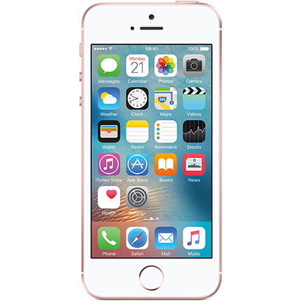
Media Strategy
Highest users of smartphones are ages 18 - 24 ( 93.5%),
Second highest are 25 - 34 (85.6%)
LinkedIn advertisements
34% of users range between 18 - 29
Instagram sponsored advertisements
59 % of users range between 18 - 29
Notes:
- Instagram and LinkedIn are the top two social media platforms for milennias
- In order to create a larger presence on social media we’re going to go through LinkedIn and Instagram
-Feasible bc they are the largest users of smartphones
-Stats are for largest group of users for each

Slide 16
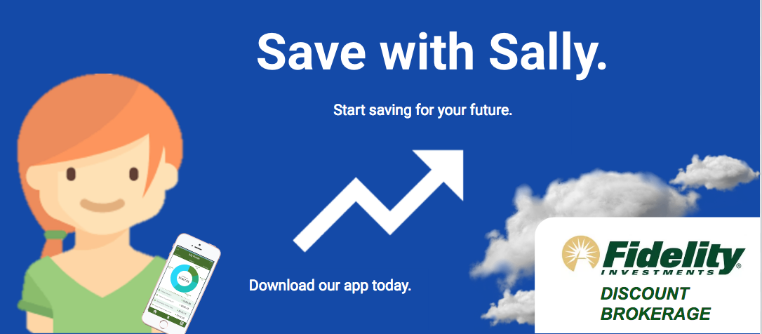
Notes:
Through research we found that relatable characters are relatable to Milennials
Chose to have a female character to promote women in investing
Sally (25), just started her first job and wants to save for a house – goal oriented

Slide 17
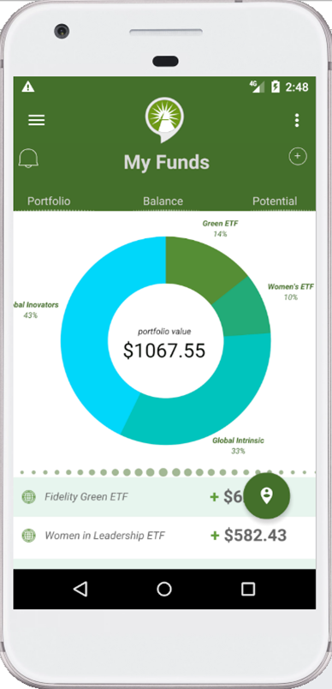
Conclusion
Notes:
Going direct through launching a Discount Brokerage will allow Millennials to conveniently invest their money
Mobile app will allow Fidelity to collect user data
Promote financial literacy through educational resources in the app
Achieve user retention through Robo Advice
Online advertising will be tailored to Millennials’ personal finance goals through data analytics

Slide 18
Questions?

