Slide 1
SO2 and VOCs
Jasmine Treviño

Slide 2
Sulfur Dioxide (SO₂)
What is it?
Colorless gas with a strong, irritating odor.
How is it measured?
Ultraviolet Fluorescence (UVF) [1] Thermo TEI 43i
Units reported
ppb (parts per billion)
Define each of the parameter code, method code?
42401 (param code)
Method code: 100 and 92
FRM/FEM TCEQ and EPA difference
None, TCEQ must follow EPA standards

Slide 3
Parameter | Parameter Code | Method Code | Method Type | Method Designation | Analysis/Measurement Method | FRM or FEM
Sulfur dioxide (SO₂) | 42401 | 092 | Continuous | Automated Analyzer | Ultraviolet Fluorescence | FEM
Sulfur dioxide (SO₂) | 42401 | 100 | Continuous | Instrumental | Ultraviolet Fluorescence | FEM
Continuous monitoring: Automated instruments continuously measure sulfur dioxide concentrations in ambient air and report data at regular intervals (typically every minute or hour), providing near real-time air quality information.

Slide 4
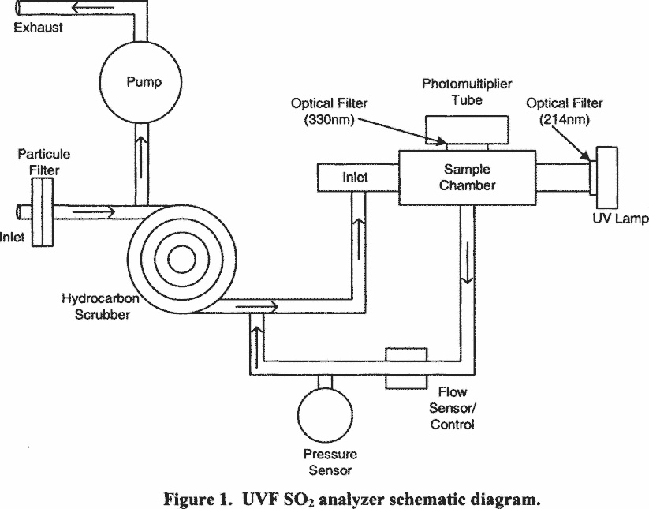
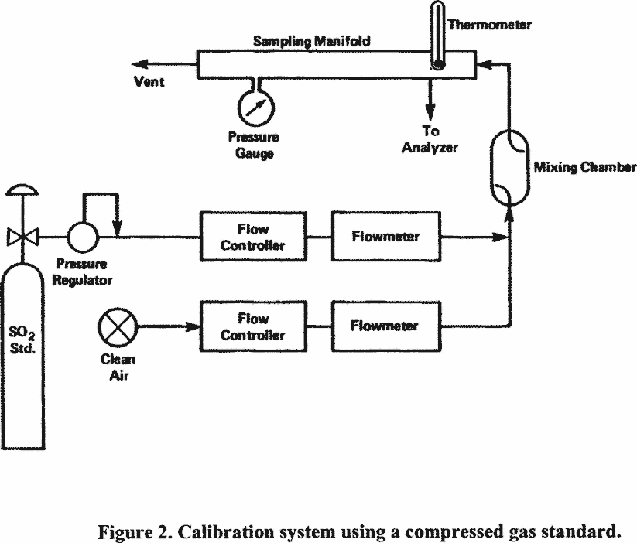
How SO2 is measured diagram :D

Slide 5
SO2 (NAAQS)
Section 109(b)(1) defines a primary standard as one “the attainment and maintenance of which in the judgment of the Administrator, based on [the air quality] criteria and allowing an adequate margin of safety, are requisite to protect the public health.” ^{[1]} Section 109(b)(1).
A secondary standard, in turn, must “specify a level of air quality the attainment and maintenance of which, in the judgment of the Administrator, based on [the air quality] criteria, is requisite to protect the public welfare from any known or anticipated adverse effects associated with the presence of such pollutant in the ambient air.” ^{[2]} Section 109(b)(2)

Slide 6
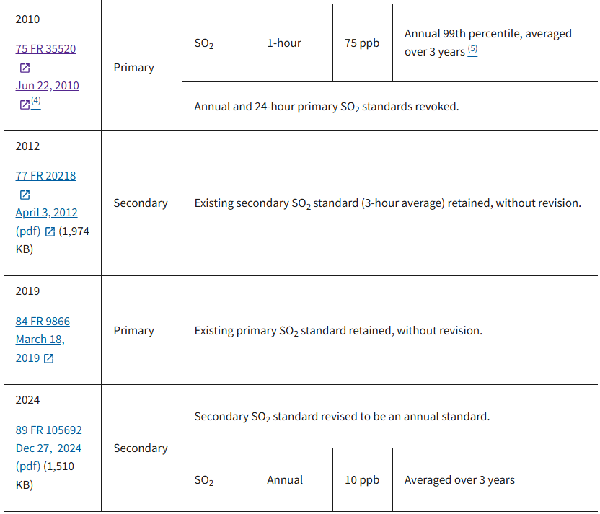
NAAQS Revisions

Slide 7
Summary of changes over the years
Years | Primary Standard (Human Health) | Secondary Standard (Public Welfare) | Notes
2010–2011 | 75 ppb, 1-hour average (99th percentile of daily maximum 1-hour concentrations, averaged over 3 years) | 500 ppb, 3-hour average, not to be exceeded more than once per year | EPA established the new 1-hour primary standard in 2010 and revoked the previous annual and 24-hour primary standards. (US EPA)
2012–2018 | 75 ppb, 1-hour average (99th percentile over 3 years) | 500 ppb, 3-hour average, not to be exceeded more than once per year | EPA reviewed the secondary standard in 2012 and retained it without revision. (US EPA)
2019–2024 | 75 ppb, 1-hour average (99th percentile over 3 years) | 500 ppb, 3-hour average, not to be exceeded more than once per year | EPA reviewed the primary standard in 2019 and retained it without revision. (US EPA)
2025–Present | 75 ppb, 1-hour average (99th percentile over 3 years) | 10 ppb, annual average, averaged over 3 consecutive years | EPA revised the secondary standard in December 2024 (effective January 2025) to better protect ecosystems from sulfur deposition. (Federal Register)

Slide 8
SO2 FEM VS FRM
Federal equivalent method (FEM) means a method for measuring the concentration of an air pollutant in the ambient air that has been designated as an equivalent method in accordance with this part; it does not include a method for which an equivalent method designation has been canceled in accordance with § 53.11 or § 53.16. [2]
Federal reference method (FRM) means a method of sampling and analyzing the ambient air for an air pollutant that is specified as a reference method in an appendix to part 50 of this chapter, or a method that has been designated as a reference method in accordance with this part; it does not include a method for which a reference method designation has been canceled in accordance with § 53.11 or § 53.16 [2]

Slide 9
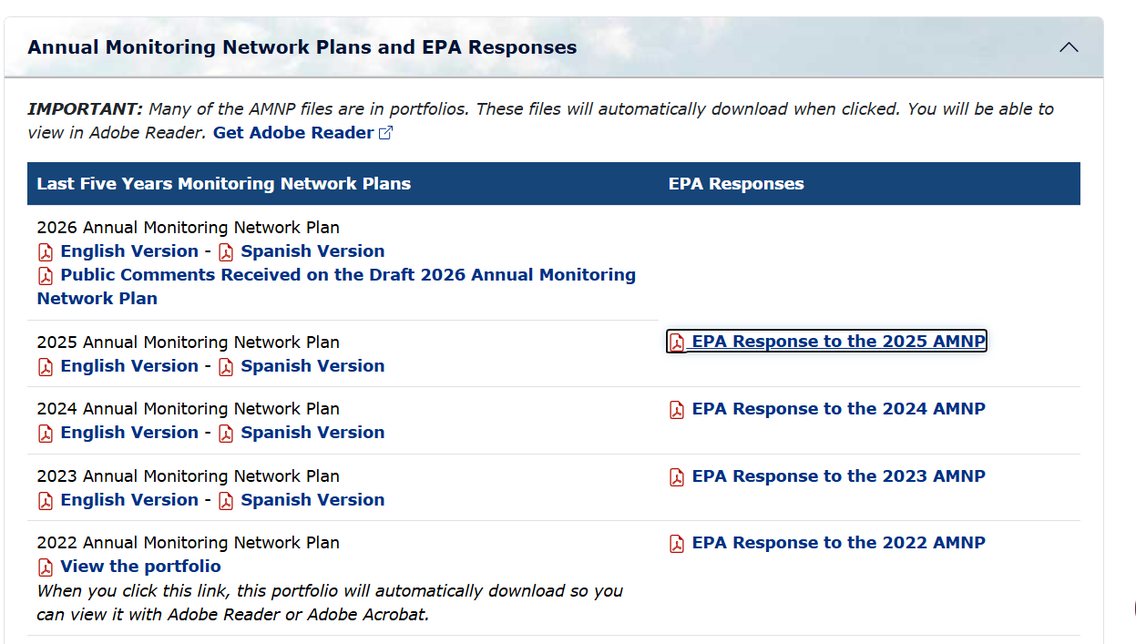
EPA approves of TCEQ

Slide 10
Weather Influences
Var | effect | What happens
Wind Speed | Higher wind speeds generally decrease SO₂ concentrations | Wind disperses emissions and dilutes pollutants.
Wind Direction | Can increase or decrease SO₂ (depends :o) | Determines whether emissions from industrial sources or power plants are transported toward a monitoring site.
Temp Inversions | Increase SO₂ | Stable air traps pollutants near the ground, preventing vertical mixing.
Boundary Layer Height | lower SO₂ (If High BL) | A deeper mixing layer allows pollutants to disperse through a larger volume of air.
Precip (Wet Deposition) | decreases SO₂ | SO₂ readily dissolves in rainwater and is removed from the atmosphere.
Relative Humidity | Usually decreases gaseous SO₂ | High humidity promotes oxidation of SO₂ into sulfate aerosols (SO₄²), reducing the amount of gaseous SO₂.
Solar Radiation | Decreases SO₂ | Sunlight accelerates atmospheric oxidation of SO₂ into sulfate particles through photochemical reactions.
Atmos Pressure | increase SO₂ (if High pressure) | High-pressure systems often produce stagnant conditions with limited mixing.

Slide 11
Volatile Organic Compounds (VOCs)
A large group of carbon-containing chemicals that easily evaporate into the atmosphere at normal temperatures because they have high vapor pressures and low boiling points
Common VOCs
Benzene
Toluene
Ethylbenzene
Xylenes (BTEX)
Formaldehyde
Acetaldehyde
Isoprene
Units : ppb (parts per billion)

Slide 12
VOC param codes
Compound | Parameter Code
Benzene | 45201
Toluene | 45202
Ethylbenzene | 45203
M-Xylene | 45204
o-Xylene | 45205

Slide 13
How are VOCs measured?
Automated Gas Chromatographs (AutoGCs)
AutoGC analysis can measure ambient levels of a number of VOCs which are of interest from an ozone formation standpoint even when their concentrations are too low to cause direct health effects.
Limitations
AutoGCs are designed to collect data at a given sampling location over time. These instruments can be configured to automatically provide speciation data for 1 to over 55 targeted VOCs. However, the more extensive the list of compounds the more difficult it becomes to ensure that any single compound is correctly identified and quantitated at the time of initial data capture. Changes to compound identification and concentration are not uncommon during this validation process. Therefore, it is vital that the data user is aware of the high degree of uncertainty in the unvalidated data and any actions or decisions based on unvalidated data should be made with this in mind.

Slide 14
NAAQS Standards
There is NO National Ambient Air Quality Standard (NAAQS) for VOCs
Instead, EPA regulates:
Ground-level ozone (formed from VOCs + NOₓ + sunlight)
Hazardous Air Pollutants (HAPs) such as benzene
Industrial VOC emissions
NO universal Method codes
Notes:
Voc regulatory guidelines

Slide 15
Weather influence
Wx var | Effect on VOC Concentrations | What happens
Temp | Higher temps generally increase VOC emissions | Warmer temperatures increase evaporation from fuels, solvents, and vegetation, releasing more VOCs into the atmosphere.
Solar Radiation | Can decrease VOC concentrations but increases ozone formation | Sunlight drives photochemical reactions that consume VOCs while producing ground-level ozone (O₃).
Wind Speed | Higher wind speeds generally decrease VOC concentrations | Wind disperses and dilutes VOCs, reducing local concentrations.
Wind Direction | Can increase or decrease VOC concentrations | Determines whether emissions from refineries, petrochemical plants, highways, or other sources are transported toward a monitoring site.
Boundary Layer Height | Higher bl = lower VOC concentrations | A deeper mixing layer allows VOCs to disperse through a larger volume of air.
Temp Inversions | Increase VOC concentrations | Stable atmospheric conditions trap VOCs near the surface, limiting vertical mixing.
precip | Generally decreases VOC concentrations | Rain removes some water-soluble VOCs and improves atmospheric mixing, though many hydrocarbons are only weakly removed by precipitation.
Relative Humidity | Variable effect | Humidity influences atmospheric chemistry and secondary organic aerosol (SOA) formation, but its effect depends on the specific VOC species.

Slide 16
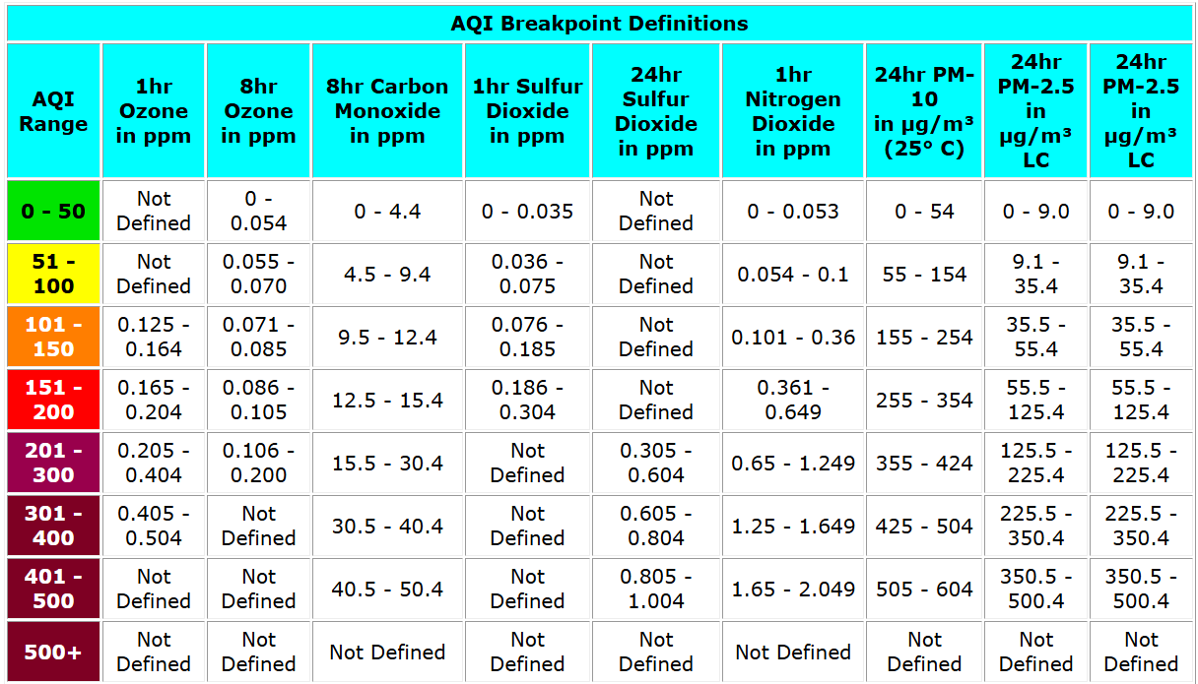

Slide 17
References
United States Environmental Protection Agency. (n.d.). AQS Method Code Table (All Methods). https://aqs.epa.gov/aqsweb/documents/codetables/methods_all.html
Electronic Code of Federal Regulations. (n.d.). 40 CFR Part 50, Appendix A-1—Reference measurement principle and calibration procedure for the measurement of sulfur dioxide in the atmosphere (Ultraviolet fluorescence). https://www.ecfr.gov/current/title-40/chapter-I/subchapter-C/part-50/appendix-Appendix%20A-1%20to%20Part%2050
Electronic Code of Federal Regulations. (n.d.). 40 CFR Part 53—Ambient air monitoring reference and equivalent methods. https://www.ecfr.gov/current/title-40/chapter-I/subchapter-C/part-53
Federal Register. (2010, June 22). Primary National Ambient Air Quality Standard for sulfur dioxide. https://www.federalregister.gov/documents/2010/06/22/2010-13947/primary-national-ambient-air-quality-standard-for-sulfur-dioxide
Federal Register. (2024, December 27). Review of the Secondary National Ambient Air Quality Standards for Oxides of Nitrogen, Oxides of Sulfur, and Particulate Matter. https://www.federalregister.gov/documents/2024/12/27/2024-29463/review-of-the-secondary-national-ambient-air-quality-standards-for-oxides-of-nitrogen-oxides-of
Texas Commission on Environmental Quality. (n.d.). Air Monitoring Operations. https://www.tceq.texas.gov/airquality/monops
United States Environmental Protection Agency. (n.d.). Air Quality System (AQS). https://www.epa.gov/aqs
United States Environmental Protection Agency. (n.d.). Ambient Monitoring Technology Information Center (AMTIC). https://www.epa.gov/amtic
United States Environmental Protection Agency. (n.d.). Criteria Air Pollutants. https://www.epa.gov/criteria-air-pollutants
United States Environmental Protection Agency. (n.d.). Ground-level ozone basics. https://www.epa.gov/ground-level-ozone-pollution/ground-level-ozone-basics
United States Environmental Protection Agency. (n.d.). Integrated Science Assessment (ISA) for Sulfur Oxides – Health Criteria. https://www.epa.gov/isa/integrated-science-assessment-isa-sulfur-oxides-health-criteria
United States Environmental Protection Agency. (n.d.). National Ambient Air Quality Standards (NAAQS). https://www.epa.gov/criteria-air-pollutants/naaqs-table
United States Environmental Protection Agency. (n.d.). Sulfur dioxide (SO₂) pollution. https://www.epa.gov/so2-pollution
United States Environmental Protection Agency. (n.d.). Volatile Organic Compounds' Impact on Indoor Air Quality. https://www.epa.gov/indoor-air-quality-iaq/volatile-organic-compounds-impact-indoor-air-quality
United States Congress. (n.d.). Clean Air Act, 42 U.S.C. § 7409 (Section 109). https://www.law.cornell.edu/uscode/text/42/7409

