Slide 1
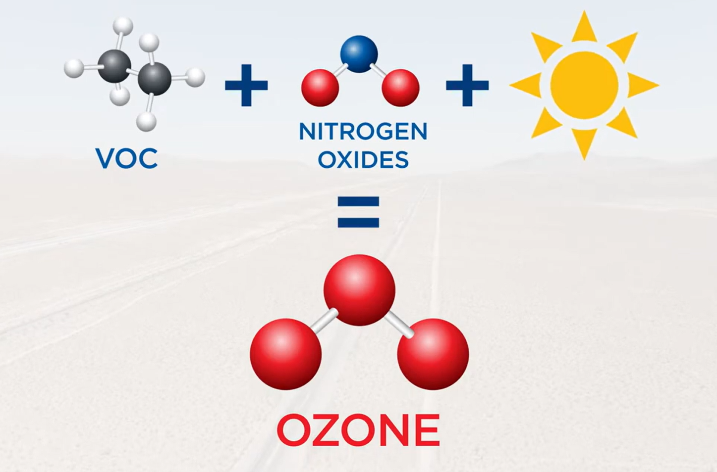


Slide 2
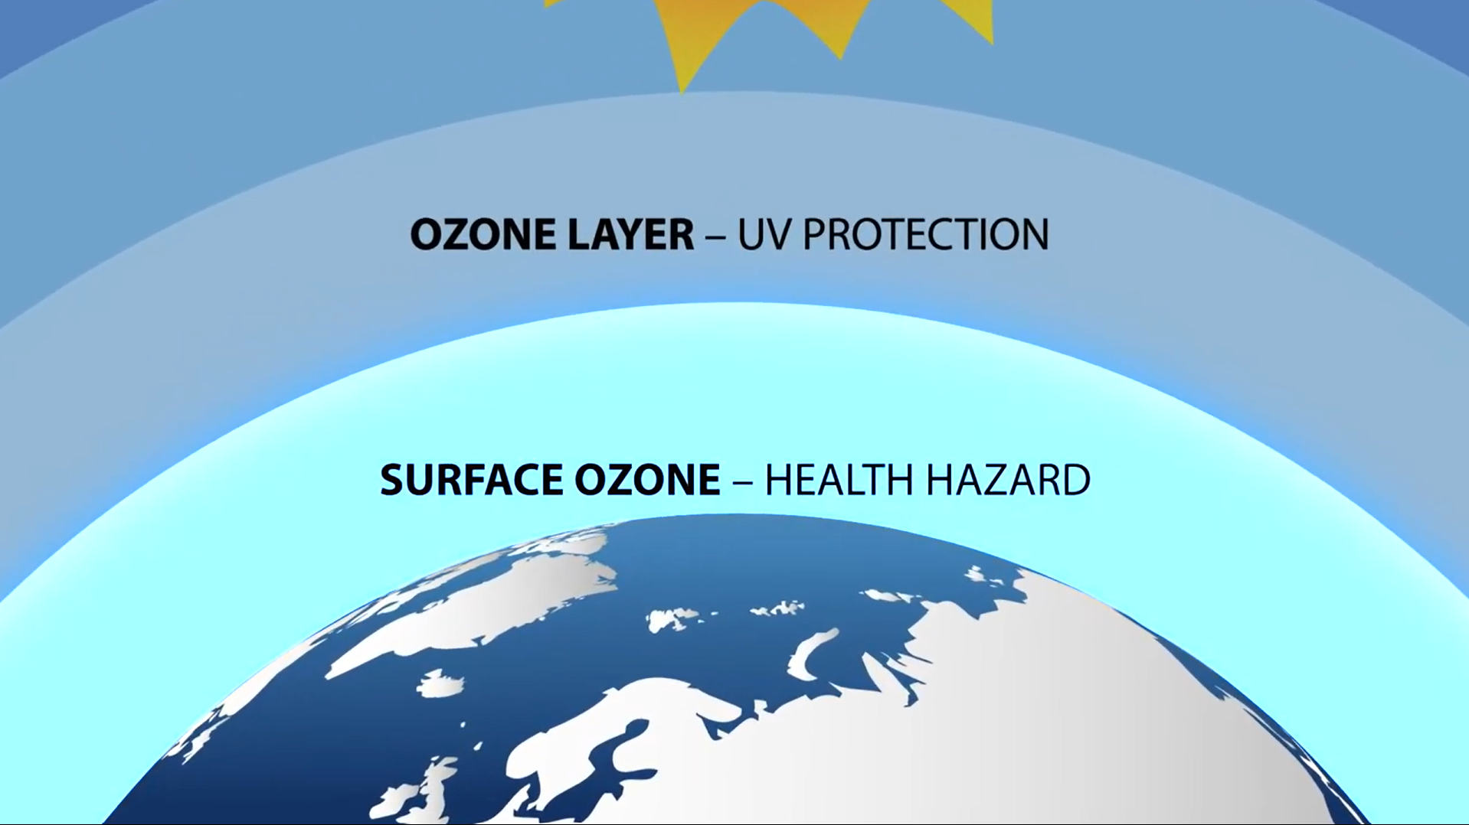
CRITERIA POLLUTANT · DEFINITION
Ground-Level Ozone (O₃): What It Is?
Definition
– Molecule. A triatomic allotrope of oxygen (O₃): three oxygen atoms in a bent, resonance-stabilized structure; a pale-blue, pungent, strongly oxidizing gas.
– Same molecule, two roles. Stratospheric ozone shields the biosphere from UV. Tropospheric (ground-level) ozone is a harmful air pollutant and short-lived climate forcer.
– Secondary pollutant. Not emitted directly in significant quantities — it forms in the lower atmosphere from precursor emissions reacting under sunlight.
– Photochemical oxidant. The principal component of photochemical smog and a powerful respiratory irritant.
Why it is a “criteria” pollutant
– One of six criteria pollutants under the U.S. Clean Air Act (with PM, CO, SO₂, NO₂, Pb).
– EPA must set National Ambient Air Quality Standards (NAAQS) using published “criteria” documenting health and welfare effects.
PRIMARY POLLUTANT
Emitted directly from a source.
e.g. NO, CO, SO₂, primary PM.
SECONDARY POLLUTANT
Formed in the atmosphere by reaction of precursors.
O₃ is the archetype.
Sources: U.S. EPA, Ground-level Ozone Basics; Clean Air Act §§108–109; 40 CFR Part 50.

Slide 3
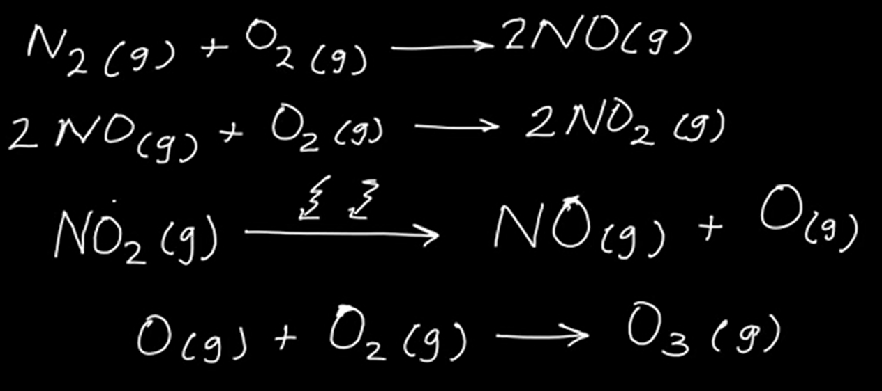
SOURCES & FORMATION
How Ozone Forms: Precursors + Sunlight
NOₓ
Nitrogen oxides
Vehicles, power plants, industry
Key characteristics
O₃
ground-level ozone
– Precursor-driven. Production is limited by the supply of NOₓ and VOCs and by sunlight intensity.
– Chemical regimes. Can be NOₓ-limited (rural/downwind) or VOC-limited (urban cores); this dictates which precursor to control.
– Diurnal cycle. Builds to a mid-afternoon peak, falls overnight as photochemistry stops and NO titrates O₃.
– Secondary & regional. Peaks often occur downwind of sources; transported background ozone adds to local production.
VOCs
Volatile organic compounds
Fuels, solvents, petrochem, biogenic
+ sunlight (UV) + heat
Simplified photochemistry
Sources: U.S. EPA Integrated Science Assessment for Ozone (2020); NRC, Rethinking the Ozone Problem in Urban and Regional Air Pollution (1991).

Slide 4
MEASUREMENT · PRINCIPLE & INSTRUMENT
How Ozone Is Measured
UV Photometric Absorption
Gas-Phase Chemiluminescence
DOMINANT IN PRACTICE (~99% OF MONITORS)
FEDERAL REFERENCE PRINCIPLE
– Ozone absorbs UV at 254 nm; absorbance → concentration via the Beer–Lambert law.
– Air measured with and without ozone (scrubbed reference) to isolate the O₃ signal.
– Continuous, hourly-reporting analyzers; most regulatory O₃ monitors use this principle.
– Ozone reacts with ethylene (or nitric oxide) to emit light proportional to O₃.
– Basis of the Federal Reference Method in 40 CFR Part 50, Appendix D.
– Highly specific and interference-resistant, but less common in routine networks.
Calibration & traceability
– Calibrations trace to a NIST-traceable UV Standard Reference Photometer (SRP).
– Uses a defined ozone absorption cross-section for consistency across the network.
– Sited and operated under 40 CFR Part 58 (monitoring network requirements).
– Ozone-“season” operation is common; many sites report April–October at minimum.
Sources: 40 CFR Part 50 App. D (calibration/traceability); Part 58; EPA List of Designated Reference & Equivalent Methods. Verify designations against EPA.

Slide 5
REGULATORY METHOD FRAMEWORK
FRM vs. FEM: Definitions & Difference
FRM
Federal Reference Method
FEM
Federal Equivalent Method
– The benchmark method EPA specifies — by measurement principle and calibration — in the 40 CFR Part 50 appendices.
– For ozone: a gas-phase chemiluminescence reference measurement principle.
– Defines the standard against which candidate methods are judged.
– An alternative method (often a different principle) EPA has tested and certified to yield data equivalent to the FRM.
– For ozone: UV photometric analyzers are the predominant FEMs.
– Must meet the performance specifications in 40 CFR Part 53 to earn designation.
The difference in one line
The FRM is the defined reference standard; an FEM is a certified equal that agencies may deploy instead. Both yield regulatory-quality data usable for NAAQS comparisons; in ozone networks the FRM sets the scale while UV FEMs do most day-to-day monitoring.
Sources: 40 CFR Part 50 (reference methods); 40 CFR Part 53 (equivalent-method designation & performance tests).

Slide 6
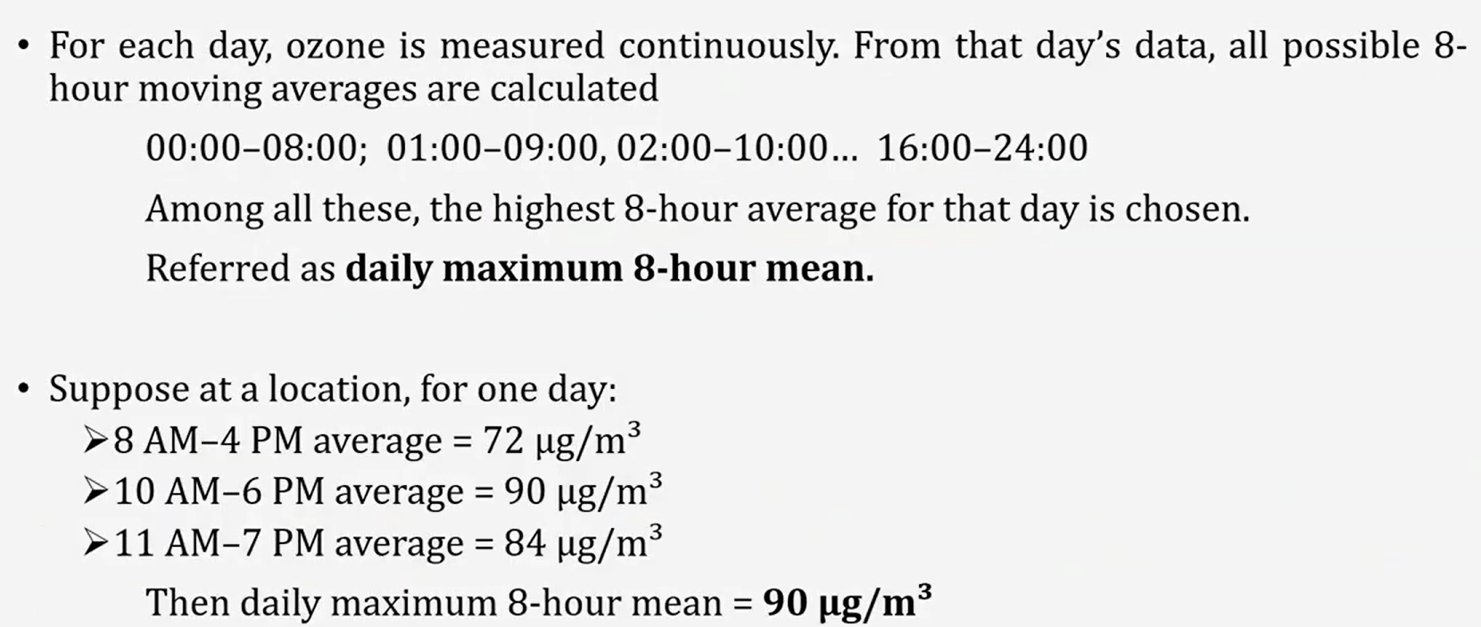
How Ozone is Calculated?

Slide 7
EVOLUTION OF METHODS
How Measurement Changed — and Why
Era | Method | Why it changed
1971 | Original FRM promulgated: ethylene-based gas-phase chemiluminescence. | Establish a specific, reproducible reference at the first ozone NAAQS.
1970s–90s | UV photometric analyzers adopted widely as Federal Equivalent Methods. | Ethylene reagent handling was costly/hazardous; UV is reagent-free and easier to run.
2015 | Reference measurement principle updated (Part 50 App. D); UV-traceable calibration refined. | Modernize specifications, tighten calibration/traceability, reflect field practice.
2023–25 | Further amendments to App. D calibration provisions. | Continued refinement of absorption cross-section and calibration rigor.
Analyst takeaway: method and calibration changes can introduce step-changes into long time series — always check the method code and any FRM/FEM transition before interpreting multi-decade trends.
Sources: 40 CFR Part 50 App. D revision history (80 FR 65453, 2015; amended 2023 & 2025); Long et al. (2021), Atmos. Meas. Tech. Verify dates against eCFR.

Slide 8
AQS IDENTIFIERS
Parameter Code & Method Codes
Instrument (representative) | Principle | EPA designation №
Thermo Scientific 49i | UV photometric (FEM) | EQOA-0880-047
Ecotech EC9810 / Serinus 10 | UV photometric (FEM) | EQOA-0193-091
2B Technologies Model 205 | UV photometric (FEM) | EQOA-1410-190
2B Technologies Model 211 | UV photometric (FEM) | EQOA-0514-215
Bendix / CSI 8002 | Ethylene chemiluminescence (FRM) | Reference (RFOA family)
AQS PARAMETER CODE
44201
Ozone (O₃)
Reported in ppm
On method codes
AQS pairs parameter 44201 with a method code identifying the instrument/principle. EPA also publishes federal designation numbers — RFOA (reference) and EQOA (equivalent) — in its designated-methods list.
Note on numeric method codes. AQS also stores a short numeric method code per monitor (distinguishing UV-photometric vs. chemiluminescence families). Pull the exact numeric codes and current designations from the EPA AQS “Methods” code table rather than assuming them — they change as instruments are approved or retired.
Sources: EPA AQS parameter code 44201; EPA List of Designated Reference & Equivalent Methods (designation numbers verified). Confirm numeric method codes in the AQS code tables.

Slide 9
UNITS & REPORTING CONVENTIONS
Units, Conversions & Reporting
Unit | AQS code | Typical use
ppm | 007 | AQS storage unit for O₃; NAAQS expressed in ppm
ppb | 008 | Common reporting/plotting (1 ppm = 1000 ppb)
µg/m³ | 001 | Mass basis; depends on temperature & pressure
Reporting conventions
– Hourly averages. Continuous analyzers report 1-hour average concentrations to AQS.
– 8-hour statistic. AQS computes the daily maximum 8-hour average (MDA8) as a running mean of eight 1-hour values.
– Design value. The regulatory metric: the 3-year average of the annual 4th-highest MDA8.
– Completeness. Data-capture and validity rules govern whether a day or quarter counts.
– Convention. U.S. regulatory ozone is handled in ppm/ppb by volume; µg/m³ appears in health and international contexts.
Conversion (25 °C, 1 atm)
1 ppb O₃ ≈ 1.96 µg/m³
0.070 ppm = 70 ppb
Mass–volume conversion varies with temperature and pressure via the molar volume; always state reference conditions.
Sources: U.S. EPA AQS/AirData documentation; 40 CFR Part 50 App. U (8-hour ozone data handling & design value).

Slide 10
THE STANDARD & ITS RATIONALE
NAAQS: Level, History & the Design-Value Test
Year | Standard | Form
1971 | 0.08 ppm (1-hr, total oxidants) | Not-to-exceed
1979 | 0.12 ppm (1-hr) | Expected exceedances
1997 | 0.08 ppm (8-hr) | 4th-high, 3-yr avg
2008 | 0.075 ppm (8-hr) | 4th-high, 3-yr avg
2015 | 0.070 ppm (8-hr) — current | 4th-high, 3-yr avg
CURRENT NAAQS (2015)
0.070
ppm (70 ppb), 8-hour
Primary & secondary, set identically
Form of the standard
Attained when the 3-year average of the annual 4th-highest daily-max 8-hour concentration is ≤ 0.070 ppm at a site.
Scientific rationale
– Controlled-exposure and epidemiological evidence link short-term O₃ to reduced lung function, airway inflammation, and aggravated asthma; long-term exposure to respiratory harm.
– The secondary standard protects welfare: vegetation, crop and forest productivity, ecosystems.
– EPA's 2020 review retained 0.070 ppm as protective with an adequate margin of safety.
Sources: 40 CFR Part 50; EPA Ozone NAAQS Timeline; EPA ISA for Ozone (2020); Dec. 2020 final decision to retain. Time-sensitive — verify current review status against EPA.

Slide 11
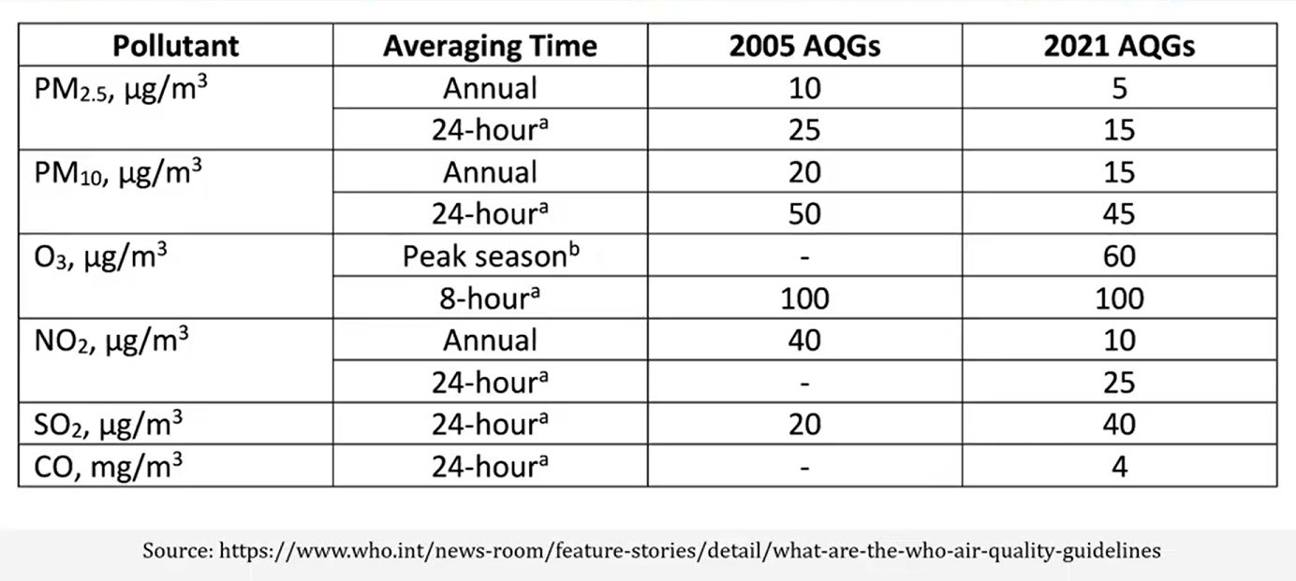
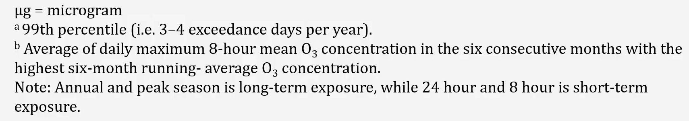
WHO Standards

Slide 12
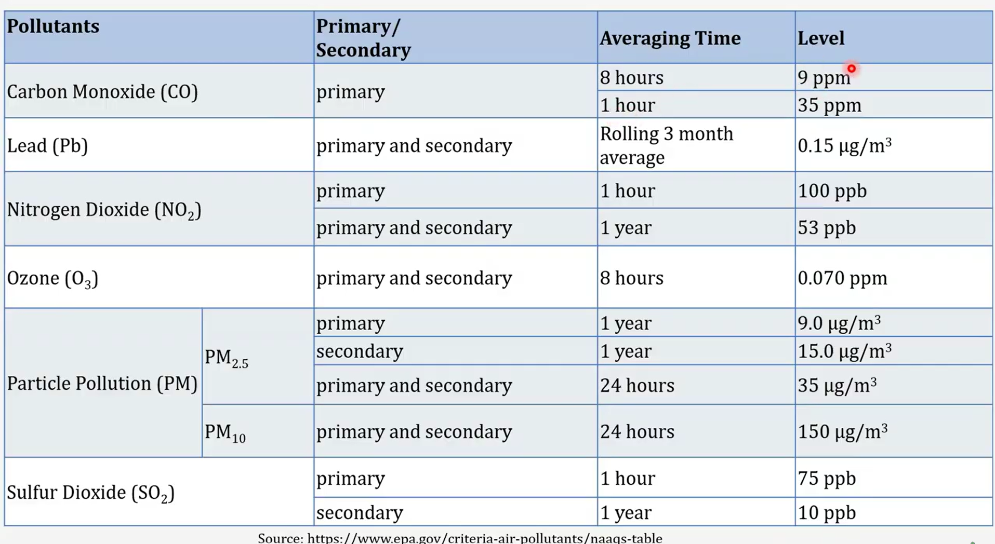

Slide 13
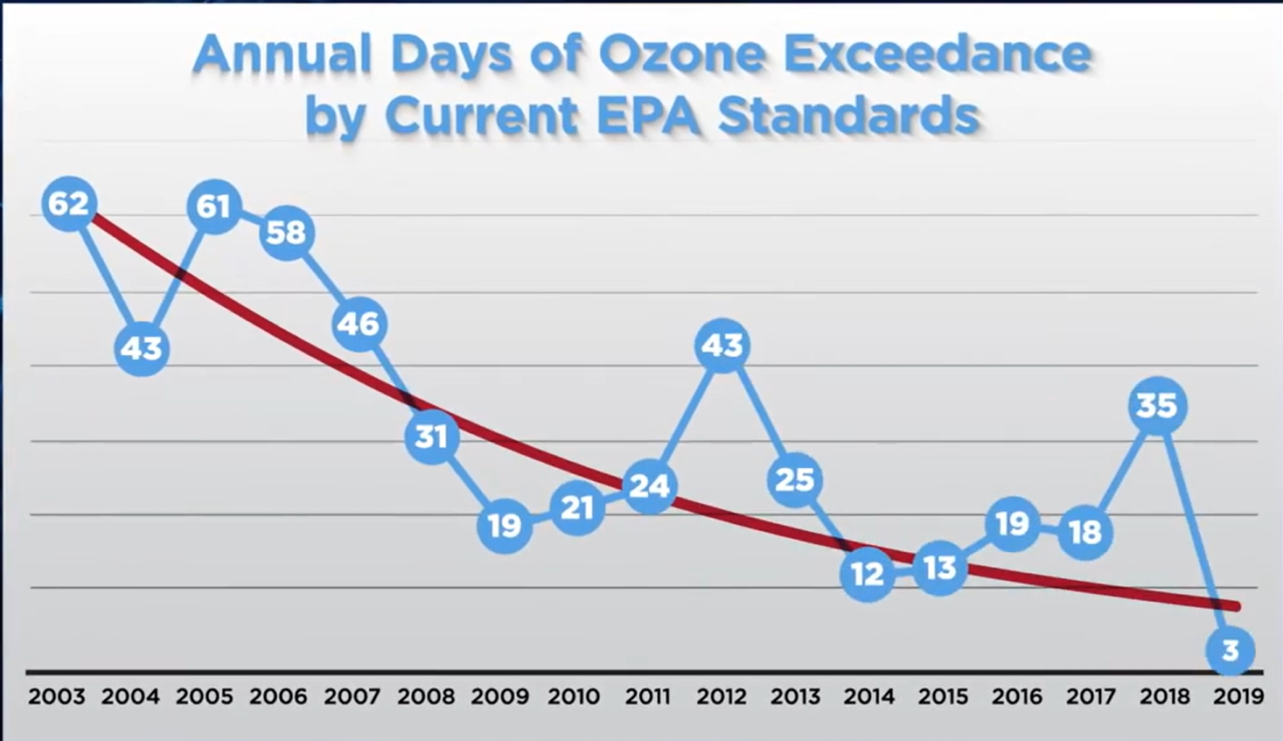
GOOD SIGN

Slide 14
METEOROLOGICAL DRIVERS
Weather Influences on Ozone
Temperature
Solar radiation
Wind & transport
Heat accelerates photochemistry and biogenic VOC emissions; ozone rises sharply on hot days.
Sunlight is the energy source for O₃ formation; clear-sky summer days maximize production.
Light winds and stagnation trap precursors; regional transport imports background ozone from upwind.
Boundary layer
High pressure
Humidity & fronts
A shallow, stable mixing layer concentrates precursors; strong mixing dilutes them.
Subsidence, clear skies, and light winds under stagnant highs are classic ozone-episode conditions.
Clean maritime or frontal passages usually suppress peaks; coastal recirculation can worsen them.
Sources: NOAA/NWS air-quality meteorology guidance; Jacob & Winner (2009), Atmos. Environ.; EPA ISA for Ozone (2020).

Slide 15
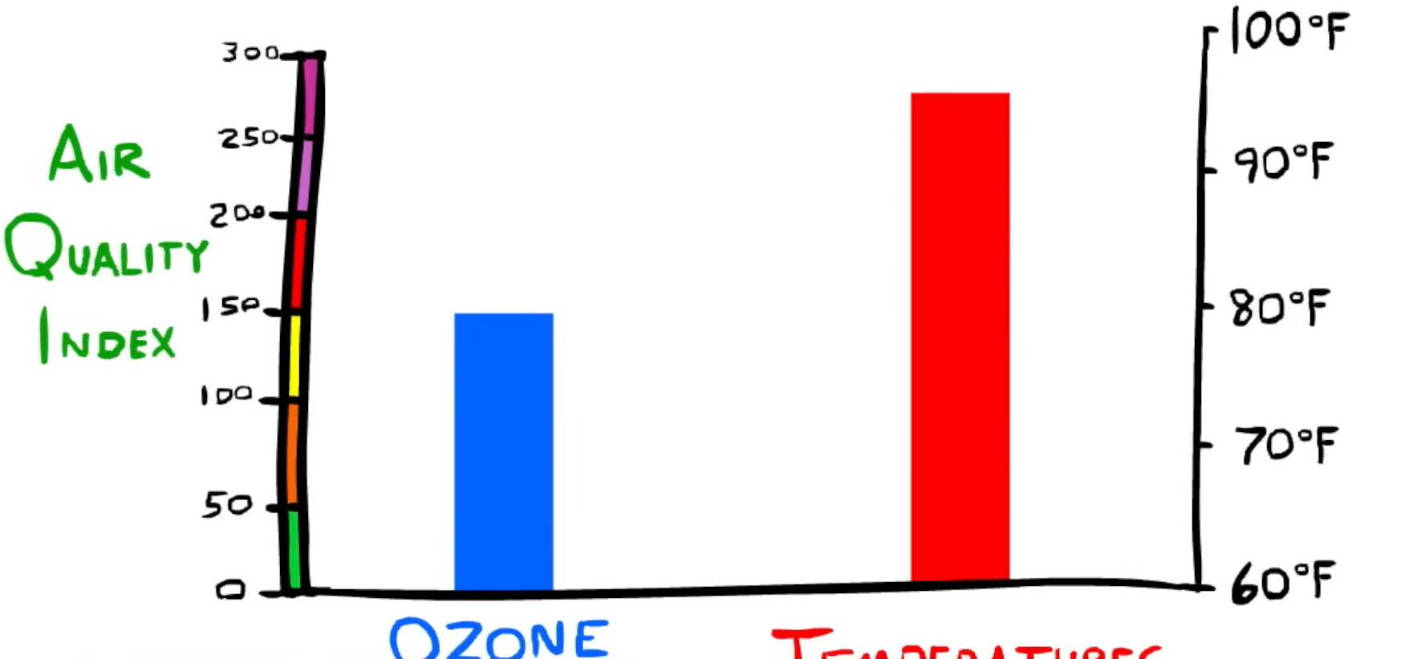
METEOROLOGICAL DRIVERS
Weather Influences on Ozone
OZONE
Temperature

Slide 16
DATA GOVERNANCE
TCEQ vs. EPA AQS: Roles & Data Flow
TCEQ
Texas Commission on Environmental Quality
EPA AQS
EPA Air Quality System (national repository)
– State agency operating Texas monitors (CAMS network) and collecting ambient data.
– Performs QA and certifies data; develops State Implementation Plans (SIPs).
– Submits validated data to EPA; provides near-real-time (uncertified) data publicly.
– National database of certified ambient data from state, local & tribal agencies.
– Standardized identifiers: state/county/site codes, parameter code 44201, method codes, POC.
– Source for design values, AirData reports, and NAAQS determinations.
Certified vs. uncertified · how they relate
Monitor → TCEQ (collect, QA, certify) → EPA AQS (national, certified). Uncertified/preliminary data support timely analysis but can change; certified AQS data are the official record for regulatory and trend work. Latency to AQS can be several months — use certified data for design values and formal conclusions.
Sources: TCEQ ambient monitoring (CAMS/TAMIS) documentation; U.S. EPA AQS documentation.

Slide 17
DATA GOVERNANCE · PRACTICAL DIFFERENCES
TCEQ vs. EPA Ozone Data: Key Differences
Dimension | TCEQ (TAMIS) | EPA (AQS / AirData)
Role | State network: operates the CAMS monitors; upstream source | National repository: receives certified data from the states
Native cadence | Raw 1-hour averages, refreshed hourly | Stores hourly; headline ozone metric is the 8-hour daily max (MDA8)
Ozone units | Parts per billion (ppb) — unit code 008 | Parts per million (ppm) — unit code 007
Regulatory metric | Raw observations; analyst derives MDA8 | 4th-highest MDA8; 3-yr design value (Part 50 App. U)
Certification | Near-real-time, uncertified (may change) | Certified national record; months of latency
Access format | AQS RD v1.6 transaction files via TAMIS portal | AQS API and AirData standard reports
Site coverage | All Texas CAMS, incl. sites absent from AQS Data Mart | Subset submitted to / exposed via AQS Data Mart
Unit trap. Ozone is ppb in TCEQ but ppm in EPA — a 1000× factor. Convert ppb → ppm (× 0.001) before any cross-source comparison or NAAQS check.

Slide 18
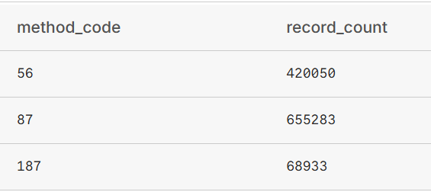
REGIONAL SCOPE
South Texas Study Area: Where Ozone Is Monitored
13
18
2015–25
44201
South Texas counties
Active number of sites
study period
AQS code for O₃
Bexar (7 sites): CPS Pecan Valley_0055, Calaveras Lake_0059, Camp Bullis_0052, Elm Creek Elementary_0501, Fair Oaks Ranch_0502, Government Canyon_1610, Heritage Middle School_0622
Cameron (2 sites): Brownsville_0006, Harlingen_1023
Comal (2 sites): Bulverde Elementary_0503, City of Garden Ridge_0505
Guadalupe (2 sites): New Braunfels Airport_0504, Seguin Outdoor Learning Center_0506
Hidalgo (1 site): Mission_0043
Nueces (2 sites): Corpus Christi Tuloso_0026, Corpus Christi West_0025
Victoria (1 site): Victoria_0003
Webb (1 site): Laredo Vidaurri_0016
Different method codes within that UV-absorption family typically correspond to different instrument manufacturers or model generations (for example, older Dasibi or Bendix analyzers versus newer Thermo Scientific, Teledyne API, or Ecotech instruments), or sometimes to different calibration/measurement protocol versions.

Slide 19
REFERENCE SUMMARY
Ground-Level Ozone — Key Facts
TYPE
CURRENT NAAQS
Secondary photochemical pollutant; a criteria pollutant
0.070 ppm (70 ppb), 8-hour — set 2015, retained 2020
FORMATION
NOₓ + VOCs under sunlight & heat
AQS PARAMETER CODE
TCEQ VS. EPA
44201 (EPA stores in ppm; TCEQ reports in ppb)
TCEQ hourly ppb · EPA 8-hr max in ppm (convert × 0.001)
MEASUREMENT
ATTAINMENT STATUS
UV photometry (dominant FEM); chemiluminescence FRM
To be determined by the analysis — not assumed here
REFERENCE METRIC
DATA GOVERNANCE
3-yr avg of annual 4th-highest daily-max 8-hour (MDA8)
TCEQ collects & certifies → EPA AQS national record

