Slide 1
Step 1: Discretize CPR
Current Phase Relation (Standard JJ)
CPR(2π /3)
0
CPR(0)
CPR(4π /3)
0
z
π
2π
Phase (rad)

Slide 2
Step 2: Divide Extended JJ into channels
CH1
CH2
CH3

Slide 3
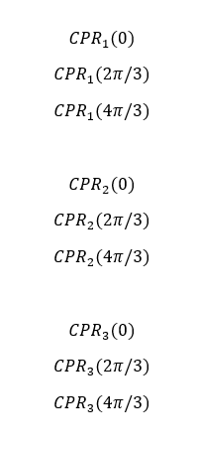
Step 3: Determine Unknowns
There are 3 channels and 3 phases of interest

Slide 4
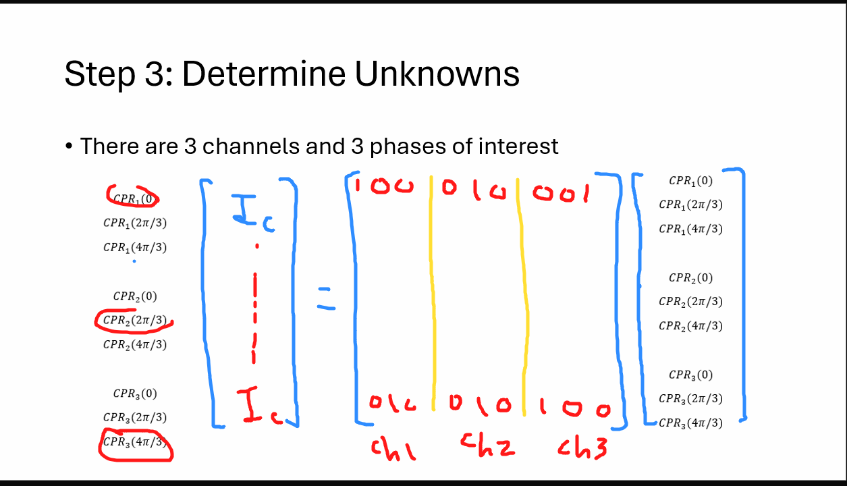

Slide 5
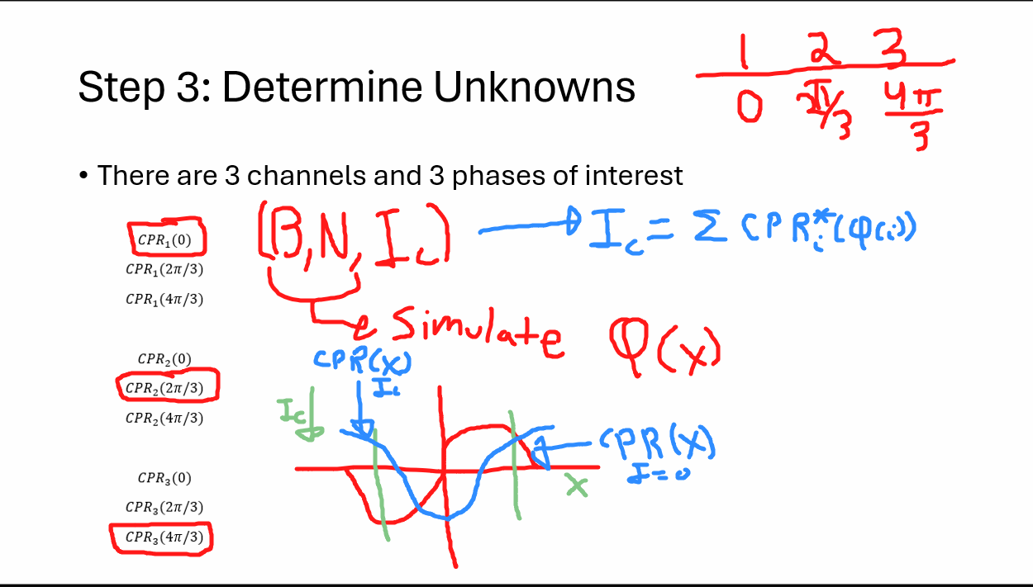

Slide 6
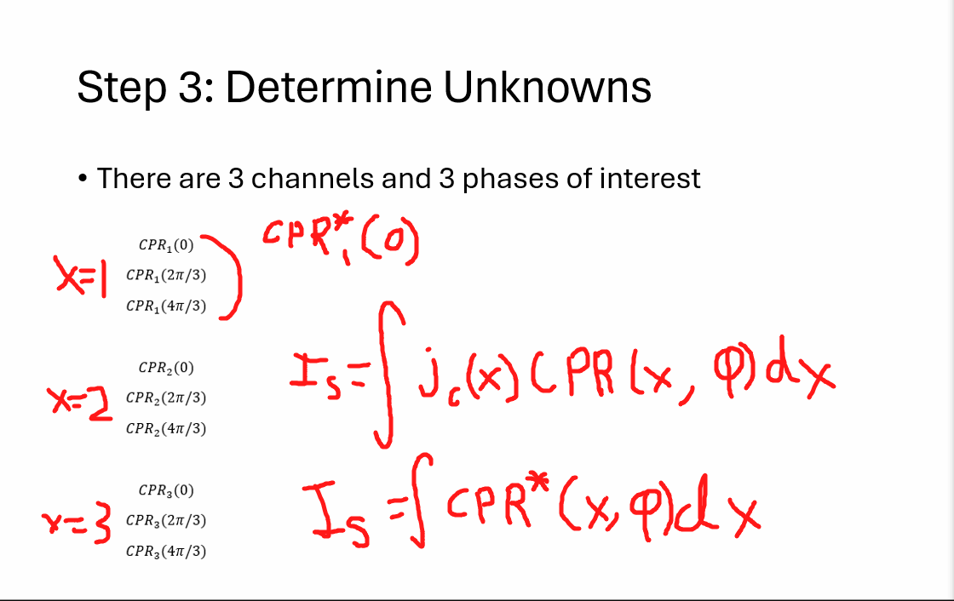

Slide 7
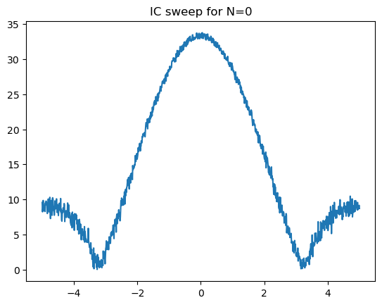
Critical Current While Sweeping Field
Critical Current (Arb Units)
Magnetic Field (Arb Units)

