Slide 1
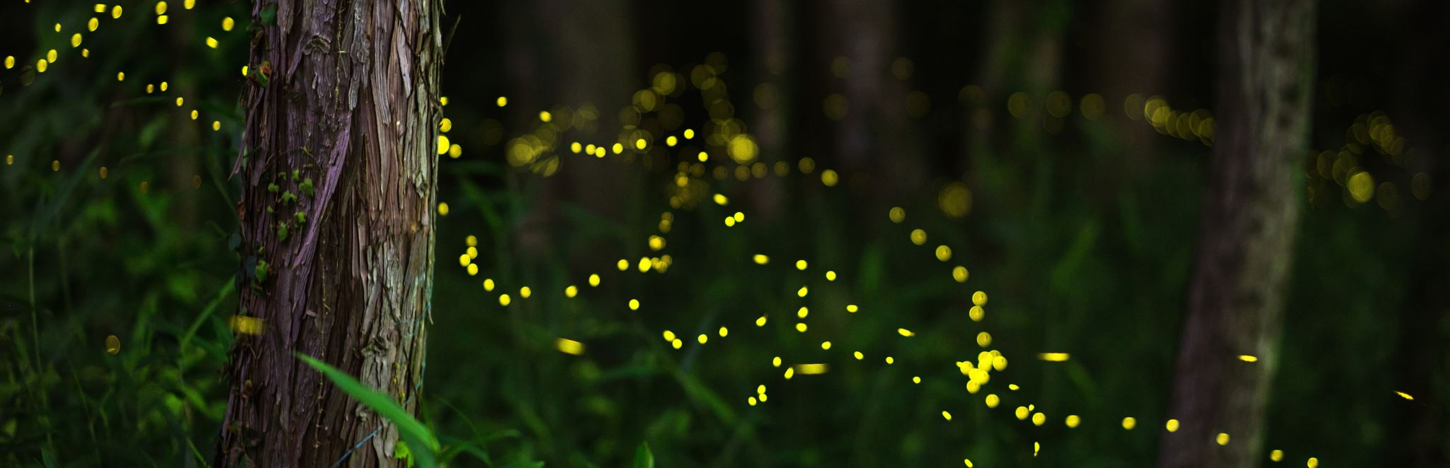
Firefly
Aidan McDougall

Slide 2
Goal:
To create a concept for a web-based game that showcases creative worldbuilding
Use p5.js to create justifiable functionality and stylization
Understand necessary steps to scale into complete game

Slide 3
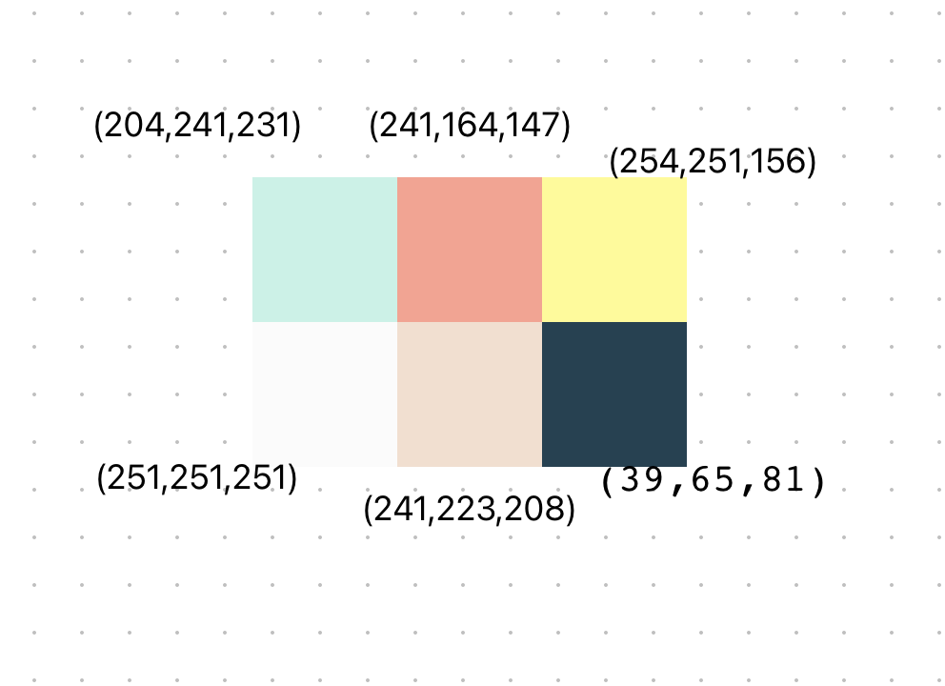

Ideas
Before I decided on a name, concept, or storyline, I made a palette of colors for what I wanted the game to look and feel like.
I also found the typeface “Jaro” by google fonts and felt this matched the style I was aiming for.

Slide 4
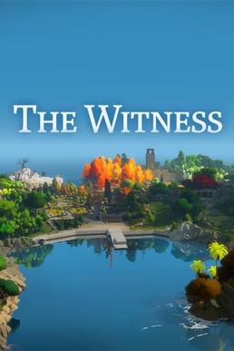

Title/concept
My palette reminded me of games like Firewatch and The Witness, but I wanted the vibe of the game to be more connected with nature and self-exploration.
After some deliberation, I came up with the idea for Firefly.

Slide 5

World 1
The ‘main menu’ of the game, I used the palette to create an ambient forest like space where fireflies would thrive. For this space, I wanted the attention of the player to be focused on the objects as opposed to the actual background.

Slide 6
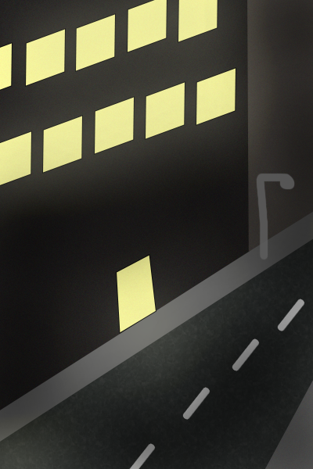
World 2
Once I created the first world, I thought I would create a place that was much less magical and uplifting. While I filled the first world with fireflies and life, I flooded the second world with artificial light and no nature. The color palette is much darker than the original, and the area is meant to be much colder.

Slide 7
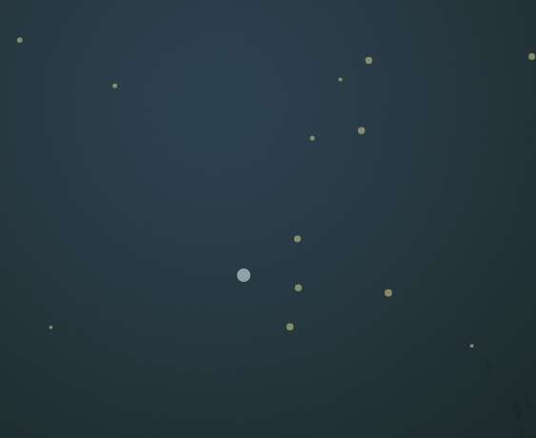
Character design
I wanted the player-controlled main character to have a completely different look and feel than the rest of the characters. I used the yellow from the palette for both the fireflies in the background and the lights in the city, so I decided to contrast that with a single blue firefly. Furthermore, all the yellow fireflies are flickering in sync with one another and the main character flickers entirely on its own.

Slide 8
Functionality ideas
Using the cursor and main character to trigger lights and sounds, and solving puzzles based on the capabilities of the main character.
Flickering of main character matches the electricity sources it is connected to.

Slide 9
Audio design
Two themes, one for each world
Contained in array, easily scalable.
Soft, humming for forest
Darker, haunting sound for city

Slide 10
Link to game
https://editor.p5js.org/AidanMcDougall/full/IDpcTXNqy

