Slide 1
UMAP – Explainable Boosting Machine (EBM)
Inspired by Salmanian et al. 2024
DimVis: Interpreting Visual Clusters in Dimensionality Reduction With Explainable Boosting Machine

Slide 2
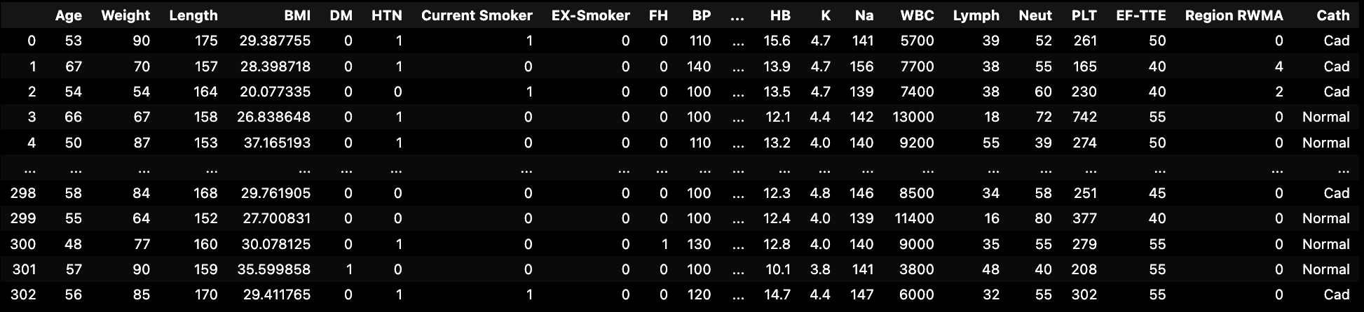
Motivation
Coronary Artery Disease
Notes:
Do me a favor, Arzaan, show me how to visualize all of this numeric data implementing a binary classifier that signifies a Coronary Artery Disease. Make sure you highlight correlations between each variable and the presence of CAD. You can’t, idiot.

Slide 3
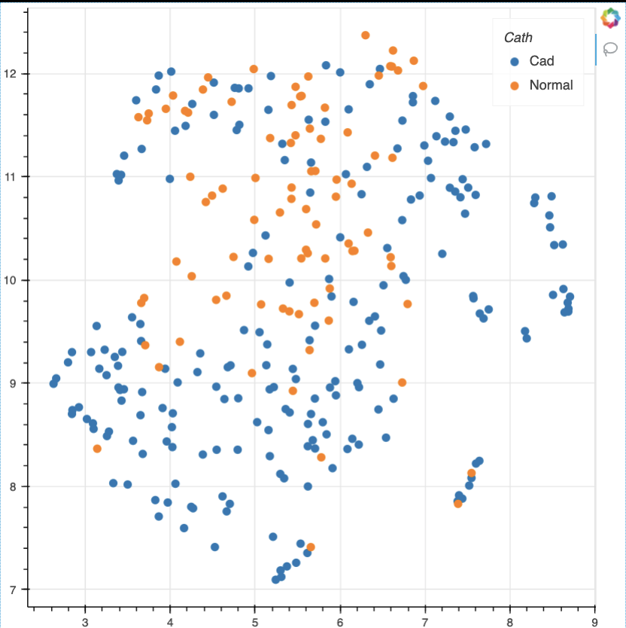
Motivation
Coronary Artery Disease
Notes:
We want a way to visualize this data by dimension reduction. Then, we’ll be able to identify clusters. Hold on! A common problem with dimension reduction is the loss of explainability pertaining to the original feature space.

Slide 4
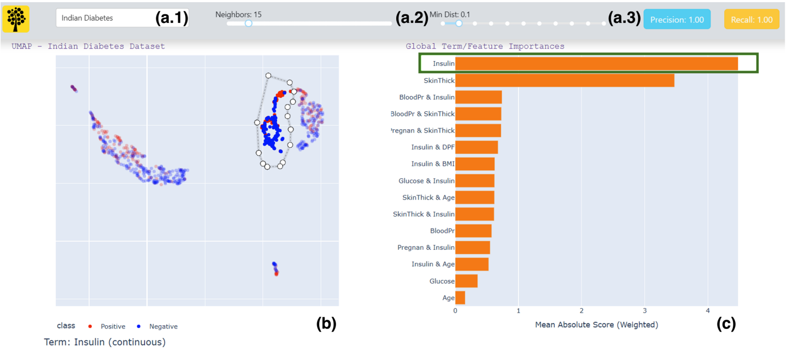

Motivation
Figure 1 from Salmanian et al. 2024
Notes:
This is where DimVis -- the tool created in the paper I read -- comes into play.
We want to reduce high dimensional classification based data into 2D and identify which features in from the high dimensional space contribute to clusters… that hopefully emerge. Now if classification based clusters don’t emerge, it’s not all useless… using EBM, we can still identify how (or which) original features determine where data is plotted after the dimension reduction method.

Slide 5
Review of Uniform Manifold Approximation Projection

Slide 6
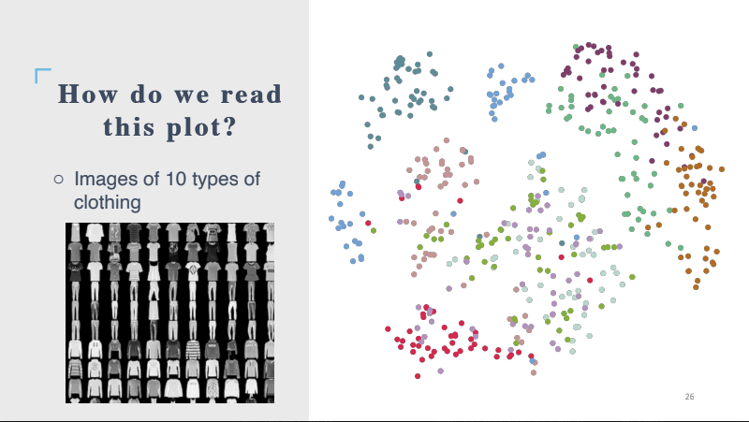
Notes:
Goal: minimize the difference between neighboring points in High Dimensional space and Low Dimensional space.
“Do nonlinear transformations that preserve the proximity of similar points”
Similar to tSNE, there are weird parameters like:
• n_neighbors and
• min_dist
that control how clustering works
Intellectual Property thief moment

Slide 7
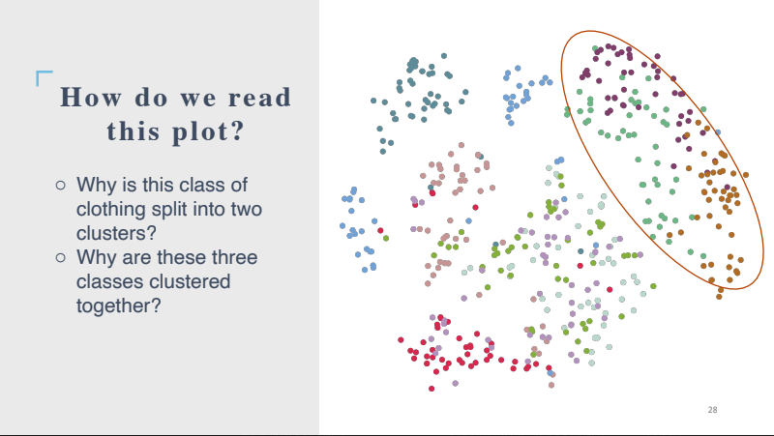

Slide 8
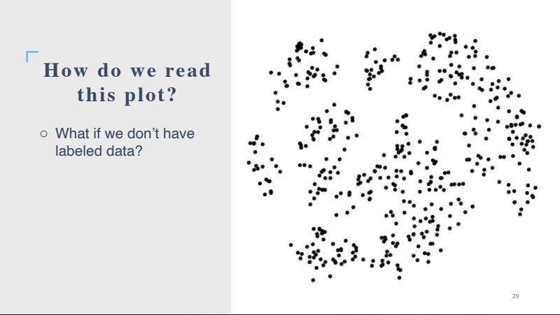

Slide 9
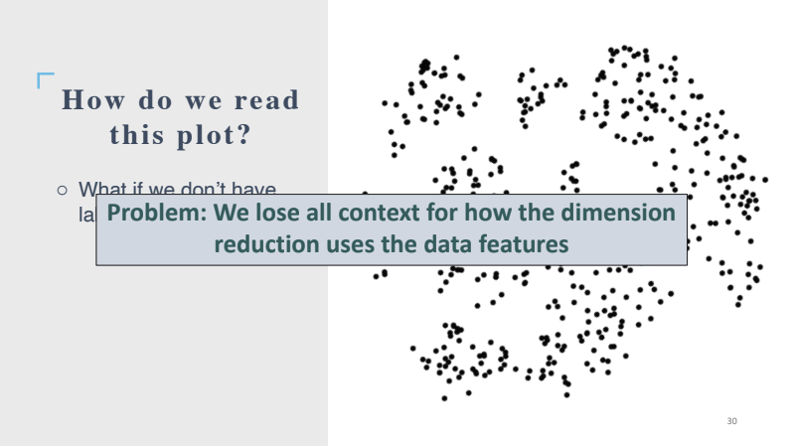

Slide 10
Enter: Sandman Explainable Boosting Machine

Slide 11

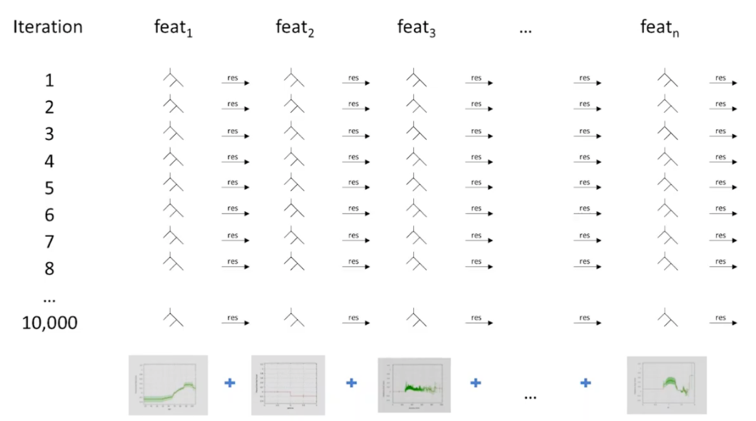
EBM
Nonlinear
Iterative
Parallel
Classification & Regression
Explainability
Notes:
In the broadest terms, the EBM iteratively learns the individual functions that alter a feature to satisfy a task.
g describes what task you’re satisfying
• Regression
• Classification
Tree
As the algorithm learns the classification data that we insert, certain feature functions start to dominate. This is how feature “explainability” is ranked.
Long story short, this algorithm identifies how much each feature and binary feature interaction contribute to the clustering seen in UMAP.

Slide 12
Insulin / Skin Thick Cluster

Slide 13
Test Example: Linearly Sep. 3D DR Classification

Slide 14
DEMO

Slide 15
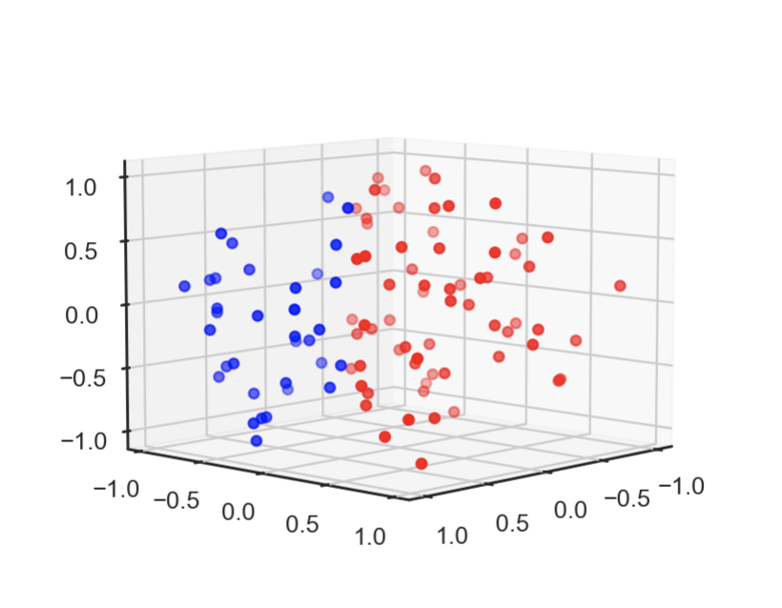
3D Classification DR

Slide 16
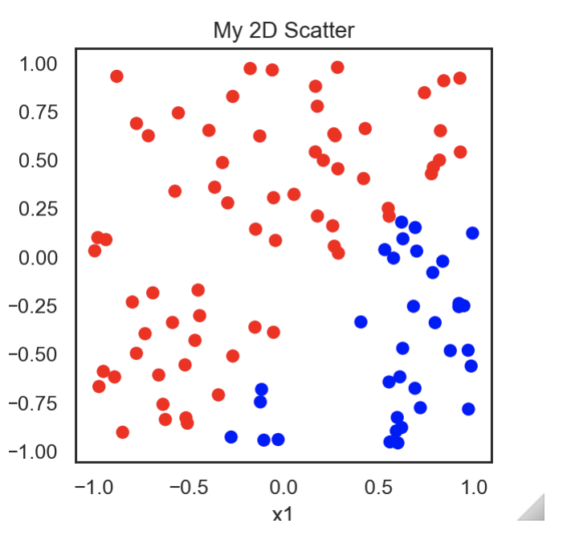
3D Classification DR

Slide 17
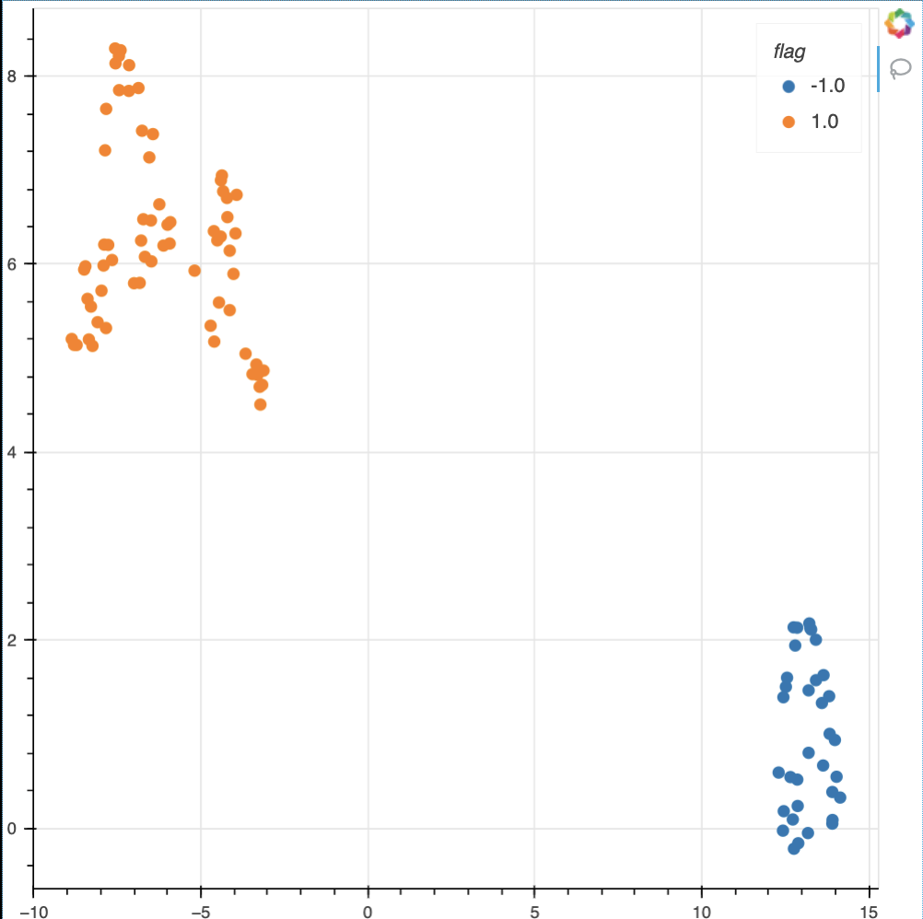
3D Classification DR

Slide 18
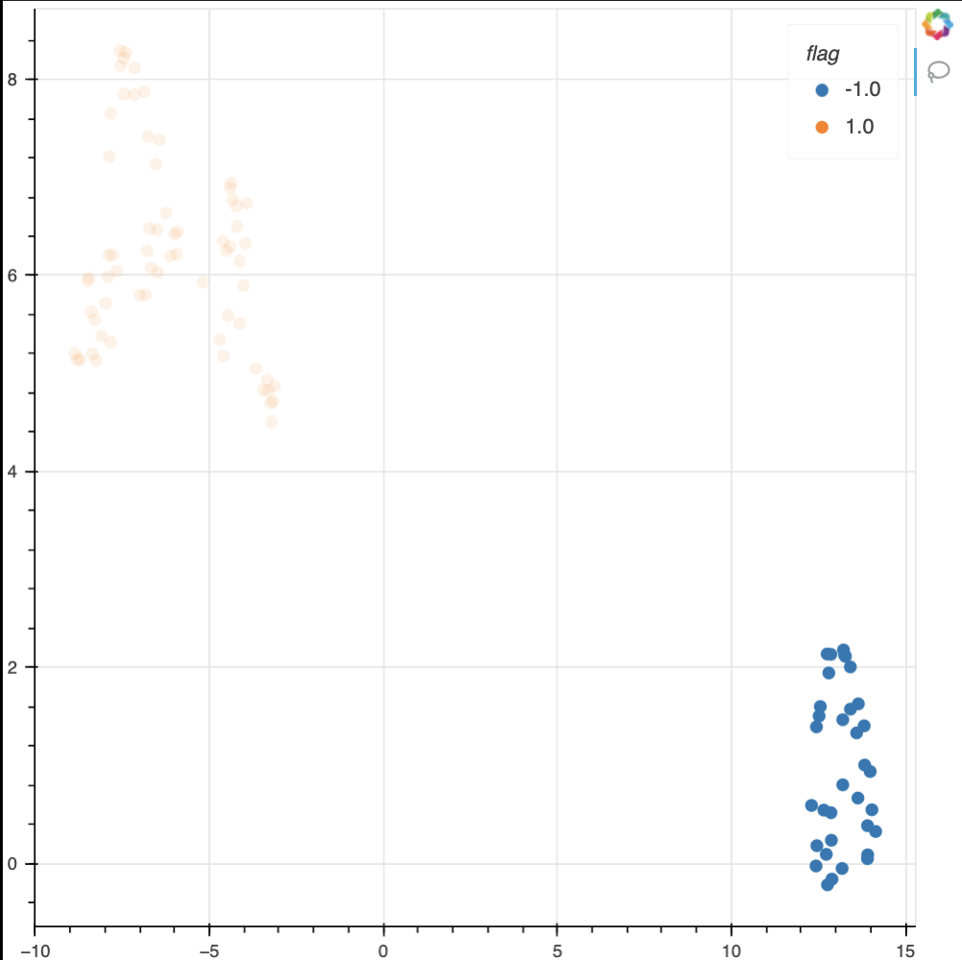
3D Classification DR

Slide 19
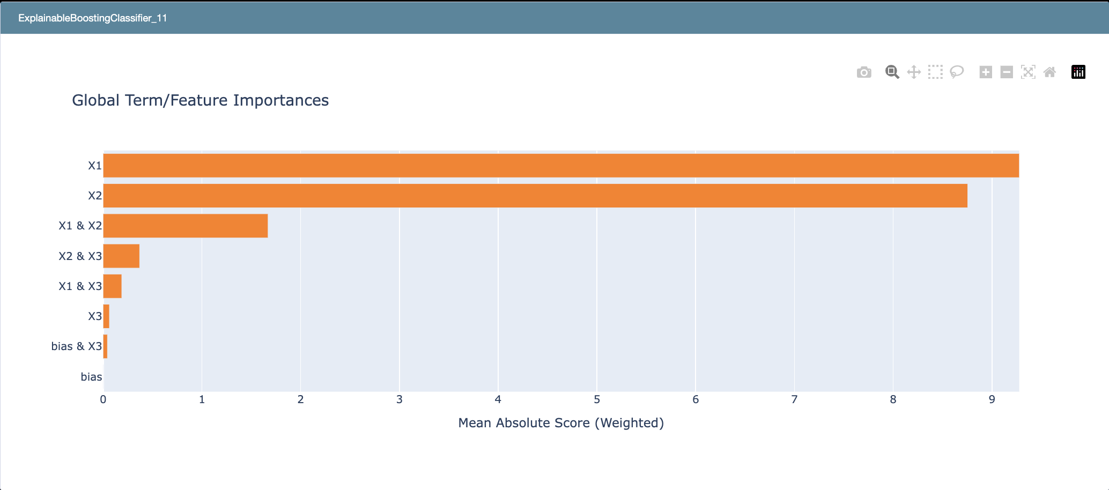
3D Classification DR

Slide 20
Practical Example 1 Coronary Artery Disease

Slide 21
Coronary Artery Disease

Slide 22
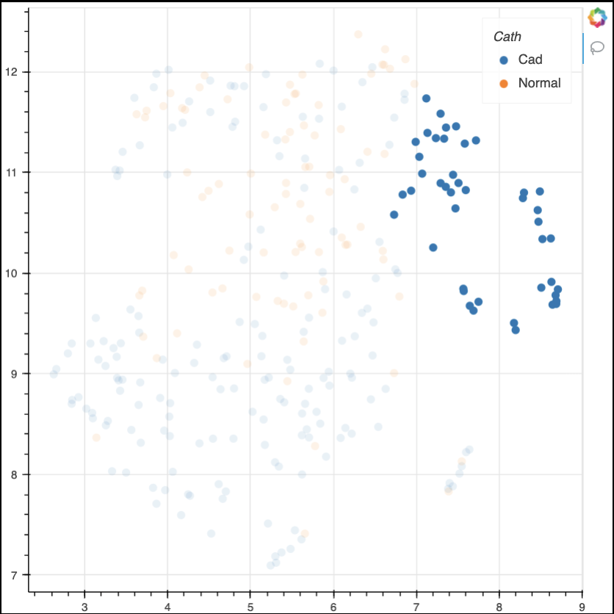
Coronary Artery Disease

Slide 23
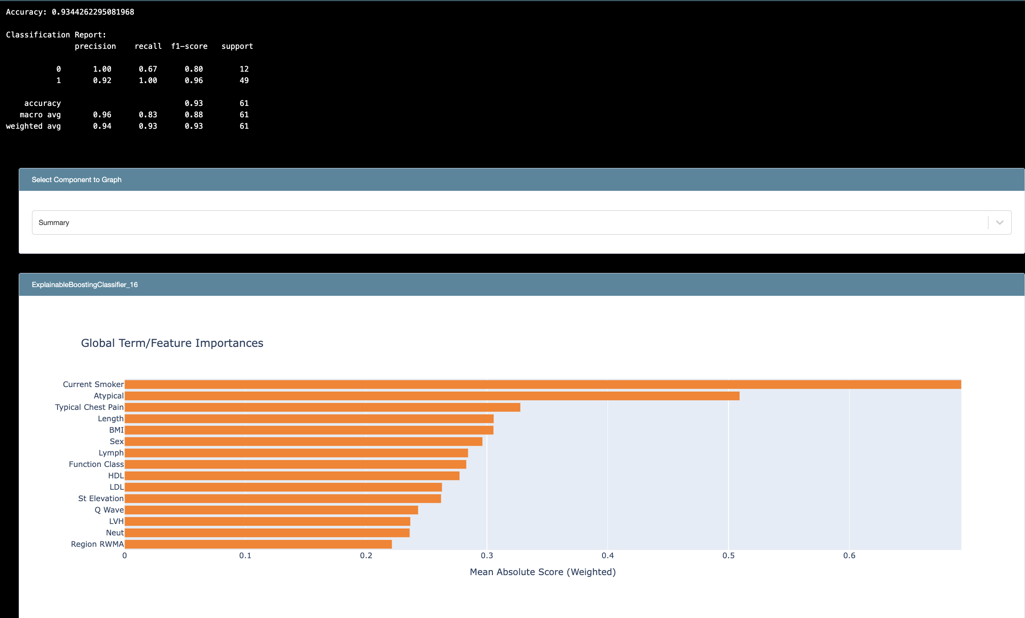
Coronary Artery Disease

Slide 24
CAD Current Smoker Cluster
Notes:
We can see where feature clusters are. If we zoom in to areas of high CAD concentration, we begin to pick out some features that indicate CAD.
Talk about how I once found a “CAD History” cluster, supporting the fact that a family history of CAD increases CAD susceptibility by 40-60%.

Slide 25
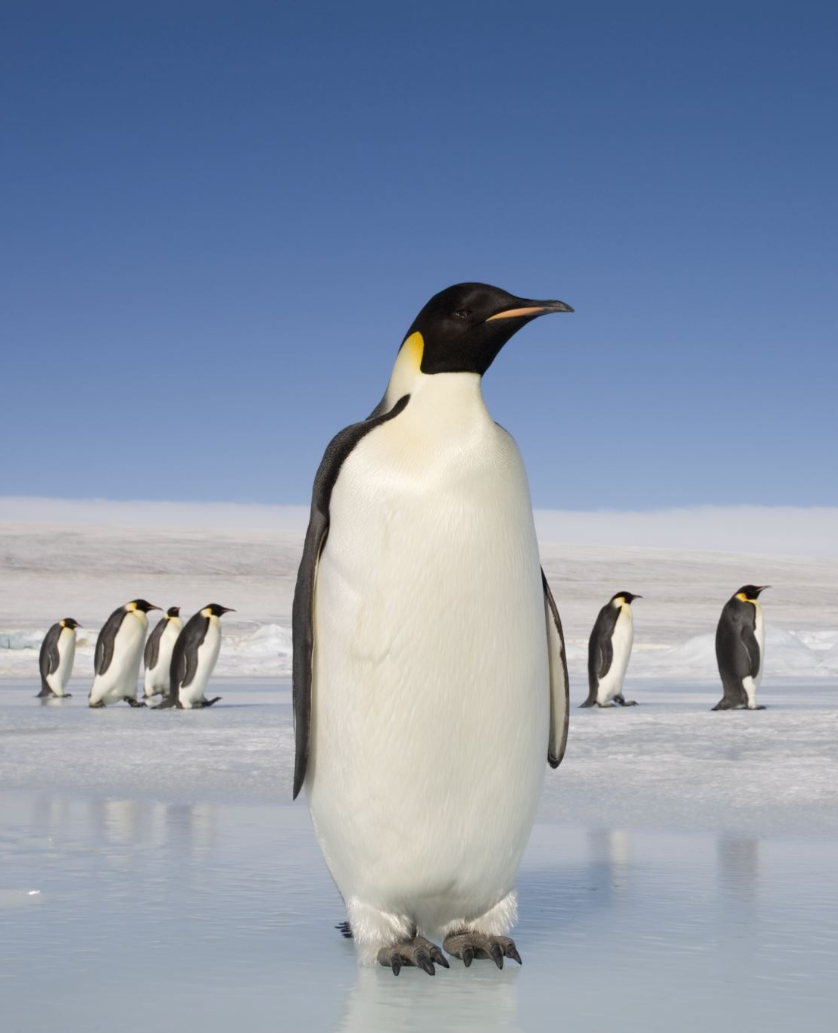
Practical Example 2 Penguins

Slide 26
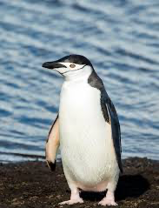
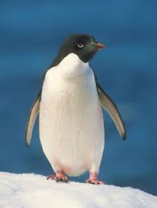

Pengins
1. Chinstrap
2. Adelie
3. Gentoo

Slide 27
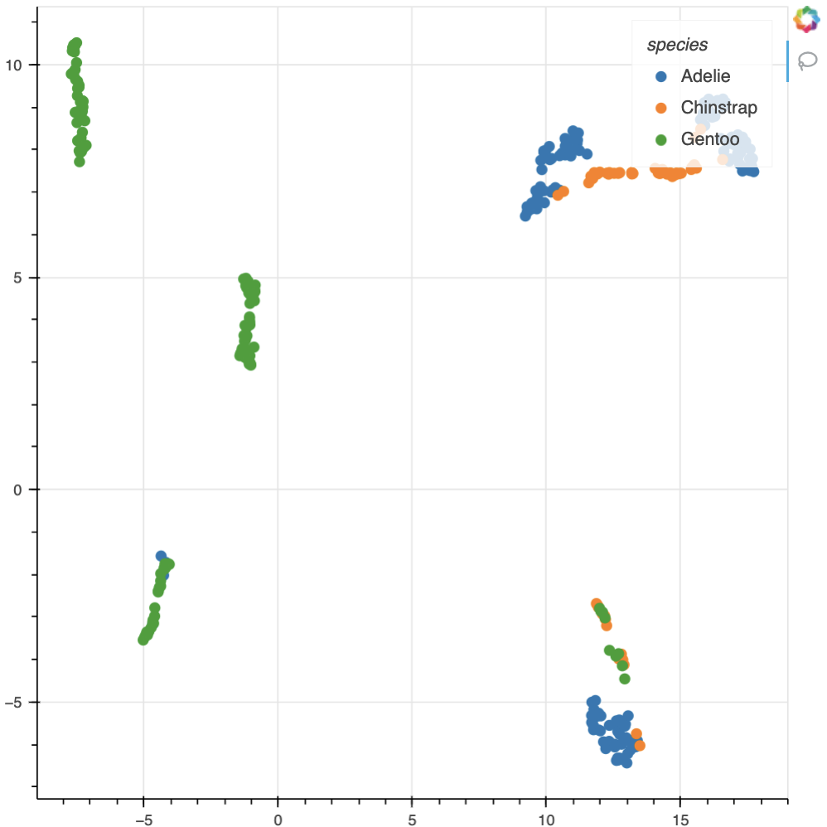
Penguins in UMAP Space

Slide 28
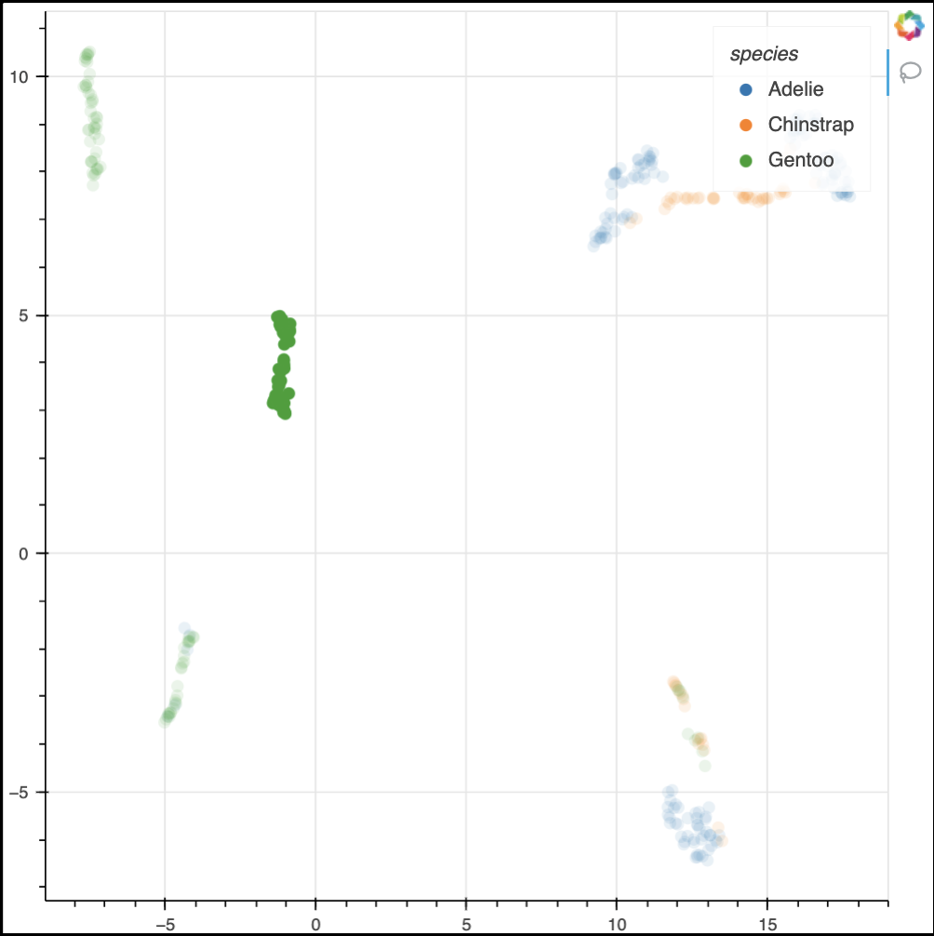
Gentoo Cluster

Slide 29
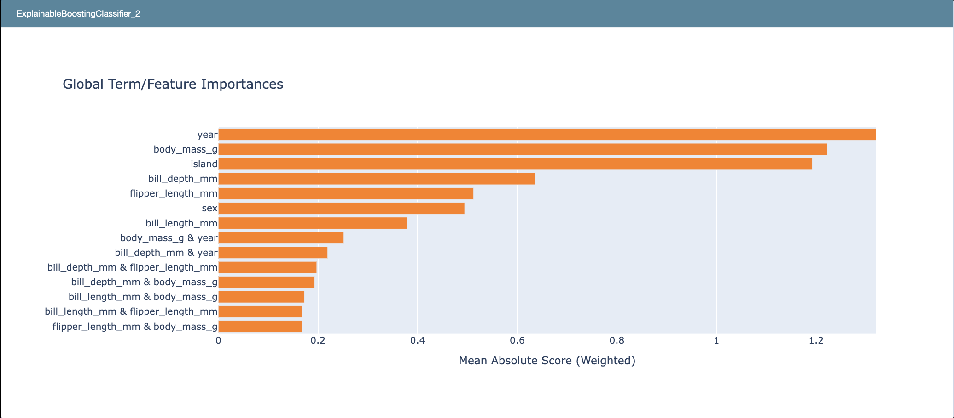
Year Separated Gentoo Cluster

Slide 30


