Slide 1
WebSphere Systems Management News
Lightweight Servers to Large Topologies
Chris Vignola, WebSphere Architecture, IBM
Mike Thompson, WebSphere Development, IBM
Vita Bortnikov, Research, IBM
TAW-1446

Slide 2
Please Note
IBM’s statements regarding its plans, directions, and intent are subject to change or withdrawal without notice at IBM’s sole discretion.
Information regarding potential future products is intended to outline our general product direction and it should not be relied on in making a purchasing decision.
The information mentioned regarding potential future products is not a commitment, promise, or legal obligation to deliver any material, code or functionality. Information about potential future products may not be incorporated into any contract. The development, release, and timing of any future features or functionality described for our products remains at our sole discretion.
Performance is based on measurements and projections using standard IBM benchmarks in a controlled environment. The actual throughput or performance that any user will experience will vary depending upon many factors, including considerations such as the amount of multiprogramming in the user’s job stream, the I/O configuration, the storage configuration, and the workload processed. Therefore, no assurance can be given that an individual user will achieve results similar to those stated here.

Slide 3



About the Speakers
Chris is the WebSphere Systems Management Architect. He has 28 years experience developing operating systems and middleware.
Chris Vignola
cvignola@us.ibm.com
Mike is the lead developer of WebSphere Systems Management for the Liberty Profile. He has 8 years experience developing security and middleware solutions.
Mike Thompson
mcthomps@us.ibm.com
Vita is leading the Distributed Middleware group at IBM Research Haifa. She has 17 years experience in research and development of distributed and highly available systems.
Vita Bortnikov
VITA@il.ibm.com

Slide 4
Agenda
Review WebSphere Administrative Domains
  Standalone
  Network Deployment
  Job Manager
  New Liberty Collective
Examine Liberty Collective
  Characteristics
  Setup
  Operations
  Liberty Clusters
Admin Scalability and High Availability
  Balancing and Failover
  Replication Engine
Announcements

Slide 5

WebSphere Administrative Domains
Standalone
  Base or Express Editions (Full Profile)
  Independently administered
app
server
app
server
Standalone

Slide 6


WebSphere Administrative Domains …
Standalone
  Base or Express Editions (Full Profile)
  Independently administered
Network Deployment (ND)
  Network Deployment and z/OS Editions
  Multi-servers administered as part of same domain
  Built-in Clustering and HA
app
server
app
server
Standalone
ND Cell
nodeagent
app
server
app
server
app
server
dmgr
nodes
Network Deployment

Slide 7

WebSphere Administrative Domains …
Job Manager Profile
  ND, z/OS Editions
  Administer multiple standalone app servers
Job Manager
adminagent
app
server
adminagent
app
server
Standalone

Slide 8


WebSphere Administrative Domains …
Job Manager
  ND, z/OS Editions
  Administer multiple standalone app servers
  Administer ND cells, too!
Job Manager
adminagent
app
server
adminagent
app
server
Standalone
ND Cell
nodeagent
app
server
dmgr
app
server
app
server
dmgr
nodes
dmgr
Network Deployment

Slide 9

WebSphere Administrative Domains …
Liberty Profile
  Base, Express, ND, z/OS, and NEW Core Edition (in v8.Next)
  Independently administered
WLP
WLP
WLP
WLP
Liberty

Slide 10
WebSphere Administrative Domains …
Liberty Profile
  Base, Express, ND, z/OS, and NEW Core Edition (in v8.Next)
  Independently administered
Job Manager
  Can also administer Liberty profiles
WLP
WLP
WLP
WLP
Liberty
WLP
WLP
WLP
WLP
WLP
WLP
Job Manager
WLP
WLP
Liberty

Slide 11

WebSphere Administrative Domains …
Liberty Profile
  Base, Express, ND, z/OS, and NEW Core Edition (in v8.Next)
  Independently administered
Job Manager
  Can also administer Liberty profiles
  Can manage heterogeneous environments
WLP
WLP
WLP
WLP
Liberty
WLP
WLP
WLP
WLP
WLP
WLP
Job Manager
WLP
WLP
dmgr
Liberty

Slide 12


WebSphere Administrative Domains …
Liberty Collective: NEW multi-server administrative domain architected exclusively for Liberty!
v8.next: Liberty Collective
WLP
WLP
WLP
WLP
WLP
Liberty Controller
Liberty Clusters

Slide 13
WebSphere Administrative Domains …
Liberty Collective: NEW multi-server administrative domain architected exclusively for Liberty!
Liberty Controller: NEW scalable admin server built on Liberty.
v8.next: Liberty Collective
WLP
WLP
WLP
WLP
WLP
Liberty Controller
Liberty Clusters

Slide 14
WebSphere Administrative Domains …
Liberty Collective: NEW multi-server administrative domain architected exclusively for Liberty!
Liberty Controller: NEW scalable admin server built on Liberty.
Liberty Clusters: NEW support for Liberty administrative clusters.
v8.next: Liberty Collective
WLP
WLP
WLP
WLP
WLP
Liberty Controller
Liberty Clusters

Slide 15
WebSphere Administrative Domains …
Job Manager can also administer Liberty controllers.
WLP
WLP
WLP
WLP
WLP
Liberty Controller
WLP
WLP
Job Manager
WLP
WLP
Liberty Clusters

Slide 16

WebSphere Administrative Domains …
Job Manager can also administer Liberty controllers…
… extending Job Manager’s reach to all WebSphere Administrative Domains.
WLP
WLP
WLP
WLP
WLP
Liberty Controller
WLP
WLP
Job Manager
WLP
WLP
Liberty Clusters
dmgr

Slide 17
Capabilities Comparison
Capability | ND Cell | JobManager | Collective
Manage Liberty | No (FP only) | Yes | Yes
Lightweight | No | No | Yes
Scalability | Low | Med | High
Admin HA | No | No | Yes
Setup speed | Low | Med | High
HA Manager | Yes | No | No
Static clusters | Yes | Partial | Yes
Dynamic clusters | Yes | No | No
Memory use | High | Med | Low
Reconfigurability | Low | Med | High
Real time admin | Yes | No | Yes
Batch admin | No | Yes | No
Liberty deploy | No | Yes | Yes

Slide 18
Capabilities Comparison
Capability | ND Cell | JobManager | Collective
Manage Liberty | No (FP only) | Yes | Yes
Lightweight | No | No | Yes
Scalability | Low | Med | High
Admin HA | No | No | Yes
Setup speed | Low | Med | High
HA Manager | Yes | No | No
Static clusters | Yes | Partial | Yes
Dynamic clusters | Yes | No | No
Memory use | High | Med | Low
Reconfigurability | Low | Med | High
Real time admin | Yes | No | Yes
Batch admin | No | Yes | No
Liberty deploy | No | Yes | Yes

Slide 19
Capabilities Comparison
= Advantage for Liberty
Capability | ND Cell | JobManager | Collective
Manage Liberty | No (FP only) | Yes | Yes
Lightweight | No | No | Yes
Scalability | Low | Med | High
Admin HA | No | No | Yes
Setup speed | Low | Med | High
HA Manager | Yes | No | No
Static clusters | Yes | Partial | Yes
Dynamic clusters | Yes | No | No
Memory use | High | Med | Low
Reconfigurability | Low | Med | High
Real time admin | Yes | No | Yes
Batch admin | No | Yes | No
Liberty deploy | No | Yes | Yes

Slide 20
Examine Liberty Collective

Slide 21
Liberty Systems Management in 8.Next is...
AUTOMATED
Less input required to establish a secure configuration.
FASTER
No Profile Management tool.
EASIER
Easier to script and consistently CLI enabled.
SELF-CONTAINED
Servers can be zipped up, moved to new location, and joined quickly.
AGENT-LESS
No Node Agents. Less cost on system resources.
DECENTRALIZED
Master copy of a server's configuration is owned by each server

Slide 22
Liberty Collective – Sets up in Minutes!
blank slate

Slide 23
Liberty Collective – Sets up in Minutes! Create Controller …
Liberty Collective
WLP
Three basic actions:
Liberty Controller
wlp/bin/server create {controller}
wlp/bin/collective create {controller} ...
wlp/bin/server start {controller}

Slide 24
Liberty Collective – Sets up in Minutes! Create Controller …
wlp/usr/servers/{controller}/server.xml
<featureManager>
<feature>collectiveController-1.0</feature>
</featureManager>
Liberty Collective
WLP
Three basic actions:
Liberty Controller
wlp/bin/server create {controller}
wlp/bin/collective create {controller} ...
wlp/bin/server start {controller}
optional feature added

Slide 25
Liberty Collective – Sets up in Minutes! Create Member(s) …
Liberty Collective
WLP
Two basic actions:
wlp/bin/server create {member}
wlp/bin/collective join {member} …
Liberty Clusters

Slide 26
Liberty Collective – Sets up in Minutes! Create Member(s) …
wlp/usr/servers/{member}/server.xml
<featureManager>
<feature>collectiveMember-1.0</feature>
[ <feature>clusterMember-1.0</feature> ]
</featureManager>
Liberty Collective
WLP
Two basic actions:
wlp/bin/server create {member}
wlp/bin/collective join {member} …
Liberty Clusters
optional feature(s) added

Slide 27
Liberty Collective – Sets up in Minutes!
server.xml
<featureManager>
<feature>collectiveController-1.0</feature>
</featureManager>
server.xml
<featureManager>
<feature>collectiveMember-1.0</feature>
[ <feature>clusterMember-1.0</feature> ]
</featureManager>
Liberty Collective
WLP
WLP
WLP
WLP
WLP
Liberty Controller
Liberty Clusters
wlp/bin/server create {controller}
wlp/bin/collective create {controller} ...
wlp/bin/server start {controller}
wlp/bin/server create {member}
wlp/bin/collective join {member} …
repeat

Slide 28
Push Out Construction Model

Slide 29
Liberty Collective – Push Out Members with File Transfer MBean
Liberty Collective
WLP
WLP
WLP
WLP
Liberty Controller
Liberty Clusters

Slide 30
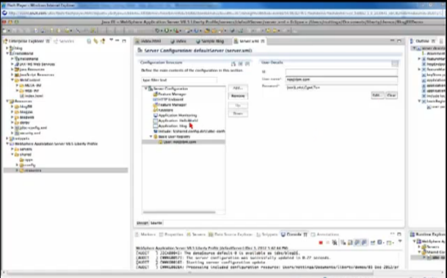

Liberty Collective – Push Out Members with File Transfer MBean
Liberty Server
Package
WebSphere Developer Tools
Liberty Collective
WLP
WLP
WLP
WLP
Liberty Controller
Liberty Clusters

Slide 31
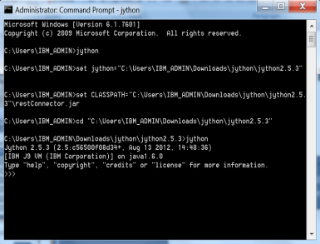
Liberty Collective – Push Out Members with File Transfer MBean
admin client
(e.g. Jython)
Liberty Server
Package
WebSphere Developer Tools
File Transfer
MBean
Liberty Collective
WLP
WLP
WLP
WLP
Liberty Controller
Liberty Clusters

Slide 32
Liberty Collective – Push Out Members with File Transfer MBean
admin client
(e.g. Jython)
Liberty Server
Package
WebSphere Developer Tools
File Transfer
MBean
Liberty Collective
WLP
WLP
WLP
WLP
Liberty Controller
Liberty Clusters

Slide 33
Liberty Collective – Push Out Members with File Transfer MBean
admin client
(e.g. Jython)
Liberty Server
Package
WebSphere Developer Tools
File Transfer
MBean
Liberty Collective
explode
archive
WLP
WLP
WLP
WLP
Liberty Controller
Liberty Clusters

Slide 34
Liberty Collective – Push Out Members with File Transfer MBean
admin client
(e.g. Jython)
Liberty Server
Package
WebSphere Developer Tools
File Transfer
MBean
Liberty Collective
Ready
To Run!
WLP
WLP
WLP
WLP
WLP
Liberty Controller
Liberty Clusters

Slide 35
Operations within Collective

Slide 36
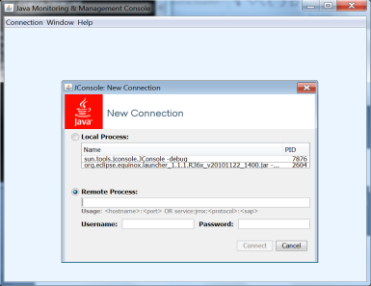
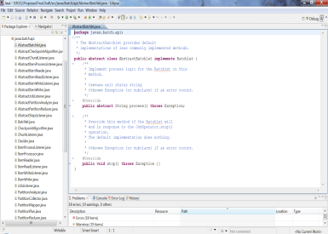
Liberty Collective Operations
JConsole
Choice of client types
MBean based admin
admin clients
Java
Jython
Liberty Collective
WLP
WLP
WLP
WLP
WLP
Liberty Controller
Liberty Clusters

Slide 37
Liberty Collective Operations
JConsole
Choice of client types
MBean based admin
Reach any MBean on any WLP
admin clients
Java
Jython
JMX (REST/HTTP)
Liberty Collective
Routing
MBean Server
MBean
WLP
WLP
WLP
WLP
WLP
Liberty Controller
Liberty Clusters

Slide 38
Liberty Collective Operations
JConsole
Choice of client types
MBean based admin
Reach any MBean on any WLP
Including NEW File Transfer MBean
Including MBean notifications
Key-based authentication model
admin clients
Java
Jython
JMX (REST/HTTP)
Liberty Collective
Routing
MBean Server
MBean
WLP
WLP
WLP
WLP
WLP
Liberty Controller
Liberty Clusters

Slide 39
Liberty Clusters

Slide 40
Liberty Clusters – What are they?
Collaborating Liberty Profiles by intent
Homogenous by best practice
  Common Configuration
  Installed Applications
Part of a Liberty Collective by design
Accessible by “Group” Operations
  Start/stop cluster
  List clusters/list members
  Get cluster status
  Generated merged HTTP plug-in config
Comprised of independent members
  Members can STILL be managed individually .
  Members can EASILY be moved into or out of cluster.

Slide 41
Liberty Clusters – from Collective Member to Cluster Member
server.xml
<featureManager>
<feature>collectiveMember-1.0</feature>
</featureManager>
Liberty Collective
WLP
WLP
WLP
WLP
WLP
Liberty Controller
Liberty Collective Members
Collective Member
not equal to
Cluster Member

Slide 42
Liberty Clusters – from Collective Member to Cluster Member
server.xml
<featureManager>
<feature>collectiveMember-1.0</feature>
<feature>clusterMember-1.0</feature>
</featureManager>
<clusterMember name=“MyAppCluster1”/>
Liberty Collective
MyAppCluster1
WLP
WLP
WLP
WLP
WLP
Liberty Controller
MyAppCluster2
Liberty Clusters
Add cluster feature:
Name the cluster:

Slide 43
Liberty Clusters – Best Practice Configuration Management
<application id=“BasicWeb location=“BasicWeb.jar” name=“BasicWeb” type=“war”/>
Shared
Config
Include
<include file=“${shared.config.dir}/MyCluster1Config”/>
Liberty Collective
MyAppCluster1
WLP
WLP
WLP
WLP
WLP
Liberty Controller
Liberty Clusters

Slide 44
Liberty Clusters – Operations via ClusterManager MBean
Operations:
Start/stop cluster (e.g. start MyAppCluster1)
List clusters/list members
Get cluster status
Generated merged HTTP plug-in config
admin client
(e.g. Jython)
Liberty Collective
ClusterManager
MBean
MyAppCluster1
WLP
WLP
WLP
WLP
WLP
Liberty Controller
Liberty Clusters

Slide 45
Liberty Collective Controller Scalability and High Availability
State Replication by Frappe

Slide 46
Scalability and Failover
Liberty Collective
WLP
WLP
WLP
WLP
WLP
Liberty Controller
Liberty Clusters
Notes:
Up to this point, we have shown you the Liberty Controller as a single point of failure. That was for presentation convenience. You see, the Liberty Controller is designed for production: it is scalable and highly available.

Slide 47
Scalability and Failover
Liberty Collective
WLP
WLP
WLP
WLP
WLP
WLP
Scalable
WLP
WLP
WLP
WLP
WLP
Liberty Controller
Replica Set
Liberty Clusters
Notes:
Scalability and high availability are achieved using a horizontal scaling model called a replica set.

Slide 48
Scalability and Failover
Liberty Collective
WLP
WLP
WLP
WLP
WLP
Connection
Balancing
Data
Replication
WLP
WLP
WLP
WLP
WLP
WLP
Liberty Controller
Replica Set
Liberty Clusters
Notes:
Data replication, which will explore more thoroughly on upcoming slides forms the informational backbone of the replica set. The JMX connector does optional connection balancing.

Slide 49
Scalability and Failover
Liberty Collective
WLP
WLP
WLP
WLP
WLP
WLP
Failover
WLP
WLP
WLP
WLP
WLP
Liberty Controller
Replica Set
Liberty Clusters
Notes:
If a controller ever fails, the surviving replicas can take over.

Slide 50
Scalability and Failover
Liberty Collective
WLP
WLP
WLP
WLP
WLP
Connection
Recovery
WLP
Failover
WLP
WLP
WLP
WLP
WLP
Liberty Controller
Replica Set
Liberty Clusters
Notes:
The JMX connector automatically recovers and connects to an available replica.

Slide 51
Scalability and Failover
Liberty Collective
WLP
WLP
WLP
WLP
WLP
WLP
Restart/
New Replica
WLP
WLP
WLP
WLP
WLP
Liberty Controller
Replica Set
Liberty Clusters
Notes:
Once the failed replica is restarted or replaced, it will receive new client connections.
So what makes all this possible? Frappe ….

Slide 52
FRAPPE – Fast Replication Platform for Elastic Services
What is Frappe?
  Frappe is a consistent data replication layer
  Supports pluggable replicated service logic and data model
What is its role in Liberty Collective Controller?
  Consistent replication of controller data => key for Controller high availability

Slide 53
Frappe Highlights
Fault-tolerant and highly available
Active-active replication
Shared-nothing and self-contained
Light-weight, Very Robust
Consistent: ACID, persistence
Dynamic replica set with continuous service
  Adapts to changing workloads (“elasticity”)
  Maintains desired availability
  Reclaims resources

Slide 54

Dynamic Replica Set
Spare
Replica
Liberty Collective
WLP
WLP
WLP
WLP
Replace
Replace
WLP
WLP
WLP
WLP
WLP
WLP
WLP
WLP
Liberty Controller
Replica Set
Liberty Clusters

Slide 55
Dynamic Replica Set
WLP
Liberty Collective
Atomic
Transition
New
Replica
WLP
WLP
WLP
WLP
WLP
Replica
Discovery
WLP
Automatic State transfer
WLP
WLP
WLP
WLP
WLP
Liberty Controller
Replica Set
Liberty Clusters

Slide 56
Frappe in Liberty Collective -Architecture
Collective Controller
Collective Controller
Collective Controller
Frappe Replication
Frappe Replication
Frappe Replication
Replication
Replication
State and Snapshots
State and Snapshots
State and Snapshots
Collective Repository
Collective Repository
Collective Repository
REST/JMX
Collective Member
Collective Member
Collective Member

Slide 57
Wrap-up and Announcements

Slide 58
WAS Capabilities in Context
Pre-
integrated
Software/
Hardware
IBM PureApplication System
Pattern-based
Cloud Provisioning
Elastic Scaling
IBM Workload Deployer
Application Server Foundation
Application Programming Model
Core admin interfaces
Basic high availability
WebSphere Application Server

Slide 59
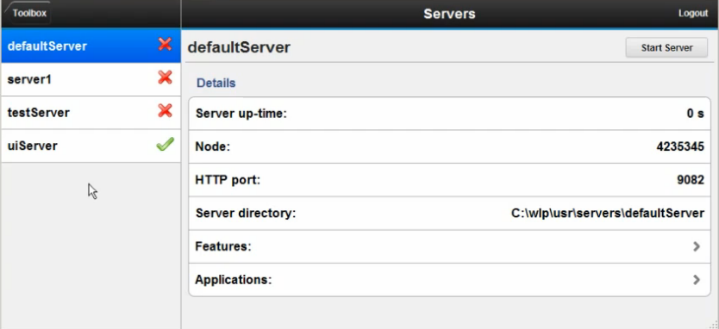
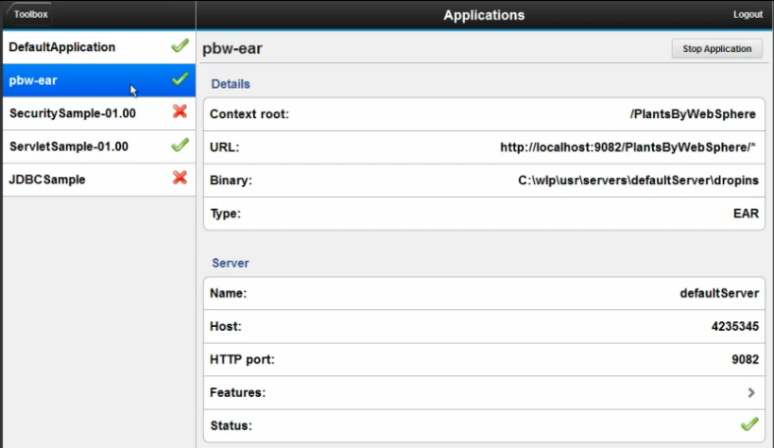
Admin UI Tech Preview
https://www.ibm.com/developerworks/mydeveloperworks/blogs/wasdev/entry/learn_admin_ui_tech_preview?lang=en

Slide 60
Hands on Experience at Impact!
TAW-1637: Hands-On Lab: Build and Administer Your Own Liberty Application Cluster, new in WAS 8.Next
Session Type: Hands-on Lab
Date/Time: Wed, 1/May, 08:30 AM - 11:15 AM
Room: Venetian - Murano 3301B

Slide 61
We love your Feedback!
Don’t forget to submit your Impact session and speaker feedback!
Your feedback is very important to us – we use it to improve next year’s conference
Go to the Impact 2013 SmartSite (http://impactsmartsite/com):
  Use the session ID number to locate the session
  Click the “Take Survey” link
  Submit your feedback
Notes:
File Name Here.ppt

Slide 62


Slide 63
Backup Material

Slide 64
Principles of Liberty Collective
Standards-based admin API
  Built on JMX (MBeans).
  Works with common tools (Jconsole, Jython, etc).
Loosely-coupled
  Exploits Liberty composable server model.
  App servers can easily and quickly be moved in and out of collective.
Distributed Cache Model
  Admin server (controller) is config/state cache.
  Doubles as bi-directional JMX proxy.
Distributed Configuration
  App Server owns its own config.
  App Servers cache sparse config and state in controller.
Scalable, Resilient Admin Domain
  Highly Available admin server (replica model)
  Agentless

Slide 65
Liberty Collective FAQ
Q. What is a Liberty Collective?
A. An administrative domain comprised of multiple Liberty Profiles.
Q. What is the purpose of a Liberty Collective?
A. To provide fast, simple, single point of control over many Liberty Profiles.
Q. How does a Liberty Collective help me?
A. It reduces costs by simplifying numerous operational concerns, including automation, security, lifecycle, monitoring, and inventory.
Q. How is a Liberty Collective different than using Job Manager to manage Liberty Servers?
A. It is faster, lighter, easier, more efficient, more scalable, more available, more flexible.
Q. What are Liberty Clusters?
A. A logical set of Liberty Profiles that can be acted upon as a group by various administrative operations.

Slide 66
What’s New in WAS v8.Next
Name | Description
1. Liberty Collective | Multi-server admin domain Loosely coupled, Highly available
2. Liberty Clusters | Support for application server clusters Multiple cluster operations provided
3. MBean Routing | Standards based admin operations Operate on any server standalone or collective
4. File Transfer | Remote access to Liberty Profile files Supported for both Collective and Standalone
5. Jython Scripting | Admin automation enablement, Mbean based Supported for both Collective and Standalone
6. JConsole Support | Standards based console Supported for both Collective and Standalone

Slide 67

Liberty Collective
Standard, remote, examples
Liberty Profile
(Collective Member)
Liberty Profile
(Collective Member)
Liberty Cluster A
jython
Controller
Collective
Controller
Liberty Profile
(Collective Member)
Provides
Operational Registry
Access all members
through controller
Highly Available
Secure, Scalable
Agentless
No central config
Liberty Profile
(Collective Member)
Liberty Cluster B
jconsole
Members “join” collective
Profiles self-assign to clusters
Simple config updates
Easily reversed, reconfigured
java

Slide 68
Liberty Clusters
Liberty Profile
(Collective Member)
Cluster operations:
Start/stop
Update config*
Install app*
Generate plugin
config
Liberty Profile
(Collective Member)
Liberty Cluster A
Controller
Collective
Controller
* Provided via sample scripts

Slide 69
File Transfer
File Operations*
Upload
Download
Create archive
Expand archive
Get File Info
Liberty Profile
(Collective Member)
transfers
Liberty Profile
(Collective Member)
Liberty Cluster A
Controller
Collective
Controller
Key features:
Transfers flow through controller (simplifies security management)
Supported for both collectives and standalone servers
Secure: user configured read and write lists
* Standards-based
(MBeans)

Slide 70
MBean Routing
MBean Operations*
Invoke
Listen
Query
Liberty Profile
(Collective Member)
MBean Actions
Liberty Profile
(Collective Member)
Liberty Cluster A
Controller
Collective
Controller
Key features:
MBean actions flow through controller (simplifies security management)
Same model for both collectives and standalone servers
Works with standard tools, including jython and jconsole.
* Standards-based

Slide 71
Jython Scripting
Liberty Profile
(Collective Member)
Liberty Profile
(Collective Member)
Liberty Cluster A
jython
Controller
Collective
Controller
Full access to MBean programming model
Key features:
Same model for both collectives and standalone servers
Customer-managed Jython install
See: wlp/clients/jython/README

Slide 72
JConsole
Liberty Profile
(Collective Member)
Liberty Profile
(Collective Member)
Liberty Cluster A
Controller
Collective
Controller
Key features:
Same model for both collectives and standalone servers
Supports all collective routing functions (MBean and file transfer)
jconsole
* Industry standard tool
See: https://www.ibm.com/developerworks/mydeveloperworks/blogs/wasdev/entry/article_howto_remotejmx?lang=en

Slide 73
Collective Command
Use to build/modify collective
wlp/bin/collective[.bat]
Supports
  [create] collective
  [join] server to collective
  [remove] server from collective
  [replicate] add another controller to replica set
  [registerHost] add a host to collective
  [unregisterHost] remove host from collective
  [updateHost] update host info in collective

Slide 74
Liberty Configuration Model
Still file based as in WAS 8.5.0.
Standard XML programming model (e.g. DOM)
Make updates by uploading changed files (e.g. server.xml)
No counterpart to WWCM
Schema generator MBean exists for deployed features.

Slide 75
Liberty App Install Model
Drop-ins directory since v8.5.0.
Remote file transfer supported starting in v8.Next.
  Works for both single server and collective.
  Expansion API allows recursive archive expansion.
Combine with Liberty Configuration Model to fully automate app install.

Slide 76
Liberty Operational Model
MBean based
What works for standalone Liberty should work for Liberty in collective
Liberty Operational Repository support
  MBean routing
    Works for all MBeanServerConnection methods
    Set route via RoutingContext Mbean
    Route= host/userdir/server
  Repository is MBean attribute cache (see MBean Support slide)

Slide 77
New Liberty MBeans for SM
ServerCommand
  Start/stop server operation
  Server started/stopped notifications
  Runs in collective controller
ClusterManager
  Cluster ops: start,stop,listCluster,listMembers,generatePluginConfig
  Runs in collective controller
RoutingContext
  Sets routing path for MBean operations routed through collective controller
  Requires restConnector.jar
FileTransfer
  Provides upload/download support for single server and server in collective when combined with RoutingContext Mbean.
  Requires restConnector.jar
FileService
  Provides operations for file manipulation, including reading meta data and archive operations (e.g. create, expand)

Slide 78
Features and Editions
All editions
  collectiveMember
  restConnector (not new)
    includes FileTransfer, FileService, RoutingContext MBeans
ND only
  collectiveController
    includes ClusterManager, ManagementRepository, and ServerCommand MBeans
  clusterMember

Slide 79
Liberty Scripting Support
Languages
  Jython: wlp/clients/jython/restConnector.py
  Future languages possible
User provides own scripting runtime
Script library to be available on wasdev.net
Planned jython scripts
  Start/stop server
  Start/stop cluster
  Generate cluster plug-in config
  Update server/cluster
  App install on server/cluster

Slide 80
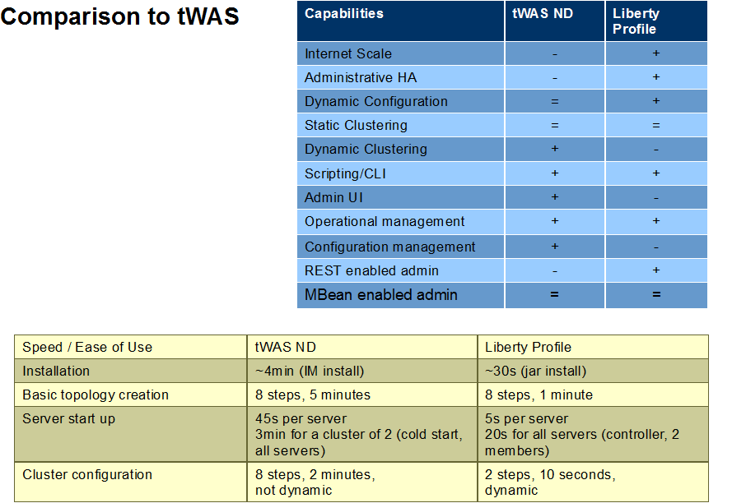

Slide 81
Legal Disclaimer
  © IBM Corporation 2013. All Rights Reserved.
  The information contained in this publication is provided for informational purposes only. While efforts were made to verify the completeness and accuracy of the information contained in this publication, it is provided AS IS without warranty of any kind, express or implied. In addition, this information is based on IBM’s current product plans and strategy, which are subject to change by IBM without notice. IBM shall not be responsible for any damages arising out of the use of, or otherwise related to, this publication or any other materials. Nothing contained in this publication is intended to, nor shall have the effect of, creating any warranties or representations from IBM or its suppliers or licensors, or altering the terms and conditions of the applicable license agreement governing the use of IBM software.
  References in this presentation to IBM products, programs, or services do not imply that they will be available in all countries in which IBM operates. Product release dates and/or capabilities referenced in this presentation may change at any time at IBM’s sole discretion based on market opportunities or other factors, and are not intended to be a commitment to future product or feature availability in any way. Nothing contained in these materials is intended to, nor shall have the effect of, stating or implying that any activities undertaken by you will result in any specific sales, revenue growth or other results.
  If the text contains performance statistics or references to benchmarks, insert the following language; otherwise delete:
  Performance is based on measurements and projections using standard IBM benchmarks in a controlled environment. The actual throughput or performance that any user will experience will vary depending upon many factors, including considerations such as the amount of multiprogramming in the user's job stream, the I/O configuration, the storage configuration, and the workload processed. Therefore, no assurance can be given that an individual user will achieve results similar to those stated here.
  If the text includes any customer examples, please confirm we have prior written approval from such customer and insert the following language; otherwise delete:
  All customer examples described are presented as illustrations of how those customers have used IBM products and the results they may have achieved. Actual environmental costs and performance characteristics may vary by customer.
  Please review text for proper trademark attribution of IBM products. At first use, each product name must be the full name and include appropriate trademark symbols (e.g., IBM Lotus® Sametime® Unyte™). Subsequent references can drop “IBM” but should include the proper branding (e.g., Lotus Sametime Gateway, or WebSphere Application Server). Please refer to http://www.ibm.com/legal/copytrade.shtml for guidance on which trademarks require the ® or ™ symbol. Do not use abbreviations for IBM product names in your presentation. All product names must be used as adjectives rather than nouns. Please list all of the trademarks that you use in your presentation as follows; delete any not included in your presentation. IBM, the IBM logo, Lotus, Lotus Notes, Notes, Domino, Quickr, Sametime, WebSphere, UC2, PartnerWorld and Lotusphere are trademarks of International Business Machines Corporation in the United States, other countries, or both. Unyte is a trademark of WebDialogs, Inc., in the United States, other countries, or both.
  If you reference Adobe® in the text, please mark the first use and include the following; otherwise delete:
  Adobe, the Adobe logo, PostScript, and the PostScript logo are either registered trademarks or trademarks of Adobe Systems Incorporated in the United States, and/or other countries.
  If you reference Java™ in the text, please mark the first use and include the following; otherwise delete:
  Java and all Java-based trademarks are trademarks of Sun Microsystems, Inc. in the United States, other countries, or both.
  If you reference Microsoft® and/or Windows® in the text, please mark the first use and include the following, as applicable; otherwise delete:
  Microsoft and Windows are trademarks of Microsoft Corporation in the United States, other countries, or both.
  If you reference Intel® and/or any of the following Intel products in the text, please mark the first use and include those that you use as follows; otherwise delete:
  Intel, Intel Centrino, Celeron, Intel Xeon, Intel SpeedStep, Itanium, and Pentium are trademarks or registered trademarks of Intel Corporation or its subsidiaries in the United States and other countries.
  If you reference UNIX® in the text, please mark the first use and include the following; otherwise delete:
  UNIX is a registered trademark of The Open Group in the United States and other countries.
  If you reference Linux® in your presentation, please mark the first use and include the following; otherwise delete:
  Linux is a registered trademark of Linus Torvalds in the United States, other countries, or both. Other company, product, or service names may be trademarks or service marks of others.
  If the text/graphics include screenshots, no actual IBM employee names may be used (even your own), if your screenshots include fictitious company names (e.g., Renovations, Zeta Bank, Acme) please update and insert the following; otherwise delete: All references to [insert fictitious company name] refer to a fictitious company and are used for illustration purposes only.

