Slide 1
Collective Repository Publishing 101
Overall Design &
Implementation

Slide 2
Topics
Publishing
  Principles
  Flow
MBean Publishing
  Automatic
  Manual
Non-MBean Publishing

Slide 3
Publishing Principles
Must not require any collective code
  No compile or runtime dependencies
Must be light-weight
  No if (collective) then (publish) logic
Must support notification of the status of publish action

Slide 4
RepositoryPublisher
Uses EventAdmin to receive and send messages
  Publish Events are sent by publishing components
  Status Events are sent to the by publishing components
    Only sent if requested
Handles all I/O with the collective repository
Complete SPI is defined in JavaDoc

Slide 5
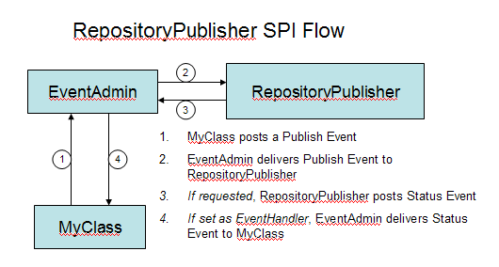
Generic Publishing & Status Flow

Slide 6
Related code
OSGI EventAdmin
com.ibm.wsspi.collective.repository.publisher
  RepositoryPublisher
com.ibm.ws.management.repository.member.internal.publisher
  RepositoryPublisherImpl

Slide 7
MBean Publishing
Two modes:
  Automatic, MBean gets published “for free”
  Manual, MBean must implement publishing logic
Optional. MBeans need not publish anything
  Although it is recommended that they follow the automatic pattern

Slide 8
Automatic MBean Publishing
MBeans are automatically published if:
  The MBean exists in the Service Registry
    Defines DS service property with the "jmx.objectname"
  Implements javax.management.NotificationBroadcaster
    (Or javax.management.NotificationEmitter, which extends the former).
  Indicates it emits AttributeChangeNotifications via NotificationBroadcaster.getNotificationInfo()
    Note: It is the MBean author's responsibility to emit AttributeChangeNotifications whenever the MBean's attributes are updated.

Slide 9
Forcing Publishing
If the MBean is an OSGi service, can set service property “publishAttributesToCollectiveController”:
  To true to force the attributes to be published. Will result in one-time publish (no attribute change detection)
  To false to prevent publishing

Slide 10
Automatic MBean Publishing Flow
Collective Member
Controller
OSGI
Service Registry
OSGI
Event Admin
HTTPS
Collective Repository
MBean
DynamicMBean
Discovery
Repository
Publisher

Slide 11
Related Code
com.ibm.ws.management.repository.member.internal.publisher
  DynamicMBeanDiscovery

Slide 12
Manual MBean publishing
MBeans can publish their own attributes
  See RepositoryPublisher JavaDoc for complete details
Not a recommended practice
  When possible use automatic publishing!

Slide 13
Manual MBean Publishing Flow
Collective Member
Controller
OSGI
Event Admin
HTTPS
Collective Repository
MBean
Repository
Publisher

Slide 14
Non-MBean Publishers
Non-MBean code must self publish via SPI
  No auto-publish support exists like it does for MBeans
Specific collective member information is published via this method

Slide 15
Collective Member Publishers
com.ibm.ws.management.repository.member.internal.publisher
  ServerManagementPublisher
    Publishes <hostAuthInfo>
  ServerPathsPublisher
    Publishes all server paths (wlp.install.dir, wlp.user.dir, etc)
  ServerStatePublisher
    Server UP / DOWN

Slide 16
Related Wiki Pages
(Assuming these pages still exist. If not all the core data is captured in this presentation)
  http://was.pok.ibm.com/xwiki/bin/view/LibertyCookbook/CreatingMbeans
  http://was.pok.ibm.com/xwiki/bin/view/LibertyCookbook/MBeans

