Slide 1
Data Science Moment
Aidan Smith
8/13/2019
Notes:
Tips:
Presentation title should be Arial font, 40 points
Title on this slide should be kept short and on a single line
All fonts throughout presentation should be Arial font
The TVA Color Palette theme color is already selected in TVA’s template

Slide 2
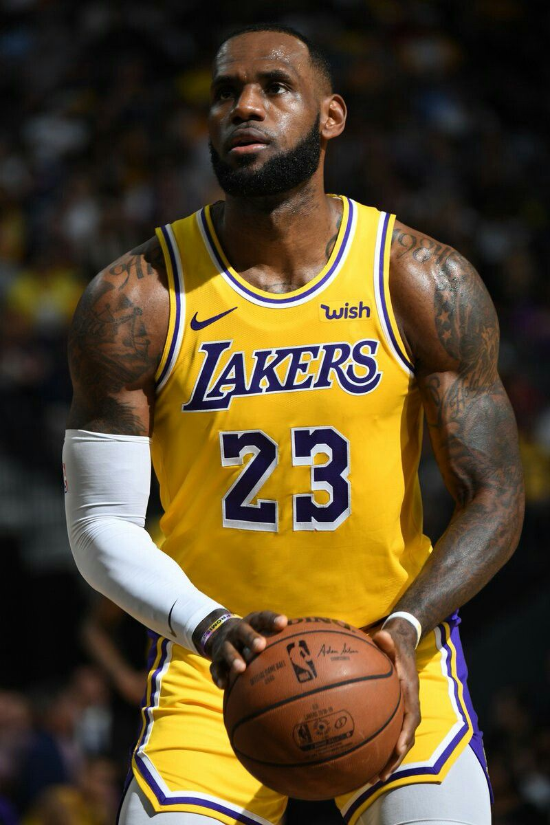
27/7/7
LeBron Raymone James has been one of the world’s most prominent athletes over his 15 years in the NBA.
LeBron has been remarkably consistent throughout his career, hardly ever missing time for injury.
In his 15 year career (1198 games), LeBron has averaged 27 points per game, 7 rebounds per game, and 7 assists per game.
However, he has never had 27 points, 7 rebounds, and 7 assists in the same game.
How unlikely is this?
Find a probability estimate that shows the chance of this not occurring up to this point.
Additionally, assuming another 5 years of averaging 27/7/7, find a probability LeBron finishes his career never having a 27/7/7 game.
Notes:
Tips:
Slide title should be Arial font, 32 points
Title should be kept short and on a single line if at all possible

Slide 3
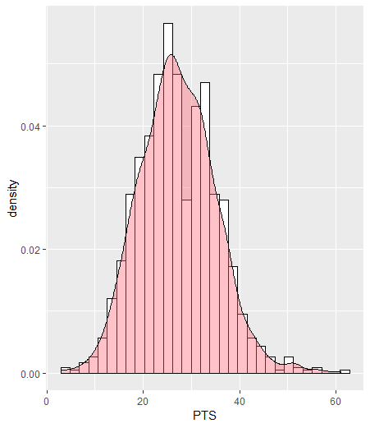
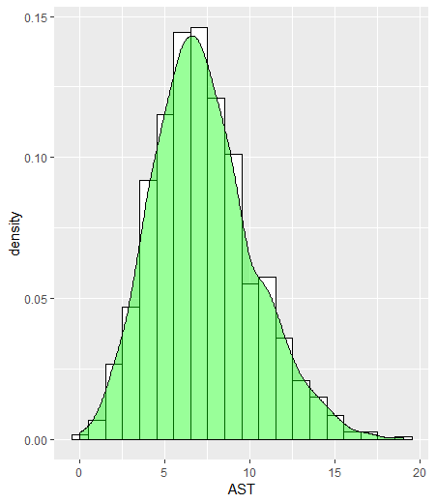
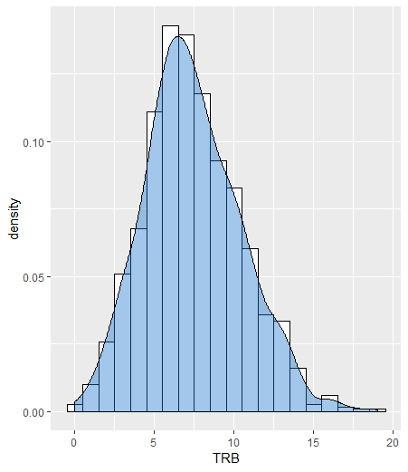
Distributions

Slide 4
Initial Estimate
Calculate joint probabilities of getting 27 points, getting 7 rebounds, and getting 7 assists, and multiply them together.
Issues?
Not independent events

Slide 5

Dealing with Dependent Data
Diagonals show variances, high for PTS, similarly low for TRB and AST.
Off-Diagonals not 0, not independent.
3.46 shows a positive corr between pts and rebounds, slightly negative correlation between pts and assists.
Makes sense if you think about it, you cannot score and assist in the same possession.

Slide 6

Multivariate Normal Distribution
Often used to describe -- at least approximately-- a set of correlated real-valued random variables, each of which clusters around a mean value.
Where μ is the vector of the means of the stats and Σ is the covariance matrix
MVN accounts for how the PTS, TRB, AST values play off each other.
Mvtnorm library in R has dmvnorm() that computes this density

Slide 7
Conclusion
32.63 % chance LeBron has made it this far without a 27/7/7, not really that unlikely.
Assuming 70 games played over 5 more years, and the same averages, 23.48% chance LeBron makes it through his career without a 27/7/7
Despite a large sample size, the large value space of 3 events makes it very unlikely to record exactly 27 points, 7 rebounds, and 7 assists in a single game.

Slide 8
Notes
Discrete data, and has to be > 0, maybe MVN isn’t the best approach.
Poisson is discrete, but mean != variance
Multivariate Negative binomial distribution?
From wiki: The negative binomial distribution can be used as an alternative to the Poisson distribution. It is especially useful for discrete data over an unbounded positive range whose sample variance exceeds the sample mean.

