Slide 1
Forest Cover
Timon Willi

Slide 2
Data Set – Basic Information
Roosevelt National Forest
518'012 Observations
55 Variables
10 numeric
45 categorical
Cover Type
Categorical
1-7

Slide 3
Research Question
Omitting Cover_Type
Can we find similar clustering structure as if we used Cover_Type as clustering?

Slide 4
Methods
Centroid-based
Kmeans
Kproto (mixed variables)
PAM
Connectivity-based (hierarchical)
Bottom-up
Top down

Slide 5
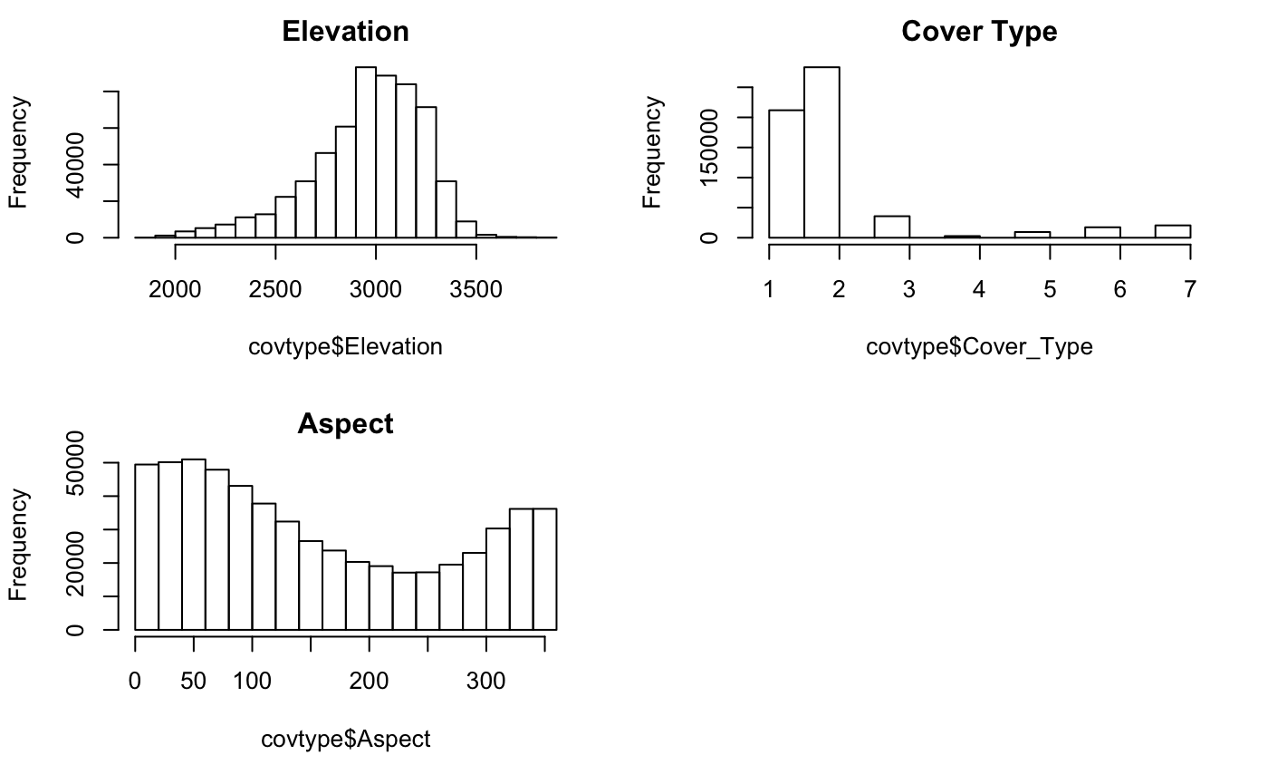
Interesting Variables

Slide 6
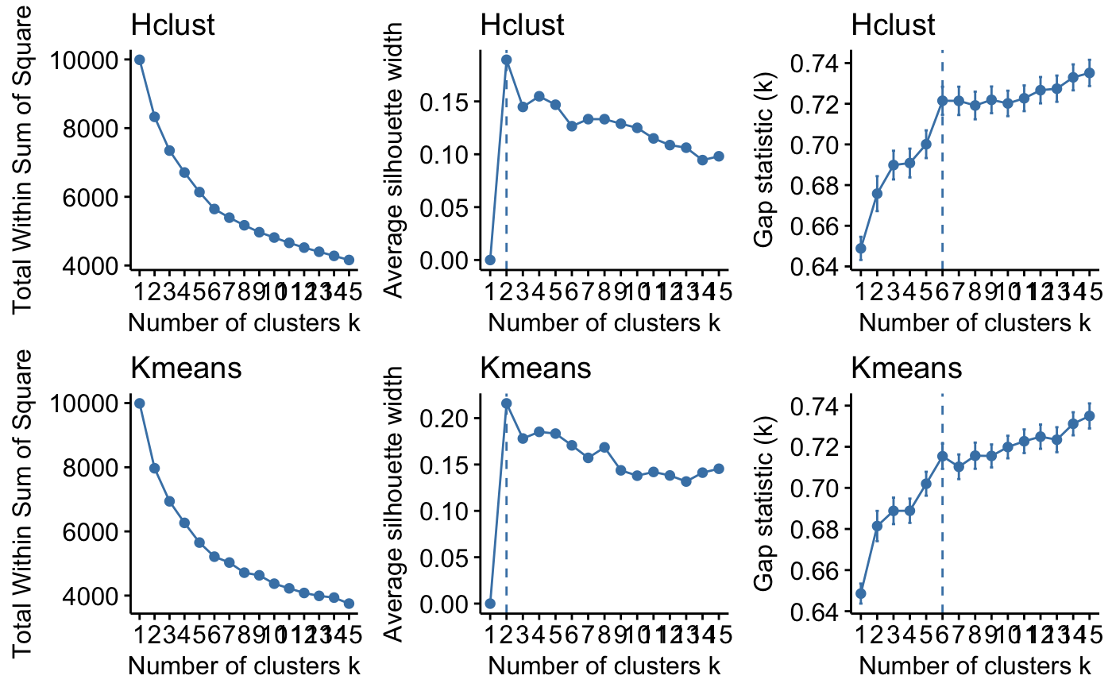
Ideal number of clusters?

Slide 7
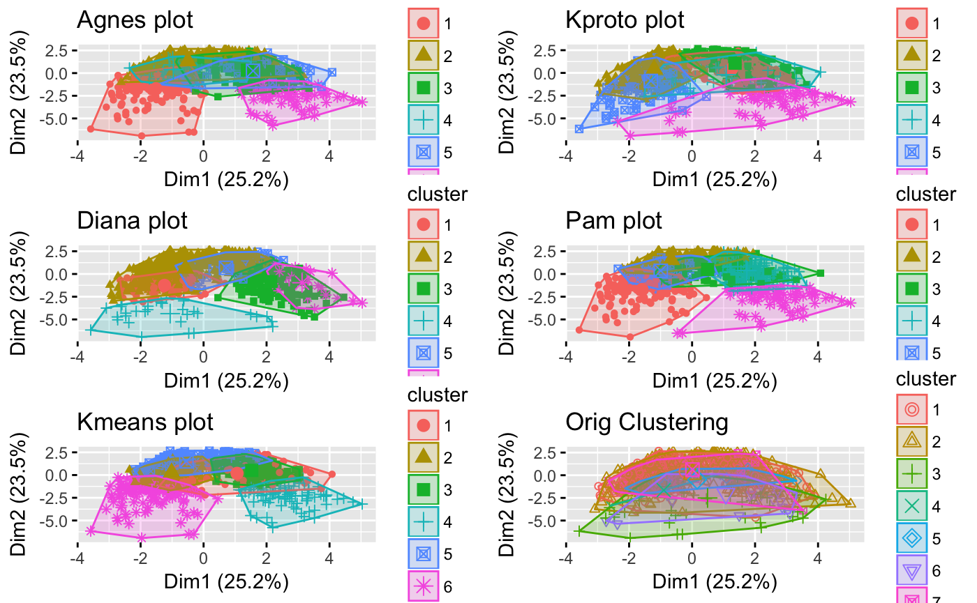
k=6 , Euclidean; Clustering Results

Slide 8
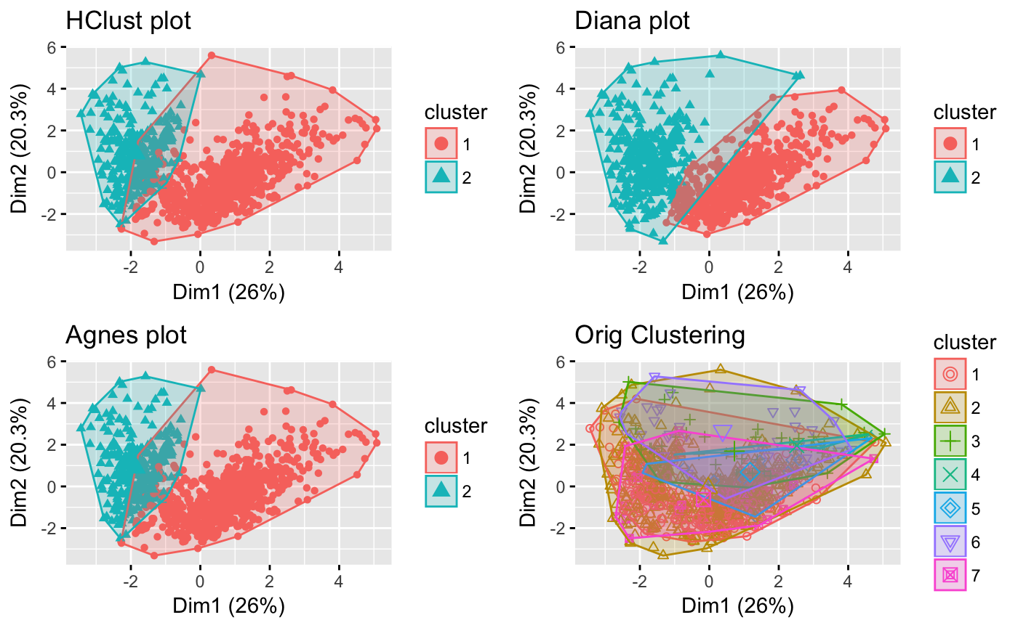
k=2, Manhattan; Clustering Results

Slide 9
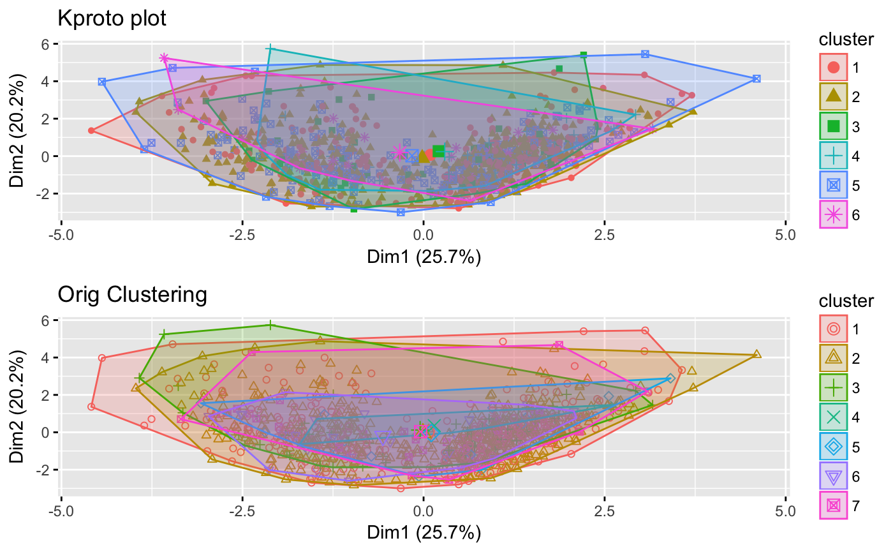
Clustering with all variables

Slide 10
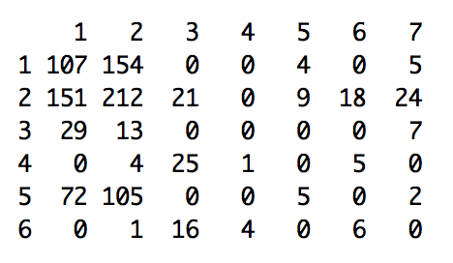
However...
Still not perfect:

