Slide 1
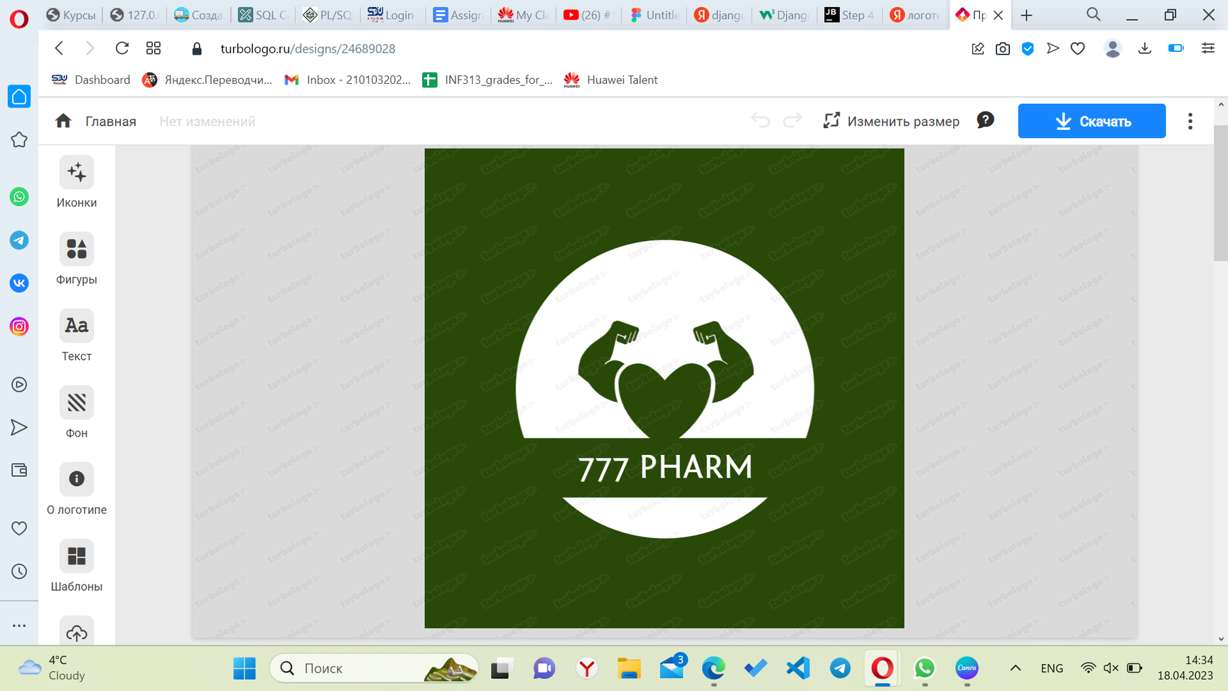

INF 305
ONLINE PHARMACY
LECTURE: AZAMAT SEREK PRACTICE INSTRUCTOR: MUKHTAR AMIRKUMAR
ENDTERM BY SAUIRBAY A, TURGYMBAY A, YEMBERGENOVA E, YAKIPOVA Z

Slide 2
Introduction
ERD
Normal forms
Coding parts(function,procedure,exception,triggers)

Slide 3
Introduction
777-pham
Idea:
9 entities:
We know that the transition from offline sales to online is now happening at a rapid pace.Therefore, our task is to make it easier for the seller. Of all the necessary online services, the most important is the database system. So in this project we plan to create a database system in which the seller could sell his goods online.
Customer
Product
Staff
Supplier
Basket
Item 1
Item 2
Delivery
Payment

Slide 4
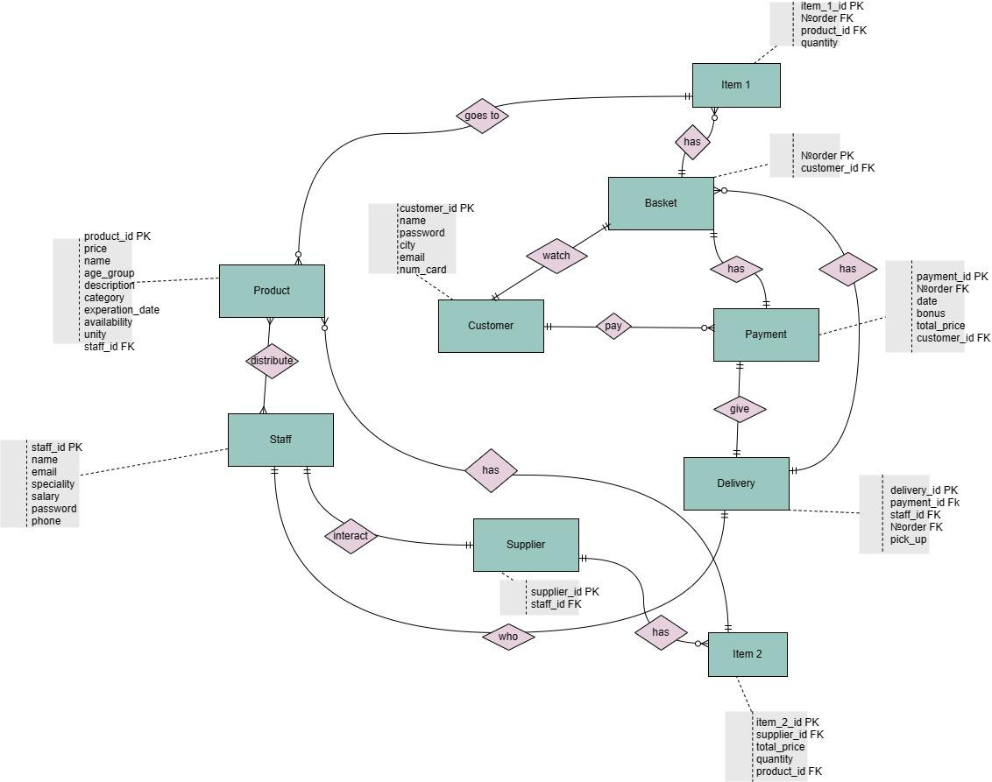
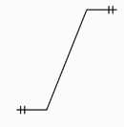
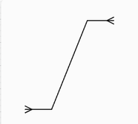
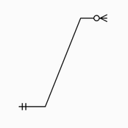
-one to one
-many to many
-many to one

Slide 5
Normal forms
In our tables we contain all three normal forms
1)In any tables you can see it's in first normal form,
because each table cell contain a single value and
each record (primary key) is unique.
2)As it should be in second normal form, in any tables
Single Column Primary Key does not functionally dependant
on any subset of candidate key relation and it is in first
normal form.
3)In third normal form has to be no transitive functional
dependencies. In our tables we divided Basket and Item _1,
Supplier and Item _2 to remove transitive functional dependency.
In other tables we do not have this type of functional dependency.
Since in each basket (NO_order) the order number can have several products, we moved and created a new entity named ITEM_1. The same scheme works with the supplier table.

Slide 6
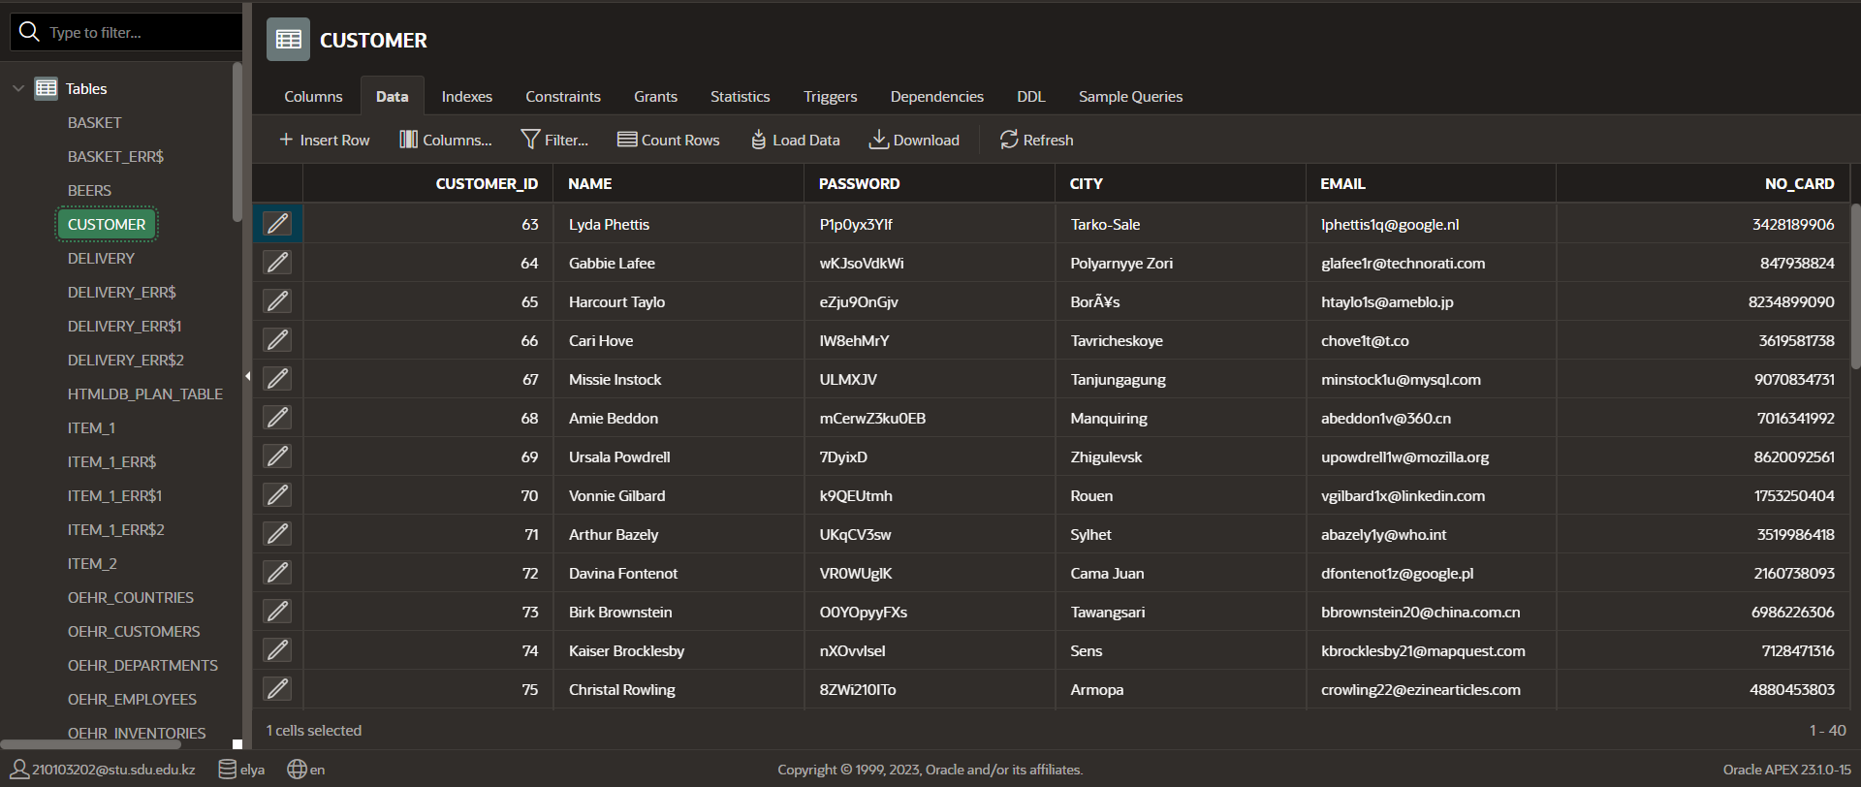

Slide 7
Procedures
1)The procedure is the cost of the products that were ordered with the quantity. We multiply the quantity of each items by the price and group by order ID
CREATE OR REPLACE PROCEDURE basket_total(
v_No_order IN item_1.NO_order%TYPE,
v_order_total OUT NUMBER
)
IS
BEGIN
SELECT SUM(item_1.quantity * product.price) INTO v_order_total
FROM item_1
JOIN product ON item_1.product_id = product.product_id
WHERE item_1.No_order = v_NO_order
GROUP BY item_1.NO_order;
DBMS_OUTPUT.PUT_LINE('Total sum for items ' || v_No_order || ': $' || v_order_total);
END;
DECLARE
v_order_total NUMBER;
BEGIN
basket_total(79, v_order_total);
DBMS_OUTPUT.PUT_LINE('Total sum for order 79: $' || v_order_total);
END;

Slide 8
Procedures
Thanks to this procedure , users can see how many items are in his ıtem*basket. This makes it very convenient for the user to navigate how many items are in the basket.
create or replace PROCEDURE check_item_basket(p_item_1_id IN NUMBER)
IS
v_basket_count NUMBER;
BEGIN
SELECT quantity INTO v_basket_count
FROM item_1
WHERE item_1_id = p_item_1_id;
IF SQL%ROWCOUNT = 1 THEN
DBMS_OUTPUT.PUT_LINE('The basket with ID ' || p_item_1_id || ' contains ' || v_basket_count || ' items.');
ELSE
DBMS_OUTPUT.PUT_LINE('The basket with ID ' || p_item_1_id || ' not found.');
END IF;
END;
/

Slide 9
Functions
1) Function to get customer information by ID
CREATE OR REPLACE FUNCTION get_customer_info(p_customer_id IN NUMBER)
RETURN customer%ROWTYPE
AS
v_customer customer%ROWTYPE;
BEGIN
SELECT *
INTO v_customer
FROM customer
WHERE customer_id = p_customer_id;
RETURN v_customer;
END;
DECLARE
v_customer customer%ROWTYPE;
BEGIN
v_customer := get_customer_info(1);
DBMS_OUTPUT.PUT_LINE('Name: ' || v_customer.name);
DBMS_OUTPUT.PUT_LINE('Email: ' || v_customer.email);
END;

Slide 10
Functions
2) Function for getting staff who works in the same speciality:
create or replace FUNCTION get_staff(same_speciality IN VARCHAR2)
RETURN staff%ROWTYPE
AS
v_staff staff%ROWTYPE;
BEGIN
SELECT *
INTO v_staff
FROM staff
WHERE speciality = same_speciality;
RETURN v_staff;
END;
/
DECLARE
v_staff staff%ROWTYPE;
BEGIN
v_staff := get_staff('Occupational Therapist');
DBMS_OUTPUT.PUT_LINE(v_staff.staff_id || ' - ' || v_staff.name || ' - ' || v_staff.speciality);
END;

Slide 11
Functions
2) Function which counts the number of records
create or replace function count_customers
return number
is
v_customers_count number;
begin
select count(*) into v_customers_count
from customer;
return v_customers_count;
end;
/
DECLARE
Res NUMBER;
BEGIN
Res := count_customers();
DBMS_OUTPUT.PUT_LINE('Count of customers is ' || Res);
END;

Slide 12
Functions
4) Function to get product information by ID
CREATE OR REPLACE FUNCTION get_product_info(p_product_id IN NUMBER)
RETURN product%ROWTYPE
AS
v_product product%ROWTYPE;
BEGIN
SELECT *
INTO v_product
FROM product
WHERE product_id = p_product_id;
RETURN v_product;
END;
DECLARE
v_product product%ROWTYPE;
BEGIN
v_product := get_product_info(1);
DBMS_OUTPUT.PUT_LINE('Name: ' || v_product.name);
DBMS_OUTPUT.PUT_LINE('Price: ' || v_product.price);
END;

Slide 13
Triggers
1)Trigger which will count row of this table
where insertig new parametres(In TABLE STAFF):
Create or replace trigger rowcount_staff
Before insert on staff
for each row
DECLARE
row_count NUMBER;
begin
Select count(*) into row_count from staff;
if inserting then
dbms_output.put_line('Row count of this table:' || row_count);
end if;
end;
insert into staff
(staff_id, name, email, speciality, password, phone)
values(51, 'Sabina Turgan', 'sab@mail.ru', 'Adviser', 'Sab123', '7777777777')
delete from staff where staff_id = 51

Slide 14
Triggers
2)This trigger will works when we get products
(means availibility turns to 'true' from 'false')
it's helps us to update expiration date with today's date:
create or replace trigger expiration_date
before update of availability on product
for each row
begin
if :new.availability = 'true' then
:NEW.expiration_date := SYSDATE;
end if;
end;
update product
set availability = 'true'
where product_id = 50;
update product
set expiration_date = '12/10/2021'
where product_id = 50;
select * from product where product_id = 50

Slide 15
Triggers
3)Also similar as previous trigger, will write expiration date with today's date when we
insert new product:
create or replace trigger expiration_date_insert
before insert on product
for each row
begin
if :new.availability = 'true' then
:new.expiration_date := CURRENT_DATE;
end if;
end;
drop trigger expiration_date_insert
insert into product(product_id, name, price, age_group, description, category, availability, unity)
values(51, 'ospamoks', '2000', '18', 'antibiotics', 'virus', 'true', 'mg')
select * from product where product_id = 51
delete from product where product_id = 51

Slide 16
Exceptions
1)This exception is related to the trigger. with this exception, the administrator cannot enter medicines into the system whose name contains less than 5 letters. when he tries to enter, an error message will come out: the product name must contain more than 5 letters
create or replace trigger CHARACTER
before insert on product
for each row
declare
invalid_name exception;
begin
IF length(:NEW.name) < 5 THEN
RAISE invalid_name;
END IF;
DBMS_OUTPUT.PUT_LINE ('Enter name of product: ' || :NEW.name);
EXCEPTION
WHEN invalid_name THEN
dbms_output.put_line('Product name must be bigger than 5 letters');
WHEN others THEN
dbms_output.put_line('Error!');
END;
insert into product(product_id, name, price, age_group, description, category, availability, unity)
values(52, 'osp', '2000', '18', 'antibiotics', 'virus', 'true', 'mg')

Slide 17
Exceptions
2) The main ideology of this exception is that a person cannot order an unlimited number of goods at the same time. And we will introduce a restriction on this. if the number of products exceeds a certain time, an error message appears:"There can be a maximum of 10 items in your cart"
create or replace trigger ITEM
before insert on item_1
for each row
declare
too_many_item exception;
begin
IF :NEW.quantity > 11 THEN
RAISE too_many_item;
END IF;
EXCEPTION
WHEN too_many_item THEN
dbms_output.put_line('There can be no more than 10 items in your basket');
WHEN others THEN
dbms_output.put_line('Error! Try again');
END;

Slide 18
Triggers
1)Trigger which will count row of this table
where insertig new parametres(In TABLE BASKET):
create or replace trigger rowcount_basket
Before insert on basket
for each row
DECLARE
row_count NUMBER;
begin
Select count(*) into row_count from basket;
if inserting then
dbms_output.put_line('Row count of this table:' || row_count);
end if;
end;

Slide 19
Triggers
1)Trigger which will count row of this table
where insertig new parametres(In TABLE CUSTOMER):
create or replace trigger rowcount_customer
before insert on customer
for each row
declare
row_count number;
begin
select count(*) into row_count from customer;
if inserting then
dbms_output.put_line('Row count of this table:' || row_count);
end if;
end;

Slide 20
Triggers
1)Trigger which will count row of this table
where insertig new parametres(In TABLE DELIVERY):
create or replace trigger rowcount_delivery
Before insert on delivery
for each row
DECLARE
row_count NUMBER;
begin
Select count(*) into row_count from delivery;
if inserting then
dbms_output.put_line('Row count of this table:' || row_count);
end if;
end;

Slide 21
Triggers
1)Trigger which will count row of this table
where insertig new parametres(In TABLE ITEM_1):
create or replace trigger rowcount_item1
Before insert on item_1
for each row
DECLARE
row_count NUMBER;
begin
Select count(*) into row_count from item_1;
if inserting then
dbms_output.put_line('Row count of this table:' || row_count);
end if;
end;

Slide 22
Triggers
1)Trigger which will count row of this table
where insertig new parametres(In TABLE ITEM_2):
create or replace trigger rowcount_item2
Before insert on item_2
for each row
DECLARE
row_count NUMBER;
begin
Select count(*) into row_count from item_2;
if inserting then
dbms_output.put_line('Row count of this table:' || row_count);
end if;
end;

Slide 23
Triggers
1)Trigger which will count row of this table
where insertig new parametres(In TABLE PAYMENT):
create or replace trigger rowcount_payment
Before insert on payment
for each row
DECLARE
row_count NUMBER;
begin
Select count(*) into row_count from payment;
if inserting then
dbms_output.put_line('Row count of this table:' || row_count);
end if;
end;

Slide 24
Triggers
1)Trigger which will count row of this table
where insertig new parametres(In TABLE PRODUCT):
create or replace trigger rowcount_product
Before insert on product
for each row
DECLARE
row_count NUMBER;
begin
Select count(*) into row_count from product;
if inserting then
dbms_output.put_line('Row count of this table:' || row_count);
end if;
end;

Slide 25
Triggers
1)Trigger which will count row of this table
where insertig new parametres(In TABLE SUPPLIER):
create or replace trigger rowcount_supplier
Before insert on supplier
for each row
DECLARE
row_count NUMBER;
begin
Select count(*) into row_count from supplier;
if inserting then
dbms_output.put_line('Row count of this table:' || row_count);
end if;
end;

