Slide 1
WebGPU rendering
T120B168 Interactive Web Technology
Authors: Aidas Litvinas

Slide 2
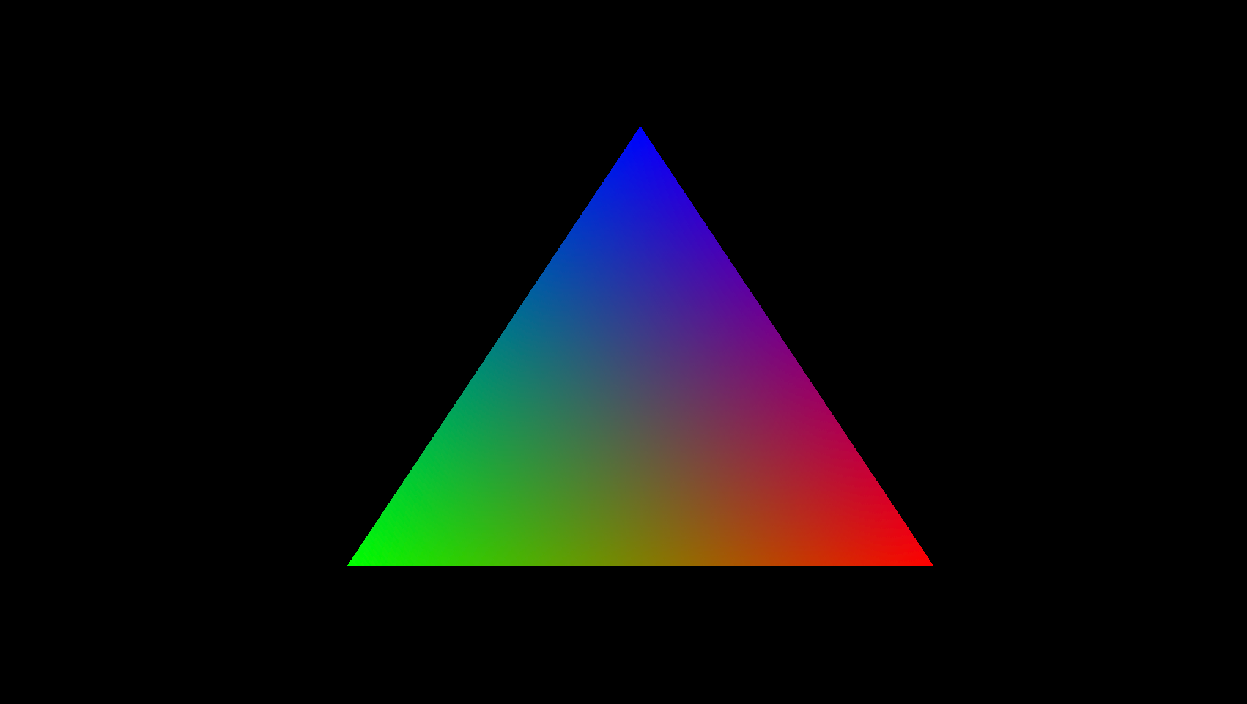
Project idea
For my project, I want to achieve real time graphics rendering using the GPU, on the web.
At the same time, I’d like to use this opportunity to learn how to use WebAssembly with Rust, for the purpose of interacting with WebGPU and displaying it on the web.

Slide 3
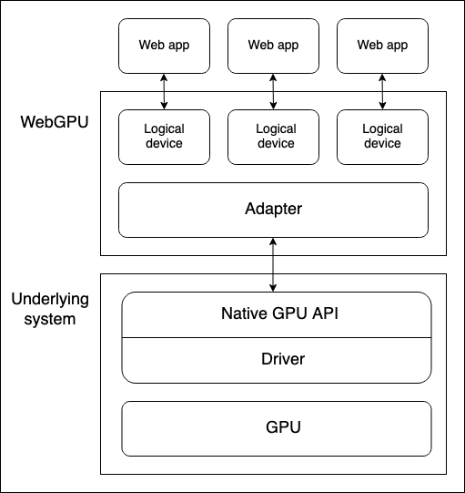
WebGPU
WebGPU is a modern web graphics and compute API. It was created for the purpose of superseding the WebGL standard. It works on top of the native graphics APIs, thus it is not necessarily a web technology, as it can run native apps as well as web apps.
Some benefits of WebGPU over WebGL include better performance, lower level GPU access and the ability to perform general-purpose GPU computing.

Slide 4

WebAssembly (WASM)
WASM is a binary instruction format that acts as a compilation target for other programming languages. WASM allows for any high-level programming language to run on the web.
This allows for better performance than JS and the ability to integrate existing codebases that otherwise couldn’t run on the web.

Slide 5



Rust and wgpu
Rust is a memory-safe, performant programming language, which offers one of the main implementation APIs for WebGPU – wgpu. This library is used by Mozilla for enabling WebGPU support on the Mozilla Firefox browser and by the Bevy game engine.

Slide 6
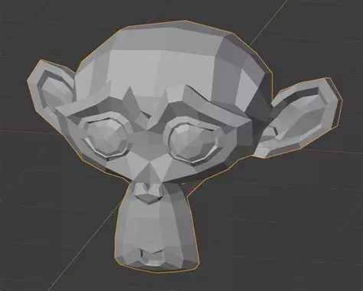
Project goals
My aim is to learn GPU API implementation skills, basics of the Rust programming language and the usage of WASM. Given the stack of new technologies, it’s hard to judge the final outcome.
In the best case scenario, the aim is rendering a 3D model with functioning vertex and fragment shaders onto the webpage canvas. In case that proves too difficult of a task, at bare minimum I want to draw a colourful triangle, as it would at least prove the successful usage of all these technologies.

Slide 7
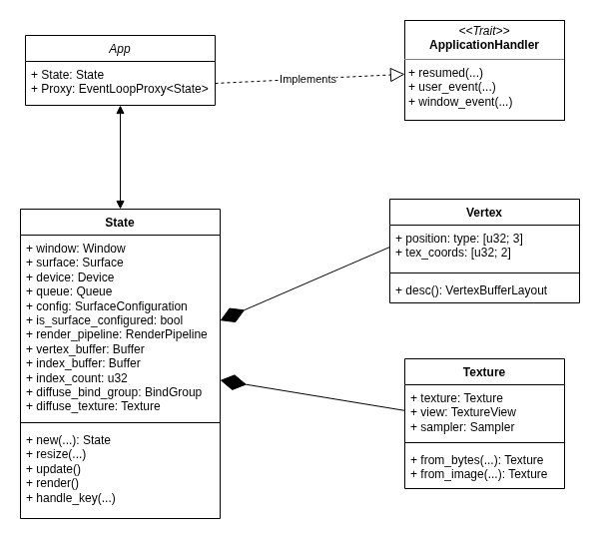
Class diagram

Slide 8

Current render

Slide 9
Thank you!

