Slide 1

POLICY IMPACT SIMULATION
SweetHome
Housing policy simulation
for lawmakers
Assess local and household impacts
before policies take effect
Google DeepMind AI Hackathon | 2026.10
Notes:
Key point: SweetHome helps policymakers compare regional impacts and household responses before a policy takes effect.
Image: a product concept illustration created with OpenAI image generation. It does not represent actual geographic boundaries or observed results.

Slide 2

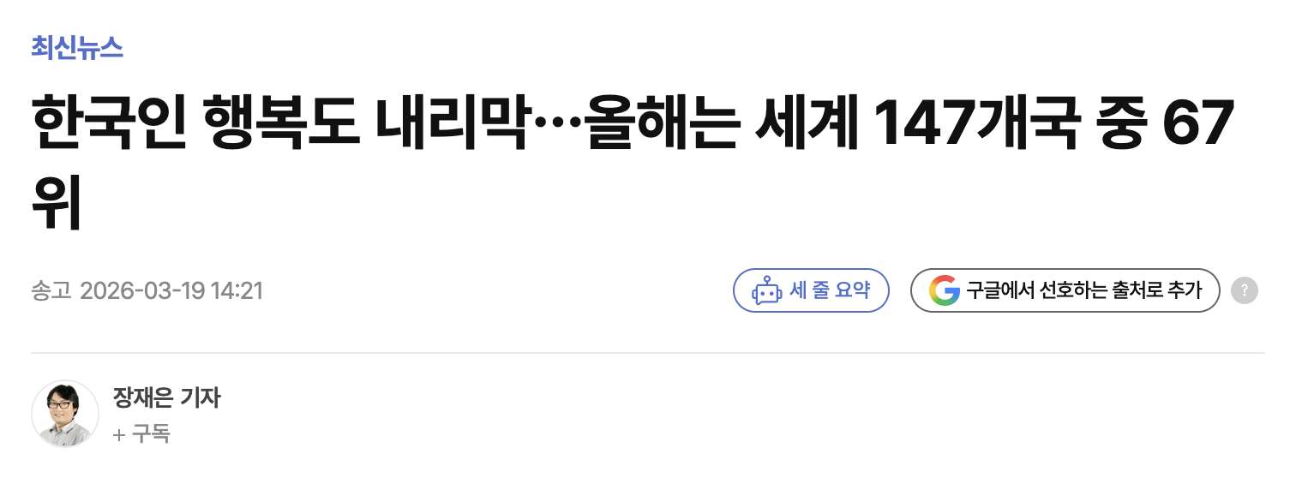
What Is Social Good?
Well, I Think...
It's about making everyone in society “Happy”.
Real Estate:
The Great Equalizer of Misery
South Korea's Happiness Ranking Falls Again…
67th Out of 147 Countries This Year (Yeonhap News, 20260319)
Why Does the Housing Market Leave Us Feeling So Hopeless?

Slide 3

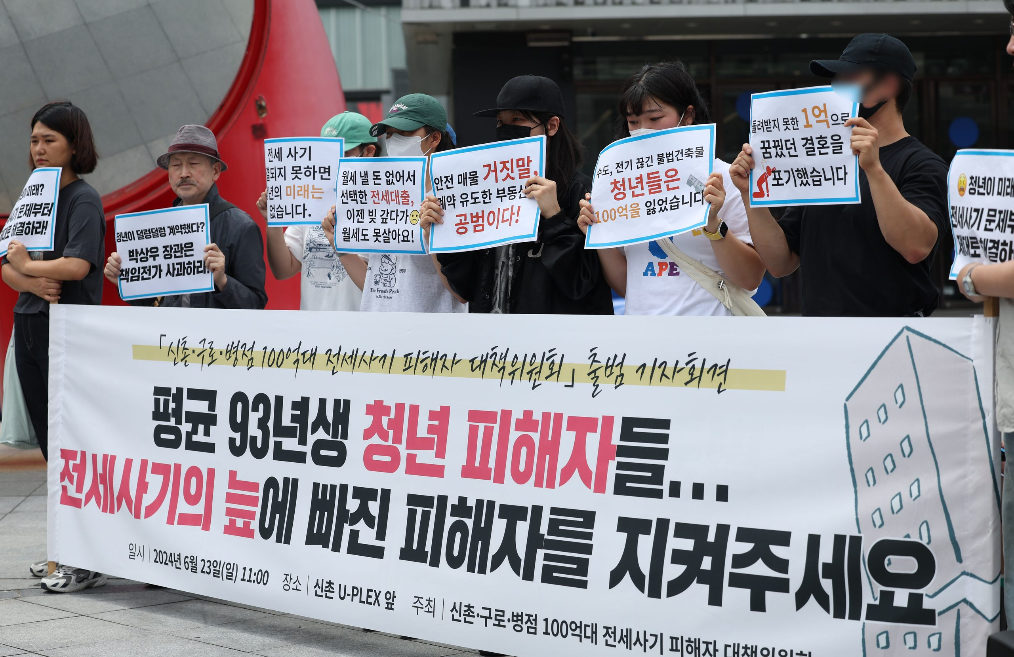
Young Victims of South Korea's Housing Deposit Scams...
Trapped in Debt, Desperately Seeking Help.
Real Estate: Despair by Design
How Did the Government Create a Game
Where the Winners Are Already Decided?
Even young Koreans, some still in their teens,
grow up believing that owning a home is the only way to be successful in life.

Slide 4
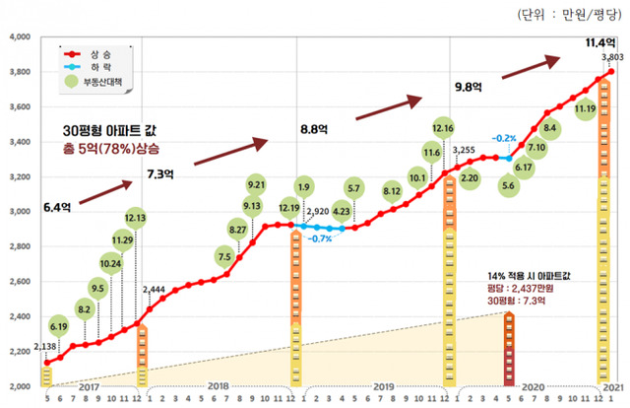

South Korea's real estate prices are heavily influenced by government housing policies.
However, these policies change dozens of times under each administration, and most people struggle to understand how these changes affect the housing market.
Even policymakers often fail to fully understand the complex economic factors and public psychology that shape the real estate market, leading to policies that fail to achieve their intended goals.
The green circles indicate
when new housing policies were announced.

Slide 5
To achieve Social Good (Happiness for All) in South Korea,
Everyone should be able to understand how housing policy changes may affect them.
We need to help lawmakers understand complex causal links and design better policies.
SweetHome is Exactly what we want!

Slide 6
01 POLICY CONTEXT
Housing policy tools change in rapid succession
Recent measures have combined area designations, lending rules and housing supply policies.
2025.02
2025.06
2025.10
Land transaction
permits eased
Household debt
rules tightened
Wider controls
Tighter lending
Jamsil, Samseong, Daechi, Cheongdam
291 apartment complexes
KRW 600m mortgage cap
Move-in requirement
All Seoul, 12 Gyeonggi areas
LTV: 70% to 40%
2025.03
2025.09
2026.04
Permit zones
expanded again
Capital region
supply plan
Household loans
further restricted
Gangnam 3 districts, Yongsan
All apartments
By 2030
1.35m homes targeted
Managed growth target: 1.5%
Loan renewal restrictions
Policymakers need to assess policy combinations and timing, alongside individual tools.
Sources: Seoul (Feb 2025), joint ministries (Mar 2025), MOLIT and FSC (Jun, Sep, Oct 2025 and Apr 2026).
SweetHome | Google DeepMind AI Hackathon
06
Notes:
Recent changes have repeatedly adjusted area designations, lending, supply and taxes, rather than a single rule.
Seoul's partial easing of land transaction permit zones: https://mediahub.seoul.go.kr/archives/2013415
March 2025 housing market stabilization plan: https://eiec.kdi.re.kr/policy/materialView.do?num=264456
June 2025 household debt controls: https://www.molit.go.kr/USR/NEWS/m_71/dtl.jsp/dtl.jsp?id=95091036
September 2025 housing supply expansion: https://m.korea.kr/briefing/policyBriefingView.do?newsId=156721813
October 2025 housing market stabilization measures: https://www.fsc.go.kr/no010101/85432
2026 household debt management plan: https://www.fsc.go.kr/no010101/86606

Slide 7
02 OBSERVED EFFECT
Targeted rules can have different effects in nearby areas
Retrospective estimates for the 2020 land transaction permit zones in Jamsil, Samseong, Daechi and Cheongdam.
Inside regulated areas
Home sales volume
-38.3%
Nearby unregulated areas
+2.3%
Home prices
-4.3%
Permit zones
Prices -4.3%
Sales -38.3%
Unregulated homes within 5 km
+2.3%
Direct effect
Spillover effect
Rules may stabilize the target area while shifting demand to nearby areas.
These estimates cannot be applied directly to other periods or the entire capital region.
Source: KDI Research Report 2023-06, Housing Markets and Regulation. Estimates apply to specific designations in Seoul.
SweetHome | Google DeepMind AI Hackathon
07
Notes:
KDI estimated the effects of land transaction permit requirements introduced in June 2020 in Jamsil, Samseong, Daechi and Cheongdam.
Sales volume in regulated areas fell by 38.3% and prices fell by 4.3%. Prices of nearby unregulated homes rose by 2.3% relative to more distant unregulated homes.
These are retrospective estimates for a specific place and period. They should not be applied directly to a new policy scenario.
Source: https://www.kdi.re.kr/research/reportView?pub_no=18385

Slide 8
03 POLICY INTERACTION
Policy effects depend on rates, timing and household finances
The same rule can have different effects across market conditions and household groups.
Monetary policy and timing
Household exposure
25 bp policy rate cut
Newlyweds without a home
Seoul apartment prices
+1.4%
Cash and policy loan eligibility change where they can afford to buy.
Average response over 1 year
Mortgage lending
+1.2%
Buyers with high DSR
The same rate change can mean larger repayment burdens and spending cuts.
Owners moving home
Early tightening
4-6 months later
Before the rate cut
Policy index raised by 0.25
Policy tightening
of the same size
Sale timing and extra loan conditions can delay a move.
Owners and landlords
Loan growth pressure
-0.4%p
~ -0.2 pp
Loan renewals, taxes and rental terms interact.
Results include sign restrictions in the VAR model
A 1 pp DSR rise slowed annual consumption by 0.37% on average, with large differences across groups.
Sources: BOK Issue Notes 2025-26 and 2022-45. Figures depend on each study's sample and model assumptions.
SweetHome | Google DeepMind AI Hackathon
08
Notes:
Bank of Korea analysis shows that the sequencing of monetary and macroprudential policies matters.
A 25 bp rate cut was associated with an average one-year response of 1.4% for Seoul apartment prices and 1.2% for mortgage lending.
Early macroprudential tightening reduced loan growth pressure by about 0.4 percentage points. Tightening 4-6 months later reduced it by around 0.2 percentage points.
The VAR identification includes sign restrictions. Do not count the direction of these results again as independent causal evidence.
Policy mix research: https://www.bok.or.kr/portal/bbs/P0002353/view.do?depth=200433&menuNo=200433&nttId=10093611
Household consumption research: https://www.bok.or.kr/portal/bbs/P0002353/view.do?menuNo=2004&nttId=10074253

Slide 9
04 DECISION GAP
Key questions for policy impact assessment
Policymakers are the primary users. Individuals can explore changes in their buying power and options.
Primary users
01
02
Policymakers
Where should it apply?
Who faces the greatest impact?
Assess target areas and demand shifts to nearby areas together.
Compare exposure by income, debt, home ownership and policy loan eligibility.
Compare scope and exemptions.
Review side effects and safeguards
before implementation.
03
04
How do effects emerge?
Where does the evidence apply?
Secondary users
Individuals
Connect borrowing capacity, transactions, expectations and supply delays.
Check whether each study's location, period and method fit the scenario.
See how borrowing limits and
affordable locations change.
Policy explanation
Impact assessment
Policy decisions
SweetHome | Google DeepMind AI Hackathon
09
Notes:
Policymakers are the main users. SweetHome provides evidence for comparing policy scope, exemptions and implementation timing, while leaving decisions to people.
Individuals can use the same model to understand changes in their borrowing capacity and affordable locations.

Slide 10
05 PRODUCT
A reviewable workflow from policy document to scenario
Upload a document, verify the extracted change, set assumptions and compare the resulting constraints.
Human review
Check the source quotation
Confirm scope and dates
Approve inputs
Scenario inputs
Policy input
Rule extraction
One selected rule
Regions and effective date
Household or supply inputs
Explicit sensitivity coefficients
Calculations
Review
Text, PDF, HWPX
Official examples
Legacy HWP: convert first
Before and after values
Source text locations
Gemini or rules engine
Borrowing and budget limits
Supply timing assumptions
Optional price sensitivity
Map
Before / after
Formulas and sources
Document parsers
Gemini (configured)
Explicit formulas
React + FastAPI
Traceability
Document hash
Quoted evidence
Input review
Model version
JSON export
SweetHome | Google DeepMind AI Hackathon
10
Notes:
Current implementation: PolicyWorkflow.tsx, PolicyExperimentView.tsx and policy_pipeline.py.
Text, text-based PDF and HWPX parsing are implemented. Legacy HWP and scanned PDFs require conversion or OCR.
Gemini extraction runs only when GEMINI_API_KEY and GEMINI_MODEL are configured. A limited rules-based engine is also available.
Users confirm one rule, its quoted text, applicable regions, effective date and household or supply inputs. Price sensitivity coefficients are assumptions, not calibrated estimates.
The implementation uses React, FastAPI, local JSON data and browser-local graph drafts. Document AI, Spanner Graph and BigQuery are not claimed as active integrations. Cloud deployment was not verified.

Slide 11
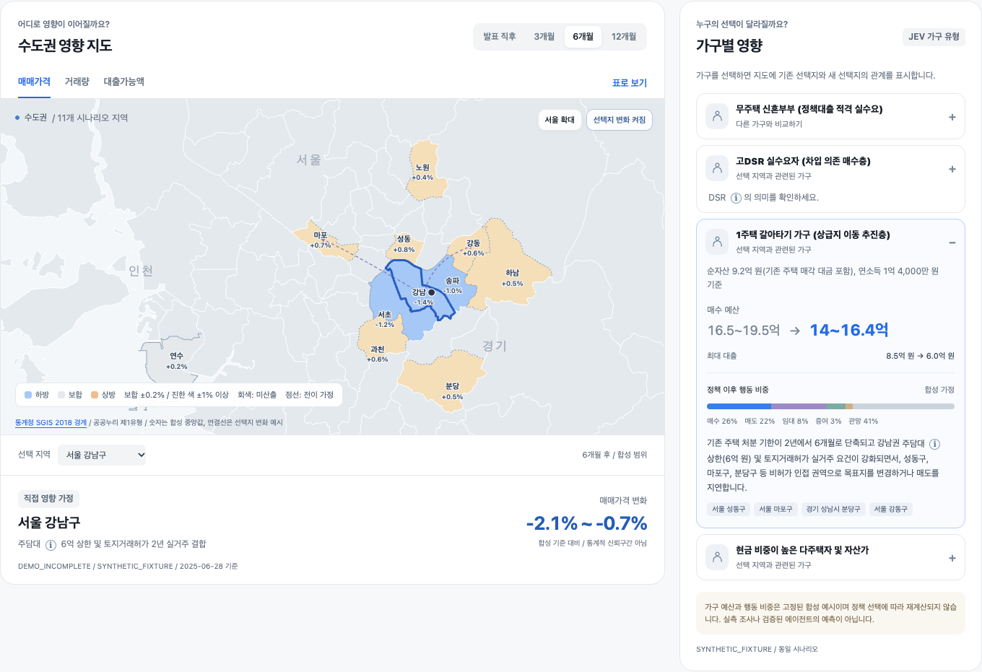
06 EXPERIENCE
The running prototype links regions and households
Select a region, compare household profiles and inspect before-and-after policy conditions.
Actual prototype screenshot, 16 Oct 2026. This historical view uses synthetic outcomes. Official transaction samples appear separately.
SweetHome | Google DeepMind AI Hackathon
11
Notes:
Actual screenshot of the running local prototype at http://localhost:5174/, captured on 16 Oct 2026.
This screenshot shows the historical demonstration view. Its prices and household behavior are synthetic fixtures, not observed or forecast results.
The new document workflow separately calculates constraints from reviewed inputs. Do not confuse those results with the historical demo map.

Slide 12
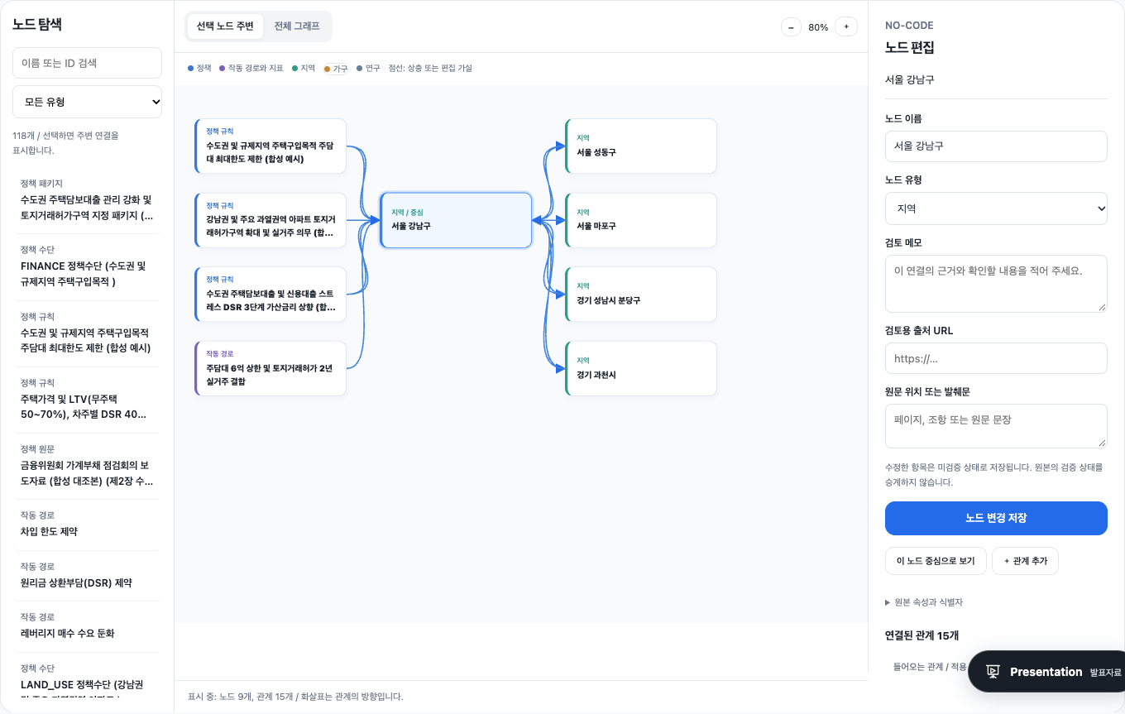
06 KNOWLEDGE GRAPH
A knowledge graph people can inspect and edit
Search nodes, inspect sources and edit relationships without code. Undo changes or exchange JSON drafts.
Actual prototype screenshot. 118 nodes and 318 relationships. Edits stay in this browser and do not update simulations or the server.
SweetHome | Google DeepMind AI Hackathon
12
Notes:
Actual local prototype, inspected 16 Oct 2026.
KnowledgeGraph.tsx and graph-editor.ts provide search, local node and edge editing, undo, redo, and JSON import/export.
Drafts use localStorage. No server write, collaborative editing or automatic simulation recalculation is implemented.
The graph contains synthetic policies and research claims. Connections are hypotheses, not proven causal links.

Slide 13
07 IMPLEMENTED FEATURES
What users can inspect and change today
The prototype separates observed data, reviewed policy inputs and assumption-based calculations.
01
02
03
Document workflow
Public data
Clear explanations
Review before calculating
Inspect the source and coverage
Understand rules and evidence
Load an official example or upload text, PDF or HWPX. Review the quoted numerical change. Confirm dates, regions and eligible households before running one-rule experiments.
View 77 capital-region boundaries from SGIS 2018 and 30 official Seoul transaction records. Filter area and cancellations. Samples do not represent the whole market.
Compare lending and permit conditions. Hover over LTV, DSR, DTI and rate spreads for definitions. Inspect research sources, conflicting findings and limits.
Gemini is optional and requires configuration
Observations remain separate from simulations
Source links and terminology at the point of use
Scope as inspected on 16 Oct 2026. Historical demo outcomes and new policy experiments are distinct workflows.
SweetHome | Google DeepMind AI Hackathon
13
Notes:
Verified against current source code and the running local prototype on 16 Oct 2026.
Data scope: data/public/README.md. There are 77 SGIS 2018 boundaries and 30 official transaction records from three Seoul districts and two contract dates.
Public records are reference observations and do not calibrate the scenario coefficients.
Definitions: GlossaryHelp.tsx and glossary-data.ts. Policy comparisons: PolicyFactors.tsx.

Slide 14
08 TRUST ARCHITECTURE
Traceable experiments, with explicit limits
Document extraction supports human review. Deterministic calculations expose their inputs and formulas.
Review gates
Check quoted values
Confirm dates and eligibility
Accept scenario assumptions
Source records
Editable knowledge
Explicit calculations
Reproducible output
Official policy links
Document SHA-256
SGIS 2018 boundaries
Seoul transaction samples
Policy and evidence graph
118 nodes, 318 relationships
Local draft edits and undo
JSON import and export
Loan cap, LTV or DSR
Household budget comparison
Supply timing scenarios
User-set price sensitivity
Inputs and source quotation
Formula and model version
Scenario ID and text hash
Downloadable JSON record
Policy coverage
Data coverage
Forecast status
Graph editing
Incomplete policy inventory
Limited samples, dated boundaries
Not calibrated or backtested
Local only, no shared approval
No causal price forecast: sensitivities depend on user inputs. Graph edits do not update the server or recalculate scenarios.
SweetHome | Google DeepMind AI Hackathon
14
Notes:
Current calculation and disclosure behavior: policy_pipeline.py and PolicyExperimentView.tsx.
Price sensitivity is a user-assumption calculation, not a validated causal forecast or a statistical confidence interval.
Graph source: API demonstration graph, 118 nodes and 318 edges. Edits live in browser localStorage, support undo and JSON exchange, and do not mutate server data or simulation outputs.
Remaining gaps include complete policy coverage, representative data, calibrated regional price effects and collaborative approval.

Slide 15
SWEETHOME
Understand the rules.
Compare who is affected.
Decide before rollout.
Regional scenarios
Household constraints
Policy
Today: reviewable policy experiments and evidence exploration.
Next: complete policy coverage and validated impact models.
Live demo
SweetHome
Policy document | Human review | Regional and household comparison | Inspect the evidence
SweetHome | Google DeepMind AI Hackathon
15
Notes:
Live demo: load an official example or upload a supported document, inspect extracted before-and-after values, confirm dates, regions and eligibility, then compare conditional outputs.
Show the formula, input assumptions and JSON export. Then open the knowledge graph to inspect or edit a local hypothesis.
This is a research prototype. Do not claim complete policy coverage or validated regional price predictions.

Slide 16
APPENDIX
Key sources
Policy changes draw on official releases. Impact estimates draw on KDI and Bank of Korea research.
Policy documents
Effects and mechanisms
01
Seoul: Easing land transaction permit zones
01
KDI: Housing markets and regulation
2025.02.13
Research Report 2023-06
02
Joint ministries: Housing market stabilization plan
02
KDI: Housing regulation and supply approaches
2025.03.19
Research Report 2022-09
03
MOLIT and FSC: Stronger household debt controls
03
BOK: Effects of housing macroprudential policy
2025.06.27
BOK Working Paper 2016-10
04
MOLIT: Housing supply expansion plan
04
BOK: Macroprudential and monetary policy mix
2025.09.07
BOK Issue Note 2025-26
05
Joint ministries: Housing market stabilization measures
05
BOK: Unequal consumption effects of rising rates
2025.10.15
BOK Issue Note 2022-45
06
FSC: 2026 household debt management plan
06
BOK: Economic effects of household debt policy
2026.04.01
Joint research final report, 2025
Full URLs appear in slide notes and the project's docs/evidence/ directory.
SweetHome | Google DeepMind AI Hackathon
16
Notes:
Seoul: https://mediahub.seoul.go.kr/archives/2013415
March 2025 measures: https://eiec.kdi.re.kr/policy/materialView.do?num=264456
June 2025 measures: https://www.molit.go.kr/USR/NEWS/m_71/dtl.jsp/dtl.jsp?id=95091036
September 2025 measures: https://m.korea.kr/briefing/policyBriefingView.do?newsId=156721813
October 2025 measures: https://www.fsc.go.kr/no010101/85432
2026 household debt management: https://www.fsc.go.kr/no010101/86606
KDI 2023: https://www.kdi.re.kr/research/reportView?pub_no=18385
KDI 2022: https://www.kdi.re.kr/research/reportView?pub_no=18124
BOK 2016: https://www.bok.or.kr/portal/bbs/P0002455/view.do?menuNo=500788&nttId=220406
BOK 2025-26: https://www.bok.or.kr/portal/bbs/P0002353/view.do?depth=200433&menuNo=200433&nttId=10093611
BOK 2022-45: https://www.bok.or.kr/portal/bbs/P0002353/view.do?menuNo=2004&nttId=10074253
BOK 2025 household debt: https://www.bok.or.kr/portal/bbs/B0000257/view.do?menuNo=200327&nttId=10095383

