Slide 1
File Systems
A file system needs to satisfy these general requirements.
We need some way of storing information
Independently from a running program, so it can be used at later time
Permanent / Persistence
Non-volatile storage, so it can be shared with other programs or users
An infinite variety of data is to be stored
The more information the OS knows about the data the more it can facilitate use of the data. E.g. binary files, textual files, executable files
Naming the data
The data needs to be stored and retrieved easily. We need a way to name the data.
We must then be able to locate the data using its name.
User can easily find, examine, modify, etc data

Slide 2
File System Operations
Create (name)
Need to specify the name, the file type
Create a file descriptor for the file including name, location on disk, and all file attributes
Specify the size of the file
Delete (name)
Remove the file. Free the dist blocks used by the file
Move (name)
Moving a file is performed depending on the before and after locations: e.g., copy + delete the original
If both locations are on the same device, change information about the file instead

Slide 3
File System Operations
Copy
Most file systems preserve attributes, e.g., last modified times when a copy is made.
This way a file can be last modified before it was created
Change attributes
Some of these should be changeable, others should be secured
(base) [mfchiang@ my_solution]$ stat source/one
16777220 12888855230 -rw-r--r-- 1 mfchiang staff 0 2 "Sep 10 18:33:00 2020" "Sep 10 18:32:47 2020" "Sep 10 18:32:47 2020" "Aug 25 10:48:36 2020" 4096 8 0 source/one
(base) [mfchiang@ my_solution]$ stat source/two
16777220 12888855256 -rw-r--r-- 1 mfchiang staff 0 2 "Sep 10 18:33:00 2020" "Sep 10 18:32:52 2020" "Sep 10 18:32:52 2020" "Aug 25 10:49:06 2020" 4096 8 0 source/two

Slide 4
File System Operations
Read
The operation works on the files contents
We need to know where the information is on the device
Must specify what data to read, how much, and where to put it
Sequential access
Data is retrieved in the same order it is stored
There is a current position pointer somewhere
Direct / Random access
The read specifies exactly where it wants to get the data from
It could be a byte offset, or or a record number
Write
Very similar to read but commonly requires the allocation of extra space
The program “seeks” to the new position
If a process writes to the empty space then real blocks are allocated and written to

Slide 5
Assignment 2
Filesystem in Userspace (FUSE)

Slide 6
Filesystem in Userspace (FUSE)
Linux has a library which allows file systems to be written and used without root privileges - libfuse
The library is used in conjunction with a kernel module which provides the privileged operations
The user’s file system gets mounted on to an existing directory

Slide 7
Mounting a File System
A file system (Unix) can be thought of as a device or partition which can be connected into the standard hierarchical file system starting from the root "/".
Multilevel Directories:
Tree structured name space
/
usr
exp
tmp
usr
home
mengfen
mf

Slide 8
Mounting a File System
We need a mount point: a directory where we plant the file system
Source: /exp/home/mengfen
Mount point: /exp/home/mf
Any files which are already in the mount point directory then disappear
They get replaced by the files/directories in the new file system
/
usr
exp
tmp
usr
home
mengfen
mf
A
B

Slide 9
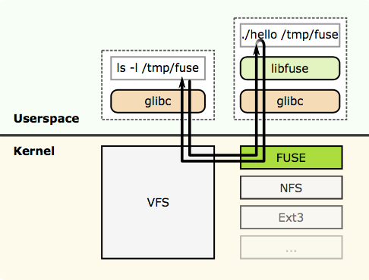
How it works
from Wikipedia
./hello is mounted on /tmp/fuse
All the operations on /tmp/fuse and its files can be handled by user level code.

Slide 10
Setup
Ubuntu in the labs or on your own machine
Virtual machines, macOS or Windows Subsystem for Linux version 2
Ubuntu 18.04 image has been made available at FlexIT (flexit.auckland.ac.nz)
Sign in to SSO which will take you to the sign-in page for FlexIT
Look for the Ubuntu 18.04 desktop icon
The Markers will use Ubuntu in the labs

Slide 11
Setup
Download fuse.py, memory.py and passthrough.py from the A2 files section on Canvas
fuse.py is from
https://github.com/fusepy/fusepy/blob/master/fuse.py
memory.py is from
https://github.com/fusepy/fusepy/blob/master/examples/memory.py
passthrough.py is from
https://github.com/skorokithakis/python-fuse-sample
You can also get examples from the github site at
https://github.com/fusepy/fusepy/tree/master/examples

Slide 12
OMG Python
Much (much) simpler to do this assignment in Python
If you don’t know how to do something in
Ask one of the tutors/lecturers for help
Forum: feel free to ask on Piazza or Canvas
Python documentation: https://docs.python.org/3.6/
StackOverflow, Google
The standard python 2 or 3.6 on Ubuntu works

Slide 13
passthrough.py
Neatly enapsulates the methods you may need to override (not all of them)
Two types of methods
filesystem methods which deal with directories and files
file methods which deal with the contents of files

Slide 14
Logging
There is some python magic which logs information to the screen as the file system works.
class LoggingMixIn:
log = logging.getLogger('A2')
def __call__(self, op, path, *args):
self.log.debug('-> path:%s %s%s', path, op, repr(args))
ret = '[Unhandled Exception]'
try:
ret = getattr(self, op)(path, *args)
return ret
except OSError as e:
ret = str(e)
raise

Slide 15
Part1
Setup
Put fuse.py, passthrough.py and a2fuse1.py in the same directory
Create a directory called "source”
Download files "one", "two", and ”three" from Canvas
Create a directory called "mount"
Run "python a2fuse1.py source mount"
Observe logs and highlight the main functionality, for example
To stop
"fusermount -u mount" (Ubuntu) or umount mount" (macOS)
DEBUG:fuse.log-mixin:-> getattr /newfile (None,)
DEBUG:fuse.log-mixin:<- getattr {'st_atime': 1599037397.463398, 'st_ctime':
1599037379.543504, 'st_gid': 20, 'st_mode': 33188, 'st_mtime':
1599037379.543504, 'st_nlink': 1, 'st_size': 12, 'st_uid': 501}
Gets attributes for "newfile".

Slide 16
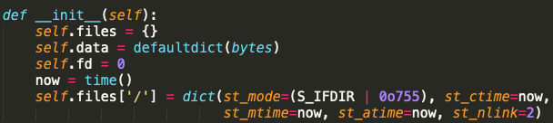
Part2
In the Memory class, explain what each method does
__init__, getattr, readdir, open, create, unlink, write, read
Example: __init__
Creates an empty dictionary self.files for the files, using the path names as the keys. Each value in the dictionary will be another dictionary.
self.data is a dictionary for the files’ data. The path names are the keys, the values are the data of that file.
Sets the starting value for the file descriptors, these are going to be used as unique file identifiers.
Grabs the current time and sets the file attributes for the root of this file system. It is a directory, with creation, modified and accessed times set to now. It has two links.

Slide 17
Part3 – Requirement 1
Setup
Create two directories, source1 and source2
Create file one in source1
Create file two in source2
Make sure that mount is initially empty
Enable your FUSE to mount two source directories into a mount point
Override the “_full_path“ method to add logic to return multiple source directories
Override the “readdir” function to add logic s.t.
“ls” command in your mount can list the content of both source1 and source2
Override the “main” method because we need an extra parameter
Run “python a2fuse2.py source1 source2 mount”

Slide 18
Part3 – Requirement 2
Override the File methods to create a totally cached file system
When a file is opened read all of the contents into memory
Any reads are extracted directly from memory with no disk access
Any writes go to memory
When the file is closed the changes get written to disk

Slide 19
Submission
Canvas submission system to submit your assignment
Zip together A2.txt and a2fuse2.py
Extra marks
1 mark for including your name and login in both files
1 mark for any files created by the file system having the correct user and group ids
Contact Info
Lecturer (Meng-Fen): meng.chiang@auckland.ac.nz
Tutor (Timo): tvan508@aucklanduni.ac.nz
Tutor (Luman): lwan353@aucklanduni.ac.nz

