Slide 1
Travis CI
Lab-7
何启凡
10184304123

Slide 2
GitHub repo
https://github.com/AidenHe2000/Travis_CI_Tutorial

Slide 3
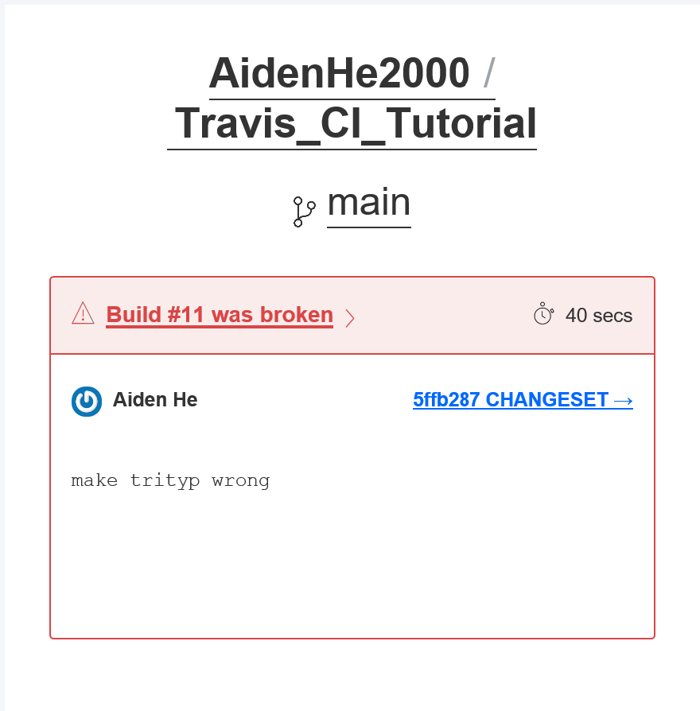
Email screenshot

