Slide 1
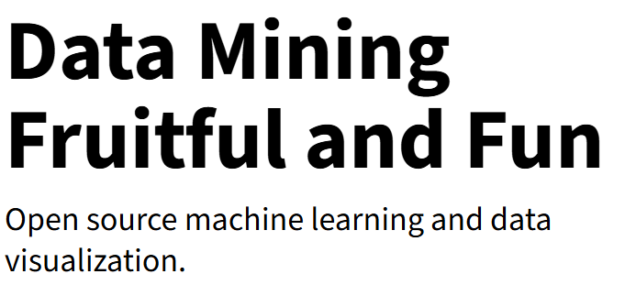
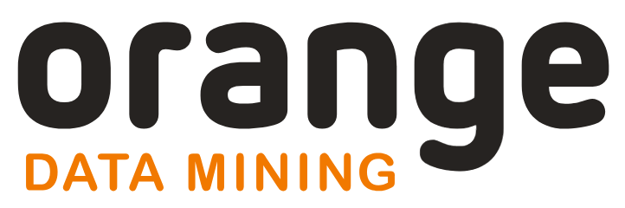
Simple AI Methods for Demetia: Orange
Samuel Maddox, School of Computing Sciences
https://orangedatamining.com/

Slide 2
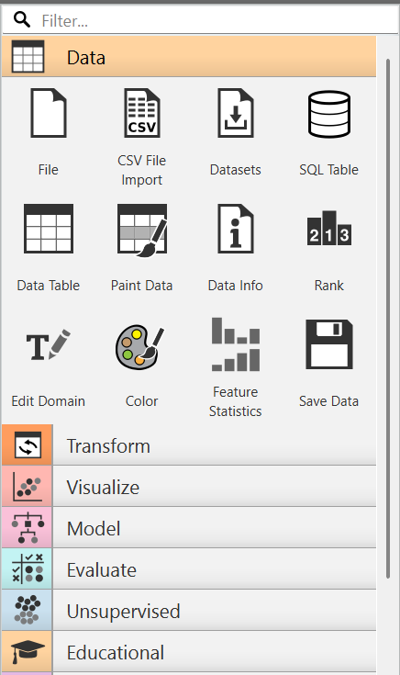
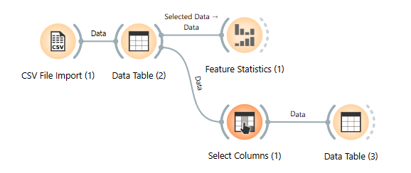
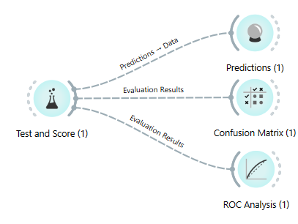
Orange: A Tool for Visual Data Science
Open-source, easy installation
Drag-and-drop widgets
Enables AI without coding

Slide 3
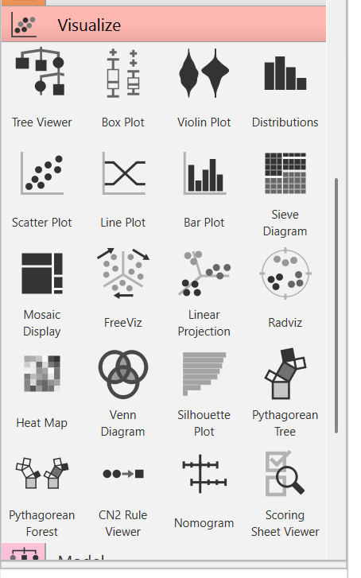
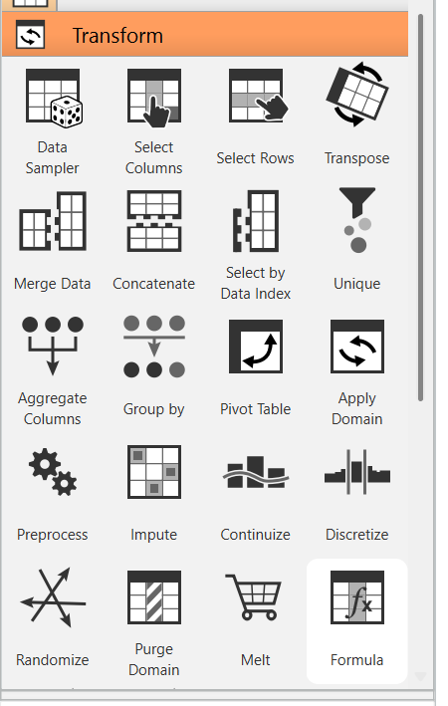
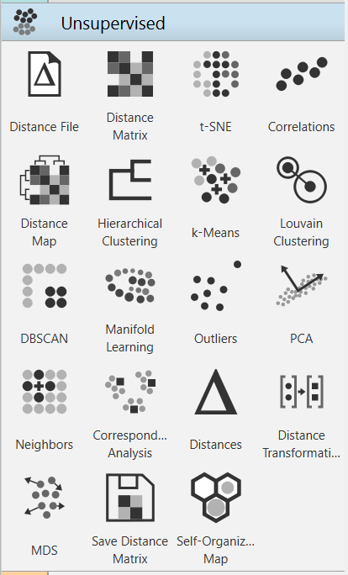
Capabilities for Healthcare Data Analysis
Easy data loading & preparation
Interactive data exploration
Essential data analysis tools

Slide 4
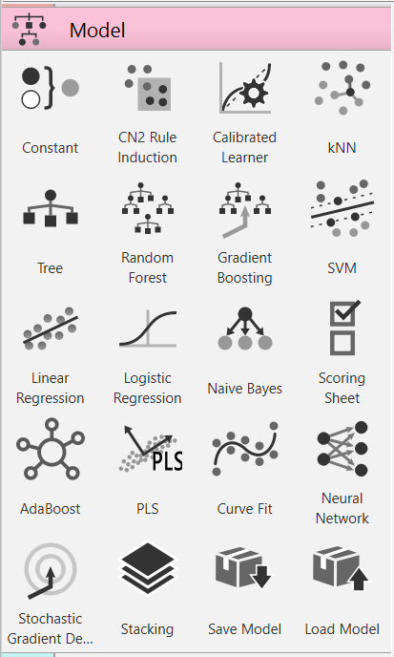
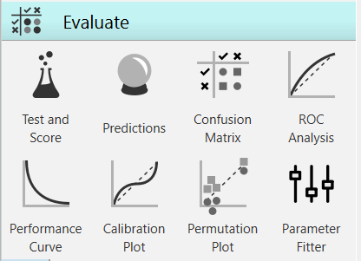
Applying Machine Learning Techniques
Access ML algorithms visually
Build predictive models easily
Train, test, and evaluate

Slide 5
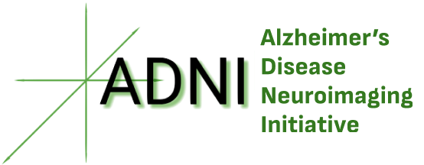
Case Study: ADNI Group Classification
Applying Orange to ADNI data
Goal: Classify patient groups
Explore various model performance metrics

Slide 6
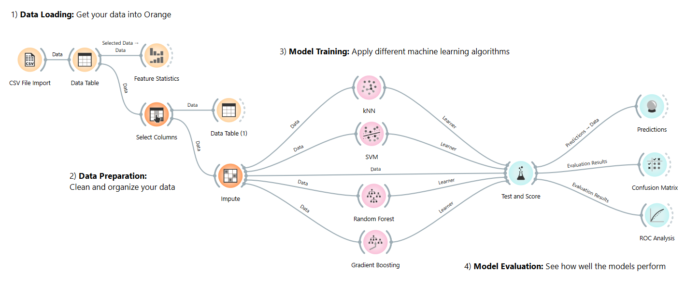
ADNI Workflow in Orange
Connect widgets to build the analysis pipeline

Slide 7
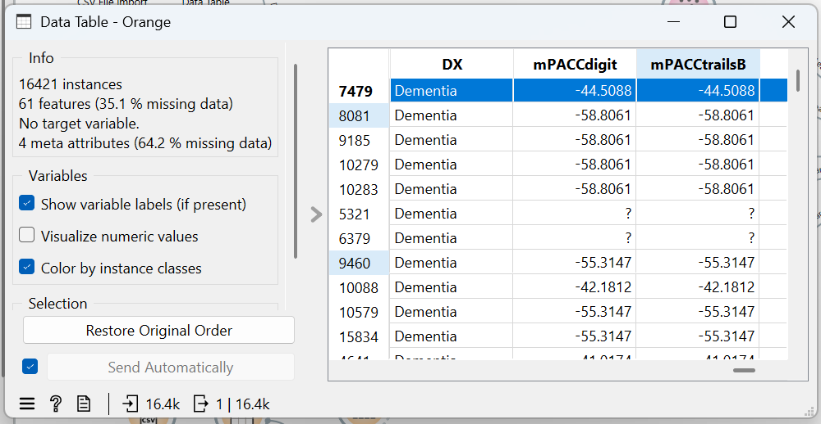
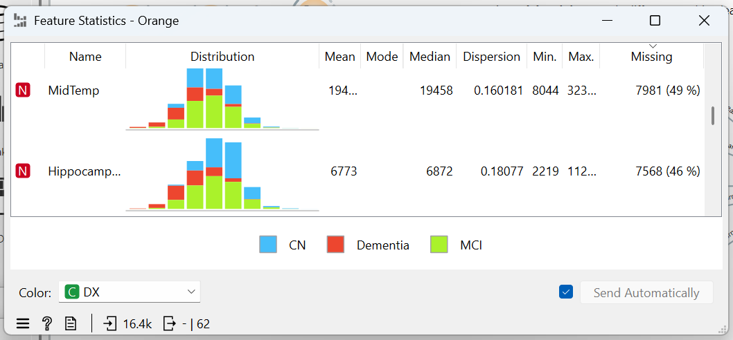
ADNI Workflow in Orange
1 – Data Loading:

Slide 8
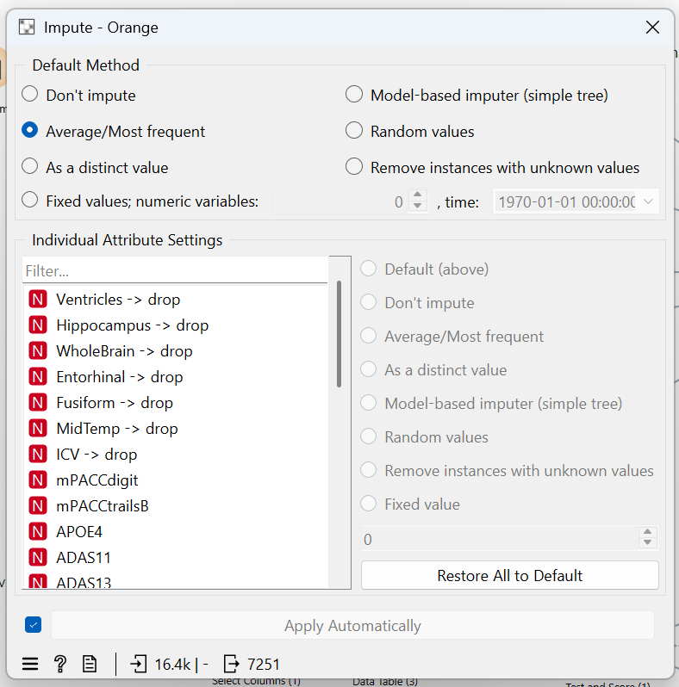
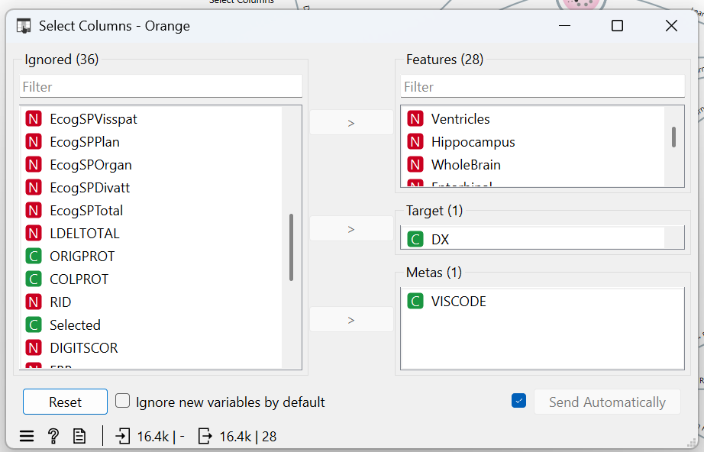
ADNI Workflow in Orange
2 – Data Preparation:

Slide 9
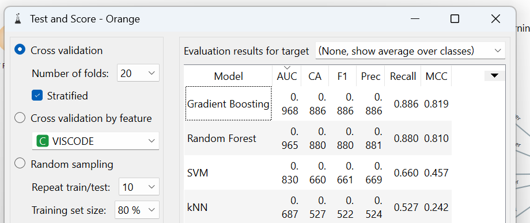
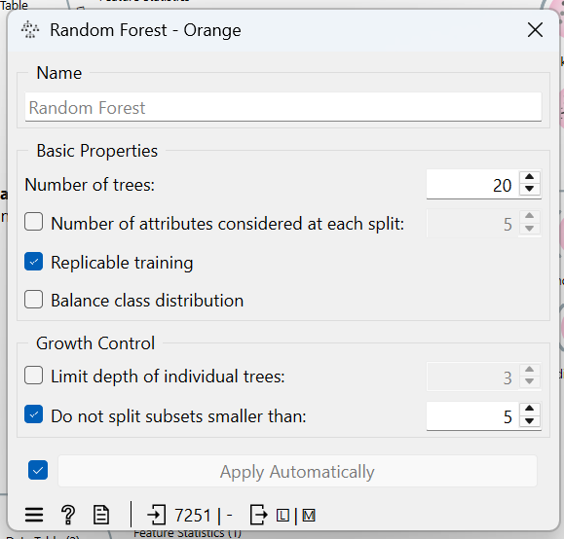
ADNI Workflow in Orange
3 – Model Training:

Slide 10
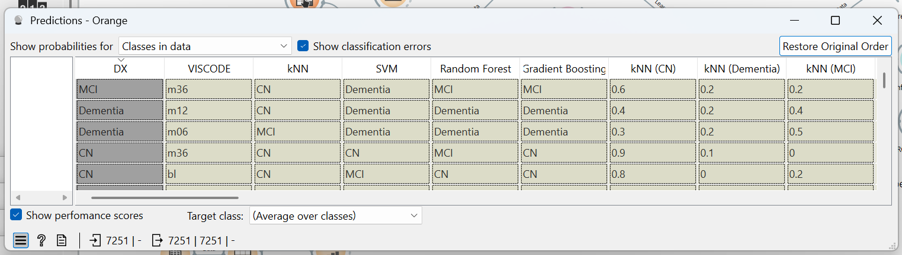
ADNI Workflow in Orange
4 – Model Evaluation:

Slide 11
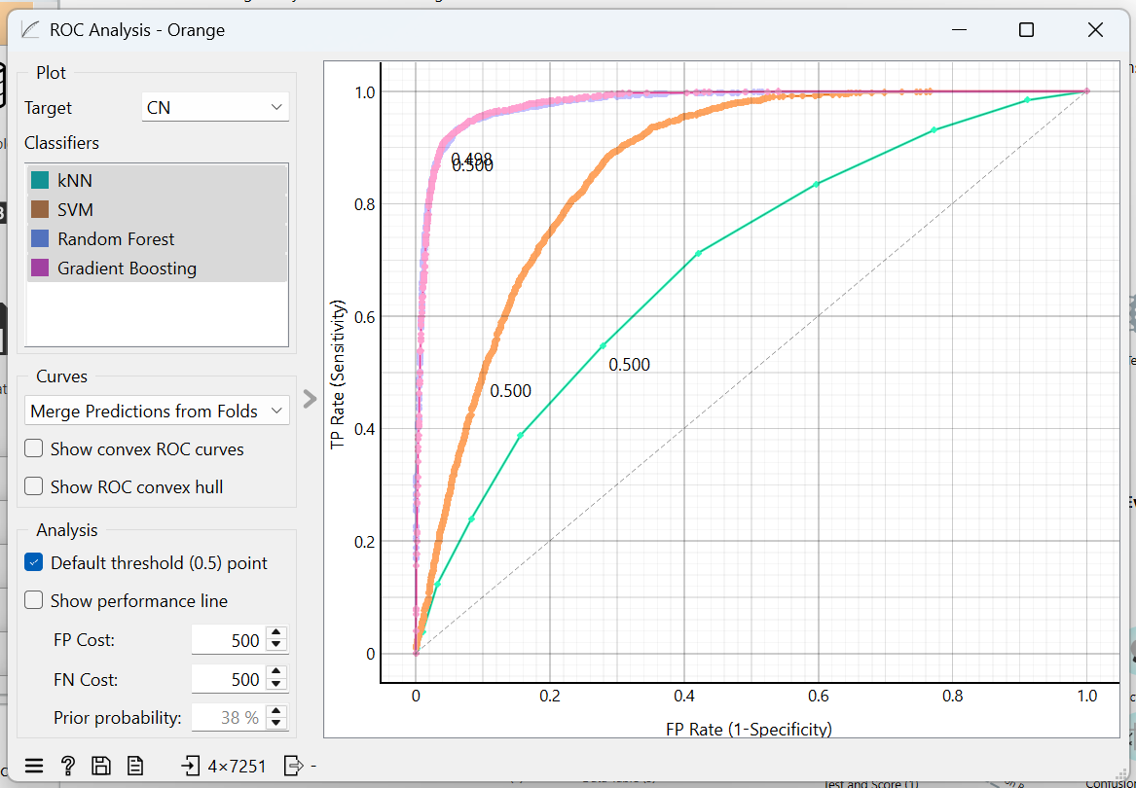
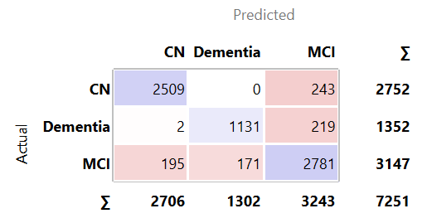
Model Performance and Interpretation
Visualize model performance

Slide 12
Try it Yourself!
Accessible AI without programming
Fast data exploration and model prototyping
Intuitive understanding via visual workflows
https://orangedatamining.com/
Try it out with our sample workflows and synthetic datasets!

