Slide 1

Green-Sense
R.A.D. Technologies
Ryan, Aiden, Daniel
https://github.com/Aidenbolos/Green-Sense

Slide 2
Work Distribution
Aiden:
- Name of Application
- Change home screen icon
- Min 2 resolutions for the home screen icon and other images
- Mock-ups
- 1 Java class
Ryan:
- Current Work Progress Report
- Project Plan
- Requirement Analysis
- Defining Tools Used
- Make sure app can be run on emulator and phone
- 1 Java class
Daniel:
- Sponsor meeting report
- Gantt Chart
- Design Documents
- Architecture Diagrams
1 Java class

Slide 3
Work Progress
Currently Completed:
Had first meeting with sponsor; Valeria from the Humber Greenhouse
Established a name and icon for the application
Multiple resolutions for the icon and other images used
Entry level mockups completed
Requirement Analysis completed
Defined current tools that have been used and/or tools that will be used
We have a minimum of 3 java classes started
The current version of the app runs on a device and an emulator
Completed report from the first meeting with the sponsor
We have a completed Project Plan and Gantt Chart
Completed Design documents and Architecture Diagrams

Slide 4
Project Plan
An application that can be run on an android smartphone that can update and grab a greenhouse systems sensor reading from a database where they are stored.
This app will also be able to display the current readings from the system in real time allowing the user to have current and up to date information about their greenhouse.
We will be adding features to allow users to manually control elements of the greenhouse from their smartphones having the changes take place in real time. These features consist of an irrigation system that is capable of adapting to different kinds of plant’s needs, a plant based feeding system that can supply different kinds of plants the appropriate amount of nutrients they need for growth, a system to allow the user to control a set of blinds or shades to reduce the amount of sunlight and heat entering the greenhouse if it is getting to hot inside for the plant and a system to control a fan to help with airflow inside the greenhouse that can be controlled manually or set to automatic based on other readings from sensors.
Some features that were brought up that were suggested to be added but not necessary were some sort of system that can cover plants completely for plants that need a certain amount of darkness for growing, a way to have the greenhouse adapt to the current weather systems from outside meaning that if it’s going to be windy to close the fans to reduce the amount of wind inside the greenhouse that could cause damage.
We have completed all required documentation and designs for the current milestone and have started to develop our backend for user authentication and holding of readings that will later be displayed on the applications interface.

Slide 5
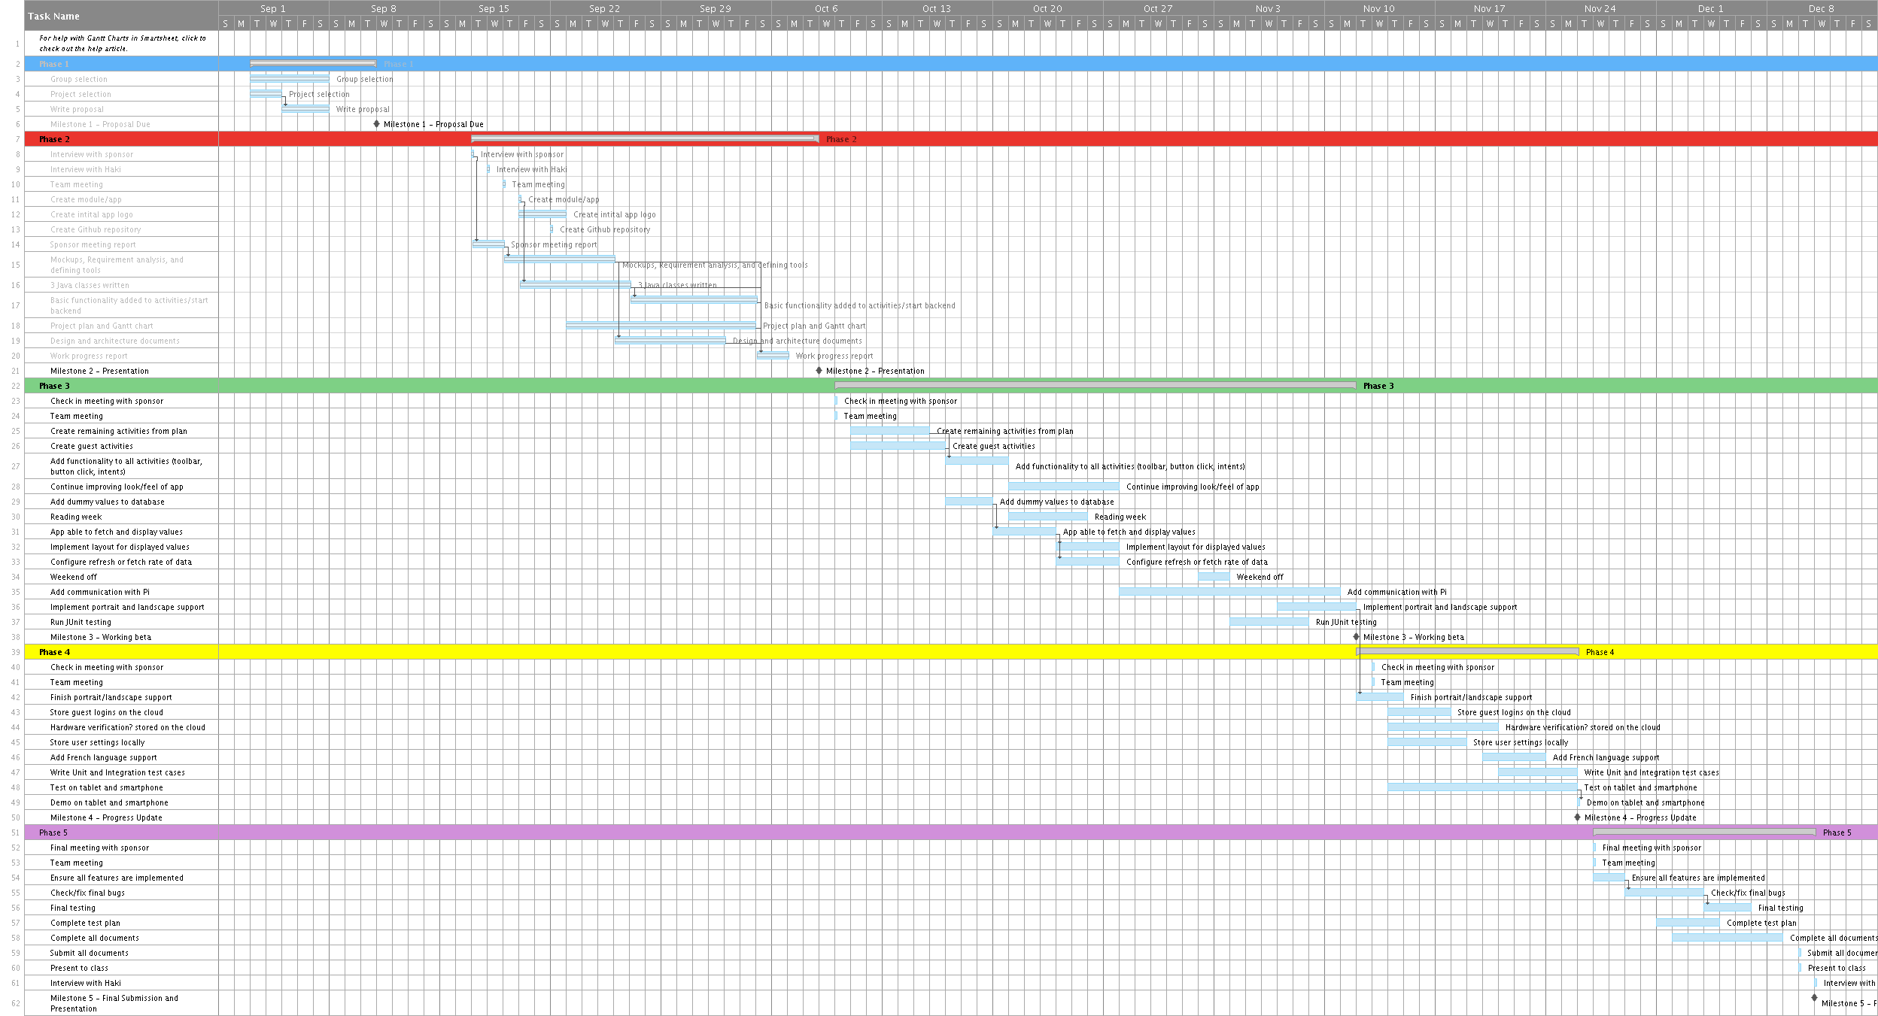
Gantt Chart

Slide 6
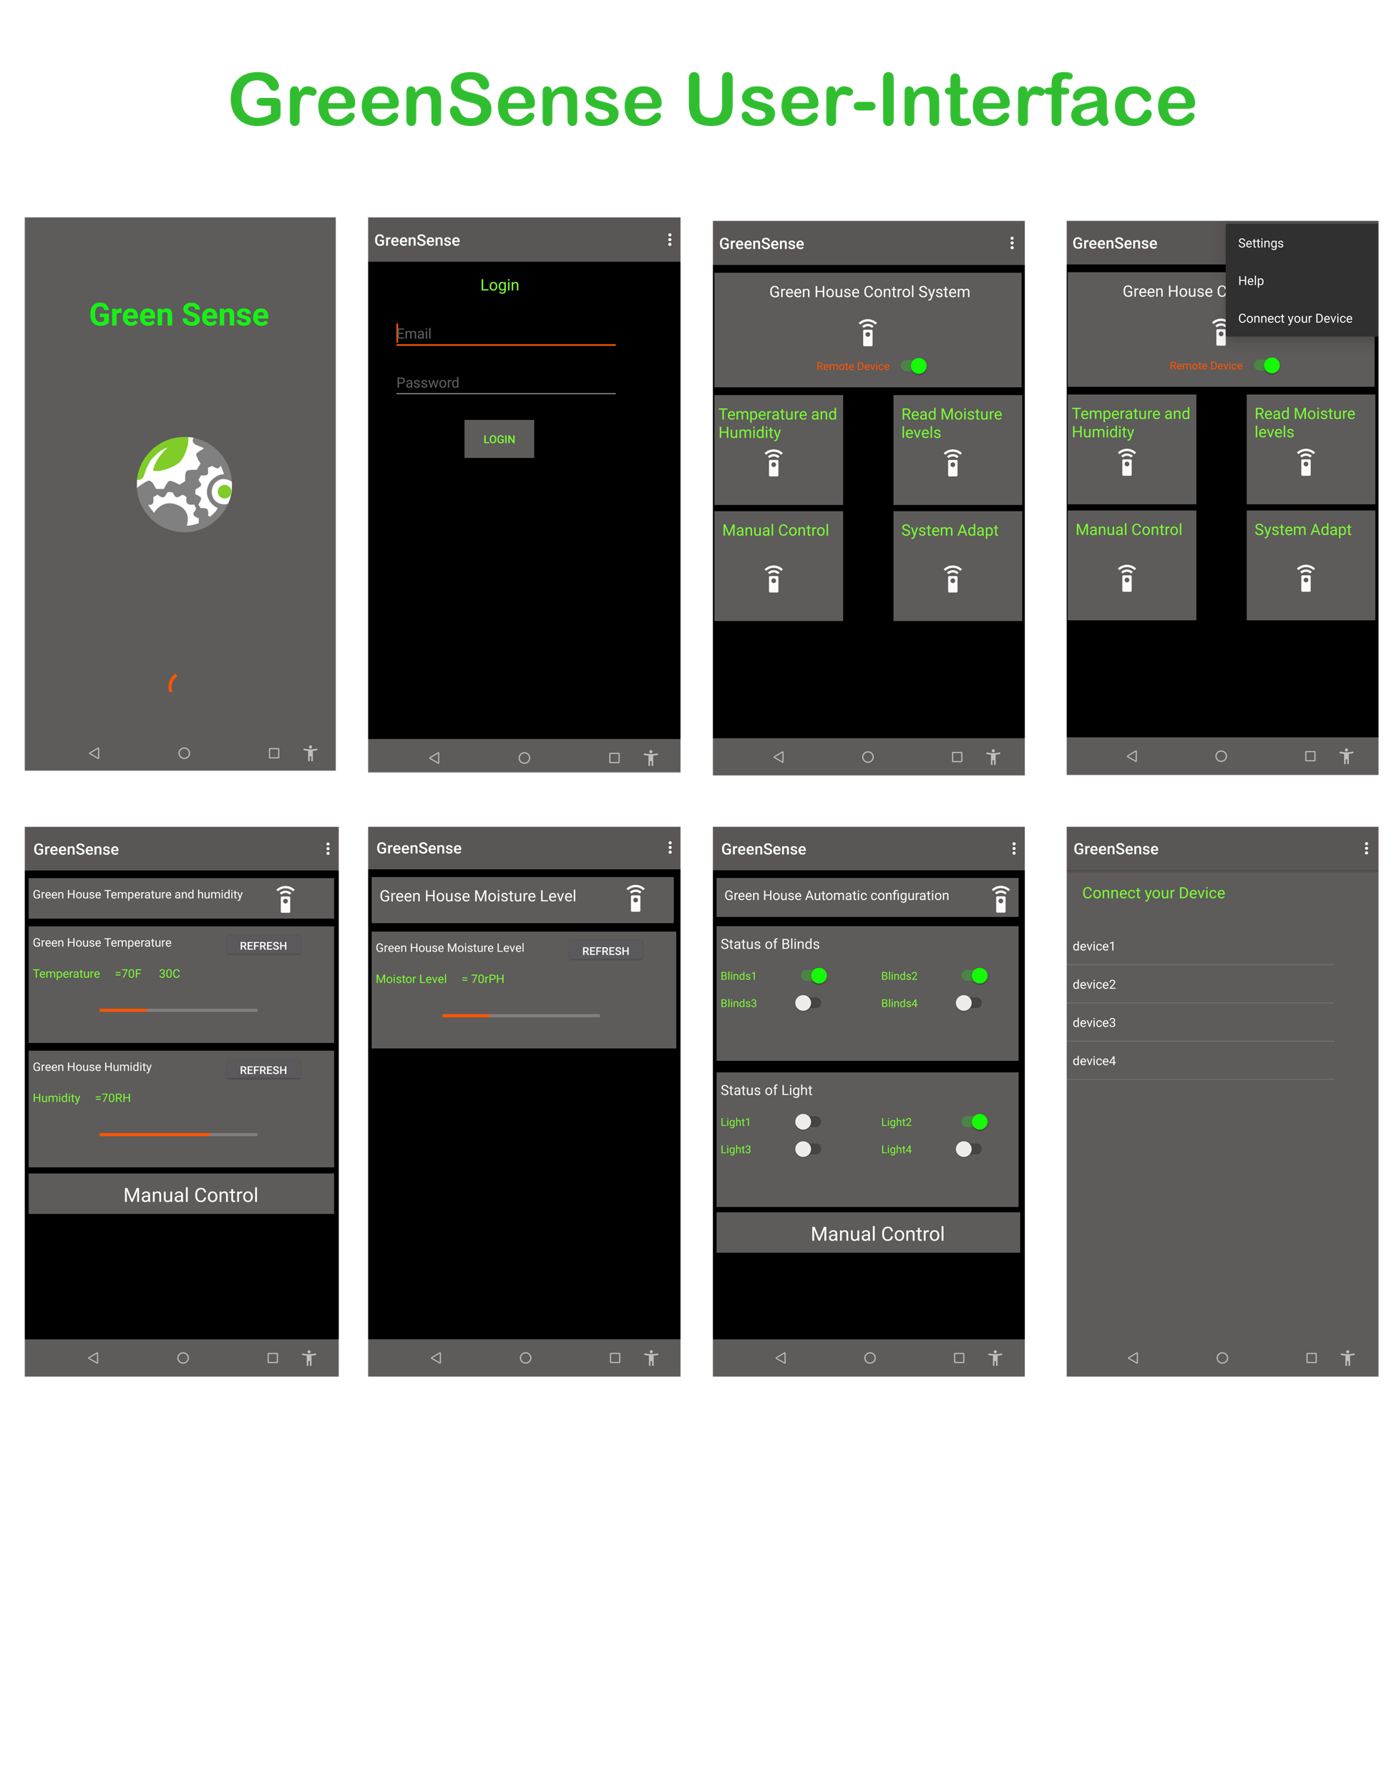
Mock-ups

Slide 7
Requirement Analysis
Monitor temperature and humidity levels from inside the greenhouse
Display the temperature and humidity levels in real time
Read moisture levels from the soil in which the plants are growing in
Display moisture levels along with if the soil needs to be watered or not
Some sort of irrigation system that can be utilized by more than one type of plant
Being able to control the irrigation from the app (i.e. manually starting or stopping the pump)
Being able to make use of ventilation and blinds to regulate temperature levels along with humidity levels from within the app
Manual control for blinds and vents to open or close when needed
Some sort of way to feed the plants the required amount of nutrients
Mostly automated
Very user-friendly interface along with user-friendly functionality
A way to have the system adapt to the current outside weather (i.e. close blinds if it’s too sunny, close vents if it’s too windy, etc.)

Slide 8
Tools Used
Microsoft Word; to write and format documents
Microsoft Power Point; to create presentations
Android Studio; to develop our application
GitHub; used for hosting our files and allowing all group members to upload their work to the same place
WhatsApp; to communicate within the group and share ideas
Firebase; will be used to store data from the hardware
Gantt Project; used to make our Gantt chart
ArgoUML; to create or design architecture
Photoshop CS6; used for the logo design

Slide 9
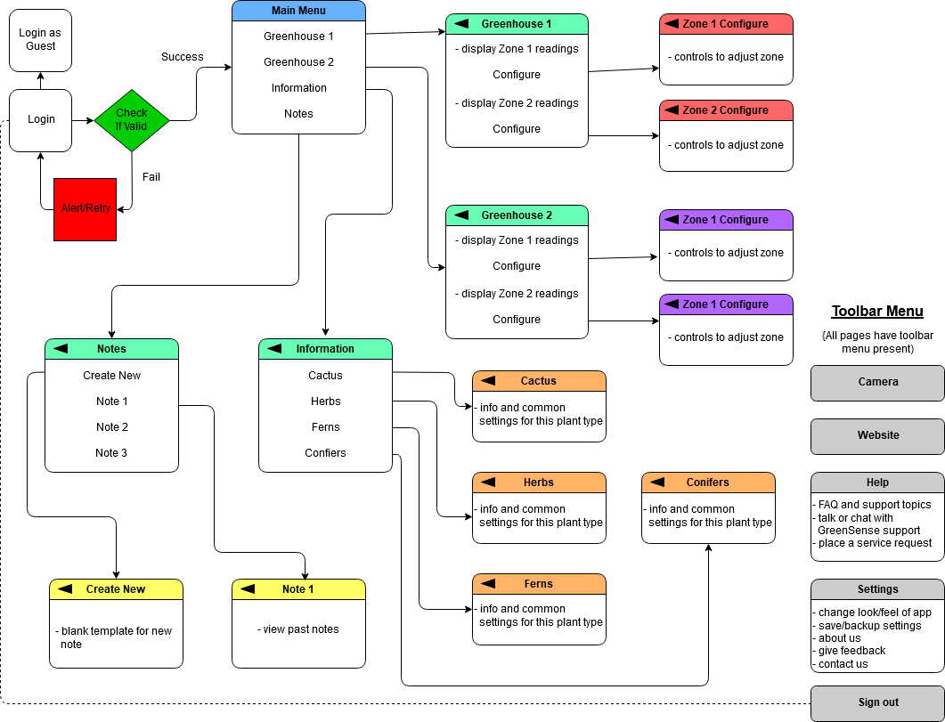
Design Documents (Employee Flow)

Slide 10
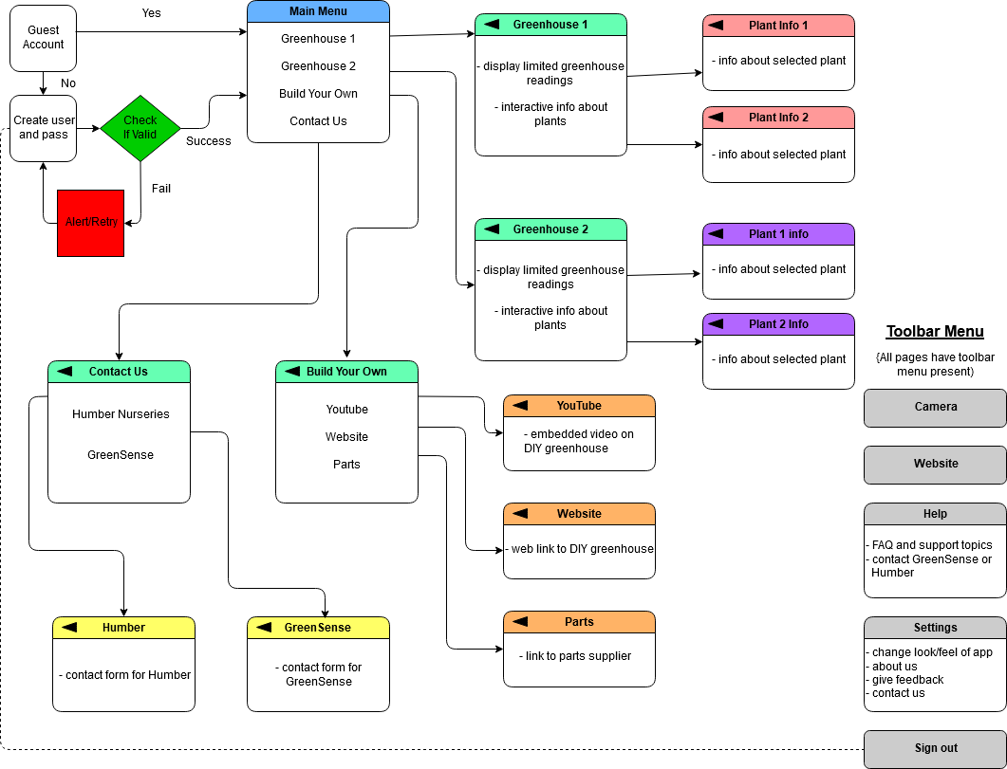
Design Documents (Guest Flow)

Slide 11
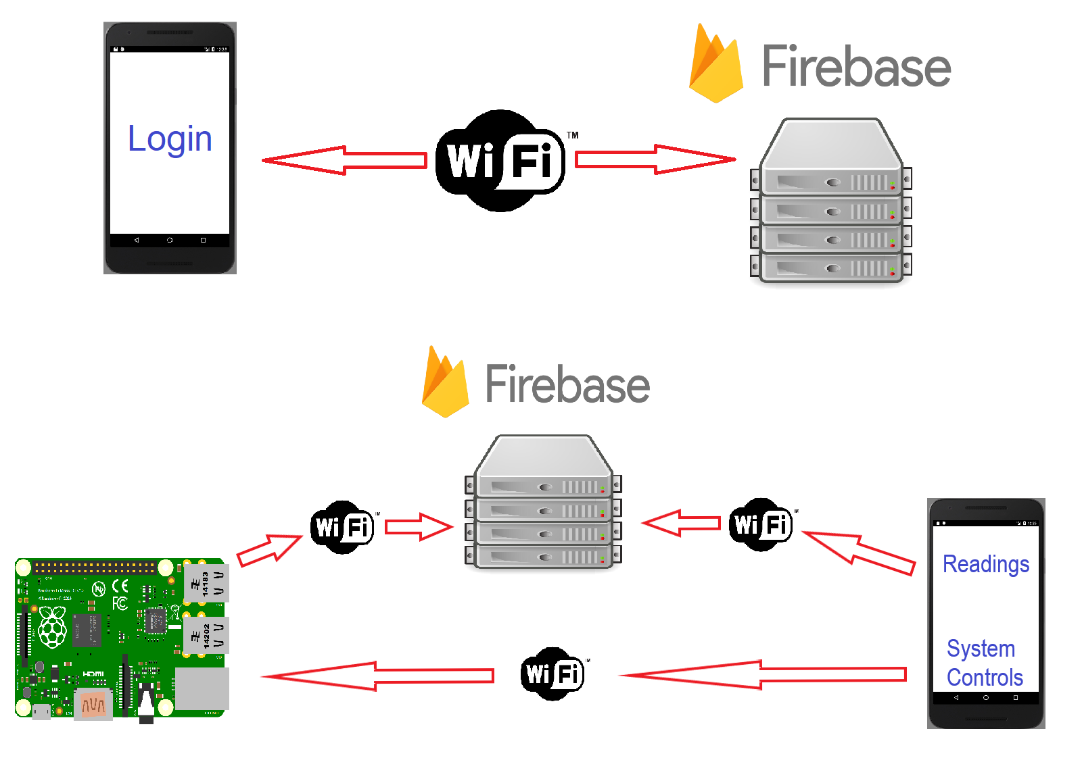
Architecture Diagrams

Slide 12
Sponsor Meeting / Meeting Minutes
- Valeria: system currently installed by a company called Argus Controls
- System consists of sensors/effectors, control panels, power panels, and connects to Argus servers. It can then be accessed/controlled locally from the client PC or remotely by Argus.
- Sensors monitor temperature, humidity, soil moisture, gas levels (CO and CO2), and a weather station monitors light, temperature, wind, rain/snow outdoors.
- Effectors include air vents/fans, a mister, roof shades/curtains, evaporative cooling/heating pipes, and an irrigation system (not enabled).
- The system monitors all the sensors and uses the effectors to control the environment in the greenhouse.
- System is mostly managed remotely by Argus, Valeria rarely uses it/adjusts it.
- Valeria may not be the primary user of our app as she doesn’t have a smartphone, but she is very knowledgeable about the greenhouse and its control systems.
- Strengths of the current system: the UV curtains, air vents/fans, the cooling/heating pipes, and that Argus controls it remotely for her.
- Current system lacking: a functional irrigation system, nutrient/seeding system, different “zones” for different types of plants, and adjustable shade/lighting for certain plants.
- Won’t be able to implement all this semester, worth considering these features for CENG 355.
- Valeria loans us the Argus installation/control manual. We will read through this to better understand the current system, see what is effective/well done, and what can be improved on.
To expand on lacking features:
- the current irrigation system is not “modular”, it can’t adjust to different size plants/pots or different watering needs.
- they did not purchase the nutrient delivery system, but she says it could be very useful.
- it would be good to split the greenhouse into different “zones” based on plant’s needs for water, light, temperature, humidity, etc (ie. a cactus has different needs than a tomato plant).
- have different “zones” for lighting, which would also be adjustable based on plant’s needs (ie. sometimes a plant requires complete shade/darkness, another needs almost full sunlight).
- curtains could be made more durable as they tear over time.

