Slide 1



eCommerce Website
By Amitabh Kumar
Date: April 29, 2020

Slide 2

Agenda
Introduction & target audience
Current problems
Solving problems
eCommerce Process Flow
Architecture (MVC)
Languages & Tools
Demonstration
Questions ?

Slide 3

Introduction & target audience
Introduction
E-Commerce is a process of buying, selling, transferring, or exchanging products, services, and/or information online
E-Commerce website is a platform to enable E-Commerce
Target Audience
Buyers - someone with money who want to buy goods or services.
Sellers – someone who offer goods and services to buyers.

Slide 4

Problem
Organizations:
High cost of entry and operating cost is high
Reach limited to a locality
Unable to provide efficient service
Customers:
Long waiting time
Noisy,crowded and narrow waiting environment

Slide 5
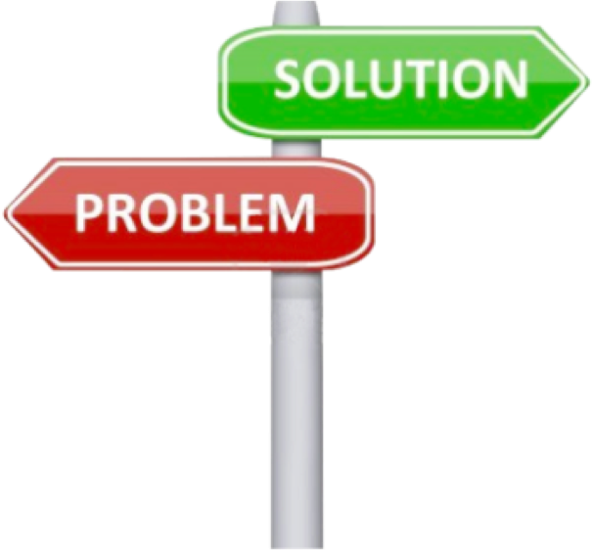
Solution
To Organisations
Global reach
Cost reduction and low cost of entry
24/7 access
To Customers
A variety of products and services to choose from
Cheaper products and services
Information availability
No privacy

Slide 6
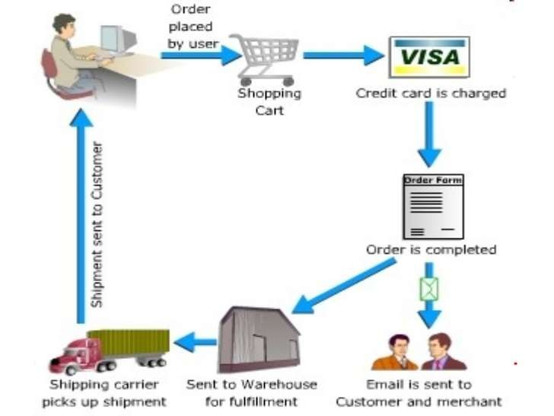
eCommerce Process Flow

Slide 7


Three-tier Architecture (MVC)
View
API
Client Side
REACT
Server Side
NodeJS
Database
MongoDB

Slide 8
Languages & Tools
Node JS API (Backend),
React JS (Frontend)
& powered byMongoDB database.
Braintree Payment Processing,
JWT Authentication,
Digital Ocean's Cloud Servers,
Cloudflare CDN for speed and SSL for security,
Custom Domain name from Godaddy.com.

Slide 9

Demo

Slide 10

Are there any questions?

