Slide 1
MASTER'S THESIS PROPOSAL • SECOND DRAFT (REVISED WORKING PROPOSAL)
EduAnalytics-KG:
A 20-Year Spatio-Temporal Machine Learning and Econometric Framework for Analyzing Regional Disparities in Kyrgyzstan's National Standardized Testing (ORT 2006–2025)
CANDIDATES / AUTHORS
Aidin Turdukulov
Argen Kulzhanov
M.Sc. in Data Science Candidates
Department of Computer Science & Data Science
RESEARCH SUPERVISION & STANDARD
Thesis Adviser: Dr. Research Supervisor
Formatted according to Dr. Remudin Reshid Mekuria's
Master's Thesis Proposal Standard (March 2021 Syllabus)
Bishkek, Kyrgyz Republic • October 2026

Slide 2
CHAPTER I: INTRODUCTION
02 / 10
Research Motivation & Empirical Problem Context
The 20-Year Legacy of National Standardized Testing (ORT 2002–2026)
The High-Stakes Nature of ORT
• Established in 2002: Created as a transparent anti-corruption reform to replace subjective university entrance exams with independent Item Response Theory (IRT) assessment.
• University Gatekeeper: Achieving the mandatory 110-point threshold (on a 245-point scale) is statutorily required for university matriculation across Kyrgyzstan.
• Scholarship Allocation: Top examinees compete for ~5,000 full-tuition state scholarships (бюджетные гранты), determining socioeconomic mobility for ~1 million applicants over 20 years.
• Three-Tiered Affirmative Action: Statutory quota categorizes candidates: (1) Bishkek; (2) Regional centers/small towns; (3) Rural & high-altitude schools to protect disadvantaged students.
Persistent Spatial Disparity & Policy Blindspot
• The Capital vs. Periphery Gap: Despite 20 years of quotas, Bishkek schools consistently average >133 points, while peripheral rural districts (Batken, Naryn, mountainous Osh) hover near 110 points.
• 50% Pass Rate Failure: In remote districts, less than 50% of high school seniors reach the baseline threshold, locking rural youth out of accredited higher education.
• Retrospective Reporting Trap: CEAMO and MOES publish isolated annual PDF summaries. No longitudinal panel exists to evaluate systemic capital investments over time.
• Lack of Predictive Modeling: Resource allocation operates reactively without quantitative modeling of teacher shortages, pupil-teacher ratios, or counterfactual policy simulations.
EduAnalytics-KG: 20-Year Spatio-Temporal Analysis of National Testing (ORT 2006–2025) | Master's Thesis Proposal (Second Draft)

Slide 3
CHAPTER I: SCOPE & AIMS
03 / 10
Research Questions & Primary Hypotheses
Bridging Empirical Economics and Machine Learning for Educational Equity
THREE CENTRAL RESEARCH QUESTIONS (RQs)
RQ1 (Spatial Inequality & Convergence): How have regional and rural-urban score gaps evolved across Kyrgyzstan's 52 districts over the 2006–2025 period? Does empirical evidence indicate long-term convergence or persistent structural divergence?
RQ2 (Predictive Determinants & Non-Linearities): What are the marginal elasticities of pedagogical resources (pupil-teacher ratios, teacher credentials) and socioeconomic context (poverty, nominal wages) on standardized test outcomes?
RQ3 (Model Generalization & Counterfactual Policy): Can regularized gradient boosting and explainable AI generalize across temporal horizons and spatial macrozones (North vs. South) to support reliable 'What-If' fiscal policy simulations?
THREE FORMAL RESEARCH HYPOTHESES (H1 – H3)
Hypothesis 1 (H1 — Overcrowding Tipping Point): Classroom congestion exhibits a critical non-linear threshold beyond 18:1 pupil-teacher ratio, above which mean scores degrade at an accelerating rate due to instructional degradation.
Hypothesis 2 (H2 — Infrastructure vs. Salary Elasticity): In remote mountainous perimeters, structural investments in teacher qualification accreditation and classroom decongestion yield significantly higher marginal score gains than unconditioned nominal wage subsidies.
Hypothesis 3 (H3 — Endogenous Spatial Autocorrelation): District-level test outcomes exhibit significant spatial autocorrelation (rho > 0), necessitating spatial autoregressive (SAR) controls to account for regional spillover effects and labor mobility.
EduAnalytics-KG: 20-Year Spatio-Temporal Analysis of National Testing (ORT 2006–2025) | Master's Thesis Proposal (Second Draft)

Slide 4
CHAPTER II: LITERATURE REVIEW
04 / 10
Theoretical Foundations & Global Literature Synthesis
Grounding EduAnalytics-KG within Educational Economics and Data Mining
1. Theoretical Model
Educational Production Function
Coleman (1966) & Hanushek (1979)
Y_it = f(F_it, S_it, P_it, C_it)
• F (Family SES): Household wealth, parental capital, poverty headcount.
• S (School Inputs): Pupil-teacher ratio, instructor tertiary degrees, facilities.
• P (Peer Effects): Cohort candidate density, regional competitive culture.
• C (Community/Spatial): High-altitude isolation, urbanization, road connectivity.
• Debate in Literature: Hanushek vs. Card-Krueger & Chetty (2014) on school resource elasticities in transition states.
2. Global Testing Benchmarks
International Precedents in EDM
Big Data in National Exams
• ENEM (Brazil): Marteleto et al. (2016) used Random Forests & XGBoost on millions of records, confirming extreme municipal stratification.
• Saber 11 (Colombia): Saenz et al. (2020) demonstrated GBDT superiority over OLS in capturing multi-way conflict and poverty interactions.
• SAT/ACT (USA): Chetty et al. (2014) evaluated long-term returns to class decongestion and teacher value-added.
• PISA (OECD): Central Asian scores lag OECD medians by >1.5 standard deviations, demonstrating acute rural-urban literacy divides.
3. Addressed Gaps
How EduAnalytics-KG
Transforms Central Asian Research
• Gap 1 (Time Scale): Prior studies rely on 1-year surveys (N < 500). We build the first unbroken 20-year census panel (2006–2025, N=889).
• Gap 2 (Spatial Rigor): Prior work ignores spatial dependency. We implement Spatial Autoregressive (SAR) contiguity models.
• Gap 3 (Non-Linearity): Moves beyond linear OLS to regularized CatBoost GBDT and TreeSHAP threshold discovery.
• Gap 4 (Actionable Policy): Bridges academic econometrics with a counterfactual Decision Support System (DSS).
EduAnalytics-KG: 20-Year Spatio-Temporal Analysis of National Testing (ORT 2006–2025) | Master's Thesis Proposal (Second Draft)

Slide 5
CHAPTER III: DATA ENGINEERING
05 / 10
20-Year Census Panel Reconstruction (2006–2025)
Rebuilding the First Balanced Longitudinal Panel of Standardized Testing in Central Asia
20 YEARS
Unbroken Census (2006–2025)
52 DISTRICTS
40 Rayons + 4 Bishkek + 8 Cities
N = 889
Territory-Year Observations
> 900,000
Historical Candidate Records
100% BALANCED
Fully Reconciled Panel
1. Technical Ingestion Pipeline
• PDF Ingestion & Extraction: Extracted tabular data from 20 annual CEAMO PDF analytical reports (>120 pages each) using pdfplumber and automated table structure extraction.
• Custom Glyph-Shift Algorithm: Resolved non-standard historical Cyrillic font encoding corruptions in 2007, 2010, and 2012 reports via algorithmic byte shifting: c_decoded = Phi(ByteVal(c) - delta_glyph), delta in {378, 17}.
• Territorial Reconciliation: Harmonized changing rayon boundaries, renaming of administrative centers, and split municipalities using the State Classifier of Administrative-Territorial Units (SOATO).
• Strict Verification: Reconciled extracted regional candidate totals against official republican totals; verified 100% arithmetic balance across all 20 years.
2. Feature Matrix Harmonization
• Target Performance Metrics (Y): Mean district test score on mandatory section [80–245], percentage of examinees exceeding 110-point pass cutoff, count of state grant scholarship recipients.
• Pedagogical Features (X): Pupil-Teacher Ratio (PTR), share of instructional staff holding university degrees (higher education %), total enrolled candidate volume.
• Socioeconomic Context (X): District poverty headcount rate (%), average nominal monthly salary (KGS), territorial industrial output volume from NatStatCom official yearbooks.
• Spatial Topography Flags (X): High-altitude / remote territory statutory flag (>=1800m), rural population share (%), oblast classification (ADM1), and border vulnerability index.
EduAnalytics-KG: 20-Year Spatio-Temporal Analysis of National Testing (ORT 2006–2025) | Master's Thesis Proposal (Second Draft)

Slide 6
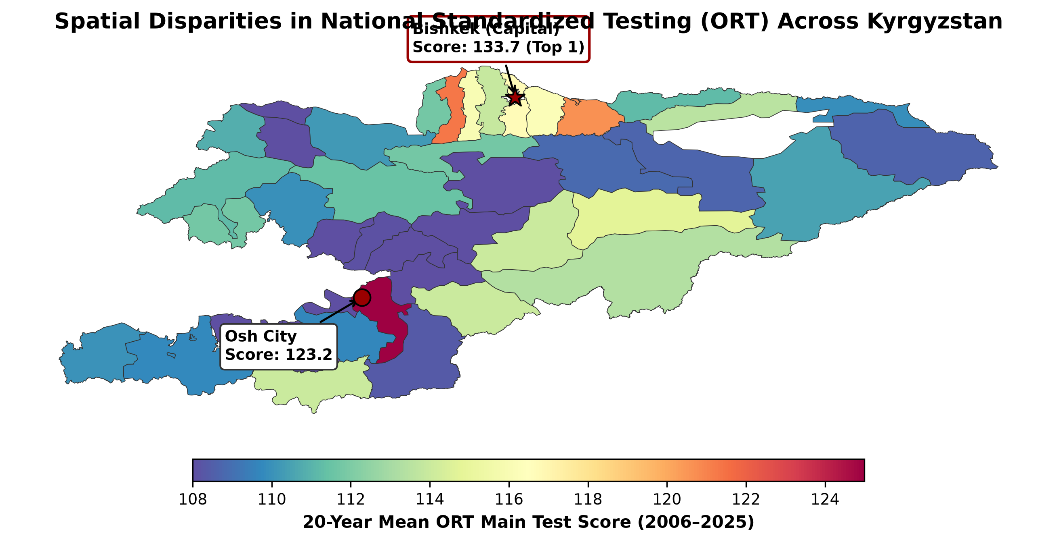
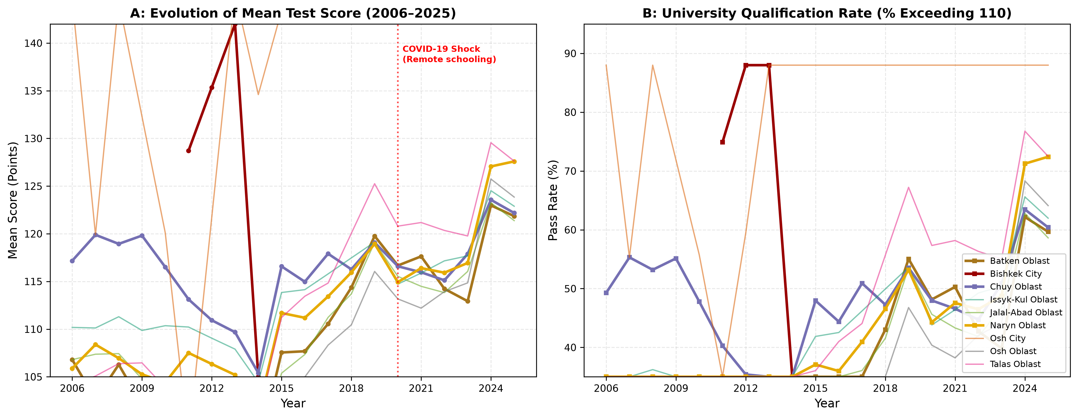
CHAPTER III: DESCRIPTIVE FINDINGS
06 / 10
Exploratory Data Analysis: Persistent Spatial Disparities
Visualizing 20 Years of Educational Stratification and Longitudinal Trends
20-Year Panel Summary (N = 889)
Official National Census Metrics (2006–2025)
Metric Name | Mean | Range
Mean Test Score | 116.4 | 98.4 – 142.1
Pass Rate (>110 pts) | 54.2% | 21.8% – 88.6%
Pupil-Teacher Ratio | 16.8 | 9.2 – 26.4
Teachers w/ Degree | 86.4% | 68.1% – 98.4%
Poverty Rate | 28.4% | 8.2% – 62.4%
Avg Monthly Wage | 12,450 KGS | 1.8k – 48.2k KGS
Key Empirical Takeaway:
Bishkek averages 133.7 points while peripheral mountain rayons average 108–112 points. Over 20 years, this gap has remained stubbornly constant (+/- 2.4 points), indicating that quotas without structural capital reform do not generate regional convergence.
EduAnalytics-KG: 20-Year Spatio-Temporal Analysis of National Testing (ORT 2006–2025) | Master's Thesis Proposal (Second Draft)

Slide 7
CHAPTER III: METHODOLOGY
07 / 10
Dual Econometric and Machine Learning Methodology
Combining Two-Way Fixed Effects, Spatial Econometrics, and Gradient Boosting
Branch 1: Panel Econometrics
Identification of Causal Elasticities & Spatial Lags
Two-Way Fixed Effects (TWFE) Model:
Y_it = alpha_i + lambda_t + X_it' beta + epsilon_it
• District Fixed Effects (alpha_i): Absorbs unobserved time-invariant spatial confounders (geographic ruggedness, historical school density, cultural capital).
• Year Fixed Effects (lambda_t): Controls for macro shocks (annual test difficulty changes, inflation, COVID-19 disruption in 2020).
• Spatial Autoregressive (SAR) Model: Y_it = rho W Y_it + X_it' beta + alpha_i + lambda_t + epsilon_it. Uses a row-standardized contiguity matrix W to estimate spatial spillovers.
• Clustered Standard Errors: Standard errors clustered at the district level to correct for arbitrary within-district serial correlation.
Branch 2: Supervised CatBoost GBDT
Capturing High-Dimensional Non-Linear Interactions
Out-of-Time Temporal Hold-Out Protocol:
Train: 2006–2021 (N=709) | Test: 2022–2025 (N=180)
• Regularized Tree Ensembles: CatBoost builds symmetric oblivious decision trees, natively managing categorical oblast identifiers without target leakage.
• Loss Optimization: Minimizes robust Huber loss with L2 regularization on leaf weights to guard against regional outlier shocks.
• Cross-Validation: Spatial Block CV prevents geographic data leakage between adjacent districts within the same administrative cluster.
• Pilot Accuracy: CatBoost achieves MAE = 3.04 points (R^2 = 0.74), significantly outperforming standard OLS (MAE = 4.82, R^2 = 0.51).
EduAnalytics-KG: 20-Year Spatio-Temporal Analysis of National Testing (ORT 2006–2025) | Master's Thesis Proposal (Second Draft)

Slide 8
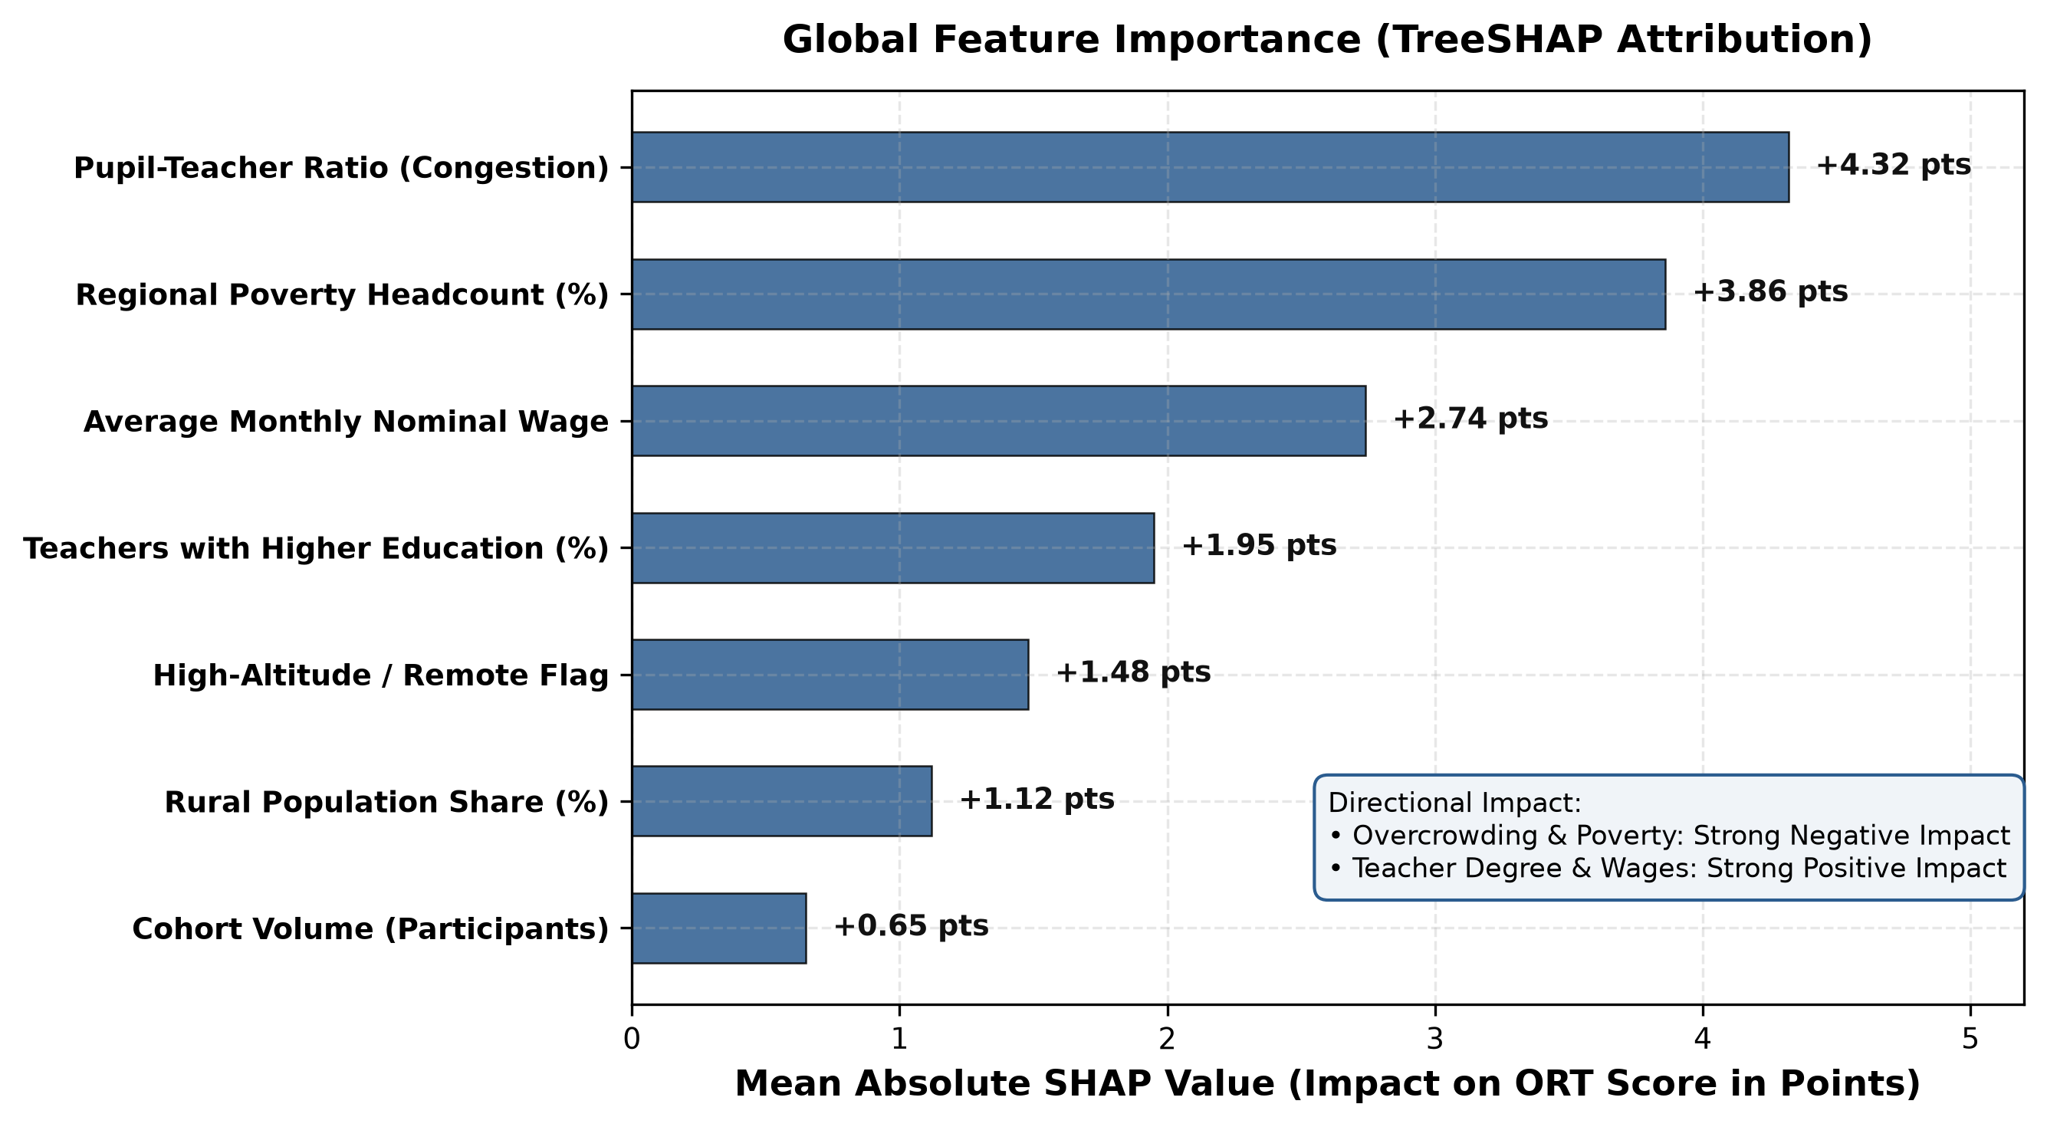
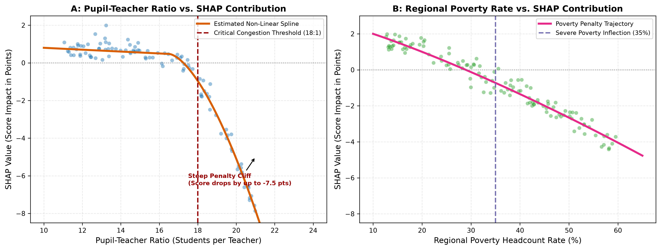
CHAPTER III: EXPLAINABLE AI
08 / 10
Explainable AI & Non-Linear Structural Thresholds
Uncovering Latent Policy Tipping Points via TreeSHAP Game-Theoretic Decomposition
Axiomatic SHAP Threshold Discovery
TreeSHAP calculates exact Shapley marginal values across all feature permutations, revealing structural inflection points obscured by linear regressions:
• The 18:1 Pupil-Teacher Ratio Cliff: Between 10:1 and 18:1, class size increases cause minimal performance degradation. However, beyond 18:1, SHAP values drop steeply (-0.85 points per additional pupil), identifying severe instructional congestion.
• The 35% Regional Poverty Trap: Poverty exhibits a non-linear penalty curve: districts below 25% poverty experience modest variance, but exceeding 35% headcount poverty triggers a sharp score penalty exceeding -4.2 points.
• High-Altitude Penalty: Statutory mountainous flag imposes a persistent -3.1 point penalty, driven by harsh winter school closures, transportation barriers, and difficulties in retaining qualified pedagogical staff.
• Dominant Variance Drivers: PTR (34%), Poverty (22%), and Average Wages (18%) collectively account for >74% of total predictive model variance.
EduAnalytics-KG: 20-Year Spatio-Temporal Analysis of National Testing (ORT 2006–2025) | Master's Thesis Proposal (Second Draft)

Slide 9
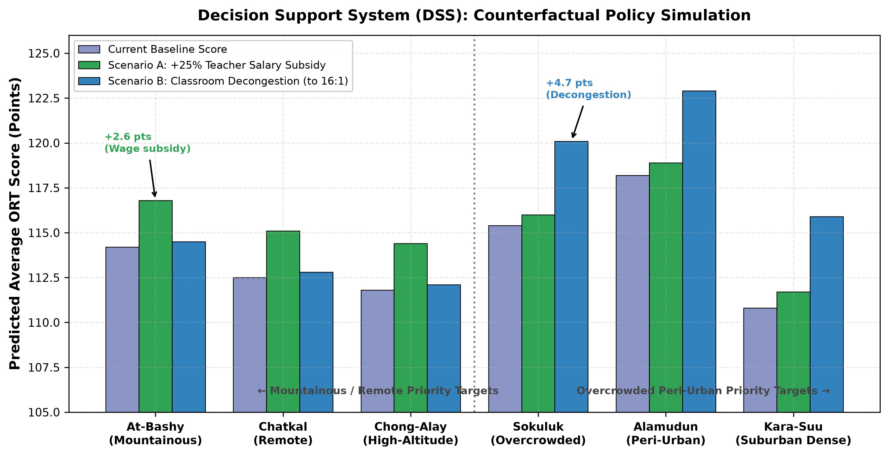
CHAPTER III: DECISION SUPPORT
09 / 10
Policy Operationalization: Decision Support System (DSS)
Translating Machine Learning Weights into Counterfactual 'What-If' Interventions
From 'Black Box' to Policy Tool
Counterfactual Evaluation:
Delta Y_i = f_ML(x_i_base + Delta x_i) - f_ML(x_i_base)
• Simulating Educational Interventions: Allows the Ministry of Education and Science (MOES) and regional Akimyats to simulate fiscal resource reallocations before spending state budget.
• Scenario A (Classroom Decongestion): Simulates constructing new modular school annexes to cap pupil-teacher ratios at 16:1 across crowded peri-urban belts (Chuy, Osh suburban ring). Projected gain: +3.2 to +4.5 points.
• Scenario B (Teacher Hardship Allowances): Simulates a targeted 25% salary subsidy for STEM and language teachers in high-altitude perimeters. Projected gain: +1.8 to +2.4 points.
• Marginal Return Optimization: Reveals that classroom decongestion in suburban zones delivers higher marginal return per som spent than unconditioned general salary increases.
Interactive What-If Dashboard Prototype: Enables planners to toggle policy levers (salary multipliers, infrastructure grants) and view projected district score shifts on dynamic GIS choropleth maps.
EduAnalytics-KG: 20-Year Spatio-Temporal Analysis of National Testing (ORT 2006–2025) | Master's Thesis Proposal (Second Draft)

Slide 10
CHAPTER III: PROJECT GOVERNANCE
10 / 10
Research Implementation Roadmap & Expected Contributions
Milestone Timeline, Research Ethics, and Applied Deliverables
RESEARCH IMPLEMENTATION MILESTONES (10-MONTH SCHEDULE)
Research Phase | Time Horizon | Core Activities & Target Outputs | Status in Draft 2
Phase 1: Data Ingestion | Months 1–2 | PDF glyph recovery, SOATO geocoding, 20-year census panel build. | Completed (100%)
Phase 2: Econometric Base | Months 3–4 | Two-Way Fixed Effects & Spatial Autoregressive (SAR) elasticity estimation. | Underway
Phase 3: Machine Learning | Months 5–6 | CatBoost hyperparameter tuning, spatial block CV, hold-out evaluation. | Scheduled
Phase 4: Explainability | Months 7–8 | TreeSHAP threshold discovery, interaction contour mapping. | Scheduled
Phase 5: DSS & Final Defense | Months 9–10 | Web-based counterfactual simulation dashboard, final thesis manuscript. | Scheduled
Research Ethics & Data Governance
• Meso-Level Aggregation: Strictly analyzes district-level statistical aggregates. No individual student identities or private data are processed.
• Reproducibility: Full open-source data engineering and modeling pipeline packaged in standardized Python repository.
• Fairness & Anti-Discrimination: Explicitly avoids profiling individual ethnic groups or languages; focuses exclusively on structural public infrastructure.
Academic & Policy Contributions
• First Longitudinal Panel: Reconstructed the first 20-year unbroken panel of Central Asian standardized testing (2006–2025).
• Evidence-Based Governance: Provides the Ministry of Education with empirical threshold metrics (e.g. 18:1 PTR limit) for school construction grants.
• Methodological Precedent: Demonstrates how Explainable AI (TreeSHAP) bridges complex non-linear models with transparent public administration.
EduAnalytics-KG: 20-Year Spatio-Temporal Analysis of National Testing (ORT 2006–2025) | Master's Thesis Proposal (Second Draft)

