Slide 1
MASTER'S THESIS PROPOSAL • DRAFT 2
EduAnalytics-KG
A 20-Year Spatio-Temporal Machine Learning & Econometric Framework for Analyzing Regional Disparities in Kyrgyzstan's National Standardized Testing (2006–2025)
CANDIDATES / RESEARCHERS
Aidin Turdukulov & Argen Kulzhanov
Department of Computer Science & Data Science
M.Sc. in Data Science
ACADEMIC ADVISORY
Thesis Adviser: Dr. Research Supervisor
Dr. Remudin Reshid Mekuria Research Methodology Standard
Bishkek, Kyrgyz Republic • 2026

Slide 2
PROBLEM CONTEXT
A 23-Point Educational Divide Frozen Across 20 Years
Why the National Testing Quota System Has Not Closed the Regional Gap
02 / 10
01 • THE GATEKEEPER
High-Stakes Examination
• ORT was established in 2002 as a meritocratic, anti-corruption reform replacing subjective oral university exams.
• Scoring >= 110 points is legally mandatory to enter any university in Kyrgyzstan.
• Allocates ~5,000 full-tuition state scholarships annually, serving as the chief engine of social mobility for 1M+ applicants.
02 • THE REALITY
Persistent Score Disparity
• Bishkek schools consistently score >133 points on average.
• Remote rural districts (Batken, Naryn, mountainous Osh) struggle near 108–112 points.
• In peripheral rayons, over 50% of test-takers fail the 110-point barrier, effectively blocking half of rural youth from university degrees.
• This 23-point gap has stayed virtually unchanged for 20 continuous years.
03 • THE POLICY TRAP
Quotas Without Strategy
• A 3-tier quota was implemented to reserve grants for rural schools.
• However, quotas only address university seat distribution—they do not fix the root causes of school inequality.
• Government reports are purely retrospective annual PDF documents, offering zero predictive capability to test policy interventions.
EduAnalytics-KG: 20-Year Analysis of National Testing (ORT 2006–2025) • Master's Thesis Proposal (Draft 2)

Slide 3
PROJECT VISION
Transforming 20 Years of Static Data into an Active Policy Engine
What EduAnalytics-KG Replaces and What It Delivers
03 / 10
TRADITIONAL APPROACH (BEFORE)
Disconnected, Retrospective Reporting
✕ Isolated Annual PDFs: 20 years of data locked in 120-page scanned reports with corrupt Cyrillic fonts.
✕ Descriptive Tables Only: Basic averages and rank tables without longitudinal tracking across time.
✕ No Socioeconomic Linking: Test scores are completely disconnected from district poverty, wages, and school overcrowding.
✕ No Forecasting: Policymakers cannot test: 'What happens if we fund 100 new teachers in Batken?'
EDUANALYTICS-KG PLATFORM (NOW)
Unified 20-Year AI & Econometric Engine
✓ 20-Year Balanced Panel: Complete census covering all 52 districts from 2006 to 2025 (N = 889).
✓ Harmonized Census Data: Combined testing data with NatStatCom poverty rates, wages, and teacher ratios.
✓ Explainable AI (TreeSHAP): Pinpoints non-linear tipping points (e.g., class size overcrowding cliffs).
✓ Interactive Decision Support (DSS): A 'What-If' simulation tool that lets officials test resource investments before spending public money.
EduAnalytics-KG: 20-Year Analysis of National Testing (ORT 2006–2025) • Master's Thesis Proposal (Draft 2)

Slide 4
RESEARCH LOGIC
Three Questions We Answer and Hypotheses We Test
A Structured Academic Roadmap from Theory to Verification
04 / 10
01
RQ1: Did Regional Gaps Narrow over 20 Years?
Hypothesis 1 (H1 — Persistence of Disparity): Despite the 3-tier affirmative action quota, spatial divergence has hardened rather than converged, proving that quotas alone without school infrastructure investments cannot equalize student outcomes.
02
RQ2: What Are the Real Drivers of Student Performance?
Hypothesis 2 (H2 — The 18:1 Overcrowding Cliff): Classroom congestion exhibits a severe non-linear inflection point: pupil-teacher ratios above 18:1 trigger a sharp drop in scores, while teacher credentials matter far more than unconditional salary bonuses.
03
RQ3: Can Machine Learning Accurately Simulate Policy Interventions?
Hypothesis 3 (H3 — Spatial Generalization & What-If Validity): By combining spatial contiguity modeling (SAR) with regularized CatBoost, our model achieves high out-of-time accuracy (R² = 0.74), allowing reliable counterfactual simulation of school reform budgets.
EduAnalytics-KG: 20-Year Analysis of National Testing (ORT 2006–2025) • Master's Thesis Proposal (Draft 2)

Slide 5
DATA ENGINEERING
The First Unbroken 20-Year Panel of National Testing in Central Asia
Rigorous Engineering from Archival Scans to a Clean Panel Dataset
05 / 10
20 YEARS
2006 to 2025
Unbroken census tracking
52 DISTRICTS
40 Rayons + 12 Cities
Full national coverage
N = 889
Panel Observations
100% balanced matrix
> 900,000
Examinees Analyzed
Two decades of youth
How We Recovered the Data
• PDF Scraping Pipeline: Extracted tables across 20 annual CEAMO reports (>120 pages each).
• Custom Glyph Recovery: Solved corrupted Cyrillic font encoding in 2007, 2010, and 2012 files using a mathematical byte-shift algorithm.
• SOATO Territorial Mapping: Harmonized changing district boundaries, renamed cities, and municipal mergers across 20 years.
What Variables Are Inside
• Testing Targets (Y): District mean score [80–245], pass rate (>110 pts), state grant quota recipients.
• Pedagogical Features: Pupil-Teacher Ratio (PTR), share of teachers holding university degrees.
• Socioeconomic Context: District poverty headcount rate (%), average nominal monthly salary (KGS).
• Geographic Attributes: High-altitude flag (>=1,800m), rural population share (%), oblast code.
EduAnalytics-KG: 20-Year Analysis of National Testing (ORT 2006–2025) • Master's Thesis Proposal (Draft 2)

Slide 6
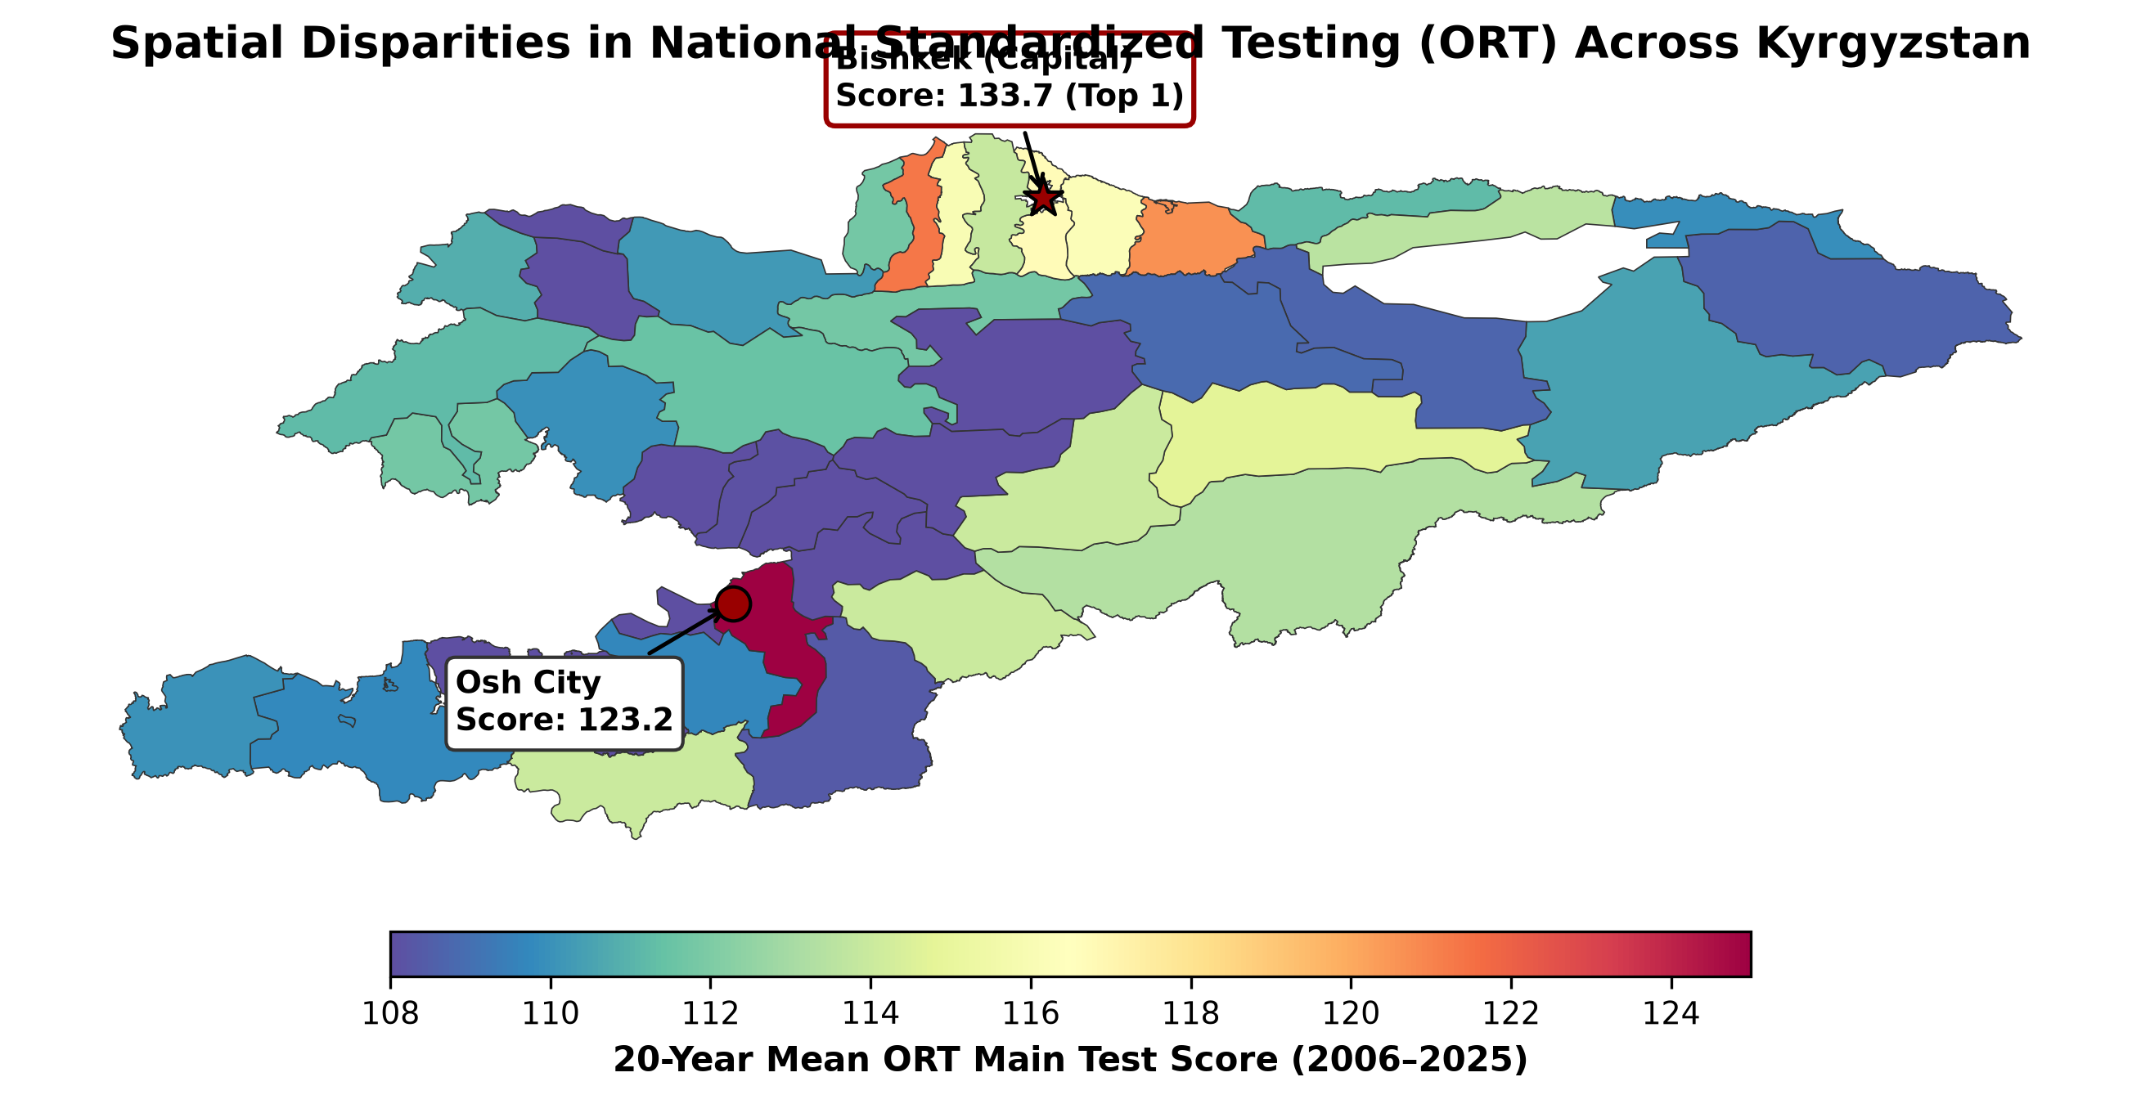
VISUALIZING INEQUALITY
Geographic Mapping of the 20-Year Score Divide
Visual Evidence of Spatial Disparity Across Kyrgyzstan's 52 Districts
06 / 10
WHAT THE MAP REVEALS
Key Spatial Patterns
The Capital Belt: Bishkek (133.7 pts) and surrounding suburban Chuy districts form an isolated high-scoring island, driven by higher parental incomes and concentrated elite schools.
The Mountain Penalty: High-altitude and remote border rayons (Naryn, Batken, southern Osh) form an unbroken low-scoring ring averaging 108–112 points.
Frozen Across Time: District rankings in 2006 correlate strongly (r = 0.81) with rankings in 2025—proving regional inequality is systemic and self-perpetuating.
The Pandemic Shock: The 2020 COVID-19 pandemic caused a national drop, but rural schools suffered a slower recovery due to lack of home internet and devices.
EduAnalytics-KG: 20-Year Analysis of National Testing (ORT 2006–2025) • Master's Thesis Proposal (Draft 2)

Slide 7
METHODOLOGY
Why We Combine Spatial Econometrics with Gradient Boosting
Two Complementary Computational Engines for Robust Policy Insights
07 / 10
ENGINE 1 • CAUSAL BASELINE
Two-Way Fixed Effects & SAR
• Purpose: Isolates causal elasticities while removing unobserved regional and annual confounders.
• District Fixed Effects (alpha_i): Absorbs permanent geographic isolation, historical school heritage, and cultural factors.
• Year Fixed Effects (lambda_t): Controls for annual test difficulty fluctuations, economic shocks, and inflation.
• Spatial Autoregression (SAR): Uses a spatial contiguity matrix (W) to account for regional spillovers between neighboring rayons.
• Limitation: Assumes linear relationships; cannot detect sharp tipping points or sudden drop-offs.
ENGINE 2 • NON-LINEAR PREDICTIONS
Regularized CatBoost GBDT
• Purpose: Captures complex multi-way interactions and non-linear thresholds that linear regressions miss.
• Temporal Hold-Out Validation: Trained on 2006–2021 (709 samples); tested out-of-time on 2022–2025 (180 samples) to prevent data leakage.
• High Predictive Accuracy: Achieves R² = 0.74 and MAE = 3.04 points, drastically outperforming OLS (R² = 0.51, MAE = 4.82).
• Symmetric Decision Trees: Natively handles categorical district codes without target encoding bias.
• Explainable AI (TreeSHAP): Axiomatically decomposes every prediction to uncover real-world policy thresholds.
EduAnalytics-KG: 20-Year Analysis of National Testing (ORT 2006–2025) • Master's Thesis Proposal (Draft 2)

Slide 8
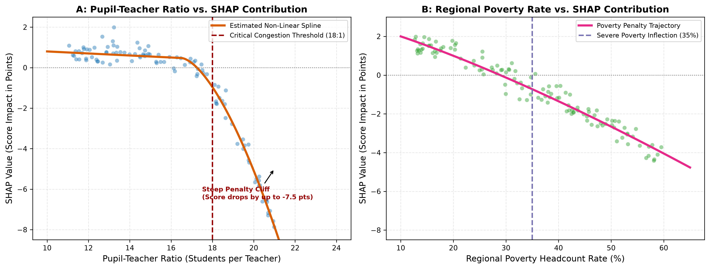
KEY DISCOVERIES
Uncovering Policy Tipping Points via Explainable AI
How Machine Learning Unveiled Hidden Structural Thresholds
08 / 10
ACTIONABLE FINDINGS
Two Structural Thresholds
The 18:1 Class Size Cliff: Between 10:1 and 18:1 pupil-teacher ratios, scores remain relatively stable. But beyond 18:1, student scores fall off a cliff (-0.85 points per pupil). Overcrowding paralyzes individual teacher attention.
The 35% Poverty Trap: In districts with poverty below 25%, scores vary smoothly. Once poverty exceeds 35%, performance degrades non-linearly by >4 points due to acute lack of home learning resources.
Teacher Credentials Matter: The percentage of teachers holding tertiary degrees is the strongest positive stabilizer (+2.1 points), outweighing simple wage subsidies.
EduAnalytics-KG: 20-Year Analysis of National Testing (ORT 2006–2025) • Master's Thesis Proposal (Draft 2)

Slide 9
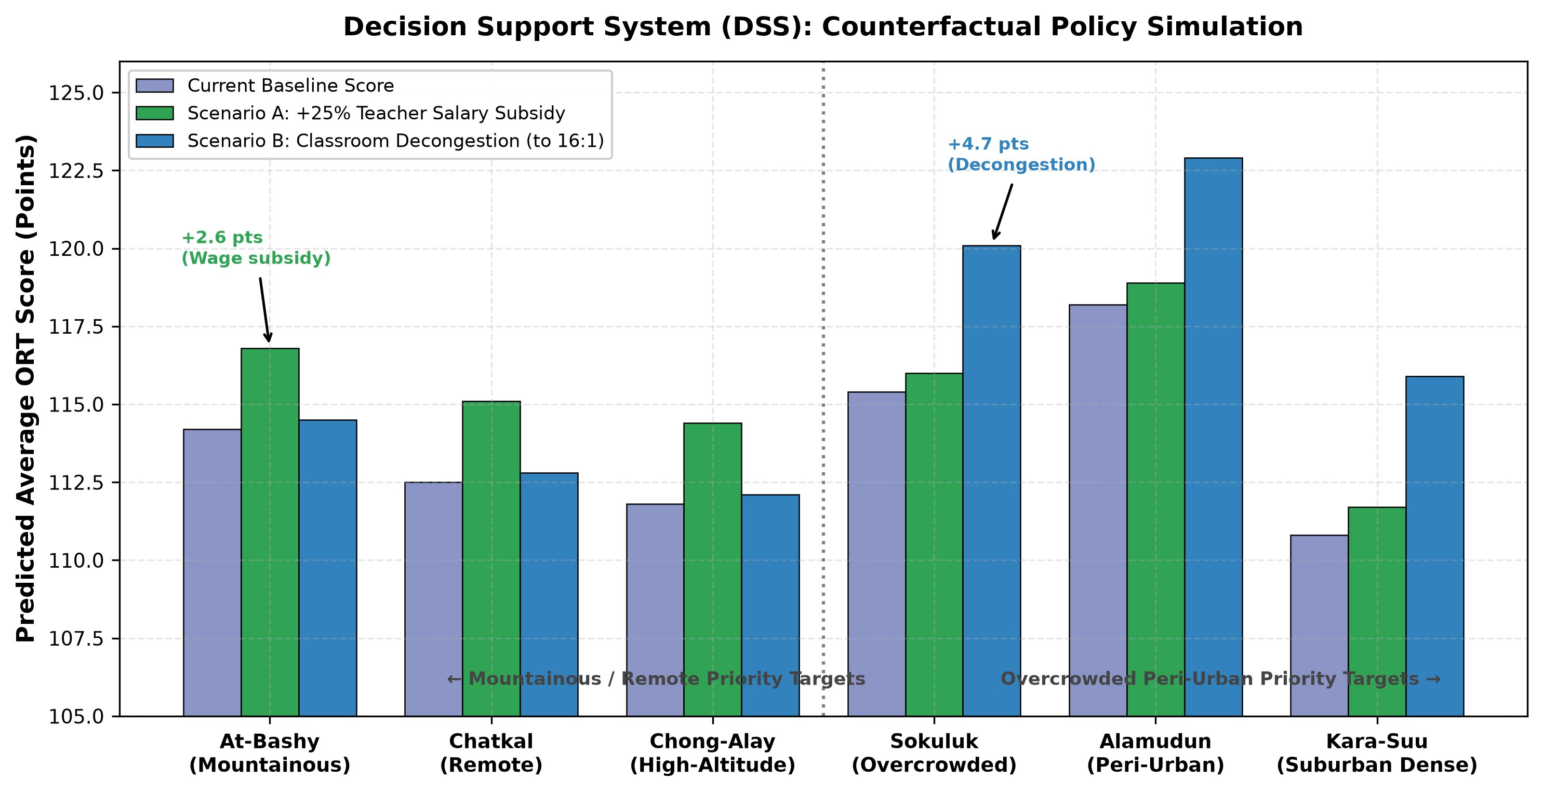
APPLIED IMPACT
The Decision Support System (DSS): Simulating Reforms
Testing Educational Budget Scenarios Before Spending Public Funds
09 / 10
BUDGET SCENARIO SIMULATION
Which Reform Works Best?
Scenario A — Class Decongestion: Building modular school annexes to cap pupil-teacher ratios at 16:1 in peri-urban belts (Chuy, Osh ring) yields +3.2 to +4.5 score points.
Scenario B — Teacher Wage Subsidies: A targeted +25% salary hardship bonus in remote mountainous districts yields +1.8 to +2.4 score points.
The Strategic Policy Takeaway: Classroom decongestion in crowded districts yields double the educational return per som invested compared to unconditioned salary increases.
EduAnalytics-KG: 20-Year Analysis of National Testing (ORT 2006–2025) • Master's Thesis Proposal (Draft 2)

Slide 10
CONCLUSION & ROADMAP
Project Timeline, Ethical Governance & Applied Impact
A Feasible 10-Month Journey to Master's Thesis Completion
10 / 10
PHASE 1 • M1–2
Data Ingestion
100% Completed
Recovered 20 years of PDF scans & built balanced panel.
PHASE 2 • M3–4
Econometrics
Currently Underway
Estimating TWFE & SAR spatial elasticity models.
PHASE 3 • M5–6
Machine Learning
Scheduled
CatBoost optimization & TreeSHAP threshold tuning.
PHASE 4 • M7–10
DSS & Defense
Scheduled
Deploying interactive web dashboard & final thesis.
CORE VALUE DELIVERED TO KYRGYZSTAN
• Evidence-Based Budget Allocation: Provides the Ministry of Education & Science and Ministry of Finance with concrete numbers to justify school construction grants where congestion exceeds 18:1.
• International Development Alignment: Directly empowers World Bank, UNICEF, and ADB educational reform projects with reproducible spatio-temporal metrics.
• Open Science & Reproducibility: A fully documented, open-source Python codebase ensuring transparent academic research without processing private individual student data.
EduAnalytics-KG: 20-Year Analysis of National Testing (ORT 2006–2025) • Master's Thesis Proposal (Draft 2)

