Slide 1
Same R score, different postal code, different answer
IVADO · ÉQUIALGO · CODEML 2026
Finding and removing two hidden regional biases in scholarship decisions
CertifiedHackerBoys · Ryan Morov · Aidin Yaseri · Arav Sahni · Makan Homayoun
Notes:
(0:00–0:10) We're CertifiedHackerBoys. Our project is about one sentence: same R score, different postal code, different answer.

Slide 2
An 88%-accurate model that copies a biased committee
THE PROBLEM
48.4%
27.3%
0.7
grant rate in Montréal and the Capitale-Nationale
grant rate in Bas-Saint-Laurent, Côte-Nord and Gaspésie
R-score points between the two groups (scale SD: 3)
A 21-point gap in awards, almost no gap in grades. The model is accurate because it reproduces past decisions, and those decisions are what is under audit.
Data: 10,000 historical files, 4,000 applicants to score (synthetic)
Notes:
(0:10–0:35) The institution's model is 88% accurate. But it grants awards to 48% of applicants from Montréal and Québec City, and only 27% from Bas-Saint-Laurent, Côte-Nord and Gaspésie. Their grades differ by 0.7 R points. A 21-point gap in awards, almost no gap in grades. The model is accurate because it copies the old committee, and the committee is what's under audit.

Slide 3
The committee docked remote applicants 1.6 R points
BIAS CHANNEL 1
Between R 28 and 29: 59% granted in the centres, 26% in the regions
A flat penalty of about 1.6 R points (95% CI 1.4–1.7), the same in all three remote regions
It explains 83% of the gap
190 of 1,628
remote applicants the production model would fund if they simply lived in Montréal, with the same grades, hours and income
audit_rapport.ipynb, sections 2, 3 and 5b
Notes:
(0:35–1:10) Look at students with the same R score. Between 28 and 29, 59% get an award in the centres and 26% in the regions. We modelled the committee and found a flat penalty worth 1.6 R points, the same in all three remote regions, and it explains 83% of the gap. Then we asked the production model a simple question: what if a remote student moved to Montréal, same grades, same job, same family? 190 students out of 1,628 flip from refused to granted. Just by changing their address.

Slide 4
Proxies rebuild the penalty
WHY DELETING THE COLUMN FAILS
Distance costs remote applicants as much as the region label itself
Location moves their probability by −10 points (centres: +6)
Distance and postal code identify the region almost perfectly (AUC ≈ 1.0)
Delete the region column and the penalty moves onto distance
The bias is in the labels, not the columns.
audit_rapport.ipynb, sections 4 and 5b · SHAP on the production random forest
Notes:
(1:10–1:35) The obvious fix, deleting the region column, doesn't work. Distance and postal code identify the region almost perfectly. SHAP shows distance costs remote students as much as the region label itself. Take the label away and the model rebuilds the penalty from distance. The bias is in the labels, not the columns.

Slide 5
The committee also rewarded family income
BIAS CHANNEL 2
4 in 10
Merit score tested | HxBuddy accuracy
R + income | 90.08
R only | 92.28
R + income + hours + distance | 92.38
R + hours + distance | 94.38
7 nearby weights and rates | 94.48 – 94.63
R + 0.146 × hours, top 41% | 94.68
deserving low-income remote students were refused by the production model
Remote families earn 25% less (median 51.6 k$ vs 69.2 k$), so an income bonus works against them too
24 HxBuddy experiments, each changing one ingredient: income always hurts, hours worked always help
audit_rapport.ipynb, sections 6 and 6b · HxBuddy indicative accuracy
Notes:
(1:35–2:10) There was a second, quieter bias. The committee also rewarded family income, and remote families earn 25% less. The two stack up: under the production model, four in ten deserving low-income remote students were refused. We confirmed it with 24 controlled experiments on HxBuddy: adding income always hurts agreement with the reference, adding hours worked always helps.

Slide 6
Equal opportunity, measured against merit
METRIC CHOICE
Equal opportunity (our choice)
Demographic parity (reported)
The trap we avoided
A deserving student in Gaspé gets the same chance as one in Montréal. It is the promise a merit scholarship makes, and what the jury scores.
Forces equal grant rates whether or not merit differs, and says nothing about who gets the award. Shown as a secondary check.
Measured against the committee's own labels, the biased model's gap is only 0.06. It passes by copying the bias.
Production model's equal-opportunity gap against penalty-free merit references: 0.22 to 0.30. The organisers report 0.270 against their hidden reference: our diagnosis brackets it.
audit_rapport.ipynb, sections 5 and 7
Notes:
(2:10–2:30) We measure fairness with equal opportunity: a deserving student in Gaspé should have the same chance as one in Montréal. Not demographic parity, which forces equal rates whether merit differs or not. And never against the committee's own labels: against those, the biased model looks fair.

Slide 7
Make the model aware of the bias, then switch it off
THE FIX
1
Train with the bias in view
2
Switch the biases off
3
Rank and grant
Fit the committee with an explicit remote-region term, so the penalty lands there instead of hiding in distance.
Remove the regional penalty, the income bonus and the distance term. Keep the committee's own weights on real merit.
Award the top 41% of the merit score (1,640 of 4,000), inside the 36–44% budget.
merit = R score + 0.146 × weekly hours worked
No region, postal code, distance or income. One formula any applicant can check.
equialgo.py · model_corrige.ipynb, sections 3 and 8 · model_final.json
Notes:
(2:30–3:00) Our fix: we fit the committee model with an explicit region term, so the penalty lands there instead of hiding in distance. Then we switch it off, along with the income bonus. What's left is the committee's own weighting of real merit: R score plus 0.146 points per weekly hour worked. Top 41% get an award. One formula any applicant can check.

Slide 8
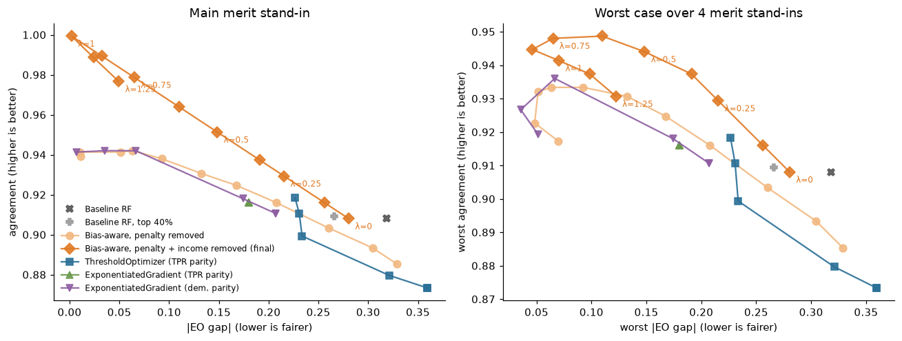
Fairness and merit improve together
PARETO FRONT
Dark diamonds: our final model, sweeping the share of the penalty removed (λ). ThresholdOptimizer closes a third of the gap at best, and ExponentiatedGradient with TPR parity does not move: on biased labels the constraint is already met.
model_corrige.ipynb, sections 4–6 · held-out split, budget enforced
Notes:
(3:00–3:25) We swept how much of the penalty to remove and compared against fairlearn's tools. Removing the bias improves fairness and agreement with merit at the same time. The fairlearn methods barely move, because they measure fairness against the biased labels.

Slide 9
Gap closed, budget kept
RESULTS ON THE 4,000 APPLICANTS
 | Production | Ours
Grant rate, centres / remote | 46.8% / 27.8% | 40.9% / 41.1%
Parity gap (95% CI) | 0.19 (0.16–0.22) | −0.002 (±0.03)
Equal-opportunity gap | 0.30 | 0.00
Moved to Montréal → funded | 190 | 0
HxBuddy accuracy / F1 |  | 94.68% / 94.47%
Same grades, different lives
Of 390 changed decisions, those who gain and those who lose an award have the same average R score (28.6).
2×
the weekly hours (14.6 vs 7.4)
½
the family income (45 k$ vs 84 k$)
for those who gain
model_corrige.ipynb, sections 8 and 8b · audit_rapport.ipynb, section 6b · predictions.csv
Notes:
(3:25–4:00) Result: 41% in the centres, 41% in the regions. Equal-opportunity gap from 0.30 to zero. HxBuddy score 94.7%, up from 92.4% for our first version. 390 decisions change. And here's the part we care about: the students who gain awards and the ones who lose them have the same grades. The ones who gain work twice as many hours and come from families earning half as much. The old model was rewarding comfort, not merit.

Slide 10
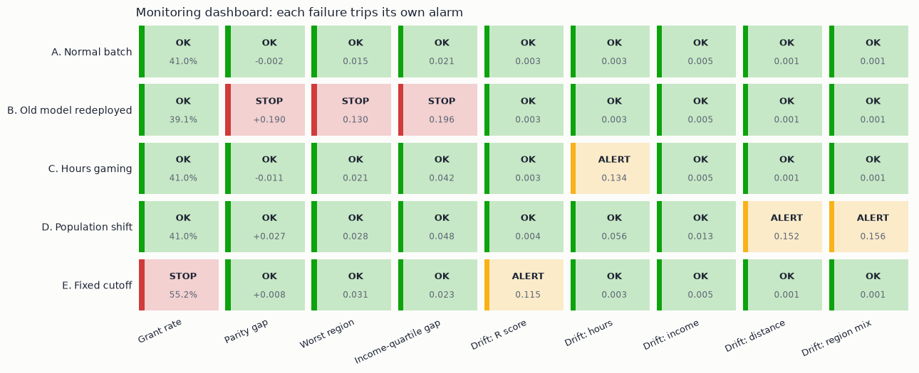
Monitoring is code, tested on failures
GOVERNANCE
Old biased model redeployed: STOP, even though its budget looks normal
Hours inflated: ALERT (otherwise 103 honest students lose out)
Region and income only measure bias, never score
Law 25 notice and human review; awards already granted are never withdrawn
Checked every batch: budget, parity, each region, income subgroups and input drift. Yearly: equal opportunity against an independent merit signal (first-year results, blind panel).
GOVERNANCE.md · monitoring.py · monitoring_demo.ipynb
Notes:
(4:00–4:35) A fix is only as good as its monitoring, so we built it. monitoring.py checks every batch: budget, parity, every region, income subgroups, and drift. We tested it on five scenarios. Someone redeploys the old model? Stopped, even though the budget looks normal. Students inflate their hours? Alert, because otherwise 103 honest students lose their award. Region and income are used only to measure bias, never to score. Applicants get a notice and a human review under Law 25.

Slide 11
The fix wasn't a better classifier. It was refusing to treat past decisions as the truth.
WHAT WE CANNOT CLAIM
We never saw the jury's reference; all 24 leaderboard experiments are disclosed
Hours worked are self-reported and must be verified
Synthetic data: other regions and a legal review are needed before roll-out
Notes:
(4:35–5:00) What we can't claim: we never saw the jury's reference, and we disclose every leaderboard experiment. Hours worked are self-reported, so they need verification. But the main lesson is simple: the fix wasn't a better classifier. It was refusing to treat past decisions as the truth. Thank you.

