Slide 1
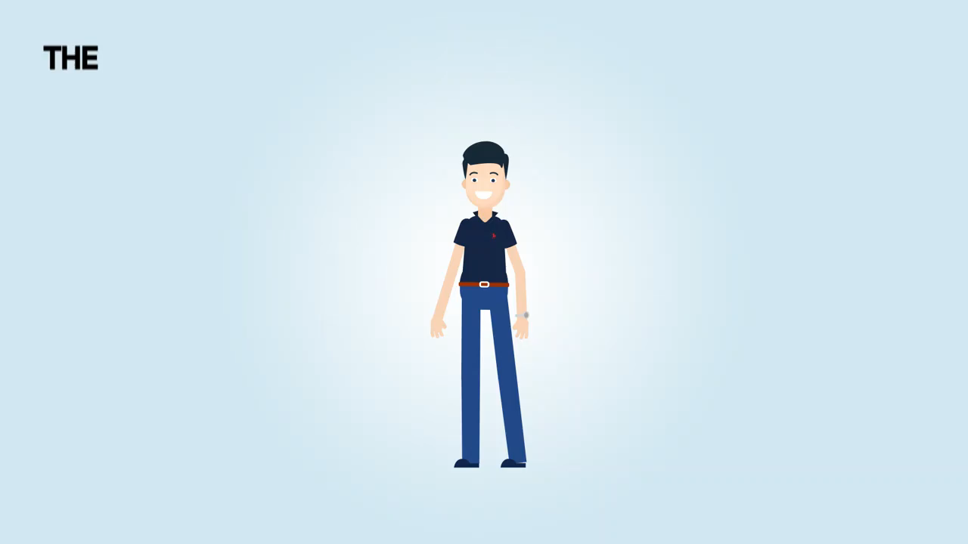

Slide 2

ELYT

Slide 3

Loss of Revenue

Slide 4

Customer Churn?
The percentage of customers that stopped using a company’s product or service during a certain time frame.

Slide 5

Ken

Slide 6
Churn Impact
Ken has monthly recurring revenue of Gh¢75,000, and every month he gets to add another Gh¢10,000 to that.
Churn Rate = 3%
If all of that persists for the next five years, he'll end up generating almost Gh¢ 13 million. Not bad at all.

Slide 7
Churn Impact
However, if he is able to decrease his churn rate by 10%, that gives him an extra amount of about
Gh¢ 15 million in revenue!

Slide 8
ELYT
Insightful Customer Intelligence

Slide 9

ELYT
Monitor and gather data of customer satisfaction in real-time. Moments that contribute to customer satisfaction and affect customer behavior. That translates into business performance

Slide 10
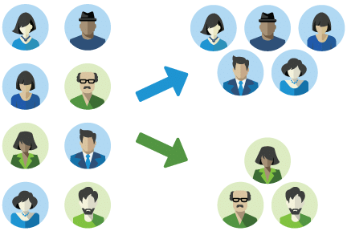
ELYT
Segment: Divide a customer base into groups of individuals that are similar in specific ways relevant to marketing.

Slide 11

ELYT
Based on segmented data, the model identifies the group of your beloved customers with the intention to leave you(company) in the near future.

Slide 12

ELYT
Identify reasons for future churns and suggest service strategies.

Slide 13

ELYT
The model gathers information about your competitors’ products and services to stay ahead of the curve and win market share.

Slide 14

Target Customers
Banks
Telcos
Micro-Finance
Super markets, etc
We generate revenue from services we
provide to these businesses.

Slide 15



Mitigate Risk
Increase Revenue
Prevent Churn

Slide 16


ELYT
Bernice Abban
Kwabena Aboagye
Co-Founder
Co-Founder
Our Team

Slide 17
ELYT
Thank you

