Slide 1


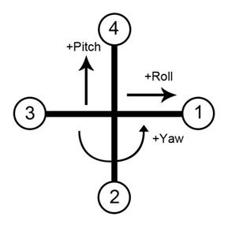
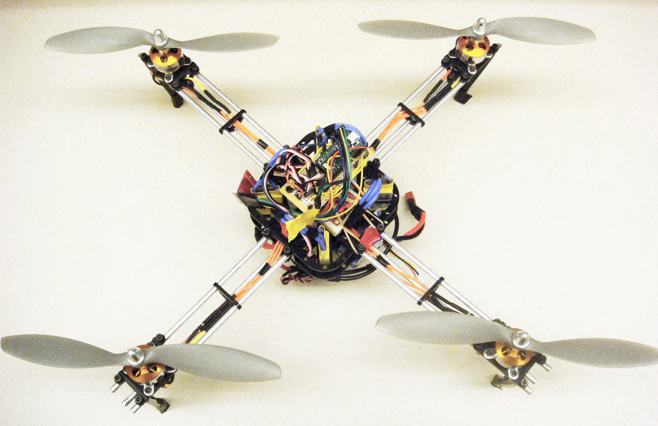
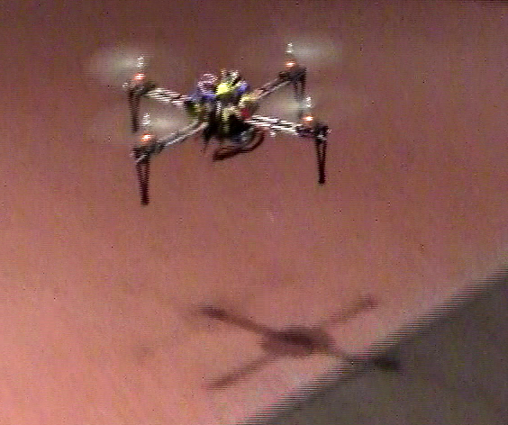
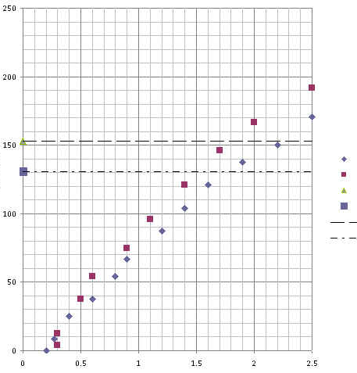
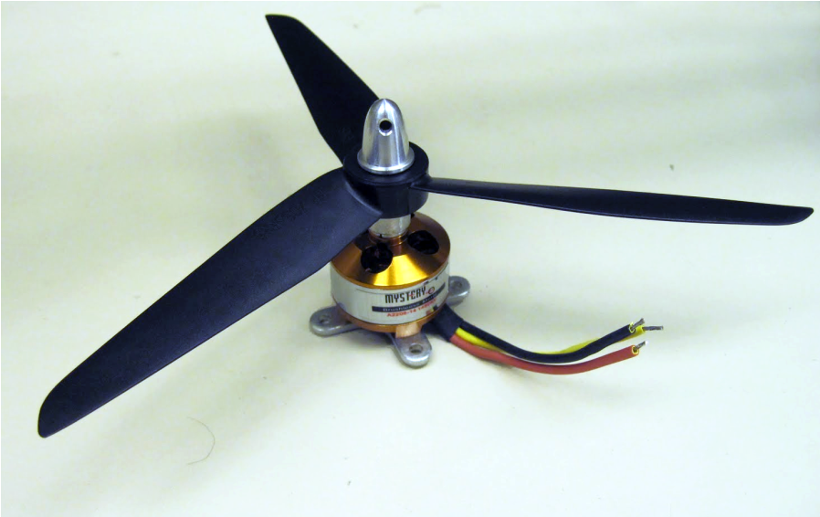
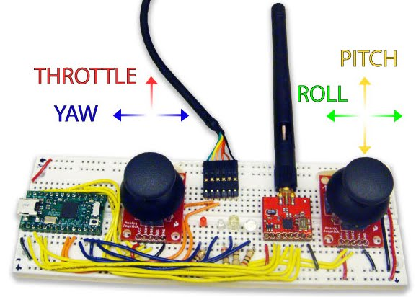
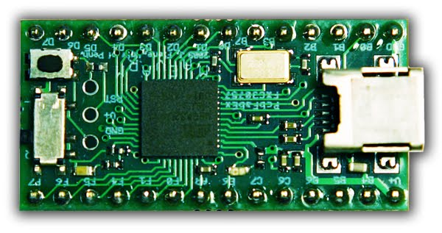
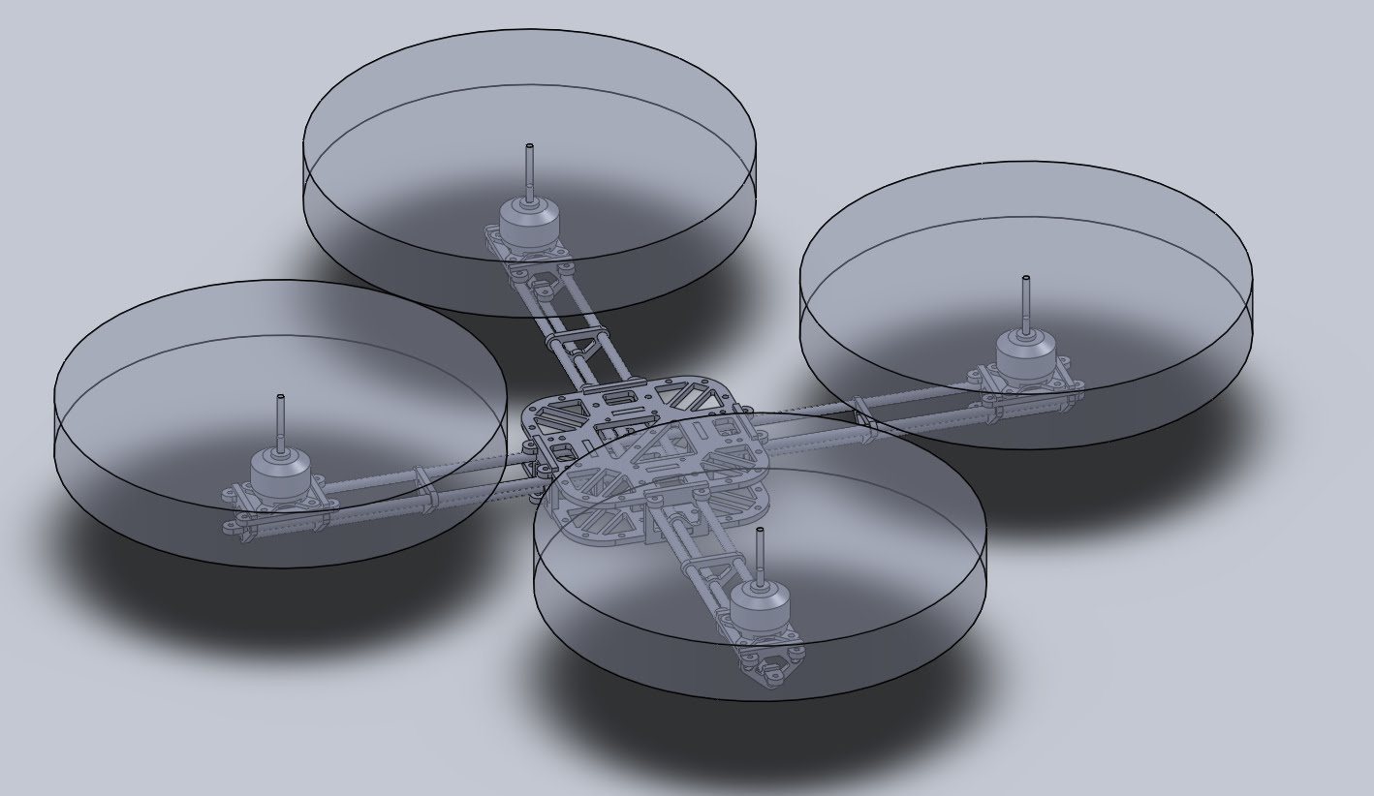
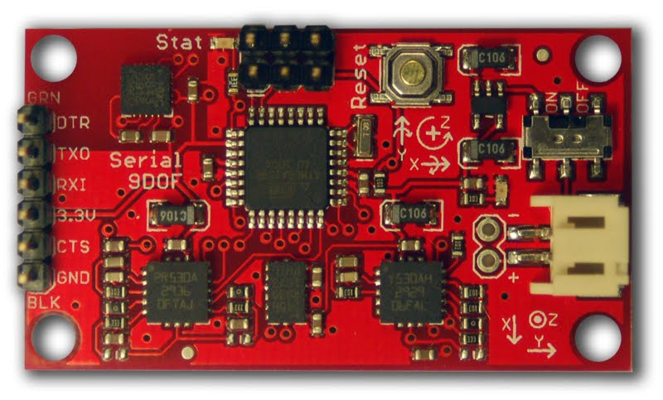
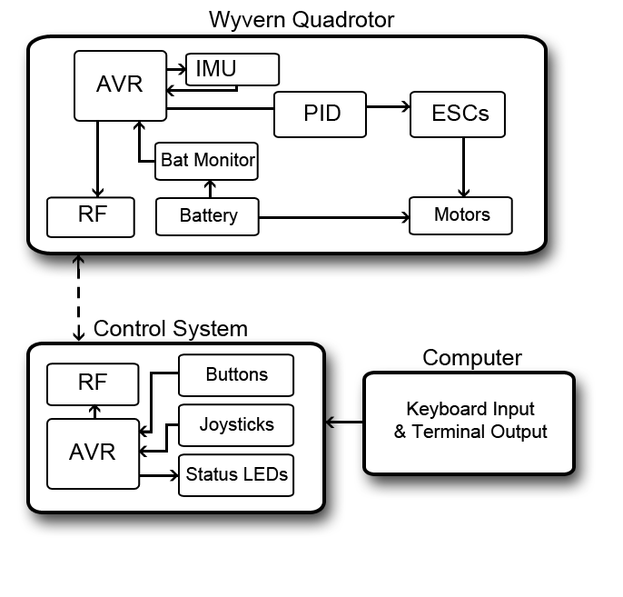
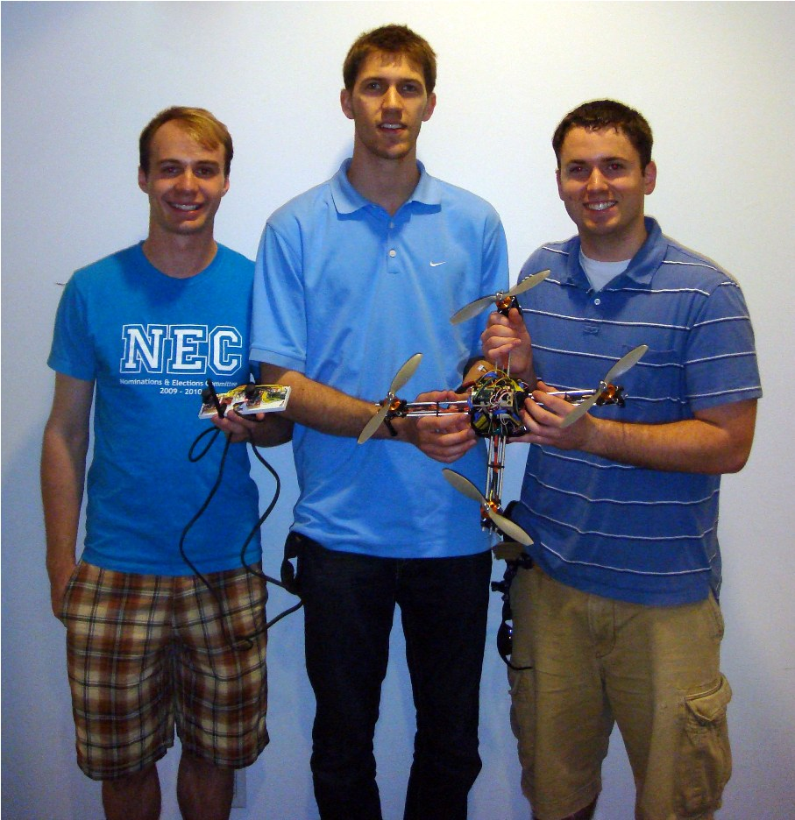
Quadrotor Robot for Search and Rescue
Constructing a Budget Quadrotor Helicopter Platform
William Etter (EE ‘11) and Paul Martin (EE ‘11) Advisor: Rahul Mangharam
http://airhacks.org http://mlab.seas.upenn.edu
Overview: Quadrotors, or helicopters constructed from four distinct rotors, are highly maneuverable platforms with several advantages over conventional aircraft. Due to the high price tag of most commercial quadrotors, creating a budget quadrotor platform opens the door to new and interesting research areas such as group communication, exploration, networking, and flocking patterns. Within the scope of this project, building a quadrotor robot offers an interesting application of wireless communication, high frequency sensor and ADC measurements, as well as a combination of mechanical design, electrical design, and controls theory.
Attitude Control
Design
Thrust Dynamics
A positive pitch is effected by decreasing motor 4 and increasing motor 2.
A positive roll is effected by decreasing motor 1 and increasing motor 3.
A positive yaw is effected by decreasing one pair of counter rotating rotors (3 and 1 or 4 and 2) and increasing the other. This will depend on which pairs are installed on which motors.
Lift vs. Current – single motor
“Lift” (grams)
Tri-Rotor
Bi-Rotor
Hover with Blue Lipo 615g
Hover for Mystery Lipo 523g
Linear (Hover with Blue Lipo 615g)
Linear (Hover for Mystery Lipo 523g)
Components
Wyvern quadrotor platform
Current (Amps)
Frame construction
Body is constructed using laser-cut ABS plastic and hollow aluminum rods. The design includes distinct modules for four motor mounts and one central node. The central node was designed to be easily expanded for future applications.
-Design by Uriah Baalke, MEAM‘11
MaEvArM – ATMega32u4 Microcontroller
Quadrotor Control
Wireless control unit with ATMega32u4
Razor IMU – 6 DOF with 3D magnetometer
Model of quadrotor frame – isotropic view
Parts List:
- (4) Brushless motors
- (4) ESC motor controllers
- (1) 6 DOF IMU
- (2) 2.4 GHz wireless transceivers
- (2) ATMega32u4 microcontrollers
- (1) 2.2 Ah, 25C lithium polymer battery
- ABS plastic
- Hollow aluminum rods
Stabilization of the quadrotor is accomplished by PID control using an ATMega32u4. Wireless communication is achieved using two 2.4 GHz wireless transceivers.
Inertial measurement unit (IMU) data provides absolute yaw, pitch, and roll . Lithium polymer battery provides ~12 minute flight time.
Project Timeline
Week 1 – Order materials and parts
Week 2 – Airframe construction
Week 3 – Modify IMU code and implement serial
data communication
Week 4 – Open-loop tests of ESCs and motors
Week 5 – PID control loop design
Week 6 – Finish adjustment of PID gains and first
test flights
From left to right: Uriah Baalke (MEAM ‘11),
Paul Martin (EE ‘11) & William Etter (EE ‘11)
Proportional, Integral, and Derivative Control:
P = desired – actual , I = I + actual , D = current_error – past_error

