Slide 1
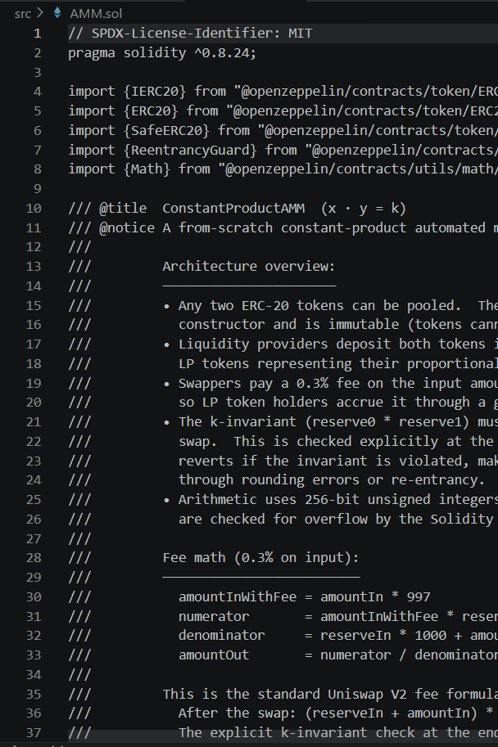

BCHT2: Quadratic Voting DeFi Governance Protocol
Full-stack decentralized governance with anti-plutocracy design
AIDYN ZHUBANYSHEV & KHVAN DANIIL
MAY 2026

Slide 2
Agenda
01
02
Project Overview & Objectives
System Architecture
03
04
Mathematical Model — Quadratic Voting
Data Indexing with The Graph
05
06
Security Architecture & Defenses
Audit Results, Centralization Analysis & Conclusion

Slide 3
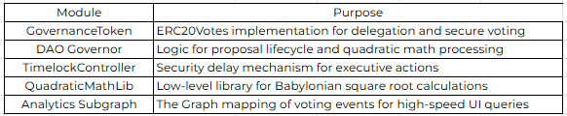
Project Objectives
Full-Stack DeFi Protocol
Built end-to-end on Ethereum Sepolia — smart contracts, indexing, and a React/Vite frontend.
Quadratic Voting
Replaces linear token-weighted voting to curb whale dominance and promote fair participation.
Security-First Design
Hardened against flash-loan attacks, centralization risks, and privilege escalation.
Production-Grade Quality
Modular monorepo architecture with full audit coverage and rigorous testing.

Slide 4
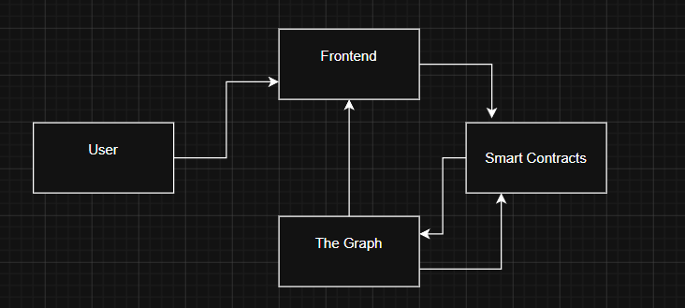

System Context & Data Flow
Key Architectural Principle
Frontend
Contracts
A clean separation of concerns keeps the system maintainable and performant. On-chain consensus handles trust and finality; off-chain querying via The Graph delivers speed and rich historical data to the frontend without expensive RPC calls.
React/Vite UI for users
Governor, Token, MathLib
The Graph subgraph indexes contract events in real time, exposing a fast GraphQL API that powers the entire dashboard.
Indexer
API
The Graph subgraph ingests events
GraphQL queries deliver rich data

Slide 5
Repository Structure
A modular monorepo with strict boundaries between layers, enabling independent CI/CD pipelines, isolated testing, and parallel development across the stack.
/contracts
/subgraph
/frontend
Solidity smart contracts — Governor, ERC20Votes token, QuadraticMathLib, and TimelockController.
The Graph indexing configuration — schema definitions, mappings, and event handlers.
React/Vite user interface — proposal dashboard, vote submission, and real-time GraphQL data binding.

Slide 6


Core Innovation — Quadratic Voting
Traditional Governance (Linear)
Voting power equals token balance directly.
Our Solution — Quadratic Voting
A whale with 100× more tokens wields 100× more influence — governance becomes plutocratic.
100× more tokens yields only ~10× more voting power. Broader participation is rewarded without eliminating stake-based incentives.
Voting power equals the square root of committed capital.

Slide 7


Quadratic Math in Detail
Individual Vote Weight
Token Balance
Linear Power
Quadratic Power
Proposal Matching Weight
1
1
1
10
10
3.16
100
100
10
The matching formula aggregates individual square-root contributions, then squares the sum, amplifying distributed participation over concentrated capital.
1,000
1,000
31.6
10,000
10,000
100
Sybil resistance is maintained through economic cost — splitting capital across wallets yields no advantage under quadratic rules.

Slide 8
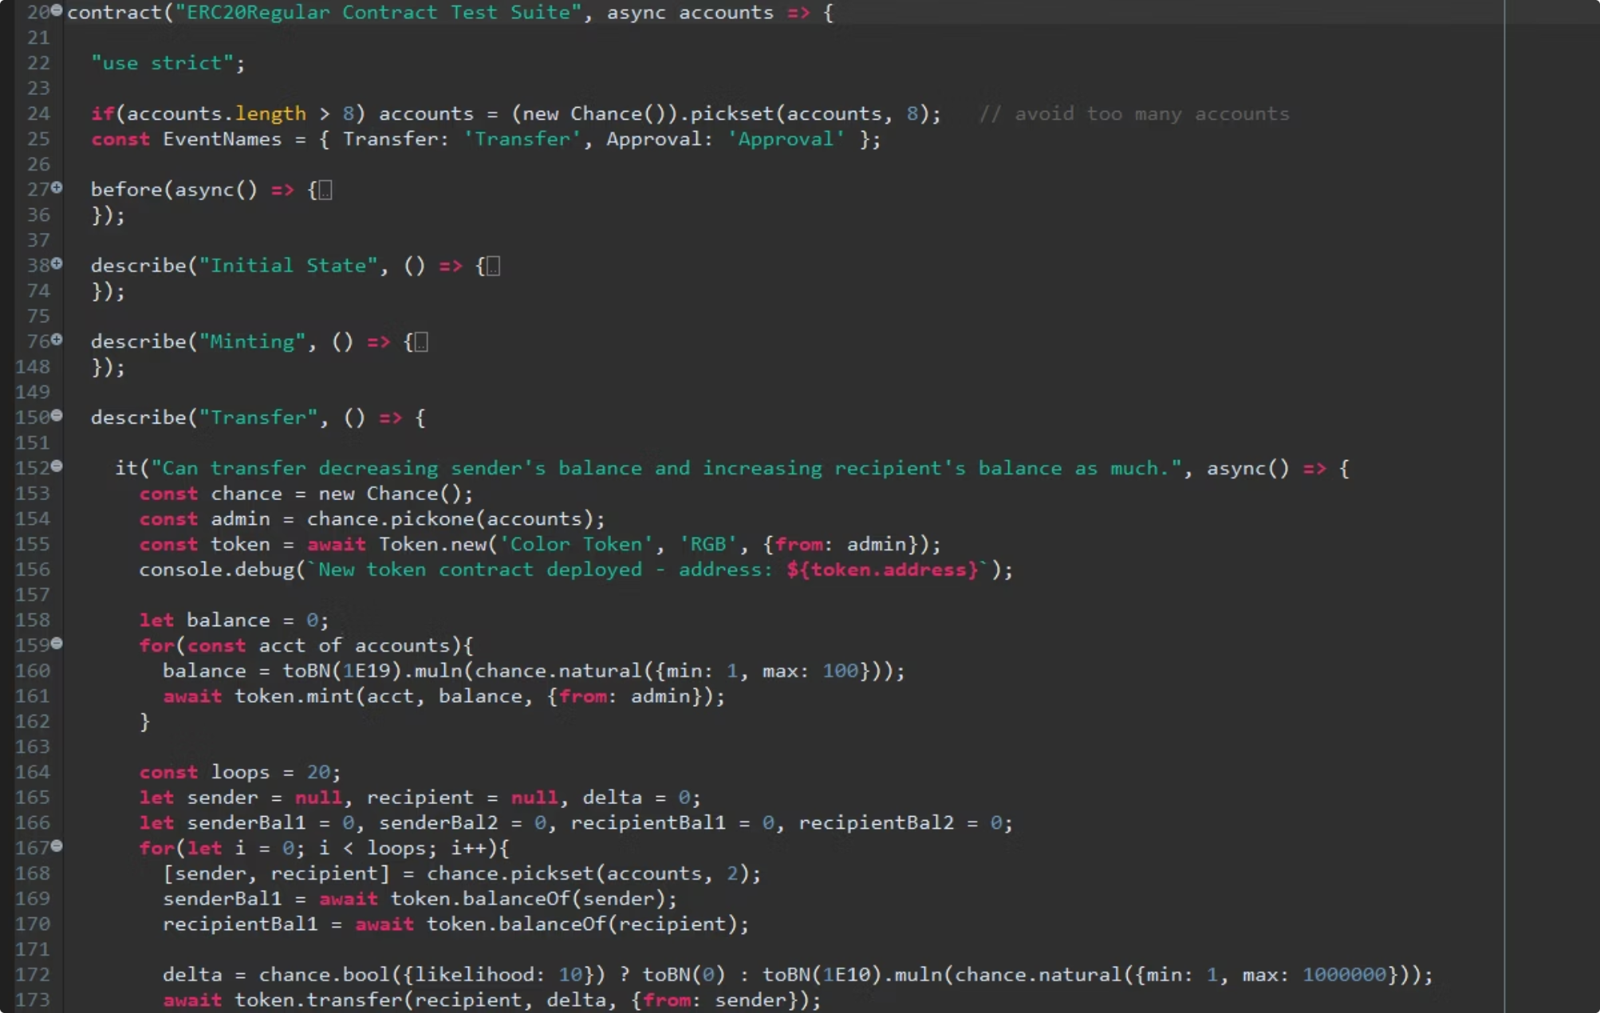
Proposal Funding & Matching Engine
How the Matching Engine Works
Each proposal competes for a shared budget pool. The quadratic matching formula allocates funds proportionally to the breadth of support, not the depth of a single whale's commitment.
Multiple independent proposals
Fair budget distribution
Capital concentration resistance
Funding follows the quadratic matching formula implemented in QuadraticMathLib.sol.
Each proposal is scored independently, preventing coordinated capital attacks.
No single actor can dominate allocation without disproportionate economic cost.

Slide 9
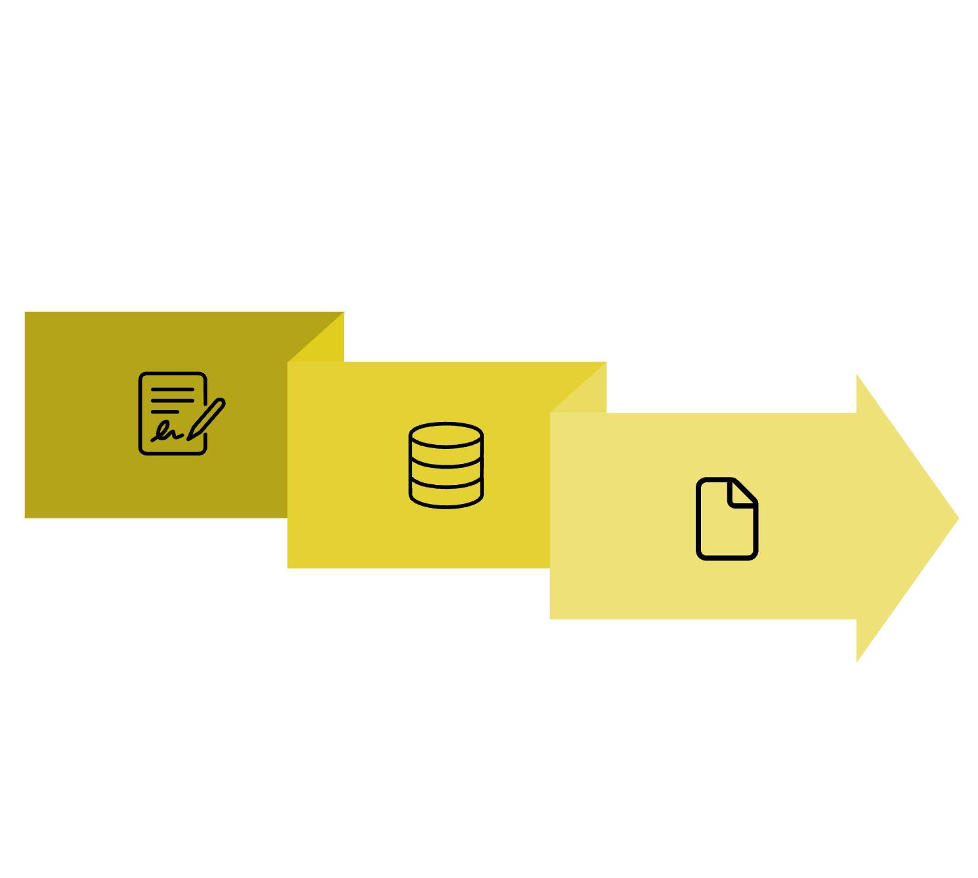
Data Indexing Layer — The Graph
Why Not Direct RPC?
Direct on-chain RPC calls are slow, expensive, and impractical for querying historical event data at scale. The Graph solves this with real-time event indexing and a clean GraphQL API.
Subgraph Schema Entities
ProposalCreated
Captures the proposal ID, proposer, targets, and description hash.
Contract Emits
Frontend Queries
VoteCast
Records the voter's address, proposal ID, support flag, and quadratic weight.
ProposalExecuted
Marks execution status and the timelock completion timestamp.
Subgraph Indexes

Slide 10




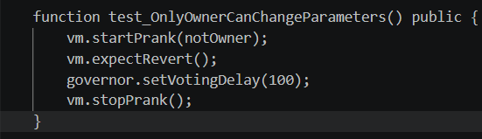
Security Architecture
Access Control
Execution Safety
The governance contract is the sole owner of all protocol contracts. This principle of least privilege means there are no deployer backdoors.
TimelockController enforces a mandatory 2-day delay between vote passage and on-chain execution.
All critical findings from the security audit were resolved before deployment. No high-severity issues remain open.
Flash Loan Resistance
ERC20Votes checkpoints snapshot voting power at proposal creation, making borrowed tokens ineligible.

Slide 11
Proof of Concept — Flash Loan Protection
Demonstrating that flash-loaned tokens carry zero voting power, and that the contract actively reverts any unauthorized vote attempts through historical snapshot enforcement.
Snapshot-Based Voting
Zero Flash Loan Power
Voting power is derived from historical token snapshots, not live balances — rendering flash loans entirely ineffective.
Tokens acquired within the same block as a proposal carry no voting weight by design.
Revert on Violation
Any attempt to cast a vote with ineligible tokens triggers an immediate contract revert, blocking the transaction entirely.

Slide 12
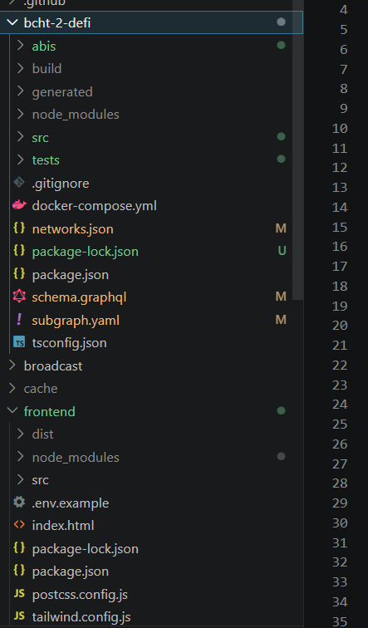
Audit Summary
SCOPE: GOVERNORCORE.SOL · GOVERNANCETOKEN.SOL · QUADRATICMATHLIB.SOL
Methodology
All Critical Findings — Fixed
Automated: Slither static analysis + Foundry fuzzing with 256+ iterations
ACC-01: Missing initializer protection → Fixed
Manual: Exhaustive line-by-line code review of all custom contracts
LOG-01: Integer overflow in sqrt → Fixed with SafeCast
GAS-01: Suboptimal sqrt → Optimized with Yul + Babylonian method
LOG-02: Zero-weight votes → Blocked

Slide 13
Audit Findings Overview
All identified vulnerabilities have been resolved or formally acknowledged. No outstanding critical or high-severity issues remain prior to deployment.
Finding ID
Severity
Location
Component
Status
ACC-01
High
GovernorCore.sol
Access Control
Fixed
LOG-01
High
QuadraticMathLib.sol
Logic
Fixed
GAS-01
Medium
QuadraticMathLib.sol
Gas
Fixed
LOG-02
Low
GovernorCore.sol
Logic
Fixed
GAS-02
Low
GovernorCore.sol
Gas
Acknowledged

Slide 14
Centralization & Operational Security
Decentralized Design
Security Council
Social Engineering Resilience
Deployer role fully renounced after deployment
Governance contract owns all critical protocol functions
Timelock enforces a mandatory execution delay as a final safeguard
3-of-5 multisig threshold for emergency actions only
Geographically distributed signers
Hardware wallets and a two-person rule are enforced
PGP-verified communications for all governance actors
Immutable on-chain documentation trail
Transparent, publicly auditable governance history

Slide 15
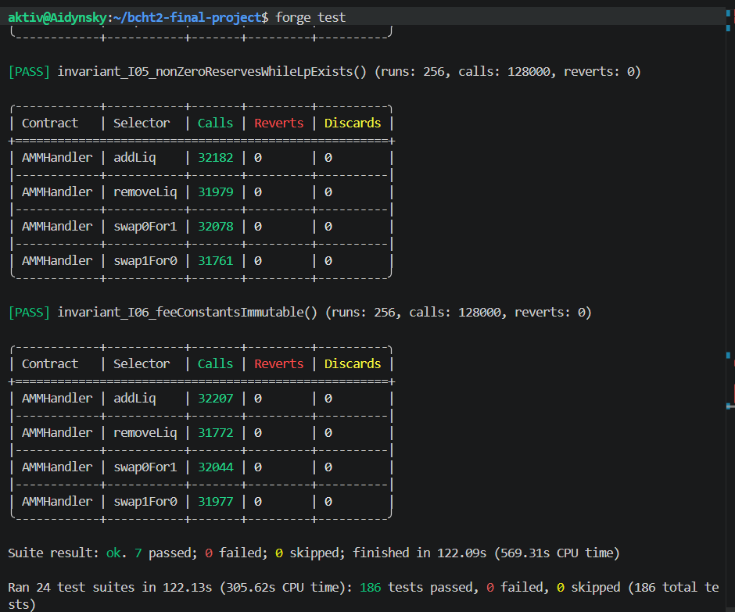

Slither Static Analysis
A comprehensive static scan was conducted across all custom contracts and inherited OpenZeppelin modules to surface potential vulnerabilities before manual review.
Overall Result: Clean for a production governance system — no unresolved critical flags.
Broad coverage: All custom logic and OZ base contracts were scanned exhaustively
Yul / Assembly: Inline assembly usage was flagged, reviewed, and justified for gas optimisation
All flags accepted: Every warning was assessed in full operational context

Slide 16
Conclusion
BCHT2 demonstrates that democratic fairness and economic security can coexist in on-chain governance.
Quadratic Voting
An innovative governance model that diminishes whale dominance and amplifies minority voices.
Flash Loan Defence
Snapshot-based voting power and contract-level reverts eliminate flash-loan attack vectors.
Professional Security
Timelock, multi-sig council, audits, and Slither analysis establish a rigorous security posture.
Efficient Data Layer
The Graph integration enables fast, reliable, decentralized query access for governance data.

Slide 17
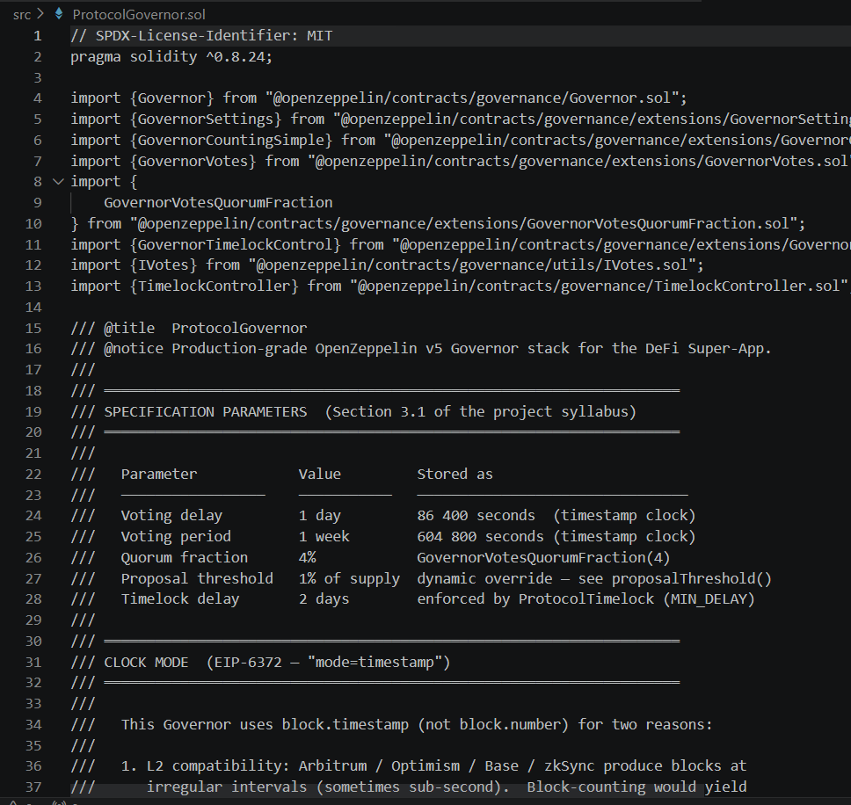

Thank You & Q&A
Repository & Commit
Questions?
github.com/Aidynnnn/finalblock
The floor is open for technical questions on the protocol architecture, security posture, governance mechanisms, or deployment strategy.
Commit: c05613f
Status: Ready for mainnet deployment
Slides, audit reports, and contract source code are all publicly accessible via the repository above.

