Slide 1
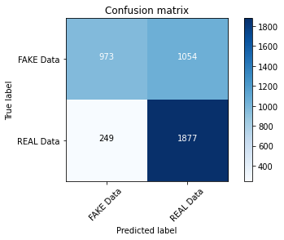
N-Model: 68% Accuracy

Slide 2
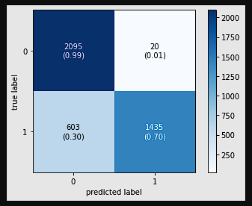
Multinomial Naïve Bayes : 84% Accuracy

Slide 3
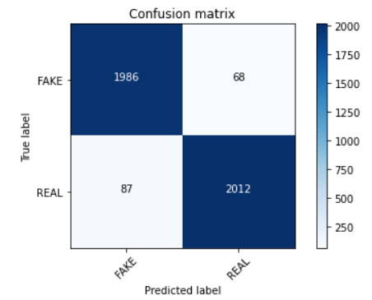
Passive Aggressive: 96% Accuracy

Slide 4
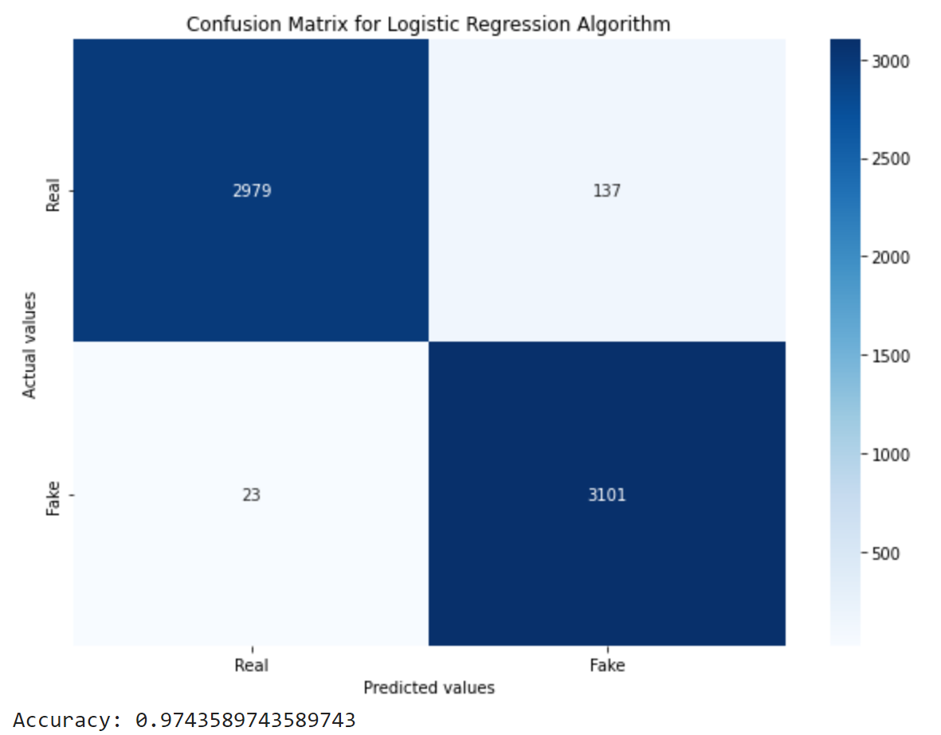
Logistic Regression: 97% Accuracy

Slide 5
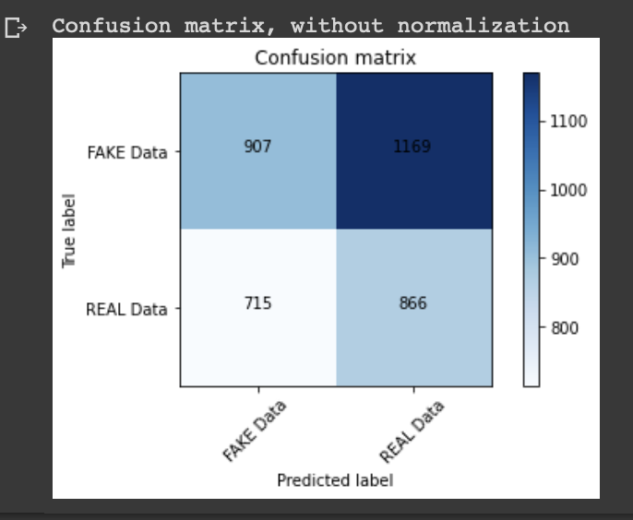
Long-Short-Term-Memory : 90% Accuracy

