Slide 1
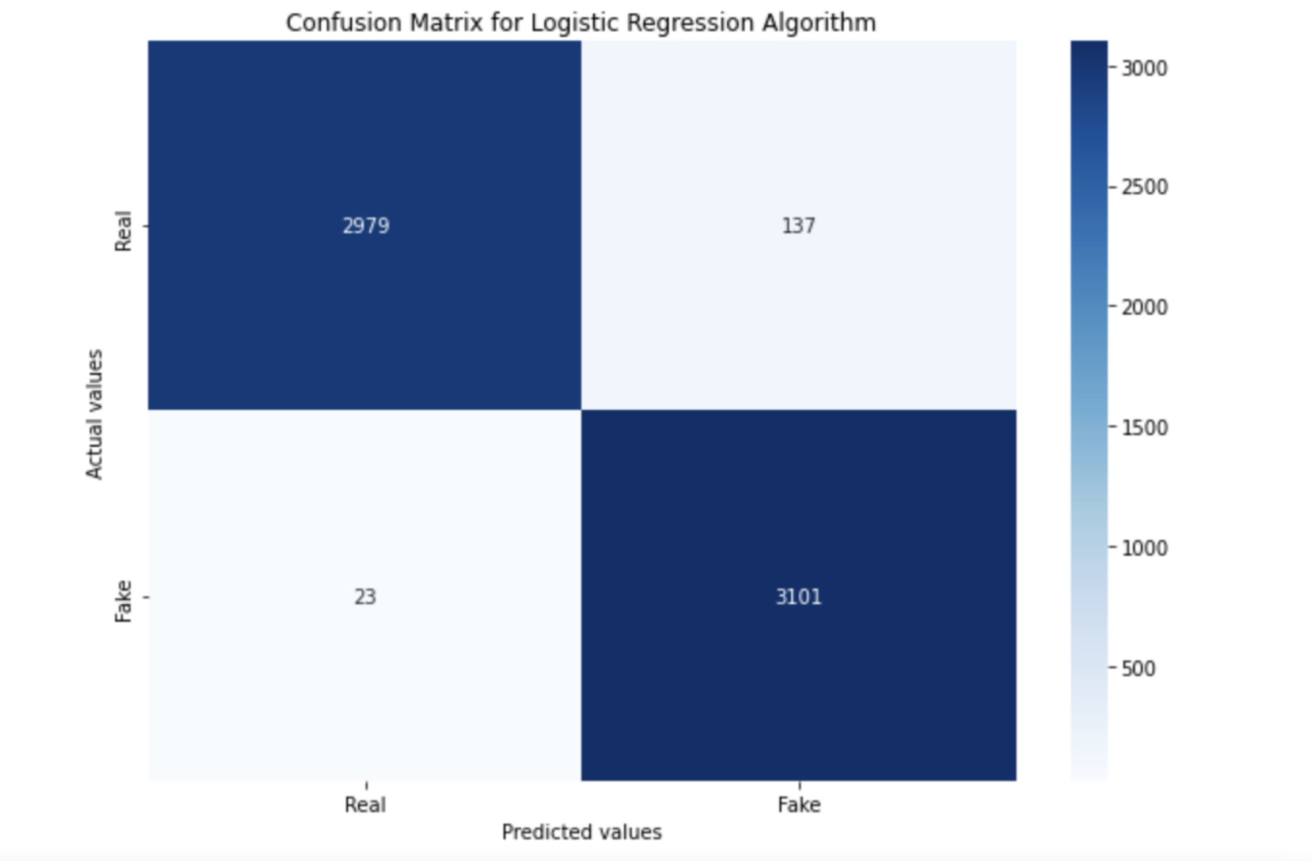
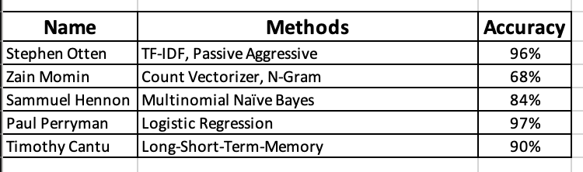


Group1: Using Natural Language Processing to Determine Fake News Accuracy
Timothy Cantu, Samuel Hennon, Zain Momin, Stephen Otten, Paul Perryman, Kevin Desai, The University of Texas at San Antonio, San Antonio, TX 78249
ABSTRACT
METHODOLOGY
This poster reports the significant details and findings from Group 1’s project over using NLP approaches to determine Fake News. Background discusses why Group 1 chose the topic of NLP. Purpose states the overall goal behind this project. Hypothesis states the general idea the group had before work began. Methodology shows all the different approaches the group used for the project. Results shows the outcomes of all the approaches used. Conclusions states the summary of the project’s results and other points of interest.
Each group member used and tested a different NLP method to implement. All of the models were tested with a common dataset to analyze common results.
Timothy Cantu: Long-Short-Term-Memory
Samuel Hennon: Multinomial Naïve Bayes Model
Zain Momin: Count Vectorizer with N-Gram
Stephen Otten: TF-IDF Word Vectorizer with Passive Aggressive Classifier.
Paul Perryman: Logistic Regression (TFIDF)
BACKGROUND
NLP research seemed very interesting to get into. We decided to to dive deeper into Multinomial Naïve Bayes Model, used in spam research. As well as Count Vectorizer with N-Gram for auto competition when typing up a sentence. One of the last ones we did research upon was Linear Regression Model used in medical research. NLP is widely used in many real-world applications.
RESULTS
Figure #2. Confusion Matrix of Paul Perryman
The results found that Logistic Regression (TFIDF) yielded the highest accuracy out of the five methods. The libraries for python have become so advanced and efficient, implementation is quick while still being accurate. The lowest accuracy was Count Vectorizer with N-Gram because KNN is not the most efficient classifier due to try to find the nearest relationship neighbor. This is in direct correlation of what the group hypothesized based off the research articles documented in the References section. The results for each group member are posted below in Table #1. The group included Figure #2 to show the model that yielded the highest accuracy in the form of a Confusion Matrix.
CONCLUSION
Multinomial Naïve Bayes Model trains the fastest but not as as accurate compared to the other models.
When using the unigram feature for N-gram is the best methodology.
Training time took the longest for Long-Short-Term-Memory.
Based off our findings we found NLP is a very broad field and new findings are coming up frequently.
Further research is needed for each method to train and test the data further for better accuracy.
PURPOSE
The purpose of this project is to test different NLP models against one another to find a model that is optimal in determining fake news accuracy.
HYPOTHESIS
Based off the group’s research we hypothesize Linear Regression Model to yield the highest accuracy, while Count Vectorizer with N-Gram will yield this lowest.
Table #1. Accuracy results of NLP Methods.
REFERENCES
https://www.researchgate.net/publication/311990858_Attention-based_LSTM_for_Aspect-level_Sentiment_Classification,https://iopscience.iop.org/article/10.1088/1742-6596/2007/1/012047/pdf, https://www.irjet.net/archives/V6/i5/IRJET-V6I5733.pdf,
CS 3793 AI, Group 1: Using NLP Approaches to Determine Fake News

