Slide 1

Binary Classification of Populist Speech
Alessandro Pala
Lorenzo Cino
Greta Grelli
Alberto Calabrese
Giacomo Filippin

Slide 2
Abstract
Classification of speeches as populist or non-populist using fine-tuned pre-trained language models.
Models evaluated:
BERT-tiny
BERT-large
GPT-2
RoBERTa-large
Alessandro Pala

Slide 3
Populism
Populism in political speech: Identifying deceitful media.
Definition of populist speech: society split into "the pure people" vs "the corrupt elite".
Politics as the expression of the people's will.
Lorenzo Cino

Slide 4
Populism
<< Modern Socialism is, in its essence, the direct product of the recognition, on the one hand, of the class antagonisms existing in the society of today between proprietors and non-proprietors, between capitalists and wage-workers; on the other hand, of the anarchy existing in production. Like every new theory, modern Socialism had, at first, to connect itself with the intellectual stock-in-trade ready to its hand, however deeply its roots lay in material economic facts. >> Socialism: Utopian and Scientific, Friedrich Engels
<< We win when we are united. Democracy is about one person, one vote. It's about all of us coming together to determine the future of our country. It is not about a handful of billionaires buying elections, or governors suppressing the vote by denying poor people or people of color the right to vote. >> Our Revolution: A Future to Believe In, Bernie Sanders
Lorenzo Cino

Slide 5




Dataset
500 speeches: 250 populist, 250 non-populist.
Data format: .xlsx file with speeches and labels.
Data sources: Digital repositories, newspaper transcripts, academic material.
Language diversity: peeches translated using deep learning models.
Alessandro Pala

Slide 6
Methodology - Preprocessing
Dataset split: 80-20 (training-testing).
Tokenization: Using model-specific tokenizers.
Attention masks for token differentiation.
Data loaders for batching and shuffling.
Custom sequence classification with dropout layer.
Alessandro Pala

Slide 7
Methodology - Model Fine-Tuning
Models: BERT-tiny, BERT-large, GPT-2, RoBERTa-large.
Training with Adam optimizer, dynamic learning rate.
Gradient clipping to prevent exploding gradients.
Batch sizes adjusted to avoid GPU memory overload.
Alessandro Pala

Slide 8
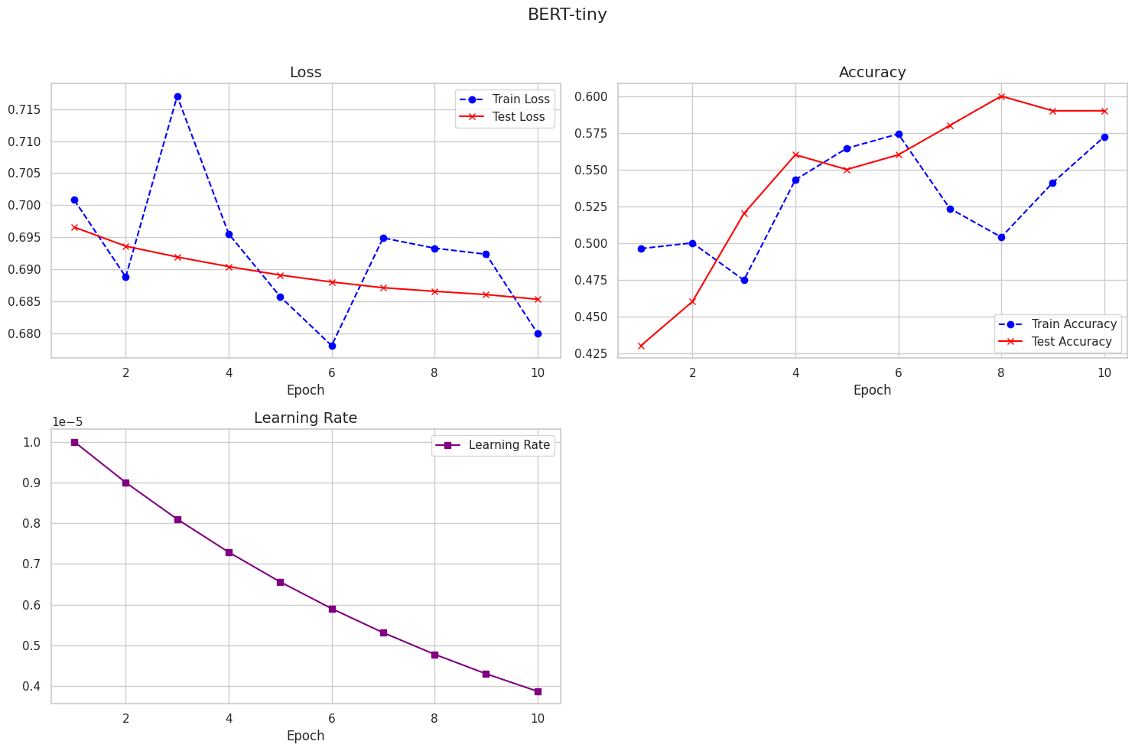
Model Performances - BERT-tiny
Training epochs: 10
Accuracy slightly above random
Noisy performance trends.
Alberto Calabrese

Slide 9
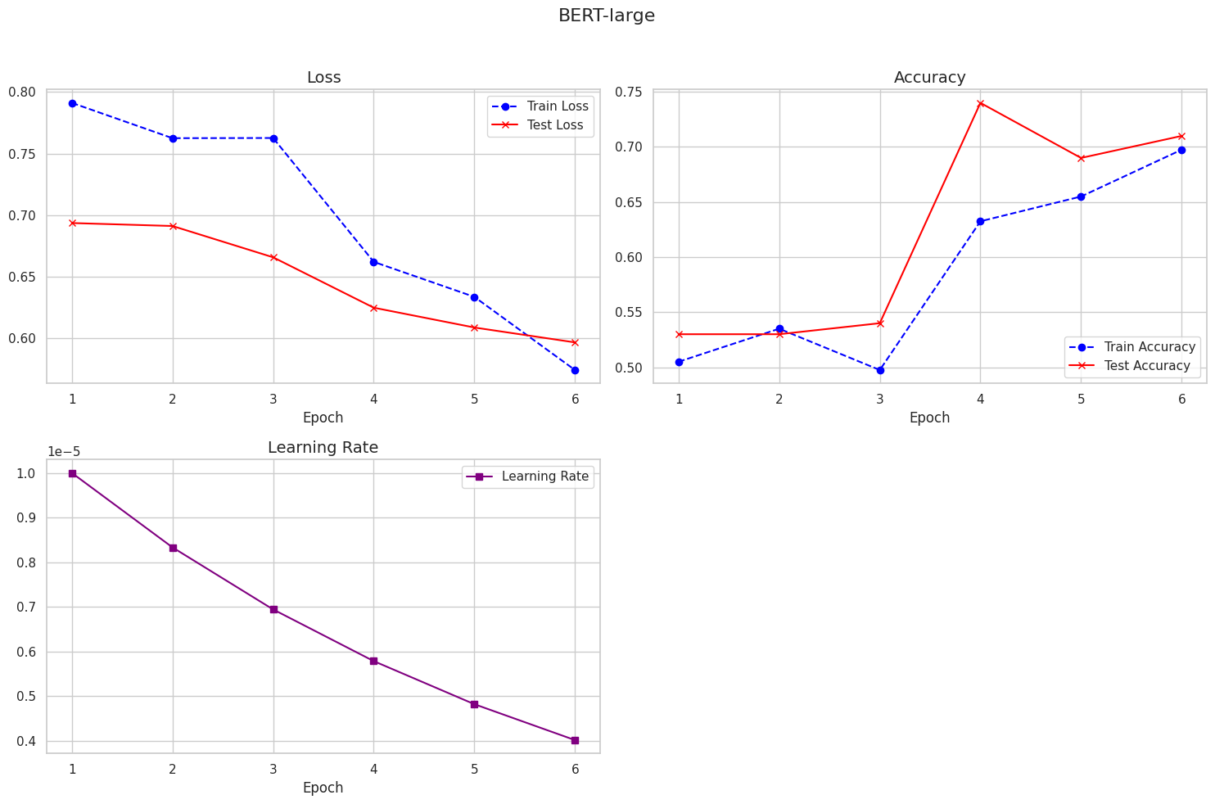
Model Performances - BERT-large
Training epochs: 6
Loss: Approximately 0.57
Accuracy: About 0.71
Improved performance but plateaued.
Lorenzo Cino

Slide 10
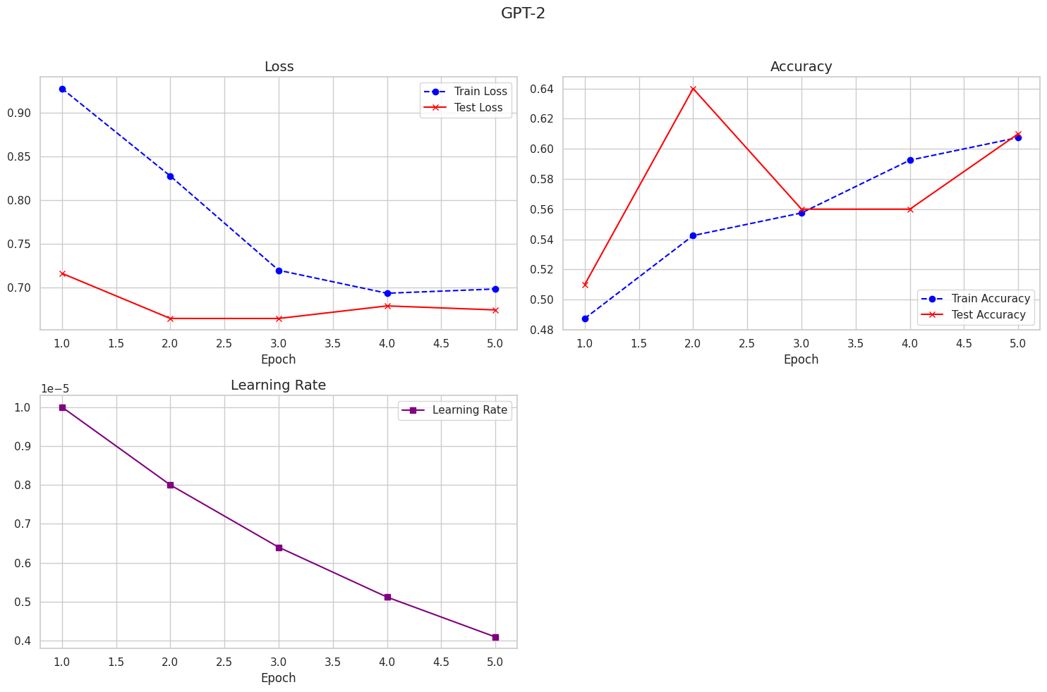
Model Performances - GPT-2
Training epochs: 5
Loss: Slight improvement, 0.67
Accuracy: Noisy, between 0.50 and 0.64
Struggles with text classification tasks.
Giacomo Filippin

Slide 11
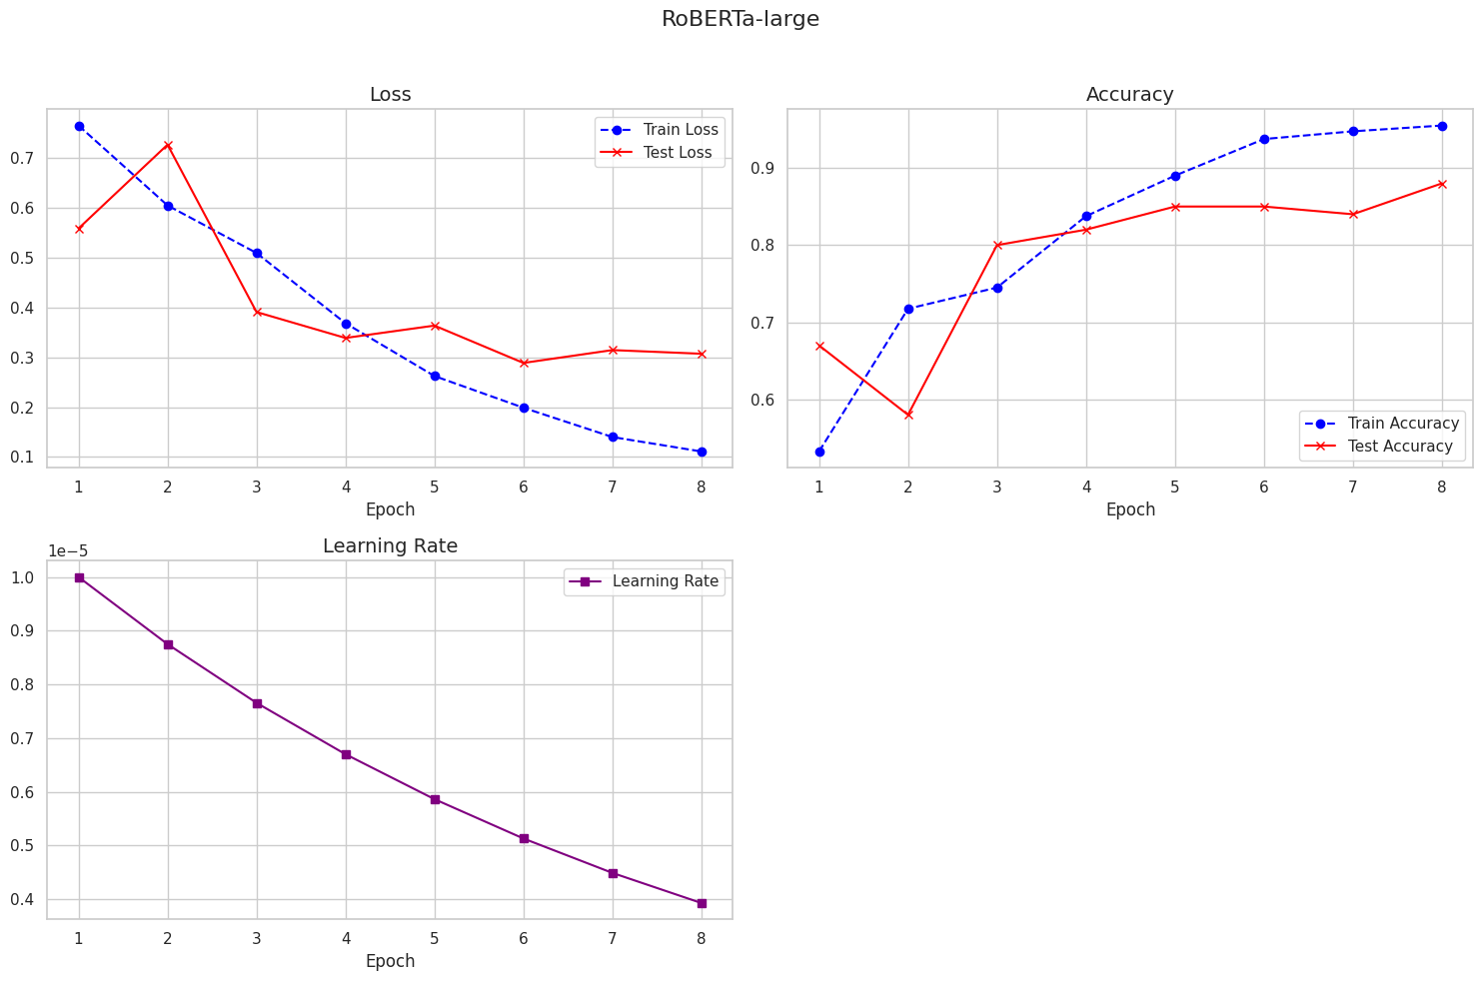
Model Performances - RoBERTa-large
Training epochs: 8
Loss: 0.2
Accuracy: 0.88
Best performing model.
Greta Grelli

Slide 12
Conclusion
RoBERTa-large is the most effective model with 88% accuracy.
Encoder-only models are suitable for binary classification tasks.
Future work: Expand dataset size, explore alternative model structures, train models to assign varying levels of populism.

Slide 13





Greta
Alessandro
THANK YOU
Giacomo
Alberto
Lorenzo

Slide 14

Want to test how populist you are? Run our model!

