Slide 1
Frank-Wolfe Variants for White-Box Adversarial Attacks
Tanner Aaron Graves – 2073559
Alessandro Pala – 2107800
June 2024

Slide 2
Project Scope
Models
1.1 Frank Wolfe (FW)
1.2 Frank Wolfe with Momentum (M-FW)
1.3 Away Steps Frank Wolfe (AFW)
1.4 Pairwise Frank Wolfe (PFW)
Problem Formulations
2.1 L2 vs L∞ Constraint Norms
2.2 Targeted vs. Untargeted Attacks
2.3 Step-size: Decay, Exact Line-searching, Amijo
Results on Models
3.1 MNIST (LeNet)
3.2 FashionMNIST
3.3 CIFAR10 (ResNet-20)

Slide 3
Adversarial attacks on deep neural networks create minimally perturbed examples that degrade model performance.
White-box attacks exploit a model's architecture and gradients to craft these adversarial examples.
The Frank-Wolfe algorithm and its variants are efficient in constrained optimization, making them suitable for generating adversarial examples.
Frank-Wolfe and its variants to non-convex problems, optimizations affecting convergence and attack efficacy.
Performance comparisons are made on MNIST, FashionMNIST, and CIFAR-10 datasets.

Slide 4
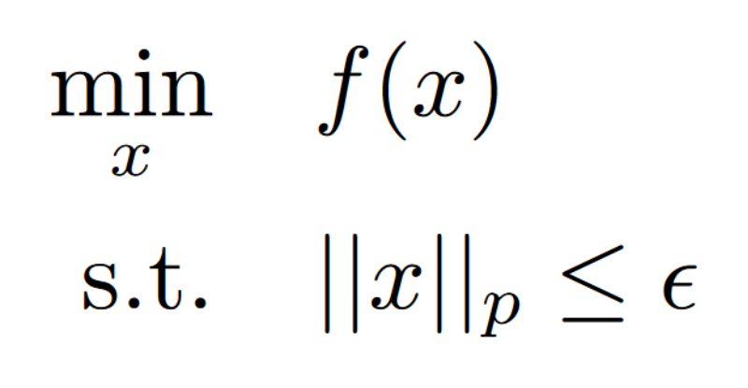
Adversarial attacks on Convolutional Neural Networks (CNNs) are framed as constrained optimization problems:
For untargeted attacks, f(x) = -ℓ(x, ŷ), while for targeted attacks, f(x) = ℓ(x, y), aiming to maximize the likelihood of an incorrect class y ≠ ŷ. The Lp constraint limits the perturbation size to ensure minimal perceptibility, where p can be 2 or ∞. This makes traditional gradient descent ineffective, necessitating methods like Frank-Wolfe that inherently respect constraints.

Slide 5


Problem statement
The Frank-Wolfe (FW) algorithm is ideal for our problem because it maintains feasibility within the constraint set at each iteration through a Linear Minimization Oracle (LMO):
The LMO ensures significant progress towards the solution while respecting constraints, enhancing efficiency and convergence.
Convergence criterion given by FW gap less than threshold:

Slide 6
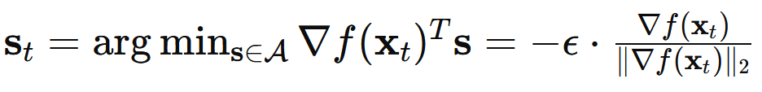
Problem statement
We have closed form solutions depending on the p.
For p = ∞,
For p = 1,
For p = 2,

Slide 7
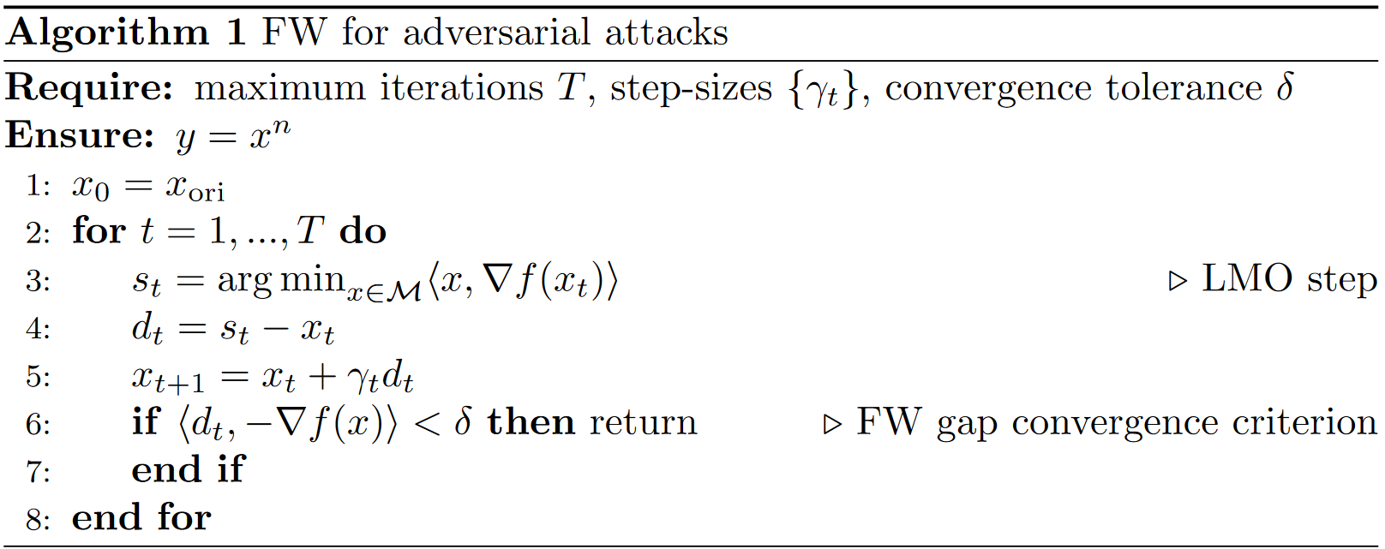
The Frank-Wolfe algorithm

Slide 8
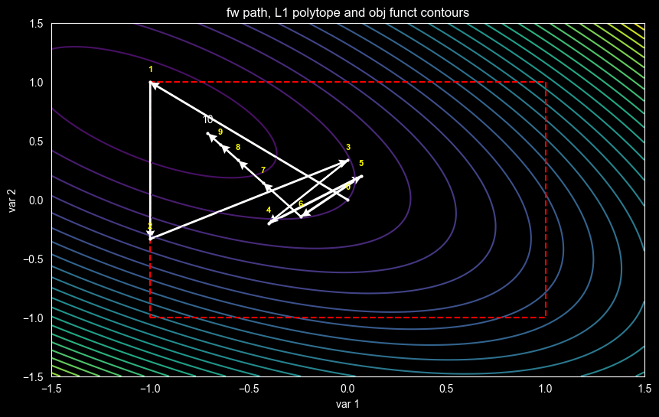
How general Frank-Wolfe works

Slide 9
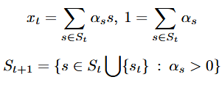
FW Variants
Momentum Frank-Wolfe (generic, applicable to the two below):
Adds momentum to improve convergence by considering an exponentially weighted average of gradients.
Away-Step Frank-Wolfe (AFW):
Moves away from bad atoms in the active set to reduce oscillations and improve convergence when the optimal point lies on the boundary.
Pairwise Frank-Wolfe (PFW):
Transfers mass between good and bad atoms, improving convergence rates by directly reducing the influence of bad atoms.
AFW and PFW variants exploit intrepretation of FW algorithims as expressing each iteration as a convex combination of past directions or ‘atoms’ selected by the LMO:

Slide 10
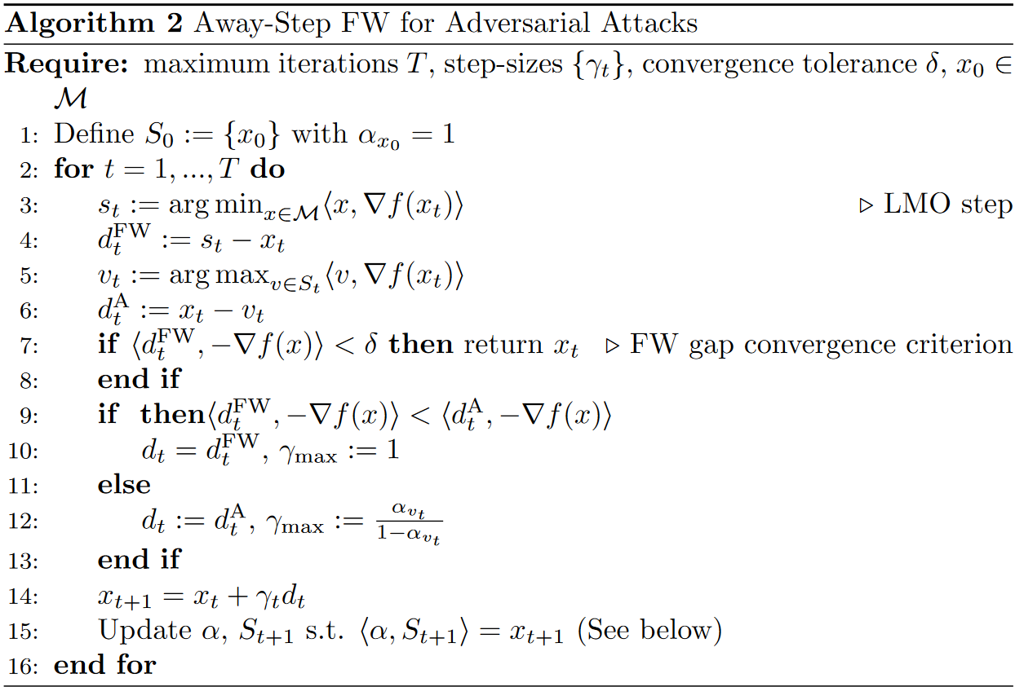
AFW:

Slide 11
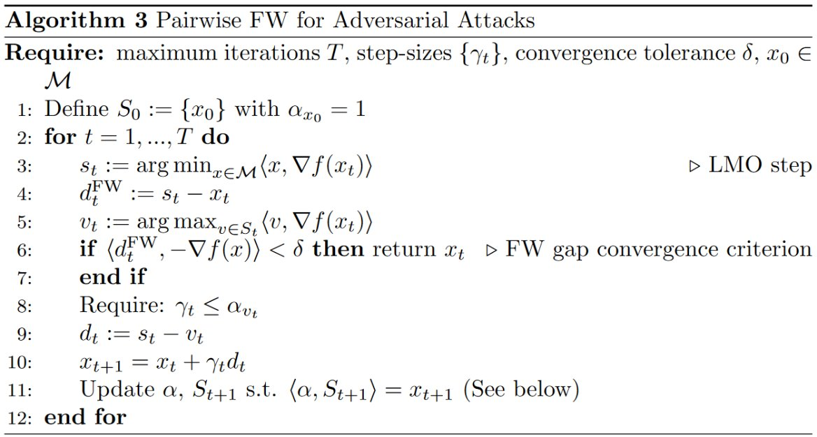
PFW:

Slide 12
Setup
We used three pre-trained models:
LeNet5: A small CNN with 62,706 parameters trained on the MNIST dataset for digit classification.
Medium-sized CNN: Trained on the FashionMNIST dataset for clothing classification.
ResNet-20: A large CNN with 20 layers trained on CIFAR-10 for object classification.

Slide 13
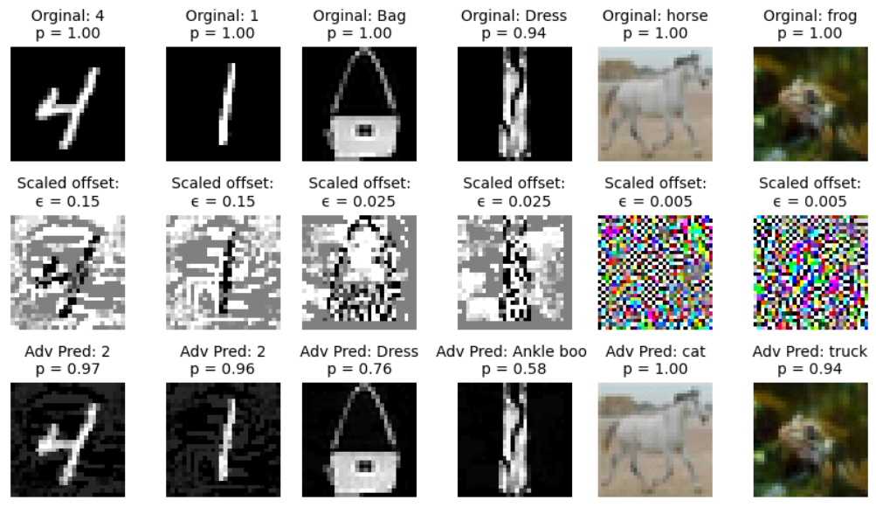

Slide 14
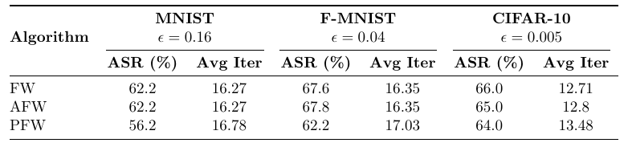
Some results
We compare the Frank-Wolfe algorithm and its variants based on:
Attack Success Rate: The percentage of successful (targeted) adversarial examples generated (accuracy).
Average Iterations: The average number of iterations required for convergence (FW gap < 0.1).
Attacks are stable: Different FW varients are most often learn nearly identical perturbations.

Slide 15
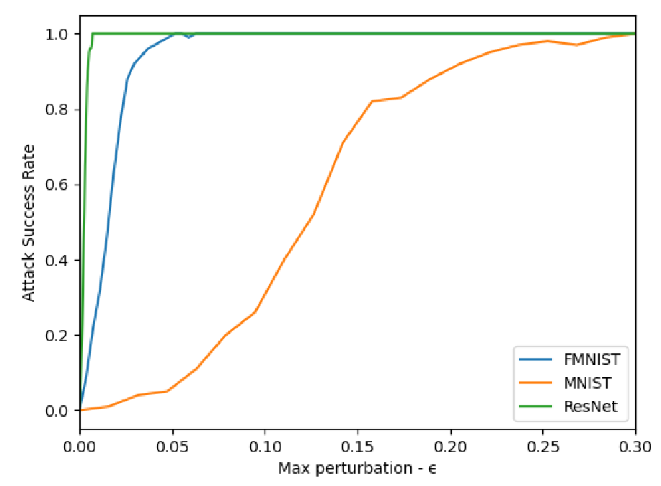
Effect of epsilon
The choice of ϵ significantly affects attack success rates.
Attack success rates vs. ϵ values for each dataset with L∞ constraint show that larger (and more complex) models like ResNet-20 and the FashionMNIST pretrained are more susceptible to attacks with smaller ϵ values compared to LeNet5.

Slide 16
Targeted vs. Untargeted Attacks
Targeted vs. Untargeted Attacks:
Untargeted attacks aim to misclassify an input as any incorrect class, while targeted attacks aim to misclassify an input as a specific incorrect class.
Comparison (Res-Net, CIFAR10, ϵ = 0.005):
Untargeted: Success rate = 93%, Average iterations = 5.44.
Targeted: Success rate = 63%, Average iterations = 13.26.

Slide 17
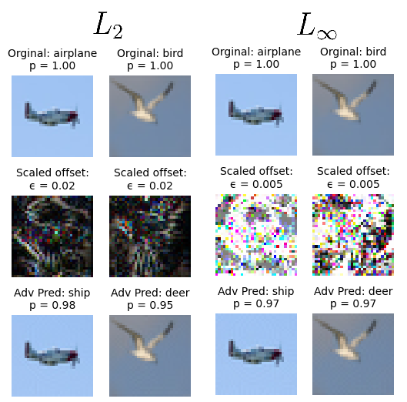
Constraint norms
We compared L∞ and L2 constraints:
L∞ focuses on maximum perturbation per pixel.
L2 focuses on the sum of squared perturbations.
L2 constrained attacks tend to be more efficient but slightly more perceptible.

Slide 18
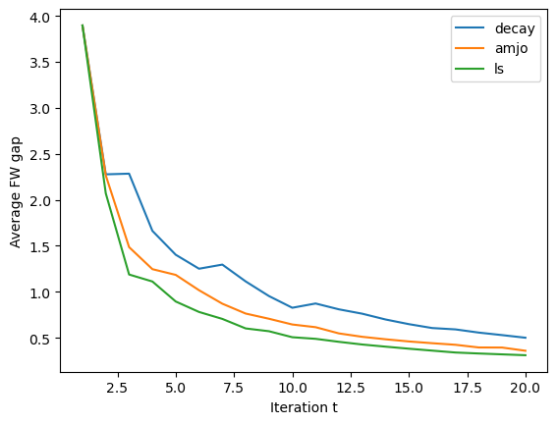


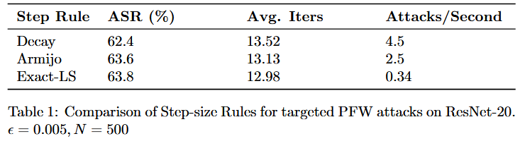

Step sizes
Fixed step size: Determined using the Lipschitz constant (for each model's example space).
Decaying step size: Decreases over time as
Exact ls: Solves
Armijo-rule ls: Ensures sufficient decrease condition in the obj function by iteratively checking
Results: line-searching techniques were marginally beneficial compared to decaying step-size.

Slide 19
Momentum Impact
Normal FW: ASR =65.4%, Average iter = 12.78.
FW with Momentum: ASR = 66.6%, Average iter = 9.81.
Momentum significantly reduces the number of iterations required for convergence with slight improvement on attack success rate.

Slide 20
Variant Analysis
Naturally, the non-convex nature of DNN loss functions complicates convergence. However,
FW with momentum has a sub-linear convergence rate.
AFW and PFW achieve linear convergence rates in convex cases.

Slide 21
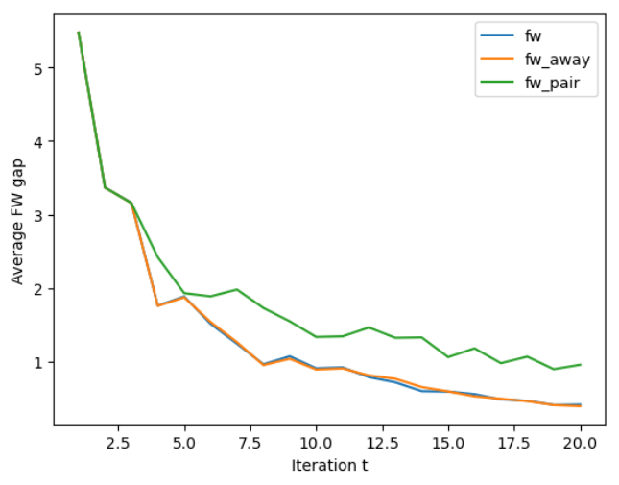
Variant Analysis
AFW seen to take between 10-20% away-steps depending on parameters, and is generally seen to be comparable to FW.
Analysis shows away steps to have typically only slightly better cost than FW direction. We attribute this to properities of spesific constraint set.
PFW seen to under perform. Often reducing or even dropping good atoms.

Slide 22
Conclusion
Frank-Wolfe and its variants are effective for generating adversarial examples within constraint sets.
Momentum FW significantly improves convergence rates.
AFW variants have contextual applications.
Choice of ϵ to be scaled with dataset and model complexity.

