Slide 1
Techniques in House Price Prediction
Alessandro Pala - alessandro.pala@studenti.unipd.it
Domenico Tremaggi - domenico.tremaggi@studenti.unipd.it

Slide 2
Overview
We tried predicting house prices with:
A linear regression
A regularized Poisson regression
A group lasso regression
A neural network
Enforce sparsity through feature selection – variables or groups.

Slide 3
Why These Models?
Linear Regression: Baseline with a simple model.
Poisson Regression with Elastic Net: Introduce sparsity and reduce multicollinearity.
Group Lasso: Test grouped predictors (real estate features vs highly correlated variables).
Neural Network: Establish an upper bound of predictive performance.

Slide 4
What We Expected
Feature regularization would outperform others due to the dataset’s dimensionality and multicollinearity.
Group Lasso to outperform other models given the nature of real-world price behavior.

Slide 5
Dataset
Attributes include temporal, physical, scenic, and locational characteristics.
Scale and preprocess features for machine learning compatibility.
Removed duplicates, dropped irrelevant columns, and scaled the data.
Created engineered variables for richer feature representation.

Slide 6

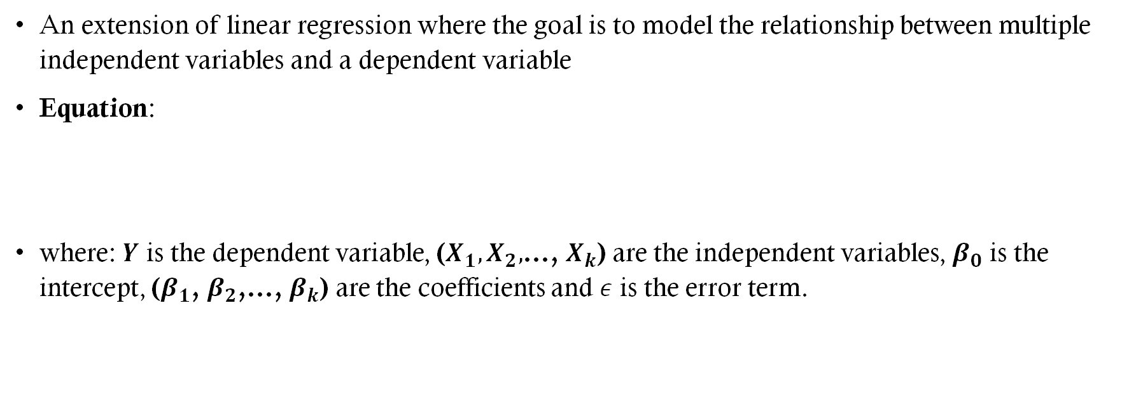
Multivariate Linear Regression
An extension of linear regression where the goal is to model the relationship between multiple independent variables and a dependent variable
Equation:
where: $Y$ is the dependent variable, ($X_{1},X_{2},$…, $X_{k}$) are the independent variables, $β_{0}$ is the intercept, ($β_{1}$, $β_{2}$,…, $β_{k}$) are the coefficients and $ε$ is the error term.

Slide 7
Multivariate Linear Regression
Results:
Adjusted R² = 1, low residual standard error.
Coefficients for bedrooms and intercept are statistically significant; others are not.

Slide 8
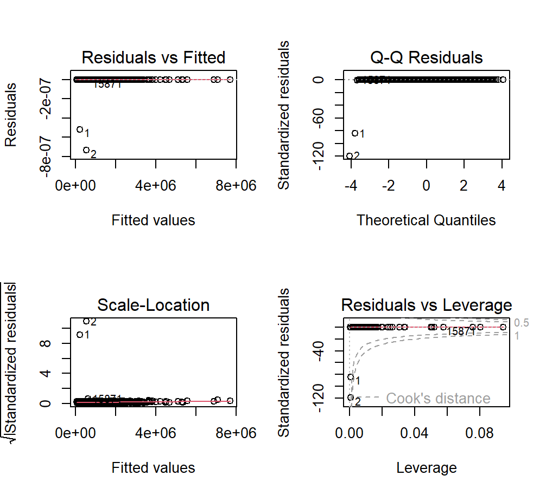
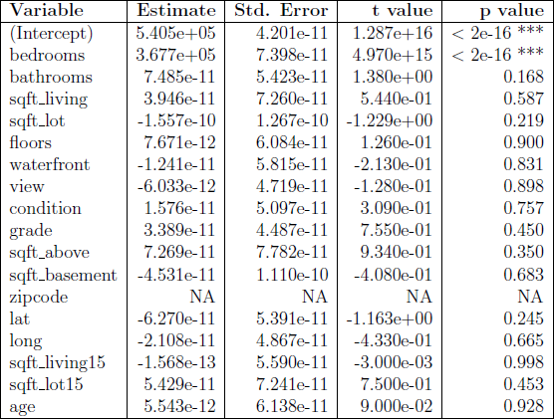
Multivariate Linear Regression

Slide 9
Multivariate Linear Regression
Interpretation
Overfitting evident in "too perfect" results.
Unsuitable.
But 'suggests' to take interest in the bedrooms variable.

Slide 10
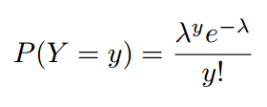

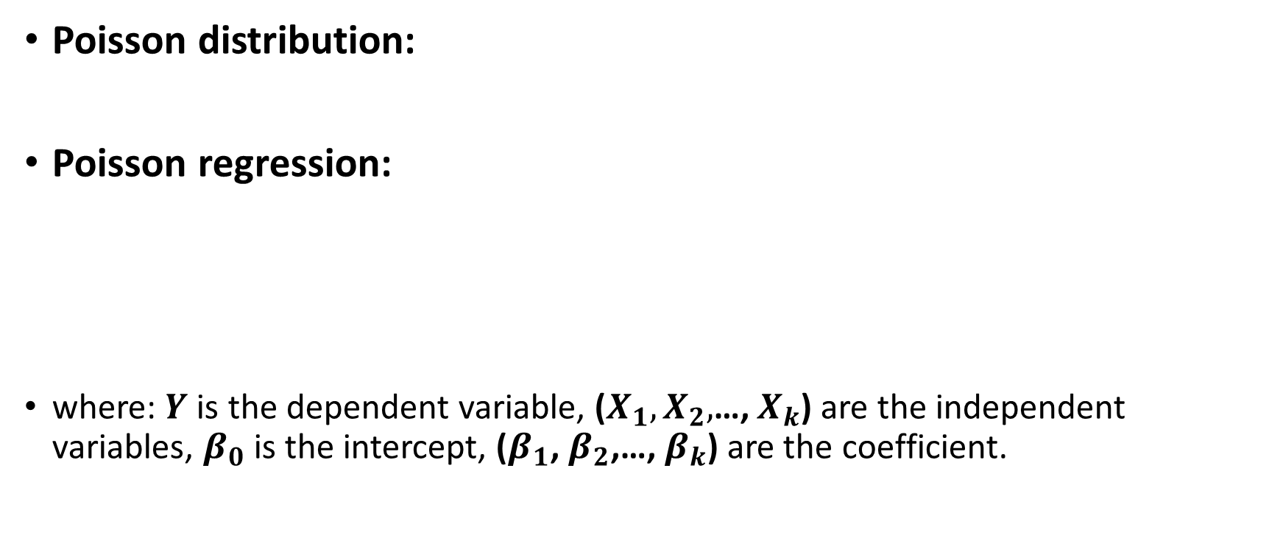
Poisson Regression with Elastic Net
Poisson distribution:
Poisson regression:
where: $Y$ is the dependent variable, ($X_{1},X_{2},$…, $X_{k}$) are the independent variables, $β_{0}$ is the intercept, ($β_{1}$, $β_{2}$,…, $β_{k}$) are the coefficient.

Slide 11
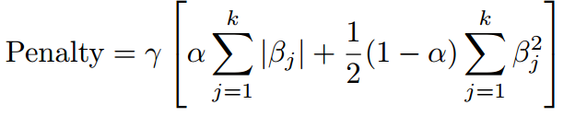
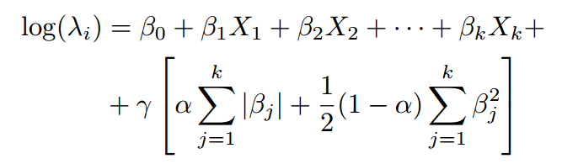

Poisson Regression with Elastic Net
Elastic Net: This kind of regularization combines $L_{1}$ and $L_{2}$ regularizations and applies penalty to coefficients
Where: γ controls the strength of the regularization, α controls the balance between Lasso and Ridge
Poisson regression with Elastic Net:

Slide 12
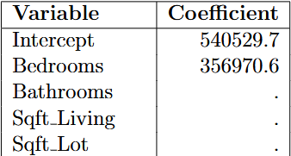
Poisson Regression with Elastic Net
Results:
Significant bedroom coefficient, effective sparsity enforcement.
Regularization mitigated overfitting observed in MLR.

Slide 13
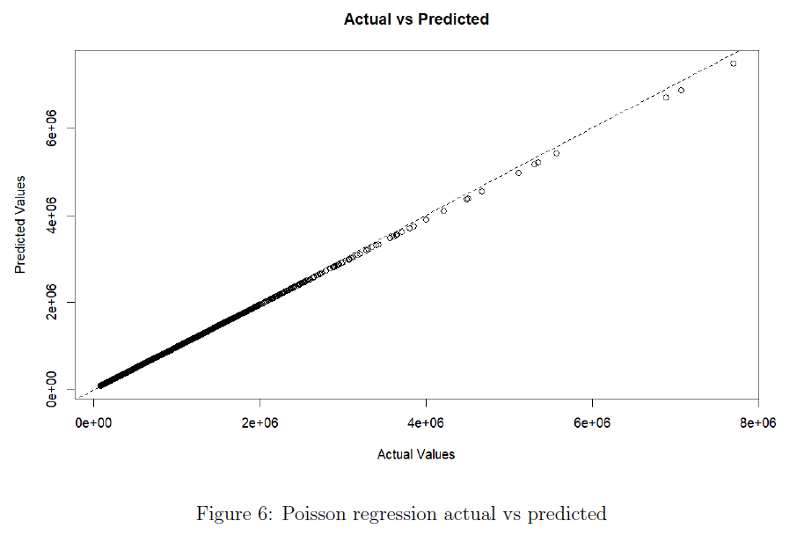
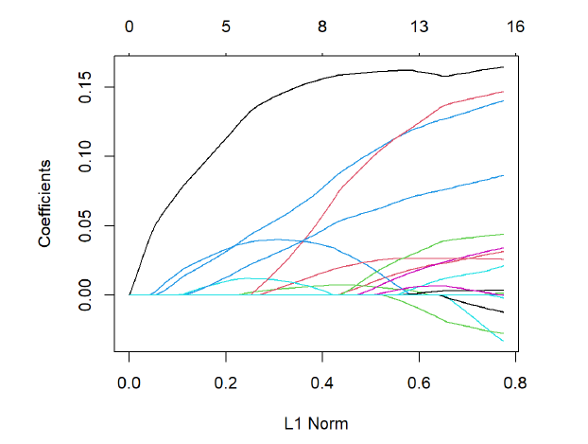
Poisson Regression with Elastic Net

Slide 14
Poisson Regression with Elastic Net
Interpretation
Bedrooms emerged as the most significant predictor, while other predictors were penalized.
Predicted values were consistent with actual target values, indicating good generalization.
Regularization likely the cause of good results rather than GLM.

Slide 15
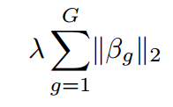
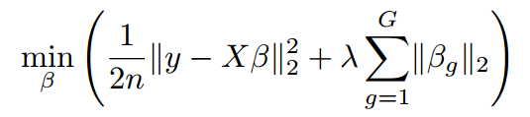
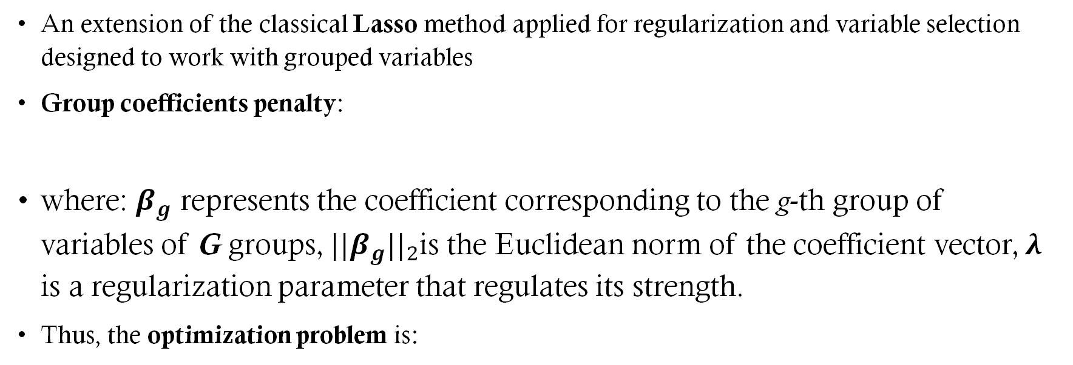
Group Lasso
An extension of the classical Lasso method applied for regularization and variable selection designed to work with grouped variables
Group coefficients penalty:
where: $β_{g}$ represents the coefficient corresponding to the g-th group of variables of G groups,${ ||β}_{g}{||}_{2}$is the Euclidean norm of the coefficient vector, λ is a regularization parameter that regulates its strength.
Thus, the optimization problem is:

Slide 16
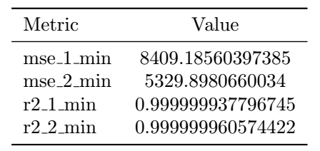
Group Lasso
Results:
Grouped variables did not outperform individual predictors.
Model struggled to capture better patterns than the others.
Cross-validation further showed that a very small lambda regularized correctly.

Slide 17
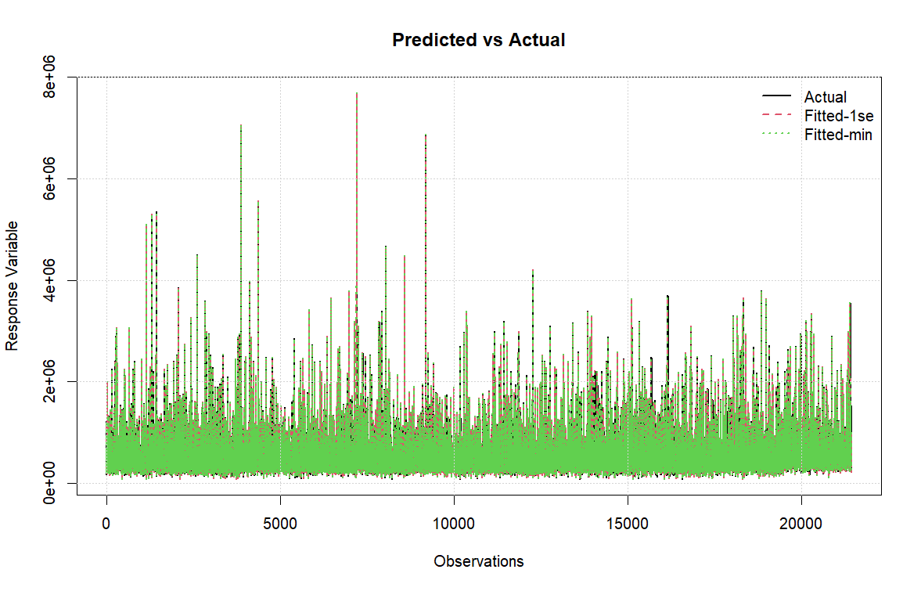

Group Lasso

Slide 18
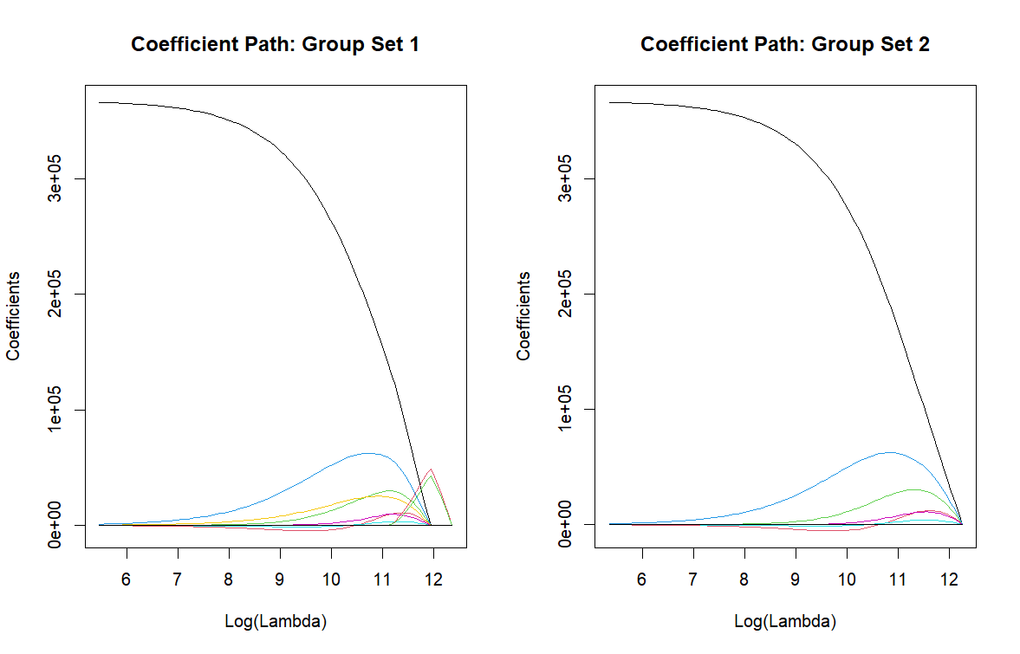
Group Lasso

Slide 19
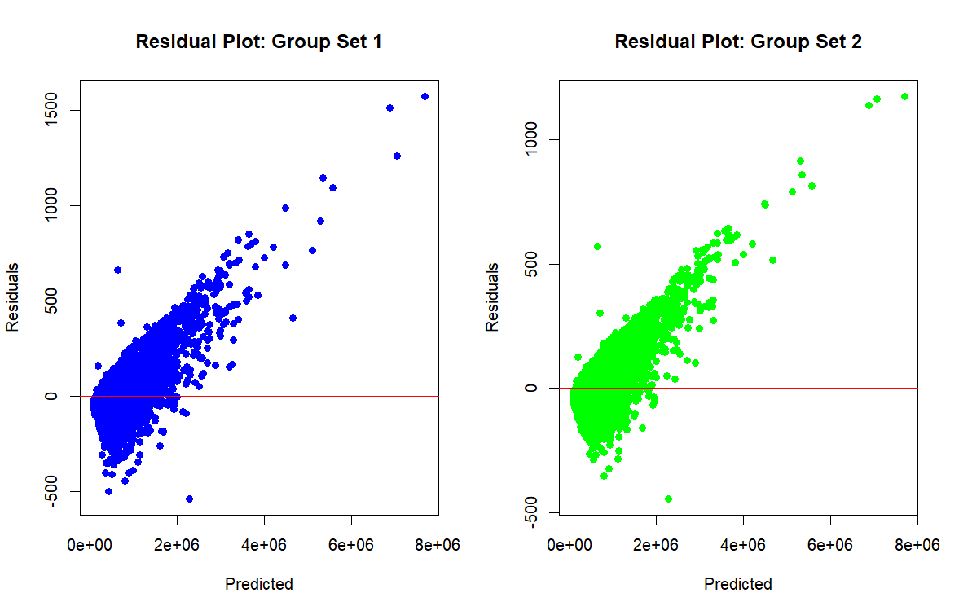
Group Lasso

Slide 20
Group Lasso
Interpretation
No meaningful relationships for the groups.
Grouping does not align with the dataset’s structure.

Slide 21
Neural Network
Architecture: Linear MLP with moderate depth.
Will the 'best' linear combination give perfect results?
self.hidden1 = nn.Linear(input_dim, 64)
self.hidden2 = nn.Linear(64, 128)
self.hidden3 = nn.Linear(128, 64)
self.output = nn.Linear(64, 1)

Slide 22
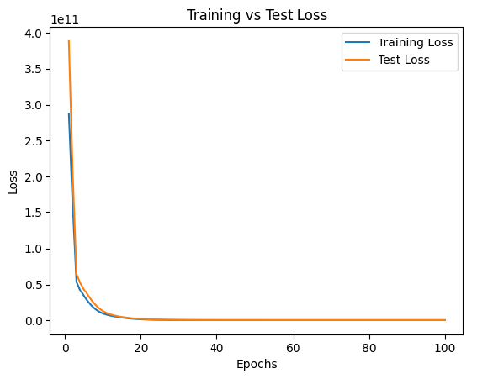
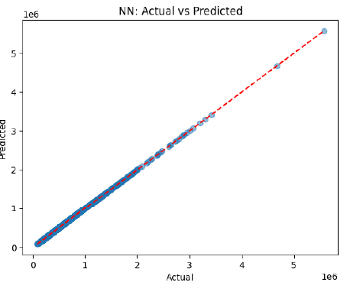
Neural Network

Slide 23
Neural Network
Interpretation
The Linear Neural Network worked like a charm.
We don't need fancy models to do predictions with this dataset.

Slide 24
Comparison
MLR: Overfit but tells us where to look.
Poisson Regression (Elastic Net): Nice sparsity and great accuracy.
Group Lasso: Effective but with no benefits.
Neural Network: Best performance is perfect performance even with linear models.

Slide 25
Conclusions
Is grouping variables based on hypotheses (e.g., real estate market trends or correlations) intuitively beneficial for modeling?
Testing this method on the dataset does not support this intuition.
The grouped regularization did not improve the predictions, likely due to the specific structure of the chosen data.

Slide 26
Conclusions
Regardless of testing methods, the data consistently identifies only one feature (bedrooms) as a predictor.
This outcome is inaccurate compared to real-world real estate price prediction models.
The result is unlikely to generalize to other datasets.

