Slide 1
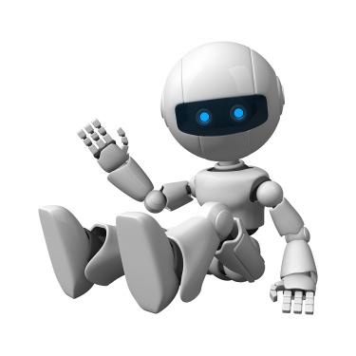
Support Vector Machine

Slide 2
Properties of SVM
Flexibility in choosing a similarity function
Sparseness of solution when dealing with large data sets
- only support vectors are used to specify the separating hyperplane
Ability to handle large feature spaces
- complexity does not depend on the dimensionality of the feature space
Overfitting can be controlled by soft margin approach
Nice math property: a simple convex optimization problem which is guaranteed to converge to a single global solution
Feature Selection

Slide 3
SVM Applications
SVM has been used successfully in many real-world problems
- text (and hypertext) categorization
- image classification
- bioinformatics (Protein classification,
Cancer classification)
- hand-written character recognition

Slide 4
Weakness of SVM
It is sensitive to noise
- A relatively small number of mislabeled examples can dramatically decrease the performance
It only considers two classes
- how to do multi-class classification with SVM?
- Answer:
1) with output arity m, learn m SVM’s
SVM 1 learns “Output==1” vs “Output != 1”
SVM 2 learns “Output==2” vs “Output != 2”
:
SVM m learns “Output==m” vs “Output != m”
2)To predict the output for a new input, just predict with each SVM and find out which one puts the prediction the furthest into the positive region.

Slide 5
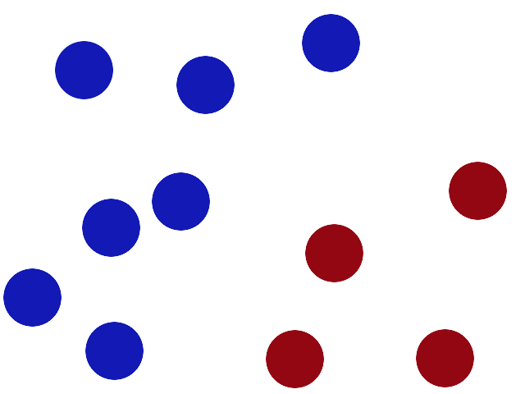
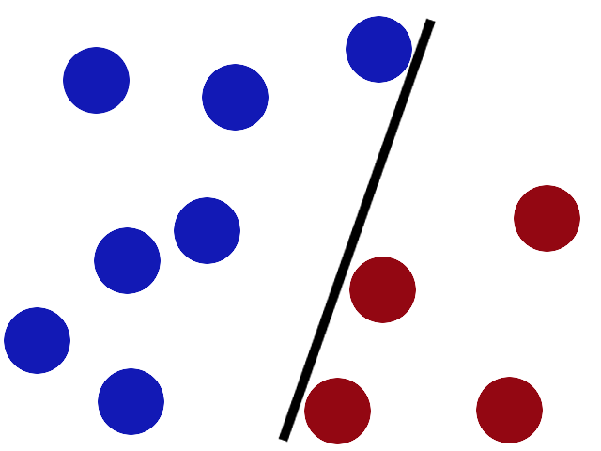
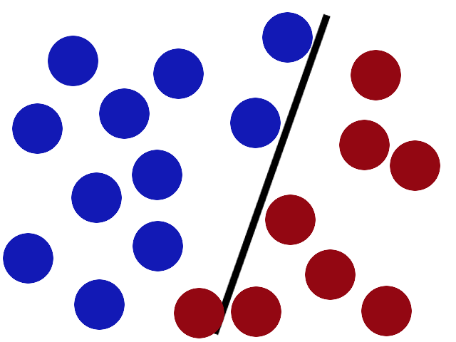
Simple explanation 1
We have 2 colors of balls on the table that we want to separate.
We get a stick and put it on the table, this works pretty well right?
Some villain comes and places more balls on the table, it kind of works but one of the balls is on the wrong side and there is probably a better place to put the stick now.

Slide 6
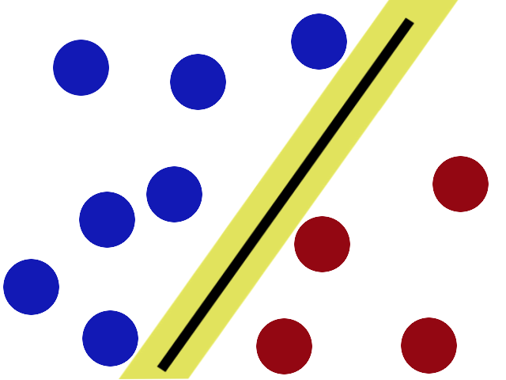
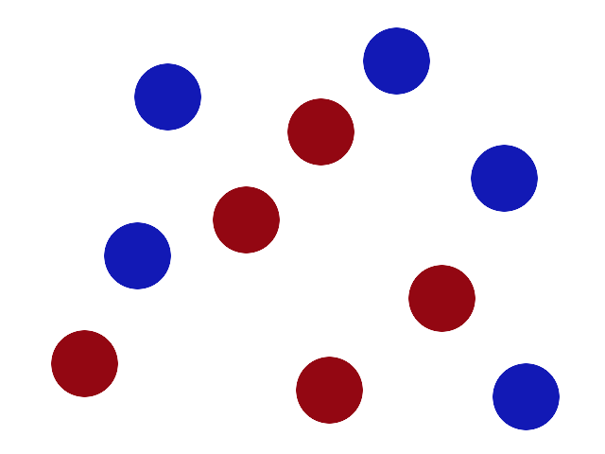
Simple explanation 2
SVMs try to put the stick in the best possible place by having as big a gap on either side of the stick as possible.
There is another trick in the SVM toolbox that is even more important. Say the villain has seen how good you are with a stick so he gives you a new challenge.

Slide 7
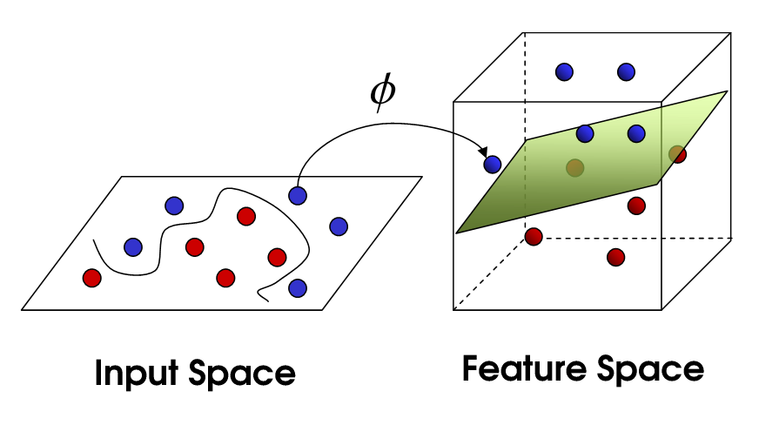
Simple explanation 3
There’s no stick in the world that will let you split those balls well, so what do you do? You flip the table of course! Throwing the balls into the air. Then, with your pro ninja skills, you grab a sheet of paper and slip it between the balls.

Slide 8
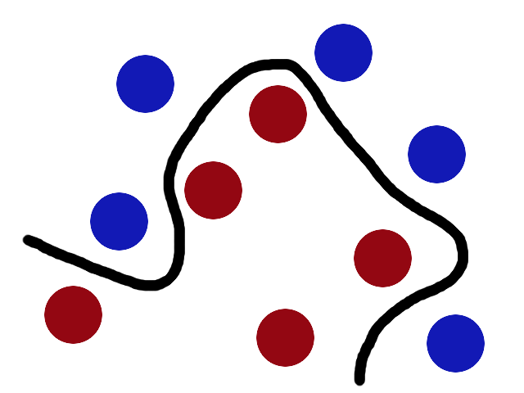
Simple explanation 4
Now, looking at the balls from where the villain is standing, they balls will look split by some curvy line.
Boring adults the call balls data, the stick a classifier, the biggest gap trick optimization, call flipping the table kernelling and the piece of paper a hyperplane.

Slide 9
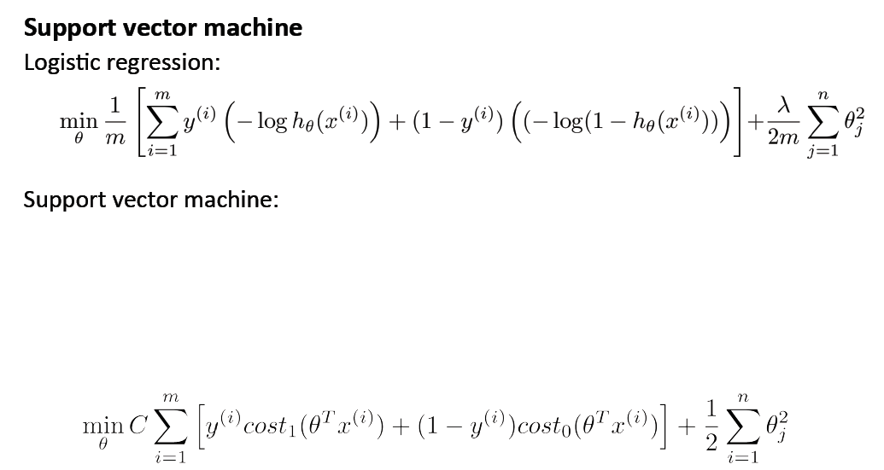
Another function is chosen instead of sigmoid.
1/m was reduced in both addendums
New constant C was added/ instead of lambda parameter.
In logistic Regression we tried to regularize THETTAS, on the contrary in SVM

Slide 10
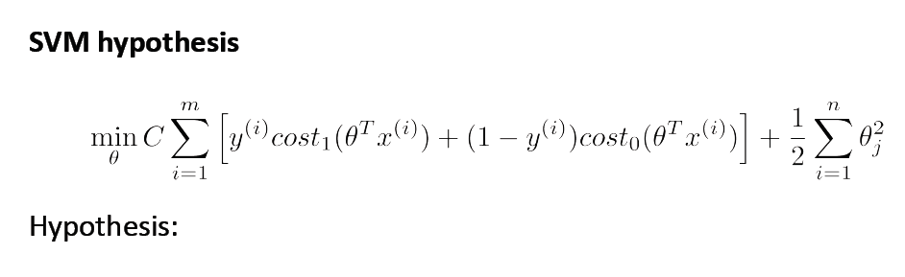
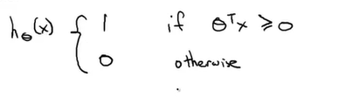

Slide 11
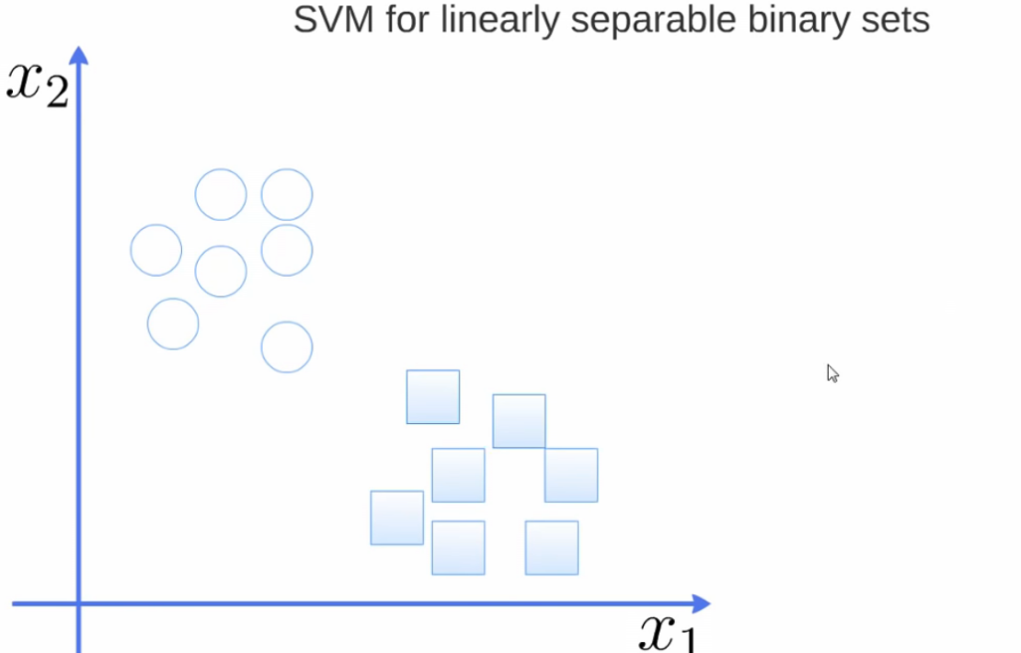
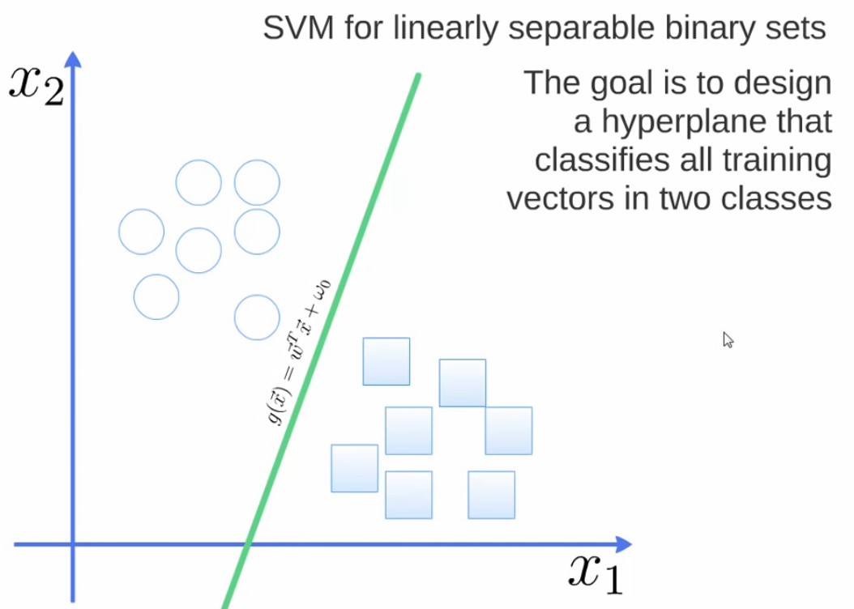
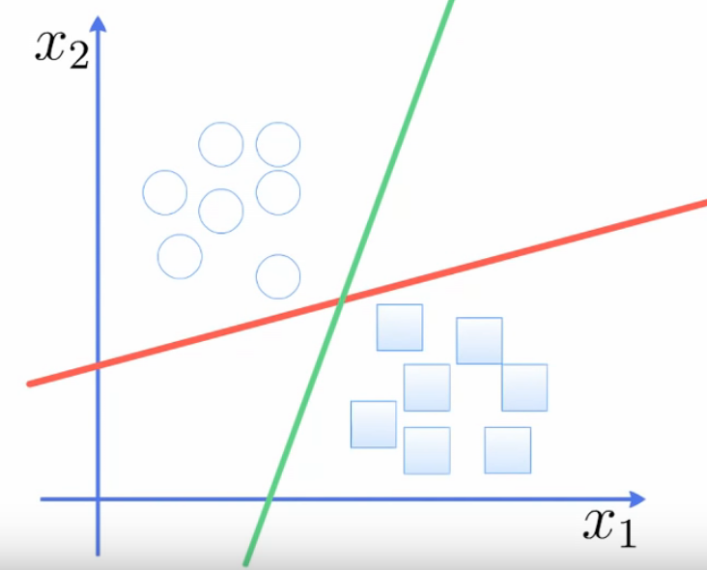
OR
Which one is best?

Slide 12
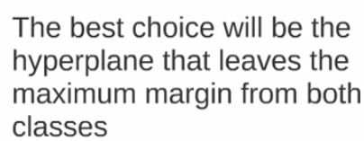
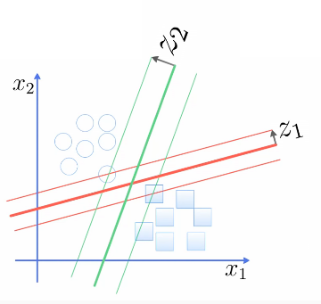
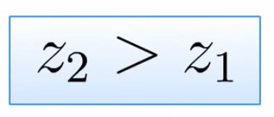
LMC
Large Margin Classifier

Slide 13
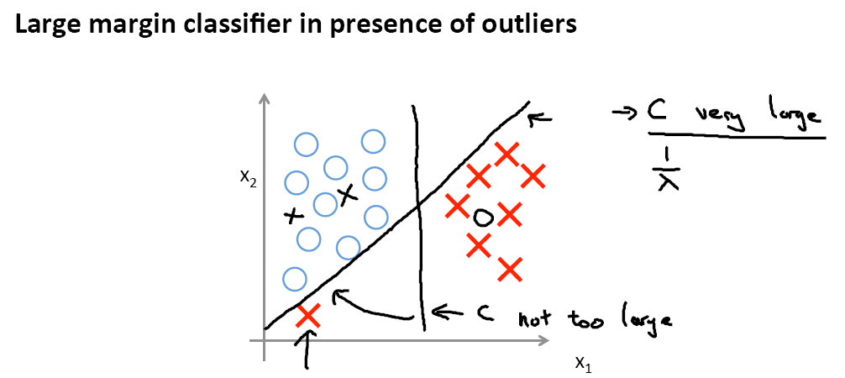
C plays a role similar to one over Lambda, where Lambda is the regularization parameter we had previously.
And so it's only of one over Lambda is very large or equivalently
if Lambda is very small that you end up with things like this decision boundary

Slide 14
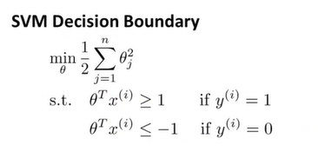
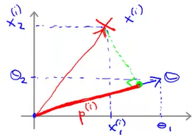
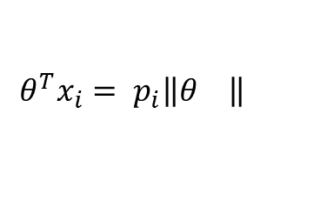
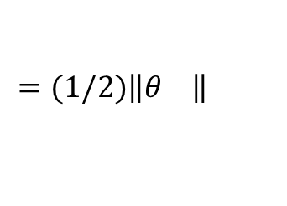
Simplification: Tetta0 = 0, n=2: 1/2(${θ1}_{}^{2}+{θ2}_{}^{2})=1/2{(\sqrt{{θ1}_{}^{2}+{θ2}_{}^{2}})}^{2}$
$$=(1/2)\left\|θ\left.\right\|\right.$$
$$θ^{T}x_{i}= p_{i}\left\|θ\left.\right\|\right.$$

Slide 15
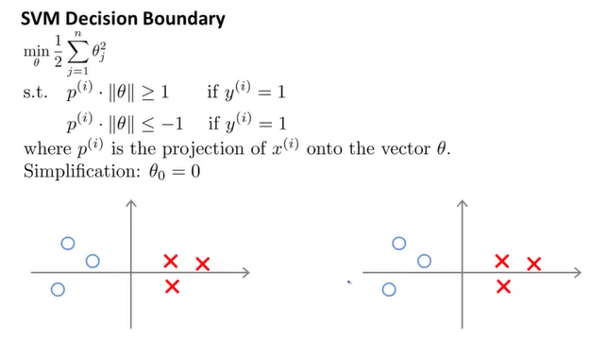
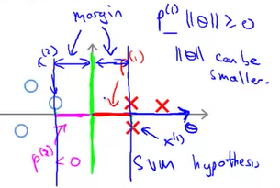
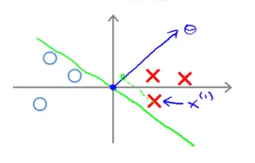
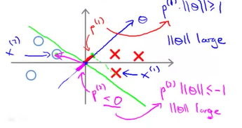

Slide 16
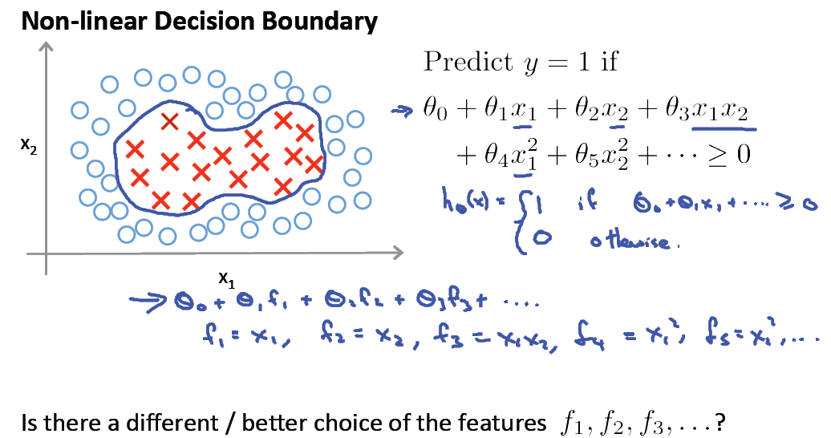

Slide 17
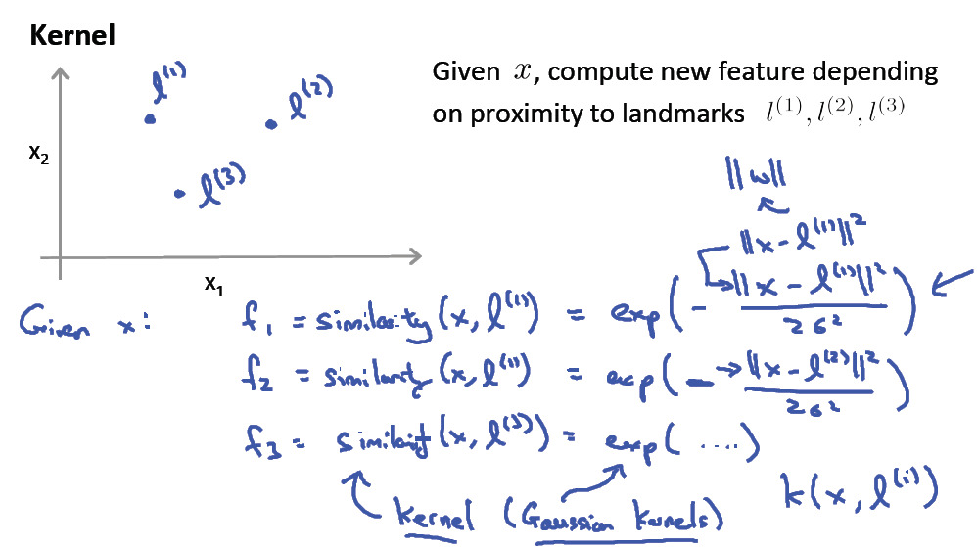

Slide 18
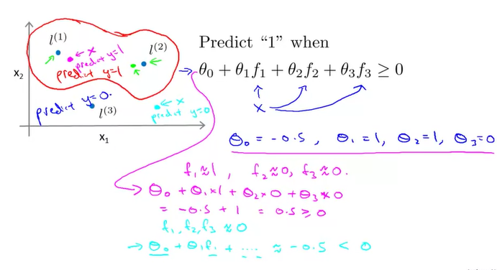

Slide 19
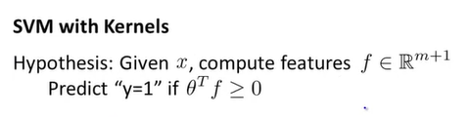
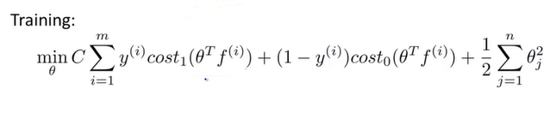
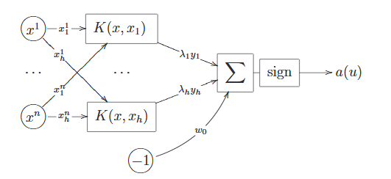

Slide 20
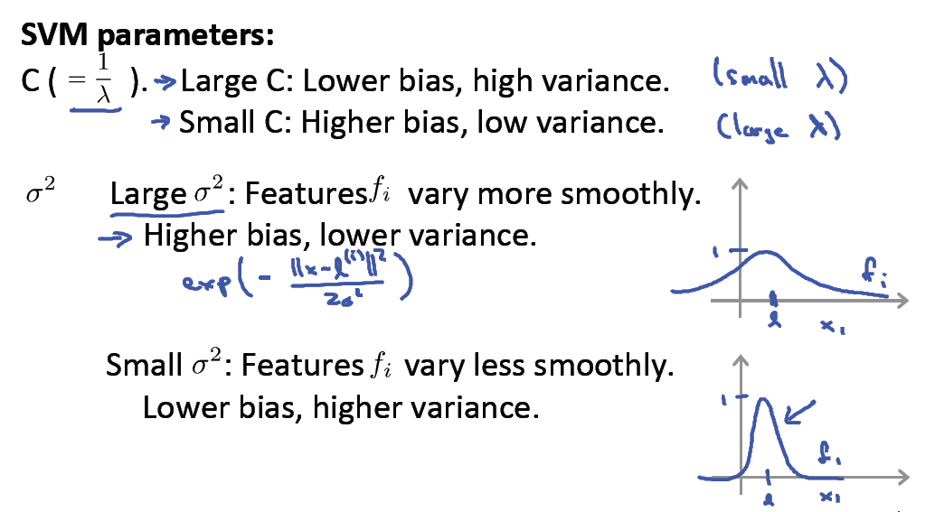

Slide 21
Преимущества SVM.
•Вместо многоэкстремальной задачи решается задача квадратичного программирования, имеющая единственное решение. Методы оптимизации в этом случае существенно более эффективны.
•Автоматически определяется число нейронов скрытого слоя. Оно равно числу опорных векторов.
•Принцип оптимальной разделяющей гиперплоскости приводит к максимизации ширины разделяющей полосы между классами, следовательно, к более уверенной классификации. Градиентные нейросетевые методы выбирают положение разделяющей гиперплоскости произвольным образом, ¾как придётся.

Slide 22
Недостатки SVM.•
Метод опорных векторов неустойчив по отношению к шуму в исходных данных. Если обучающая выборка содержат шумовые выбросы, они будут существенным образом учтены при построении разделяющей гиперплоскости.
До сих пор не разработаны общие методы построения спрямляющих пространств или ядер, наиболее подходящих для конкретной задачи. Построение адекватного ядра является искусством и, как правило, опирается на априорные знания о предметной области. На практике ¾вполне разумные¿ функции K(x,x′), выведенные из содержательных соображений, далеко не всегда оказываются положительно определёнными

Slide 23
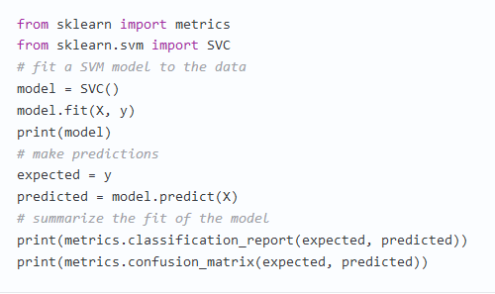
Use built-in libraries
Метод опорных векторов
SVM (Support Vector Machines) является одним из самых известных алгоритмов машинного обучения, применяемых в основном для задачи классификации. Также как и логистическая регрессия, SVM допускает многоклассовую классификацию методом one-vs-all.

Slide 24
Additional Resources
An excellent tutorial on VC-dimension and Support Vector Machines:
C.J.C. Burges. A tutorial on support vector machines for pattern recognition. Data Mining and Knowledge Discovery, 2(2):955-974, 1998.
The VC/SRM/SVM Bible:
Statistical Learning Theory by Vladimir Vapnik, Wiley-Interscience; 1998
http://www.kernel-machines.org/

Slide 25
Reference
Support Vector Machine Classification of Microarray Gene Expression Data, Michael P. S. Brown William Noble Grundy, David Lin, Nello Cristianini, Charles Sugnet, Manuel Ares, Jr., David Haussler
www.cs.utexas.edu/users/mooney/cs391L/svm.ppt
Text categorization with Support Vector Machines: learning with many relevant features
T. Joachims, ECML - 98

