Slide 1

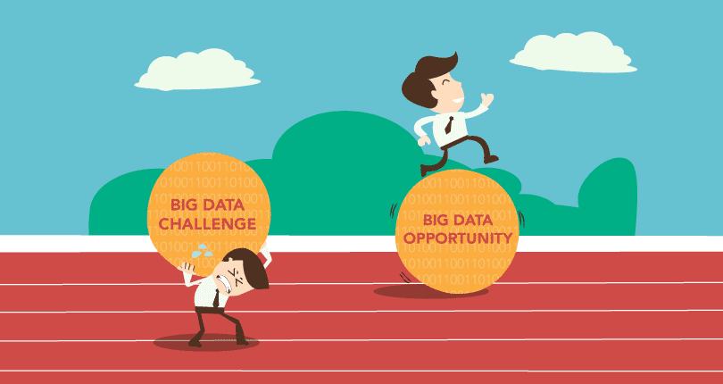
Challenges and Opportunities with Big Data
Slides: Tatyana Mozgacheva
tmozgach@sfu.ca
Notes:
Good afternoon. My name is Tanya. Thank you very much for coming today.
Do you know that every minute on the internet there are more than
2,000,000 Google searches,
700,000 (seven hundred thousand) Facebook updates and
200 million sent emails.
It is huge volume of data. Isn’t it?
So, today I am going to talk about Challenges and Opportunities with Big Data.

Slide 2
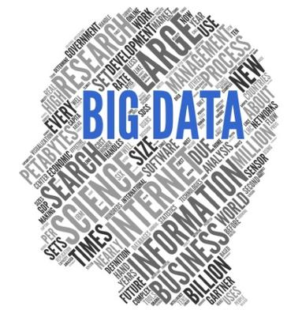
Agenda
What is the Big Data?
Application of the Big Data
3 Vs of the Big Data
The Big Data analysis pipeline
Challenges
Notes:
I will begin by discussing what Big Data is, why it is important and in what areas we can use Big Data .
After that we will focus on 3 main characteristics of Big Data and
finally I will cover phases of Big Data analysis pipeline in detail and challenges that connected with them.

Slide 3
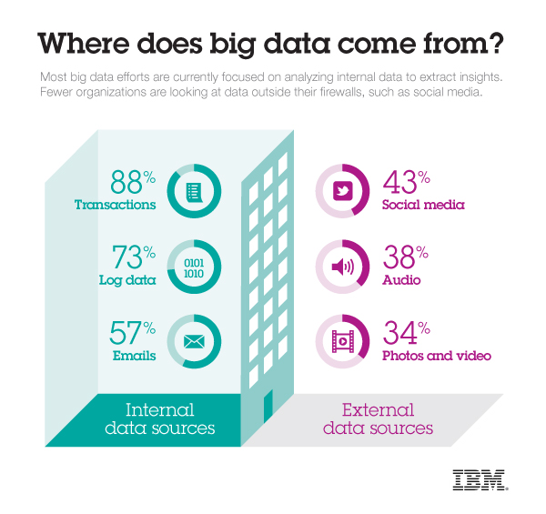
Big Data
Every day, we create 2.5 quintillion bytes of data — so much that 90% of the data in the world today has been created in the last two years alone.
Source: IBM Big Data And Analytics Hub
Notes:
Every day we create huge volume of data.
This data comes from everywhere:
sensors,
social media, digital pictures and videos,
transaction records,
cell phone GPS signals.
Why is it important?
Because more data leads to better analysis and better decisions!

Slide 4
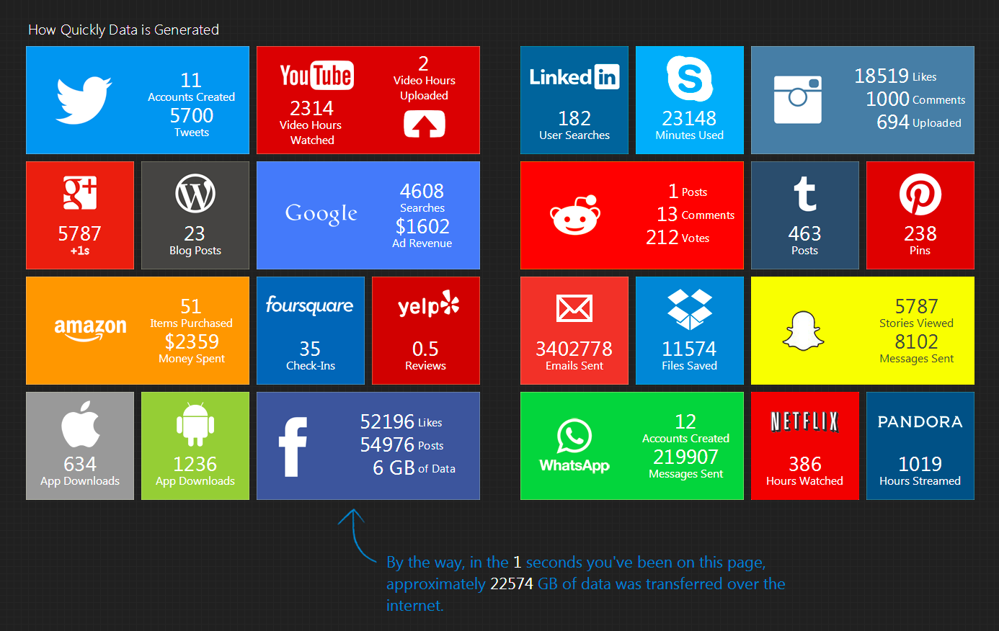
How much data is generated in social media in 1 second ?
Source: “digitalinformationworld.com – Social Media in Real-Time
Notes:
Now let’s take a look at more incredible examples.
For instances:
Walmart handles more than 1 million customer transactions every hour.
Facebook handles 40 billion photos.
Decoding the human genome originally took 10 years to process; now – it is one week.

Slide 5
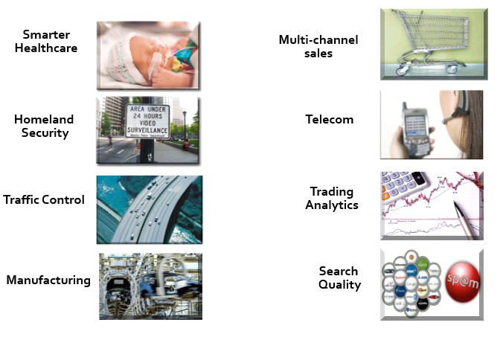
Application Of Big Data
Notes:
Such Big Data analysis would be part of every aspect of our modern society, including mobile services, retail, financial services, life sciences, and physical sciences.
For example, It is widely believed that the use of information technology can reduce the cost of healthcare while improving its quality.
It can be achieved by making care more personalized and basing it on more home-based monitoring.

Slide 6
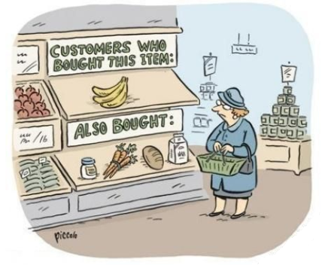
Our future? ☺
Notes:
May be our future would be like that, who knows.
5 min.

Slide 7
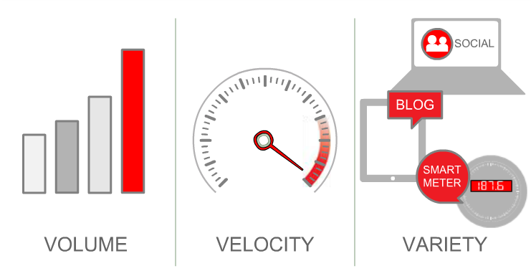
Big data spans three dimensions:
Notes:
The term “Big data” can be defined in terms of 3 V’s: volume, velocity and variety

Slide 8
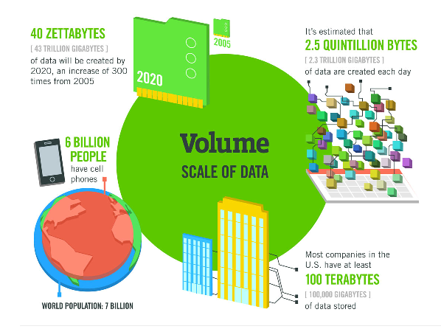
Volume
Source: McKinsey Global Institute, Twitter, CISCO, Gartner, EMC, SAS, IBM
Notes:
Big data has a large volume.
– Transactions-based data stored through the years.
– There is unstructured data from social media
– Also, Sensor and machine-to-machine data is increasing with time.
All these factors contribute to increase in volume of data.
Previously data storage was a big issue ; today it is not. But there are other issues, for instance:
•How to determine relevance within large data volumes?

Slide 9
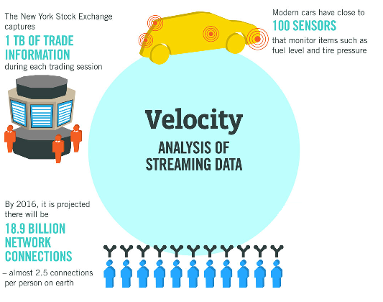
Velocity
Source: McKinsey Global Institute, Twitter, CISCO, Gartner, EMC, SAS, IBM
Notes:
Data is streaming in at speed and must be dealt with in a timely manner. For example, sensors.
Reacting quickly enough to deal with data velocity is a challenge for most organizations.

Slide 10
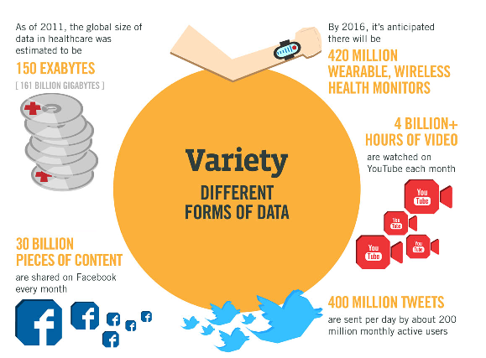
Variety
Source: McKinsey Global Institute, Twitter, CISCO, Gartner, EMC, SAS, IBM
Notes:
Data today comes in different formats. Structured (files systems and relational database records) and unstructured (text, video, email, audio).
Managing, merging and governing different formats of data is challenge.

Slide 11
What has been Achieved…
Declarative querying
Physical and logical independence
Cost-based optimization
Big Data
Notes:
During the last 35 years, data management principles such as:
• physical and logical independence,
• declarative querying and
• cost-based optimization
laid the foundation for managing and analyzing Big Data today
3 min = 5 + 3 = 8

Slide 12
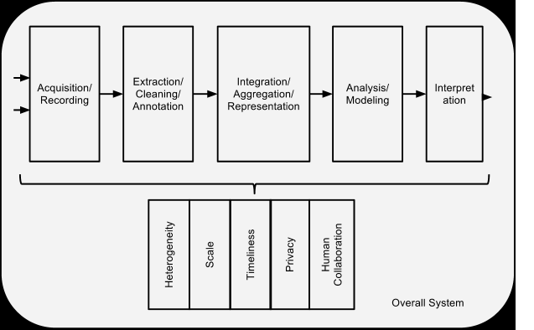
Phases and challenges in the Big Data Analysis Pipeline
Notes:
Now I'd like to discuss the Big Data Analysis Pipeline.
There are five phases in Big Data pipeline
•Acquisition/Recording
•Extraction, Cleaning/Annotation
•Integration/Aggregation/Representation
•Analysis/Modeling
•Interpretation
Each phase has challenges.

Slide 13
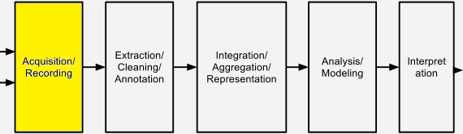
The Big Data Analysis Pipeline
Notes:
Let’s consider first stage – Acquisition / Recording.

Slide 14
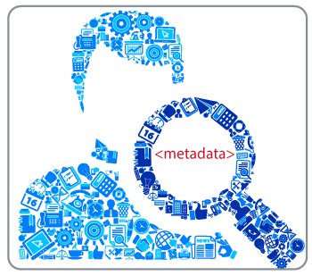
Data Acquisition and Recording
What data to keep?
What to discard?
How to filter out the data on the fly?
What is right metadata?
Notes:
As we know, data comes from the different sources.
However, part of this data is not interesting, and it can be filtered out.
One challenge is to define these filters in such a way that they do not discard useful information.
In addition to this we, want to filter out data on the fly. It means, do not store it first and reduce afterward.
The second big challenge is to automatically generate the right metadata.
• For example, in scientific experiments, information about experimental conditions and procedures may be required to interpret the results correctly,
and it is important that such metadata be recorded with observational data.
Another important issue here is data provenance.

Slide 15
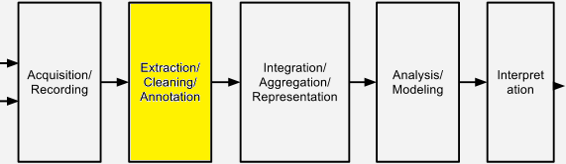
The Big Data Analysis Pipeline
Notes:
Next stage is Information Extraction and Cleaning.

Slide 16
Information Extraction and Cleaning
Raw unformatted data
Structured and suitable data for analysis
Technical challenge
Notes:
The collected information has not got suitable format for analysis.
For example, lets consider information in a hospital such as x-rays image, information from physicians, data from sensors.
We can not analyze these data in that formats.
So, we require an information extraction process that pulls out the required information from the these sources and expresses it in a structured form suitable for analysis
However, doing this correctly and completely is a technical challenge.

Slide 17
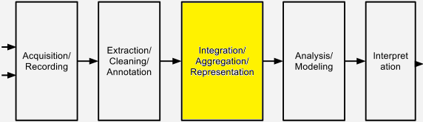
The Big Data Analysis Pipeline
Notes:
Now let’s take a look at 3rd stage.

Slide 18

Data Integration, Aggregation, and Representation
How to combine heterogeneous data?
How to select a suitable database design?
Notes:
In this stage we should think about how to combine heterogeneous data and how to select a suitable database design?
Even for simpler analyses suitable database design is very important.
•Usually, there will be many alternative ways in which to store the same information.
• Certain designs will have advantages over others for certain purposes, and possibly drawbacks for other purposes.

Slide 19
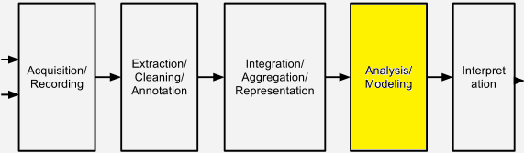
The Big Data Analysis Pipeline
Notes:
Our next stage is analysis.

Slide 20
Query Processing, Data Modeling, and Analysis
Querying and mining Big Data are fundamentally different from traditional statistical analysis.
Information redundancy can be explored for:
– missing data,
– to crosscheck conflicting cases,
– to validate trustworthy relationships,
– to uncover hidden relationships and models.
Lack of coordination between database systems with analytics packages (e.g. statistical analyses).
Notes:
Methods for querying Big Data are fundamentally different from traditional statistical analysis.
Heterogeneous information redundancy of Big Data can be used to compensate for many things for example:
– missing data,
– to crosscheck conflicting cases,
– to uncover hidden relationships and models
Etc.
For example, a physician may write “DVT” as the diagnosis for a patient. This abbreviation is commonly used for both “deep vein thrombosis” and “diverticulitis,” . A knowledge-base constructed from related data can use associated symptoms or medications to determine which of two the physician meant.
Moreover, A problem with current Big Data analysis is the lack of coordination between database systems with analytics packages. For that reason, user has to export data from the database, performing statistical analyses and bringing the data back.

Slide 21
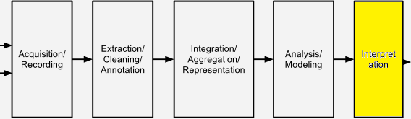
The Big Data Analysis Pipeline
Notes:
So, last stage is interpretation

Slide 22

Interpretation
Simplify life of analyst.
Necessity of provenance data to repeat the analysis with different assumptions, parameters, or data sets.
Notes:
There are many possible sources of error: computer systems can have bugs, models almost always have assumptions, and results can be based on erroneous data.
•For all of these reasons, user will not rely on the computer system completely. Analyst will try to understand, and verify, the results produced by the computer.
The computer system must make it easy for user to do that.
In short, it is not enough to provide just the results.
The system should provide opportunities to repeat the analysis with different assumptions, parameters, or data sets.
8 min = 8 + 8 = 16 min

Slide 23
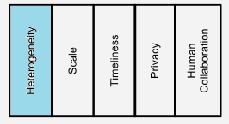
Challenges in the Big Data Analysis Pipeline
Notes:
We now turn to some common challenges that underlie these phases.

Slide 24

Heterogeneity and Incompleteness
Data from different sources/platforms.
Data formats are different.
Data missing due to security, privacy, or other reasons.
Notes:
As we know, analysis algorithms expect homogeneous data, and cannot understand nuance.
Also, After data cleaning and error correction, some incompleteness and some errors in data are likely to remain.
This incompleteness and these errors must be managed during data analysis. It is challenge.

Slide 25
Challenges in the Big Data Analysis Pipeline
Notes:
Next issue is scale.

Slide 26
Scale
Data volume is scaling faster than compute resources.
Dramatic shift:
Increasing numbers of cores
Parallelism within a single node
Parallel data processing techniques that were applied in the past for processing data across nodes don’t directly apply for intra-node parallelism
Notes:
Today we faced the problem that data volume is scaling faster than compute resources, and CPU speeds are static.
In order to solve this problem, we started to increase numbers of cores. It means that we deal with parallelism within a single node. However, we can not apply techniques that we used for processing data across nodes.

Slide 27
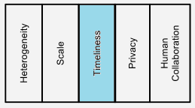
Challenges in the Big Data Analysis Pipeline
Notes:
Next problem is timeliness.

Slide 28
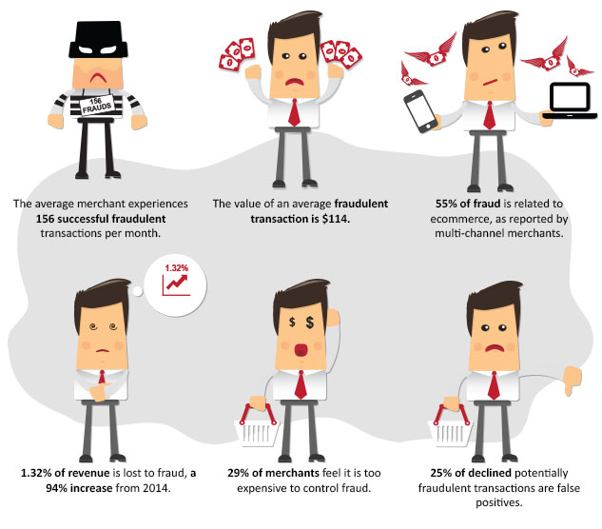
Timeliness
A full analysis of data is not feasible in real-time.
Source: http://monicaec.com/red-flags-warning-signs-of-potential-credit-card-fraud/
Notes:
With increasing volume of data, the time for analysis this data is also increasing.
But there are many situations in which the result of the analysis is required immediately.
For example, in order to prevent fraudulent credit card transaction, the analysis should be done before transaction is complete. Obviously, full analysis of client history is not feasible in real-time.

Slide 29
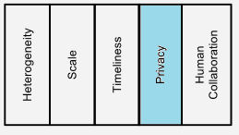
Challenges in the Big Data Analysis Pipeline
Notes:
So far I have concentrated on the computational, and technological challenges of
Big Data.

Slide 30
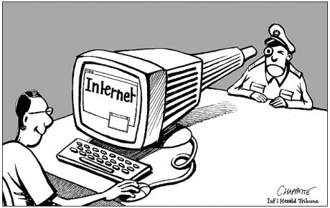
Privacy
Notes:
The privacy of data is another huge concern. We know that big data is extremely exciting and there are more amazing possibilities of things that we can do with large of datasets regardless of that there are technical problems. But it is important to realize that there is a lot of fear out there.
There is now data your age, where you live, your social class, your salary,
what credit cards you use and what Web sites you visit. Data is also available on your ethnicity, job history, financial status, health, education, social life, food intake, religion, and the number of cars you own.
A lot of fear about what’s happening with this data, who is using this data to do what and a lot of questions connected with privacy.

Slide 31
Challenges in the Big Data Analysis Pipeline

Slide 32
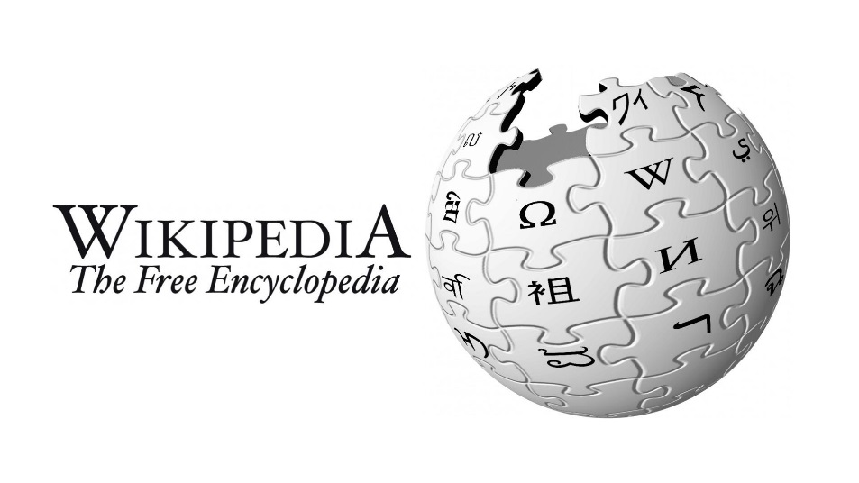

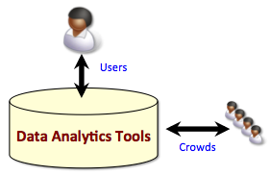
Human collaboration
Notes:
Last thing, that I am going to talk today is Human collaboration. There are many patterns that humans can easily detect but computer algorithms have a hard time finding.
Ideally, Big Data system must have a human in the loop. A popular new method of using human to solve problems is crowdsourcing.
Wikipedia is the best known example of crowd-sourced data. In this example, one person can provide false information. While most such errors will be detected and corrected by others in the crowd, we need technologies to facilitate this. We also need a framework that can analyze conflicting crowd-sourced data.

Slide 33
Conclusion
Objective: many technical and ethnical challenges must be addressed before this potential can be realized fully.
Volume
Velocity
Variety
Challenges
Heterogeneity Incompleteness
Timeliness
Privacy
Scale
Human collaboration
Big Data analysis pipeline
Analysis
Interpretation
Integration
Representation
Acquisition
Recording
Extraction
Cleaning
Notes:
We have entered an era of Big Data. Through better analysis of the large volumes of data, there is the potential for making faster analysis in many scientific disciplines and improving the income and success of many organizations. However, many technical and ethnical challenges must be addressed before this potential can be realized fully.
Heterogeneity, scale, timeliness, complexity, and privacy problems with Big Data exist at all phases of the pipeline. The authors of this paper believe that these research problems have the potential to create huge economic value in the world economy.

Slide 34

Notes:
We have entered an era of Big Data. Through better analysis of the large volumes of data, there is the potential for making faster analysis in many scientific disciplines and improving the income and success of many organizations. However, many technical and ethnical challenges must be addressed before this potential can be realized fully.
Heterogeneity, scale, timeliness, complexity, and privacy problems with Big Data exist at all phases of the pipeline. The authors of this paper believe that these research problems have the potential to create huge economic value in the economy.

