Slide 1
Universe Trade Commercial Website
Presentation by
Bekzhan Kassenov
and
Aigerim Bazarbayeva

Slide 2
Outline
Introduction:
Overview of Universe Trade (UT) Project
Main Part:
Design
EER
Relational
UI
Implementation
PHP
Conclusion:
Summary and suggestions

Slide 3
What is UT?
Store
Buyer
Seller

Slide 4
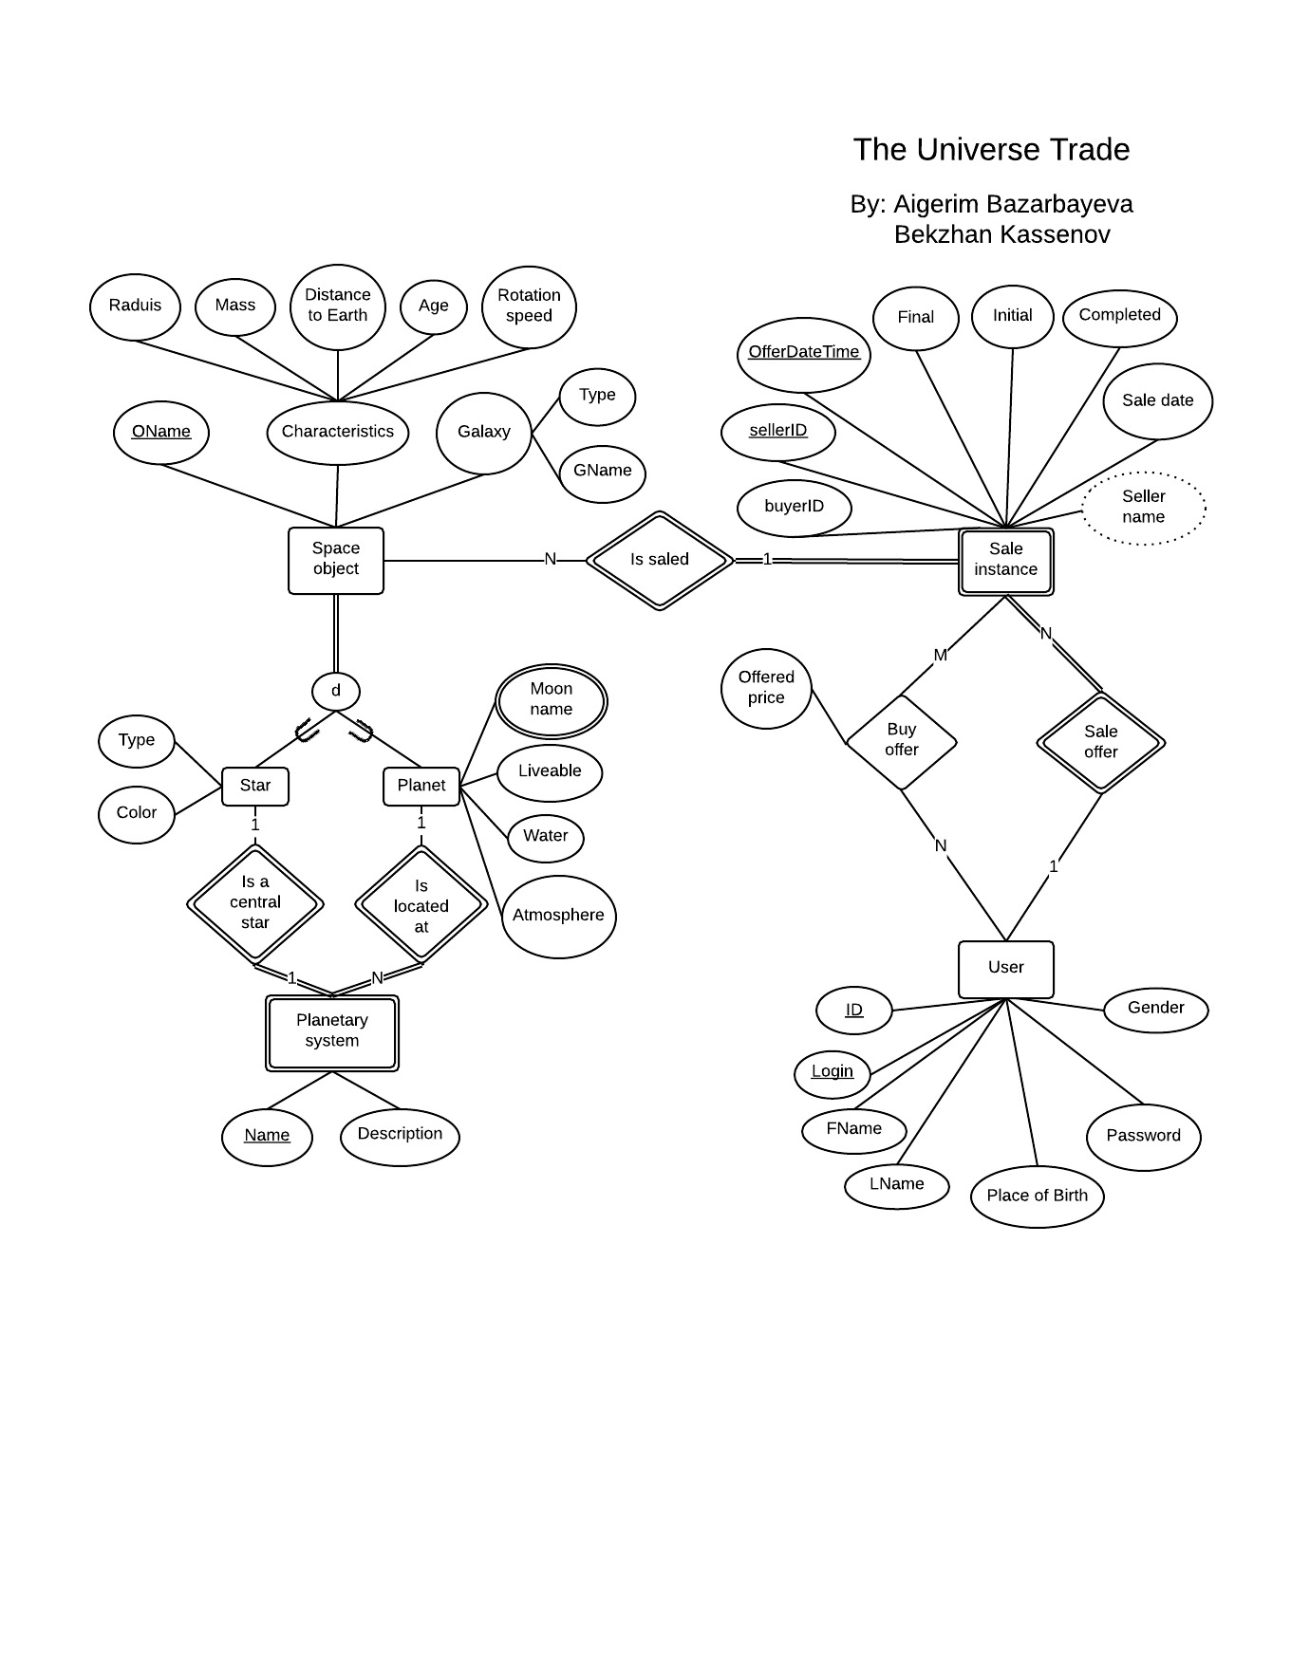
Design: EER

Slide 5
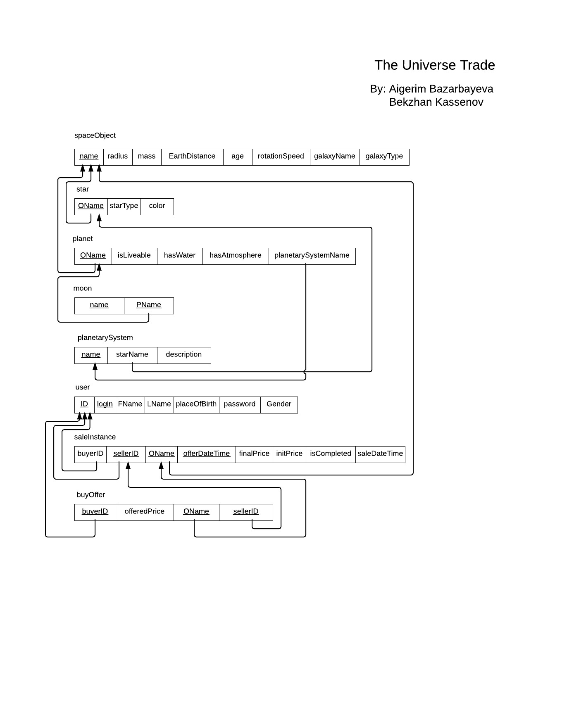
Design: Relational

Slide 6
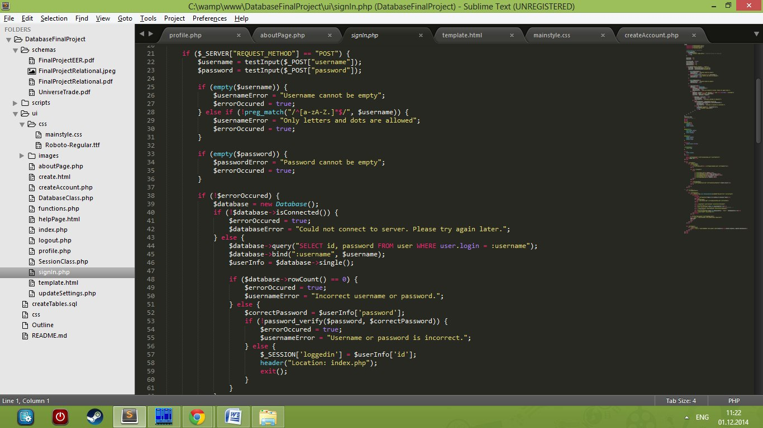
Implementation: PHP

Slide 7
Design: UI
Home
Create Account
Login
Profile
Store
About
Link to website now

Slide 8
Conclusion
Project needs some improvements with
Extension of features for advanced searching with filtering and sorting
Fixing security issues
Adding integration with money transaction: creation of cart page and Pay Pal options
Move site to some hosting
Better analysis for User Client side

