Slide 1
Book recommender bot
Каттабеков Бекнур
Садир Айгерим,
Турекул Нургалам

Slide 2
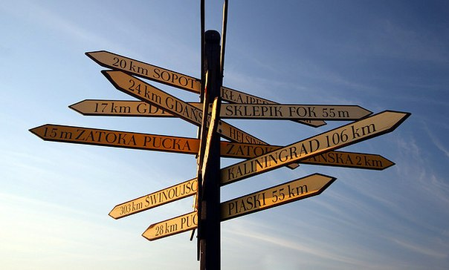
Too many choises

Slide 3
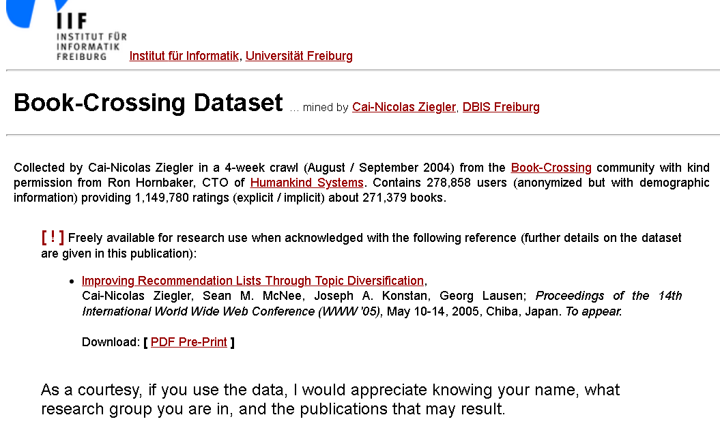
Let’s start with the first set of slides

Slide 4
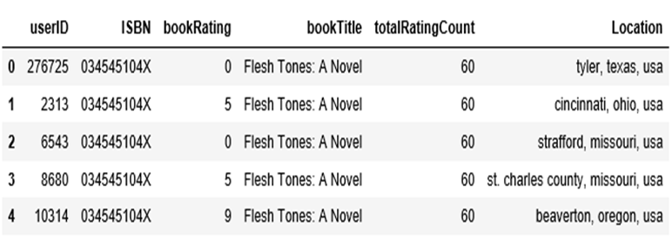
Books.head()

Slide 5
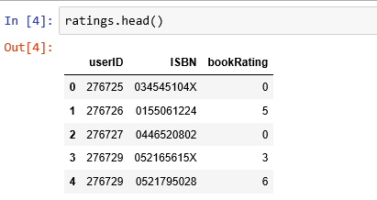
.

Slide 6
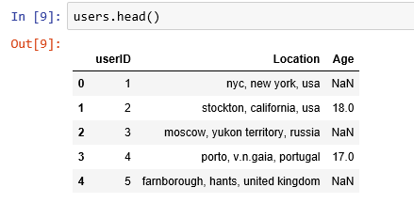

Slide 7
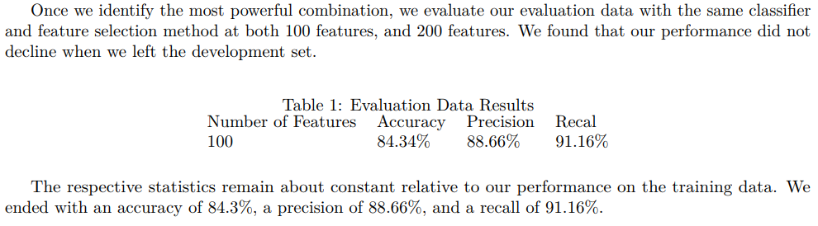
Accuracy of book recommender system
...and we hope to have the same result

Slide 8
Implemetation
Collect the dataset with book content
Find most correlated samples
LDA and wordnet for top correlated books
Wrap up algorithms in the bot

Slide 9
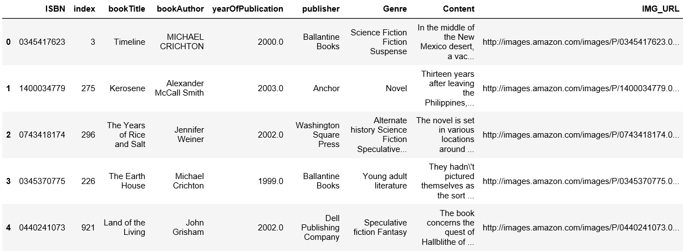
Collect the dataset with book content

Slide 10
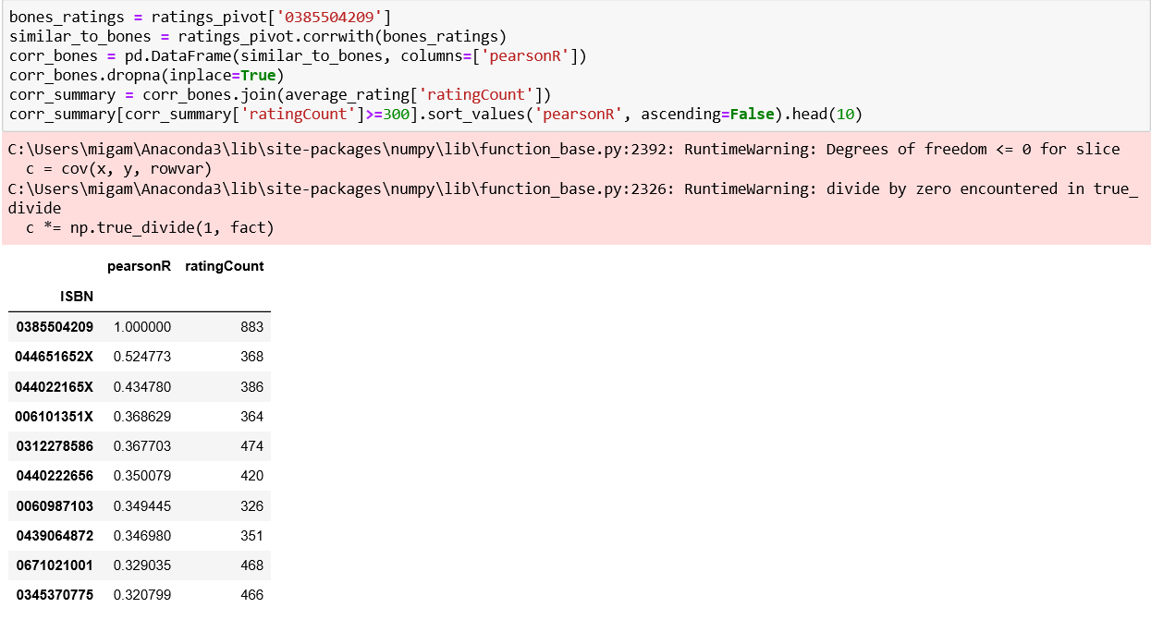
Find most correlated samples

Slide 11
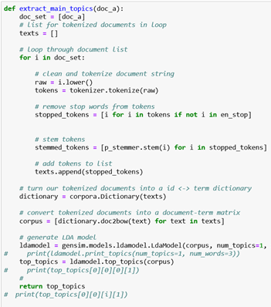
LDA and wordnet for top correlated books

Slide 12
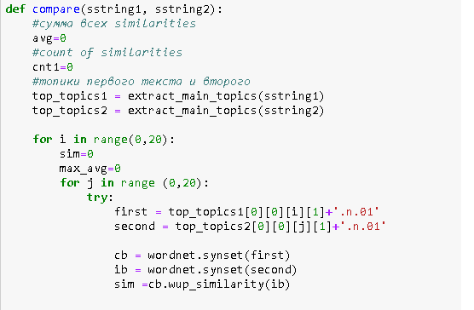

Use of Wordnet synsets to find similarity between 2 paragraphs

Slide 13
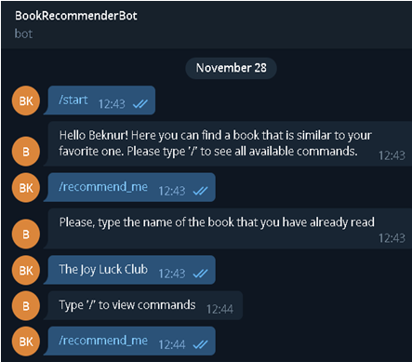
Wrap up algorithms in the bot

Slide 14
What do we get from this project?
No stresses in finding what to read next.
No need to search for similar books
Bot can recommend you what to present someone, according to the book he\she has read

Slide 15
Thank you for your attention!

