Slide 1
Copy job titles
Copy frameworks
Copy programming languages
Copy organization

Slide 2
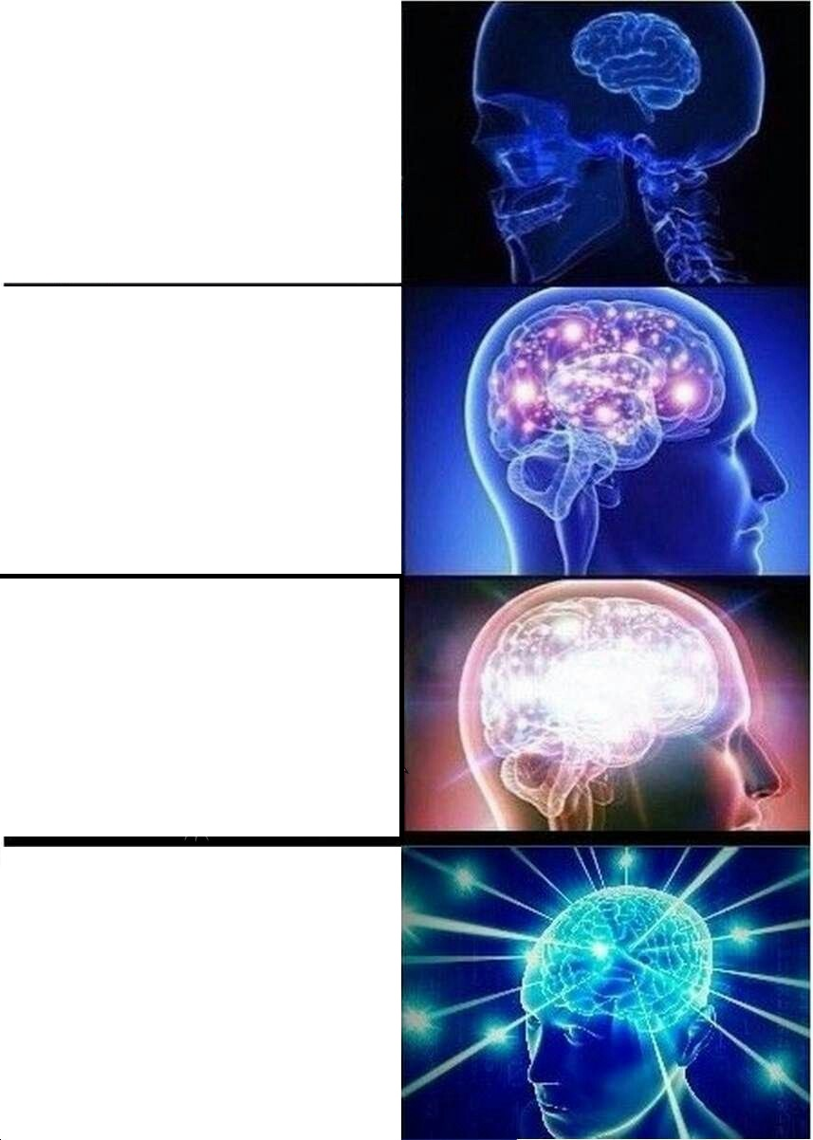
Copy programming languages
Copy frameworks
Copy organization
Copy job titles

