Slide 1

Revision course Functional Programming and Verification
Jonas Hübotter

Slide 2
1. Functional Programming and Haskell
Basic Haskell
Recursion, guards, pattern matching
List comprehensions
QuickCheck
Polymorphism
Currying, partial application

Slide 3
1.1 Basic Haskell
function types | f :: a -> b -> c
function definitions | f a b = a + b
function application | f 1 2
function composition | f . g means f(g(x))
conditional | if True then a else b
prefix/infix precedence | f a `g` b means (f a) `g` b
$ sign | f $ a `g` b means f (a `g` b)

Slide 4
Types
Bool | True or False
Int | fixed-width integers
Integer | unbounded integers
Char | ‘a’
String | “hello” (type [Char])
(a,b) (Tuple) | (“hello”,1) :: (String,Int)

Slide 5
Tuples
(1,“hello”) :: (Int,String)
(x,y,z) :: (a,b,c)
-- ...
Prelude functions: fst, snd

Slide 6
Lists
Two ways of constructing a list:
a = [1, 2, 3]
b = 1 : 2 : 3 : []
Cons (:) and [] are constructors of lists, that is a function that uniquely constructs a value of the list type.
Intuitively (:) :: a -> [a] -> [a].

Slide 7
Lists (2) – Prelude functions
head :: [a] -> a | first element
last :: [a] -> a | last element
init :: [a] -> [a] | every element but last element
tail :: [a] -> [a] | every element but first element
elem :: a -> [a] -> Bool | element in list?
(++) :: [a] -> [a] -> [a] | append lists
reverse :: [a] -> [a] | reverse list
length :: [a] -> Int | length of list
null :: [a] -> Bool | empty?
concat :: [[a]] -> [a] | flatten list
zip :: [a] -> [b] -> [(a,b)] | combine lists element-wise
unzip :: [(a,b)] -> ([a],[b]) | separate list of tuples into lists of components

Slide 8
Lists (3) – Prelude functions
replicate :: Int -> a -> [a] | build list from repeated element
take :: Int -> [a] -> [a] | prefix of list with given length
drop :: Int -> [a] -> [a] | suffix of list with given length
and :: [Bool] -> Bool | conjunction over all elements
or :: [Bool] -> Bool | disjunction over all elements
sum :: [Int] -> Int | sum over all elements
product :: [Int] -> Int | product over all elements
search for functions by type signature on https://hoogle.haskell.org/

Slide 9
Lists (4) – Ranges
[1..5]
= [1,2,3,4,5]
[1,3..10]
= [1,3,5,7,9]
[1..]
= [1,2,3...]
[1,3..]
= [1,3,5...]

Slide 10

Local definitions
let x = $e_{1}$ in $e_{2}$
defines x locally in $e_{2}$.
$e_{2}$ where x = $e_{1}$
also defines x locally in $e_{2}$ where $e_{2}$ has to be a function definition.

Slide 11
1.2 Recursion, guards, pattern matching
Guards
Example: maximum of two integers.
max2 :: Integer -> Integer -> Integer
max2 x y
| x >= y = x
| otherwise = y

Slide 12
Recursion
Reduce problem into a solving a series of smaller problems of a similar kind.
Example
factorial :: Integer -> Integer
factorial n
| n == 0 = 1 -- base case
| n > 0 = n * factorial (n – 1) -- recursive case

Slide 13
Recursion (2) – accumulating parameter
Alternatively, factorial could be defined as
factorial :: Integer -> Integer
factorial n = aux n 0
where
aux :: Integer -> Integer -> Integer
aux n acc
| n == 0 = acc
| n > 0 = factorial (n - 1) (n * acc)
The resulting function is tail recursive, that is the recursive call is located at the very end of its body.
Therefore no computation is done after the recursive function call returns.
In general, recursion using accumulating parameters is less readable.

Slide 14
Pattern matching
A more compact syntax for recursion:
factorial 0 = 1
factorial n | n > 0 = n * factorial (n – 1)
Patterns are expressions consisting only of constructors, variables, and literals.

Slide 15
Pattern matching (2) - examples
head :: [a] -> a
head (x : _) = x
tail :: [a] -> [a]
tail (_ : xs) = xs
null :: [a] -> Bool
null [] = True
null (_ : _) = False

Slide 16
Constructors vs Types
What is the difference between True and Bool?
True is a constructor, Bool is a type.
True can be used in expressions to build values of a type
Bool can be used in type signatures to hint at the type of bindings.
Constructor or type?
False
(:)
Maybe
Just
Nothing

Slide 17
Pattern matching (3) - case
Pattern matching in nested expressions
singleOrEmpty :: [a] -> Bool
singleOrEmpty xs = case xs of [] -> True
[_] -> True
_ -> False

Slide 18
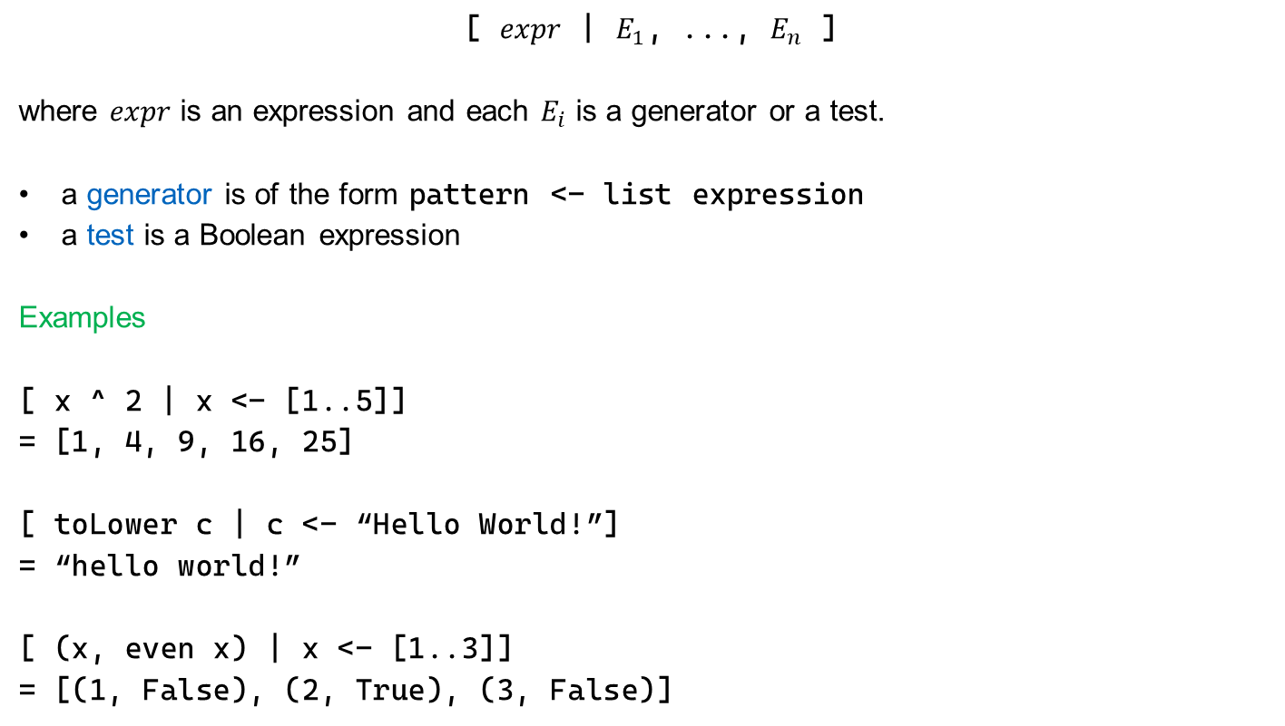
1.3 List comprehensions
[ $expr$ | $E_{1}$, ..., $E_{n}$ ]
where $expr$ is an expression and each $E_{i}$ is a generator or a test.
a generator is of the form pattern <- list expression
a test is a Boolean expression
Examples
[ x ^ 2 | x <- [1..5]]
= [1, 4, 9, 16, 25]
[ toLower c | c <- “Hello World!”]
= “hello world!”
[ (x, even x) | x <- [1..3]]
= [(1, False), (2, True), (3, False)]

Slide 19
Multiple generators
Generators are reduced from left to right.
A generator or test can depend on any generator to its left.
Example
[(i,j) | i <- [1 .. 3], j <- [i .. 3]]
= [(1,j) | j <- [1..3]] ++
[(2,j) | j <- [2..3]] ++
[(3,j) | j <- [3..3]]
= [(1,1), (1,2), (1,3), (2,2), (2,3), (3,3)]

Slide 20
The meaning of list comprehensions
[e | x <- [a1,...,an]]
= (let x = a1 in [e]) ++ · · · ++ (let x = an in [e])
[e | b]
= if b then [e] else []
[e | x <- [a1,...,an], E]
= (let x = a1 in [e | E]) ++ · · · ++ (let x = an in [e | E])
[e | b, E]
= if b then [e | E] else []

Slide 21
1.4 QuickCheck
QuickCheck tests check if a proposition holds true for a large number of random arguments.
It can be used to test the equivalence of two functions.
Examples
import Test.QuickCheck
prop_max2 x y =
max2 x y = max x y
prop_max2_assoc x y z =
max2 x (max2 y z) = max2 (max2 x y) z
prop_factorial n =
n > 2 ==> n < factorial n
Run quickCheck prop_max2 from GHCI to check the property.

Slide 22
1.5 Polymorphism
Idea: one function definition, having many types.
length :: [a] -> Int is defined for all types a.
a is a type variable.

Slide 23
Subtype vs parametric polymorphism
parametric polymorphism – types may contain universally quantified type variables that are then replaced by actual types.
subtype polymorphism – any object of type T’ where T’ is a subtype of T can be used in place of objects of type T.
Haskell uses parametric polymorphism.

Slide 24
Type constraints
Type variables can be constrained by type constraints.
(+) :: Num a => a -> a -> a
Function (+) has type a -> a -> a for any type a of the type class Num.
Some type classes:
Num
Integral
Fractional
Ord
Eq
Show

Slide 25
Quiz
f x y z = if x then y else z
f :: Bool -> a -> a -> a
f x y = [(x,y), (y,x)]
f :: a -> a -> [(a,a)]
f x = [ length u + v | (u,v) <- x ]
f :: [([a],Int)] -> [Int]
f x y = [ u ++ x | u <- y, length u < x ]
invalid
f x y = [[ (u,v) | u <- w, u, v <- x] | w <- y]
f :: [a] -> [[Bool]] -> [[(Bool, a)]]

Slide 26
1.6 Currying, partial application
A function is curried when it takes its arguments one at a time, each time returning a new function.
Example
Any function of two arguments can be viewed as a function of the first argument
that returns a function of the second argument.
function type signatures are right associative
function application is left associative
f :: Int -> Int -> Int f x y = x + y | f :: Int -> (Int -> Int) f x = \y -> x + y
f a b = a + b | (f a) b = (\y -> a + y) b = a + b

Slide 27
Anonymous functions (lambdas)
An anonymous function (or lambda abstraction) is a function without a name.
Examples
(\x -> x + 1) 4
= 5
(\x y -> x + y) 3 5
= 8
What is the type of \n -> iter n succ
where i :: Integer -> (a -> a) -> (a -> a), succ :: Integer -> Integer?
Integer -> (Integer -> Integer)

Slide 28
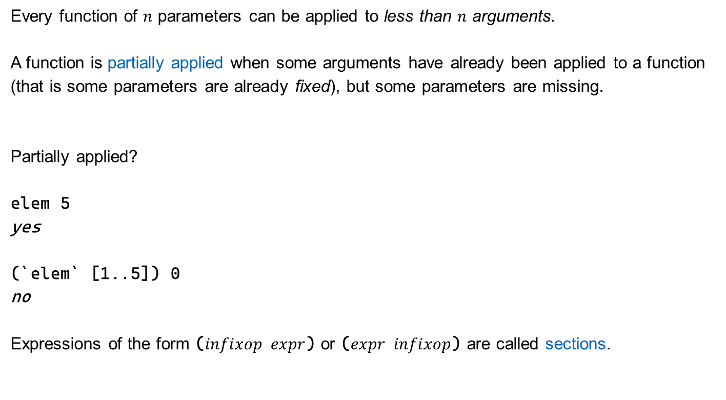
Partial application
Every function of $n$ parameters can be applied to less than $n$ arguments.
A function is partially applied when some arguments have already been applied to a function (that is some parameters are already fixed), but some parameters are missing.
Partially applied?
elem 5
yes
(`elem` [1..5]) 0
no
Expressions of the form ($infixop expr$) or ($expr infixop$) are called sections.

Slide 29
Higher-order functions
A higher-order function is a function that takes another function as an argument or returns a function.
Examples
filter :: (a -> Bool) -> [a] -> [a]
map :: (a -> b) -> [a] -> [b]
all, any :: (a -> Bool) -> [a] -> Bool
takeWhile, dropWhile :: (a -> Bool) -> [a] -> [a]
(.) :: (b -> c) -> (a -> b) -> (a -> c)

Slide 30
Fold
Folding is the most elementary way of combining elements of a list.
Right-associative (foldr):
foldr :: (b -> a -> a) -> a -> [b] -> a
foldr f a [] = a
foldr f a (x:xs) = f x (foldr f a xs)
Why is this right-associative?
foldr (+) 0 [1,2,3]
= 1 + foldr (+) 0 [2,3]
= 1 + (2 + foldr (+) 0 [3])
= 1 + (2 + (3 + foldr (+) 0 []))
= 1 + (2 + (3 + 0))
= 1 + (2 + 3)
= 1 + 5 = 6

Slide 31
2. Types
Type aliases
Type Classes
Algebraic Data Types
Modules, Abstract Data Types
Type inference

Slide 32
2.1 Type aliases
Allows the renaming of a more comples type expression.
Examples
type String = [Char]
type List a = [a]

Slide 33
2.2 Type Classes
Type classes are collections of types that implement some fixed set of functions.
Similar concepts are commonly called interfaces.
define set of functions (~ creating an interface)
implement set of functions for members of type class (~ implementing an interface)
Example
class Eq a where
(==) :: a -> a -> Bool
instance Eq Bool where
True == True = True
False == False = True
_ == _ = False

Slide 34
Constrained instances
Instances can be constrained.
Example
instance (Eq a) => Eq [a] where
[] == [] = True
(x:xs) == (y:ys) = x == y && xs == ys
_ == _ = False

Slide 35
Subclasses
Example
class (Eq a) => Ord a where
(<=), (<) :: a -> a -> Bool
Class Ord inherits all functions of class Eq.
Before instantiating a subclass with a type, the type must be an instance of all “superclasses”.
instance Ord Bool where
b1 <= b2 = not b1 || b2
b1 < b2 = b1 <= b2 && not(b1 == b2)

Slide 36
2.3 Algebraic Data Types
Custom data that allow us to specify the shape of each element.
Examples
data Bool = False | True
data Maybe a = Nothing | Just a
deriving (Eq, Show)
data Nat = Zero | Suc Nat
deriving (Eq, Show)
data [a] = [] | (:) a [a]
deriving Eq
data Tree a = Empty | Node a (Tree a) (Tree a)
deriving (Eq, Show)

Slide 37
Constructors vs Types (again)
Repetition:
constructors can be used in expressions to build values of a type
types can be used in type signatures to hint at the type of bindings.
An Algebraic Data Type is a custom type with one or more constructors.
Constructors can have varying arity:
a constructor with arity 0 acts like a value of the type
a constructor with arity k combines k values of varying types into a single value of the type

Slide 38
Pattern matching
Pattern matching works just the same for custom constructors as for predefined constructors.
Examples
find :: Ord a => a -> Tree a -> Bool
find _ Empty = False
find x (Node a l r)
| x < a = find x l
| a < x = find x r
| otherwise = True
insert :: Ord => a -> Tree a -> Tree a
insert x Empty = Node x Empty Empty
insert x (Node a l r)
| x < a = Node a (insert x l) r
| a < x = Node a l (insert x r)
| otherwise = Node a l r

Slide 39
2.4 Modules, Abstract Data Types
Modules
Collection of type, function, class and other definitions.
Examples
module M where
exports everything defined in M
module M (T, f, …) where
exports only T, f, …

Slide 40
Exporting data types
module M (T) where
data T = ...
exports only T, but not its constructors
module M (T(C,D,...)) where
data T = ...
exports T and its constructors C, D, ...
module M (T(..)) where
data T = ...
exports T and all its constructors
Not allowed (why?):
module M (T,C,D) where
Constructors can have the same name as a type.

Slide 41
Abstract Data Types
Hides data representation by wrapping data in a constructor that is not exported.
Example
module Set (Set, empty, insert, isin, size) where
-- Interface
empty :: Set a
insert :: Eq a => a -> Set a -> Set a
isin :: Eq a => a -> Set a -> Bool
size :: Set a -> Int
-- Implementation
newtype Set a = Set [a]
empty = Set []
insert x (Set xs) = Set (if elem x xs then xs else x:xs)
isin x (Set xs) = elem x xs
size (Set xs) = length xs

Slide 42
type vs data vs newtype
type is used to create type aliases
data is used to create custom data types
newtype is used to create a custom constructor for a single type
syntax similar to data
may only have a single constructor taking a single argument
introduces no runtime overhead
creates strict types while data creates lazy types

Slide 43

2.5 Type inference
How to infer/reconstruct the type of an expression.
Algorithm (sketch)
Given an expression $e$.
give all variables in $e$ distinct type variables
give each function $f ∷T$ in $e$ a new general type that does not use type variables from (1)
for each sub-expression in $e$ set up an equation linking parameters and arguments
simplify set of equations by replacing equivalences and constructors

Slide 44
Type inference example
Given f u v = min (head u) (last (concat v))
Step 1
u :: a
v :: b
Step 2
head :: [c] -> c
concat :: [[d]] -> [d]
last :: [e] -> e
min :: Ord f => f -> f -> f
Step 3
from head u derive [c] = a
from concat v derive [[d]] = b
from last (concat v) derive [e] = [d]
from min (head u) (last (concat v)) derive f = c and f = e

Slide 45
Type inference example (2)
Step 4
goal f :: a -> b -> f
apply [c] = a and update
u :: [c]
apply [[d]] = b and update
v :: [[d]]
apply [e] = [d] to get e = d and update
v :: [[e]]
concat :: [[e]] -> [e]
apply c = f and update
u :: [f]
head :: [f] -> f
apply e = f and update
v :: [[f]]
concat :: [[f]] -> [f]
last :: [[f]] -> [f]
no further simplification possible, return f :: Ord f => [f] -> [[f]] -> f

