Slide 1

A general-purpose, statically-typed, purely functional programming language with type inference and lazy evaluation
1990
CMPT 383
Summer 2022
SFU Surrey

Slide 2
What was going on in 1990?

Slide 3
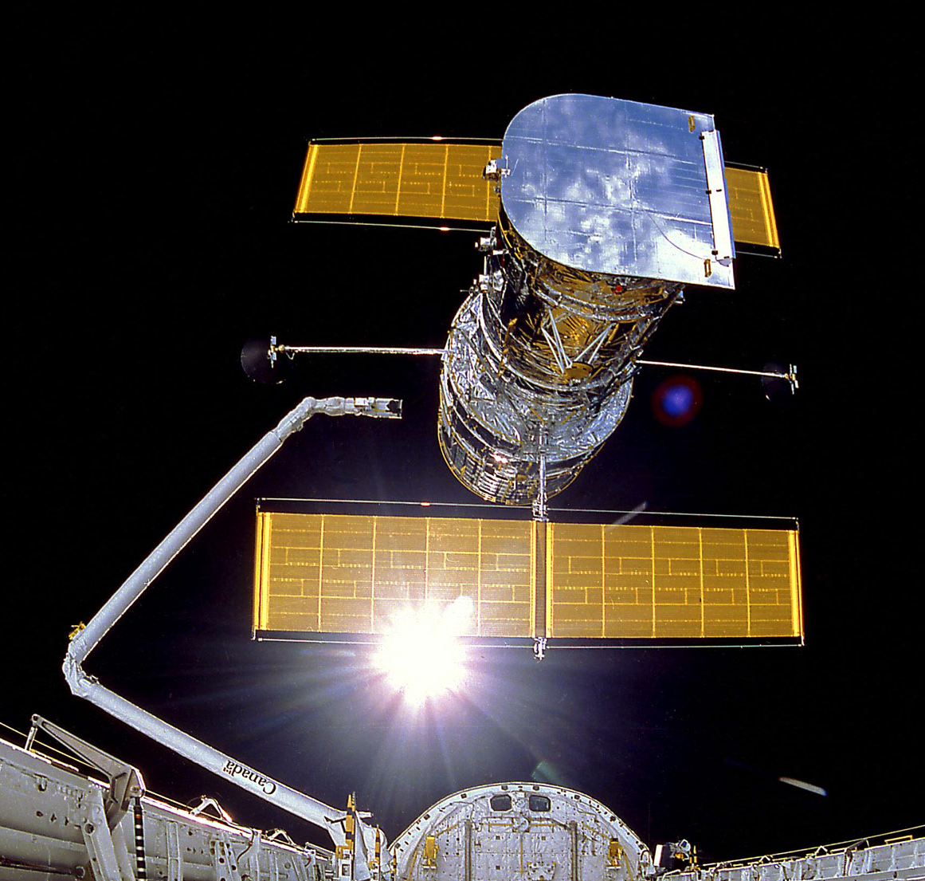
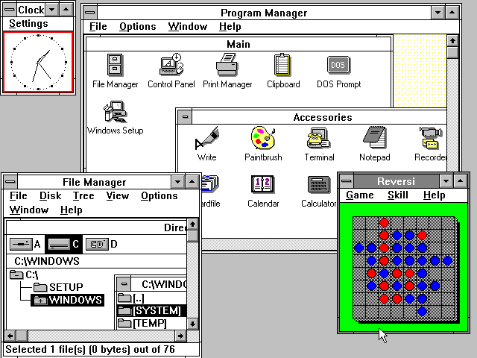
1990: First Appearances
Hubble Space Telescope
Windows 3.0

Slide 4
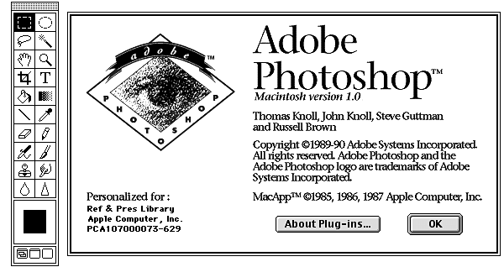
1990: First Appearances
Photoshop 1.0

Slide 5
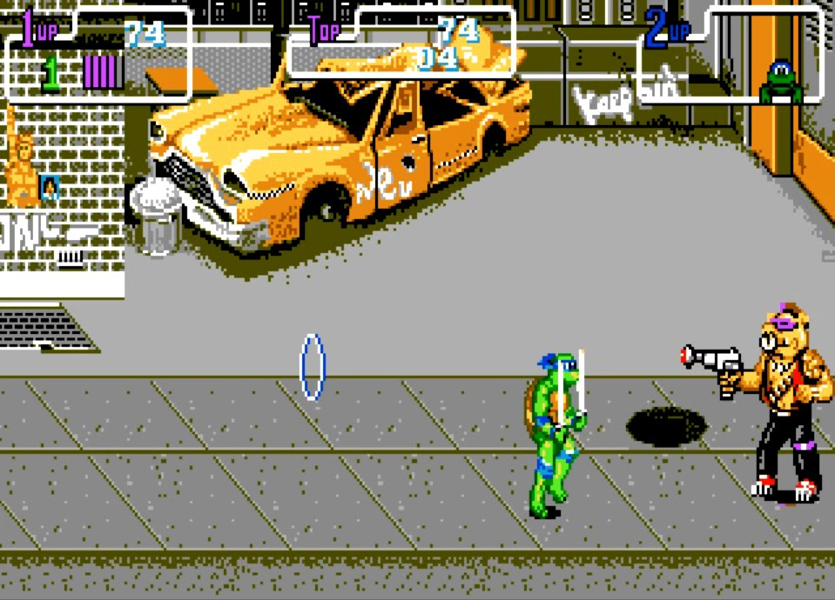
1990: Highest-grossing Arcade Game
Teenage Mutant Ninja Turtles

Slide 6
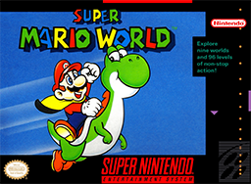
1990: Highest-grossing Arcade Game
Super Mario World

Slide 7
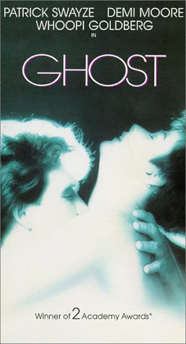
1990: Highest-Grossing Movie

Slide 8

1990: Most Popular Song
Hold On
Wilson Philips

Slide 9
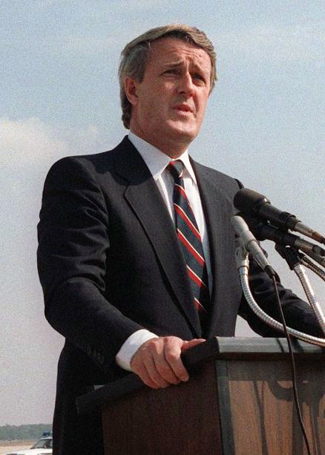
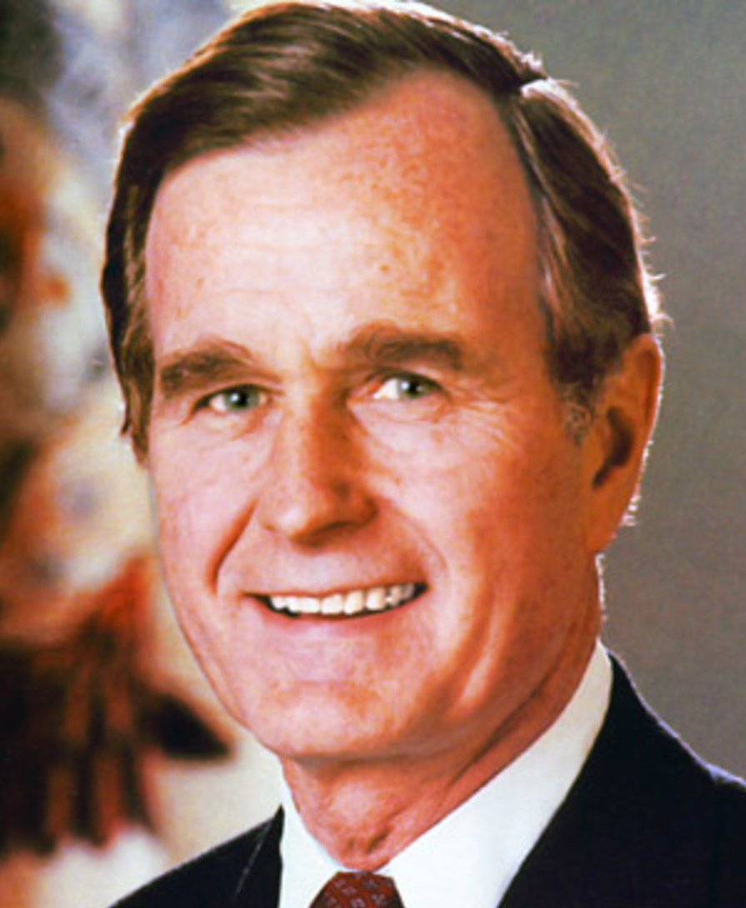

1990
Canadian PM
US President
This TV show started
Brian Mulroney
George H. W. Bush

Slide 10
1990
A general-purpose, statically-typed, purely functional programming language with type inference and lazy evaluation

Slide 11
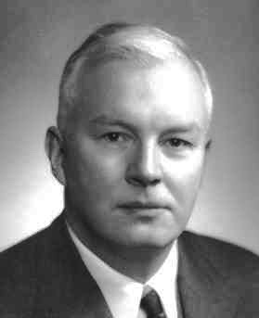
Haskell’s Namesake
Haskell Curry
1900 – 1982
Mathematician who did much of foundational work in the lambda calculus, the mathematical foundation of functional programming.

Slide 12
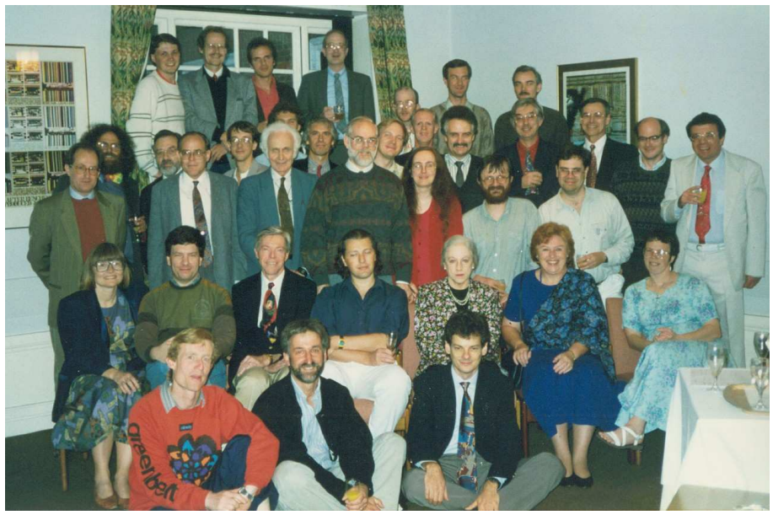
Haskell’s Original Designers
1992 Haskell Working Group

Slide 13
Haskell Probably Can’t Get You a Job!
Haskell has been most influential as a research language used by a subset of academic programming language researchers.
Similar to LISP, Haskell is filled with lots of ideas that have influenced many other languages.

Slide 14
What’s Haskell Good for?
Programming language type systems.
Inspiration and new ways of thinking about programming.
Further development of the functional programming paradigm, aiming towards practicality.

Slide 15
What’s Haskell Not so Good For?
Haskell is generally not as efficient as other languages.
Immutability can lead to inefficient solutions to problems that can be easily implemented efficiently in other languages.
Compared to the most popular mainstream languages, Haskell is not used much in practice, so it can be hard to find support for it.
Haskell’s was born in academia and has a very mathematical flavor, which many programmers dislike, or at least find quite different than C-style languages.
Haskell syntax can be terse, and uses many operators in ways that require you, the programmer, to have memorized their precedence levels. This can make some Haskell code quite difficult to understand.
Haskell’s strict typing can take some getting used to, and may be frustrating at first.
Measuring the performance of different programming languages is surprisingly difficult to do fairly. Check out the Computer Language Benchmarks Game.

Slide 16
Major Features of Haskell
Functions are first-class objects
Functions can be passed and returned (closures)
Interpreted
Easy to evaluate individual expressions
Memory-safe and garbage-collected
No manual memory deletion

Slide 17
Major Features of Scheme
Types
Statically typed, i.e. types checked before run-time
Type inference, i.e. often Haskell infer what types must be with the programmer needing to write them explicitly
Purely Functional
All values are immutable: once you create them, they cannot be changed
All functions are pure
Lazy Evaluation
When you pass an expression to a Haskell function, the expression is passed unevaluated to the function

Slide 18
Major Features Not in Scheme
Features not part of Scheme
No type declarations
No pointers
No built-in notion of object-oriented programming

Slide 19
Features We Won’t Be Using
No loops
No mutation, e.g. no changing values of variables
Instead, we’ll use functional style, which is what our next language (Haskell) will force us to use.

Slide 20
Hello, World!
Follow the download instructions at https://www.haskell.org/downloads/
We’ll only be using ghci, the Glasgow Haskell interpreter
❯ ghci
GHCi, version 8.6.5: http://www.haskell.org/ghc/ :? for help
Prelude> putStrLn "Hello, World!"
Hello, World!

