Slide 1

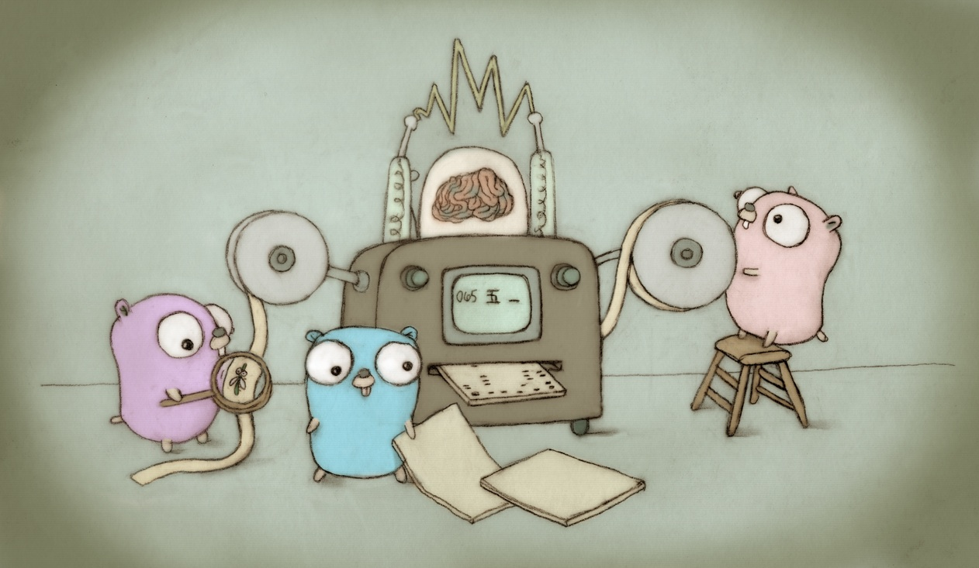
A popular procedural language with
support for objects and concurrency.
2009
CMPT 383
Summer 2022
SFU Surrey
Artwork by Renee French

Slide 2
What was going on in 2009?

Slide 3

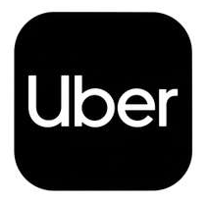
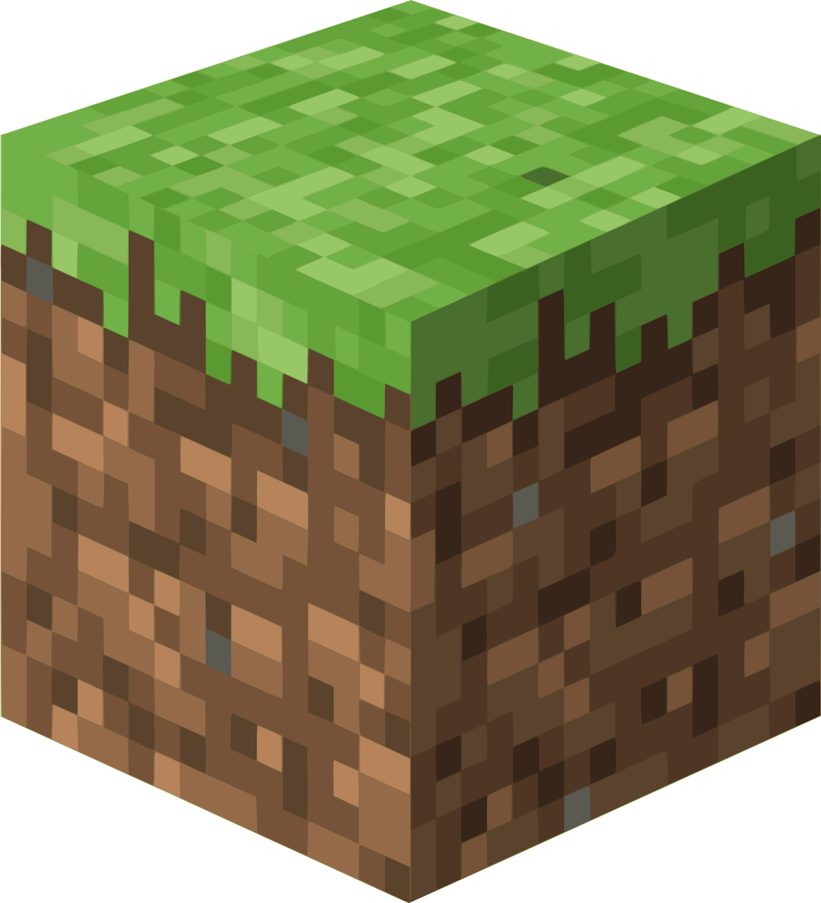

2009: First Appearance
Bitcoin

Slide 4

2009: Most Popular Console Video Game

Slide 5

2009: Highest-Grossing Movie
Transformers Revenge of the Fallen

Slide 6
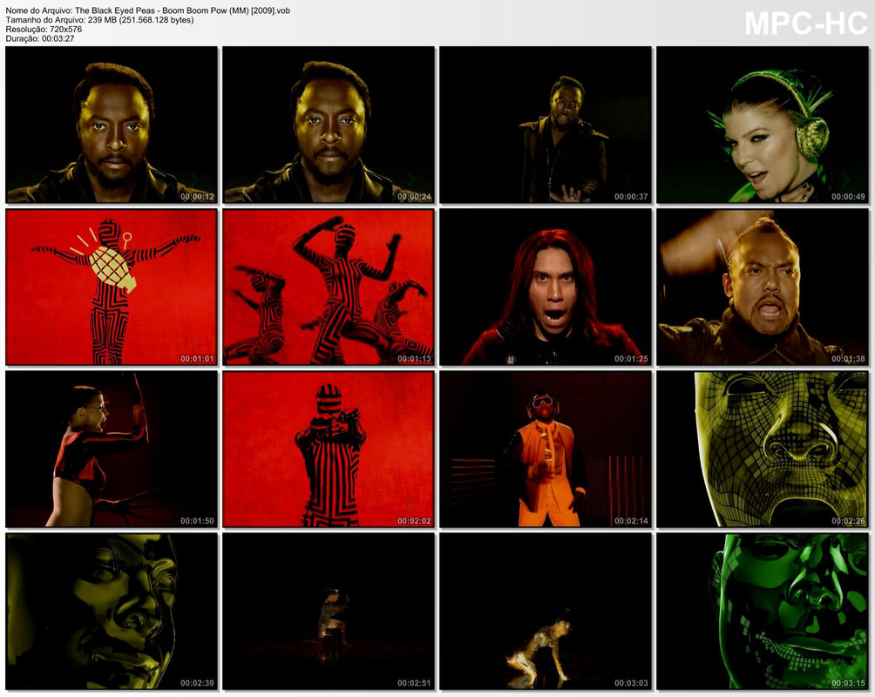
2009: Most Popular Song
Boom Boom Pow,
The Black Eyed Peas

Slide 7
2009 Facts
13th of February, 2009 at 11:31:30pm: Unix time passed 1,234,567,890 seconds
H1N1 flu declared a global pandemic
Usain Bolt set 100m world record of 9.58s
Popstar Michael Jackson died.
On June 28, 2009 physicist Stephen Hawking threw a party for time-travelers. He announced the party the day after it happened, and according to Hawking, no one came.

Slide 8
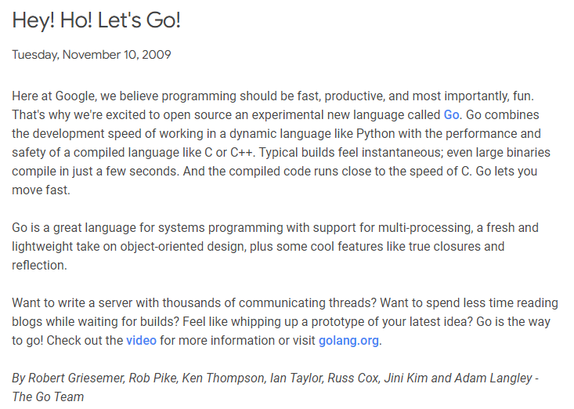
Go
Created at Google in 2007
First public release 2009

Slide 9
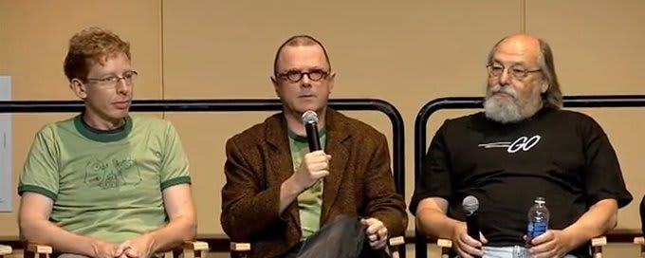
Go’s Original Designers
One of the original designers of Unix. Also won a Turing Award!
Robert Griesemer Rob Pike Ken Thompson

Slide 10

Go Can Get You a Job!

Slide 11




What’s Go Good For?
Command-line utilities.
Websites and servers
e.g. Hugo is a popular static website generator
DevOps tools Like Docker and Kubernetes

Slide 12
What’s Go Not so Good For?
Go is garbage collected, so you don’t get same flexibility as C/C++ when it comes to memory management
Go is generally not as efficient as C, C++, Rust, so it is not the best choice when performance is the primary concern
Go discourages “clever” code in favour of straightforward, simple code that some programmers think is not as “fun”
Measuring the performance of different programming languages is surprisingly difficult to do fairly. Check out the Computer Language Benchmarks Game.
Go was designed by software engineers needing to solve real-world problems. They weren’t programming language theoreticians.

Slide 13
Major Features of Go
Syntactically similar to C, but with some important differences
Multiple ways to define new variables
Optional semi-colons; some syntax simplifications
Compiled
Fast compile times are one of the distinctive features of Go
Memory-safe and garbage-collected
No dangling pointers, no manual memory deletion
Uses interfaces and embedding instead of inheritance
Lack of inheritance is not usually a problem, but it can take some getting used to at first
Apparently the decision to start the Go project was made while waiting for a C++ program to compile.

Slide 14
Major Features of Go
Types
Statically typed: type of values is known at run-time and checked by the compiler
Basic numeric types
Pointers
Arrays
Slices: “point” to a sequence of elements in an array
Built-in hash maps
Structures and interfaces
Functions
Can return multiple values
Methods are functions with a special “self” parameter that can be used with interfaces
Closures: functions can be passed to functions and returned by functions
Packages and Modules
Organized collections of code
Support for downloading from online
Closures are a major feature we’ll see again in other languages.

Slide 15
Major Features of Go
Many programmers say Go’s good built-in support for concurrency is its killer feature.
Concurrency
Based the CSP model of concurrency
Goroutines allow you to run multiple functions concurrently
Channels communicate information between goroutines in a structured way
Extensive Standard Library
Go is ready to write web servers and apps out of the box
Software tool support
Syntax of Go was deliberately made as simple as possible to make it easier for software tools to process it
Go source code has a standard format; use the gofmt tool
Other standard tools, such as support for unit tests, fuzzing
Generics
Added in Go 1.18 in 2022; we probably won’t cover them in this course

Slide 16
Major Features Not in Go
Features not part of Go
No inheritance
No pointer arithmetic
No assertions
No implicit type conversions
No C++-style exceptions; instead, defer/panic and functions return error values
No interpreter, compiled only
Go aims to be simple yet practical. The core rules of Go programming are pretty small compared to other modern languages.

Slide 17
Hello, World!
// hello_world.go
package main
import "fmt"
func main() {
fmt.Println("Hello, world!")
}
$ go run hello_world.go
$ ./hello_world

