Slide 1

A dynamic interpreted high-level programming language with focus on simplicity and productivity.
1995
CMPT 383
Summer 2022
SFU Surrey

Slide 2
What was going on in 1995?

Slide 3







1995: First Appearance

Slide 4

1995: Most Popular Console Video Game
DragonQuest VI Nintendo Super Famicom

Slide 5
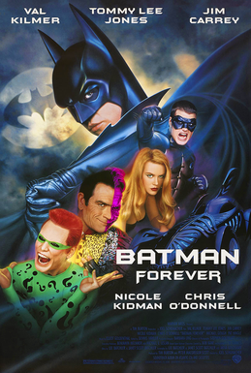
1995: Highest-Grossing Movie
Batman Forever

Slide 6

1995: Most Popular Song
Gangsta’s Paradise,
Coolio

Slide 7
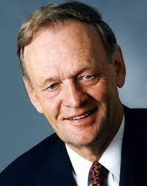





1995 Facts
Jean Chretien: Canadian PM
Bill Clinton: American President
Dua Lipa and Post Malone born
DVDs were invented
Starbucks introduced the Frappuccino

Slide 8
First release was version 0.95 in a Japanese newsgroup in December 1995.

Slide 9

Ruby’s Original Designer
Yukihiro Matsumoto

Slide 10





Ruby Can Get You a Job!

Slide 11

What’s Ruby Good For?
Ruby on Rails is the “killer app” for Ruby. It lets you quickly create websites.
Ruby is also a good a good choice for things that you might use Python for, such as scripting or text processing.

Slide 12
What’s Ruby Not so Good For?
Measuring the performance of different programming languages is surprisingly difficult to do fairly. Check out the Computer Language Benchmarks Game.
Ruby is generally not as efficient as C, C++, Rust, so it is not the best choice when performance is the primary concern.
Ruby does not provide many compiler-time checks, so it is easy to release code with errors that aren’t discovered until run-time.
Ruby has many powerful features that can lead to clever code that can cause readability problems.
Ruby was designed to improve the programmers experience, even at the cost of lower run-time performance and correctness.

Slide 13
Major Features of Ruby
Everything is an object
Much more object-oriented than languages like C++ or Java or Python
Interpreted
Easy to evaluate individual expressions
Memory-safe and garbage-collected
No dangling pointers, no manual memory deletion
Flexible: Easy to Alter
Can add to and change many existing features
Errors
Exception handling system
Monkey patching is when you change the how a program works a run-time. This is a possible technique in Ruby, with pros and cons.

Slide 14
Major Features of Ruby
Types
Dynamically typed, i.e. types checked at run-time
New types can be created with classes
Existing types can be extended
Symbols
Blocks
A practical way to deal with higher-order functions
Text Processing
Built-in regular expressions
Extensive Standard Library
Many useful functions ready to use
Ruby is a feature-rich language, often with more than one way to do simple things.

Slide 15
Major Features Not in Ruby
Features not part of Ruby
No type declarations
No pointers

Slide 16
Hello, World!
# hello_world.rb
puts 'Hello, world!'
$ ruby hello_world.rb
Hello, world!

Slide 17
Hello, World!
To launch Ruby interpreter:
$ irb
irb(main):001:0> puts "Hello, world!"
Hello, world!
=> nil
>> puts "Hello, world!"
Hello, world!
=> nil
We’ll usually use a simplified prompt.

