Slide 1
Team 24
Fan Aijun, Lai Yilin, Tian Zheng, Zhang Hao

Slide 2
Topic of the site
New Sport Brand

Slide 3
Target Audience
All the people who like sports like running, playing basketball, playing football, badminton, hiking and so on.

Slide 4
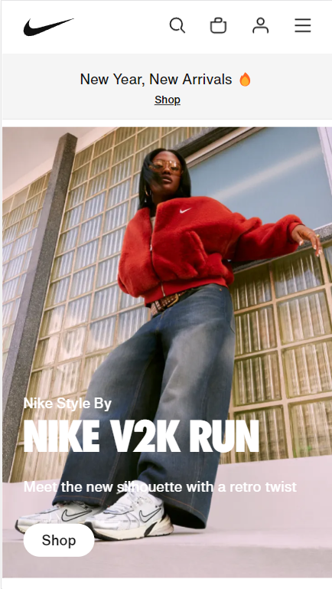
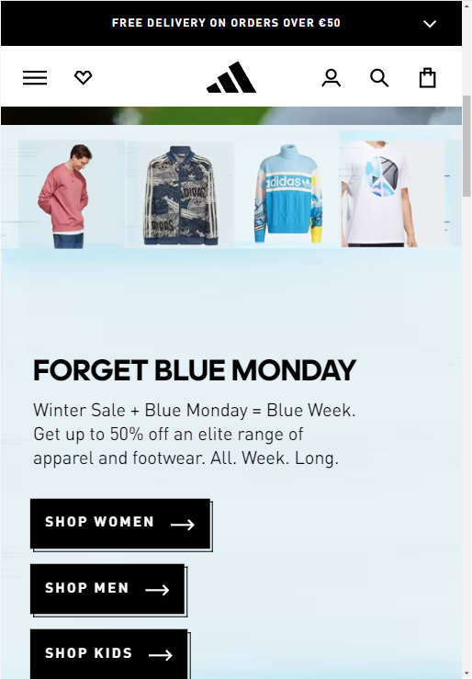
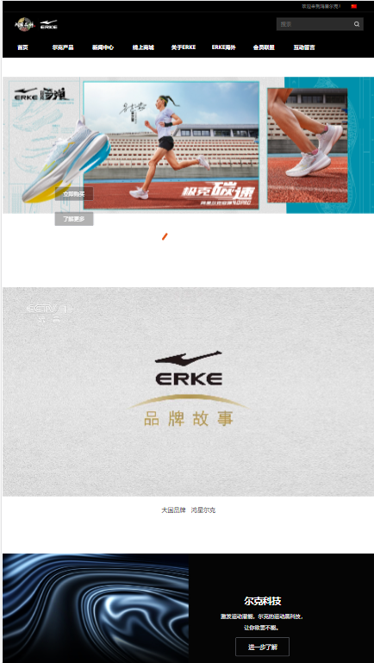
Website look and feel
Simple but clear
Competitors: Nike, Adidas, Erke etc. Their sites are as below.

Slide 5
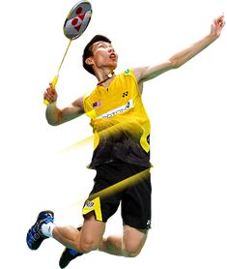
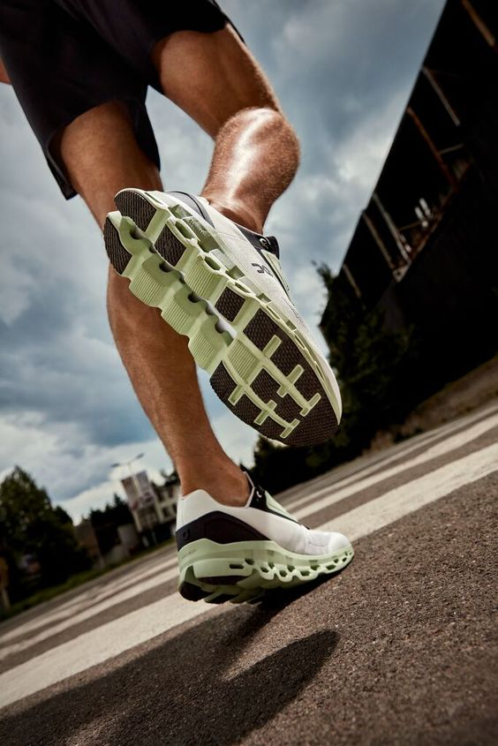
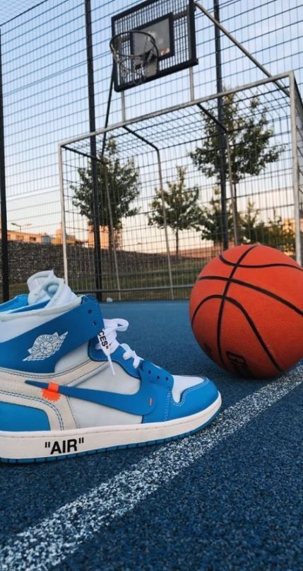
Website look and feel
Simple but clear
Competitors: Nike, Adidas, Erke etc.
Using some pictures with sports elements. As below

Slide 6
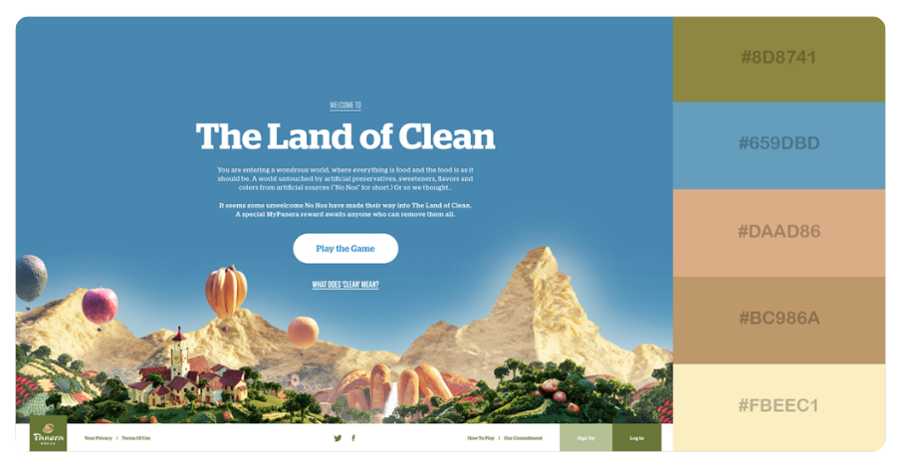
Color Palette New one
3 Natural and Earthy
Change the color palette to a clear one.

Slide 7
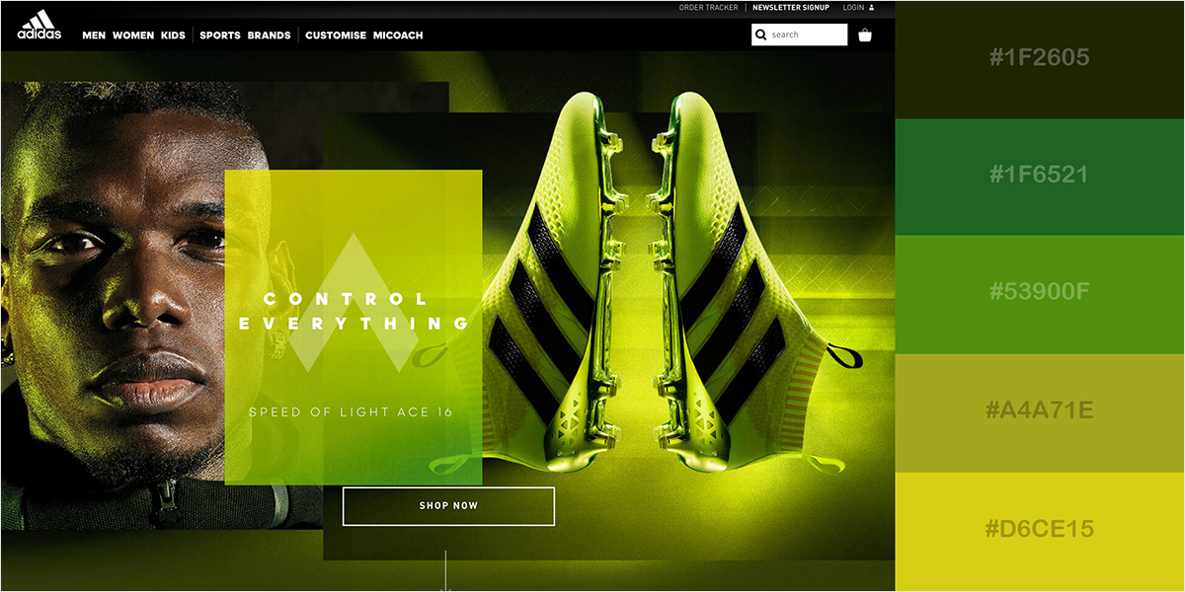
Color Palette OLD ONE NOT USE
33 Striking Citrus Colors
This fresh and citrusy blend of light greenish-yellows, lime green and black is a favorite among brands related to high-adrenaline sports and energy drinks.

Slide 8
Teamwork Practices
We are going to work mainly online.
We will have a short daily meeting everyday.
Create a GitHub for Team 24.

Slide 9
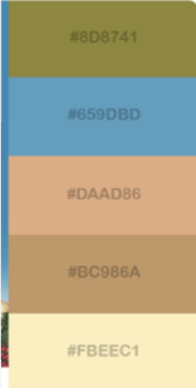
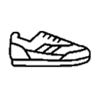

Logo
24-Sports
Keep Moving

