Slide 1
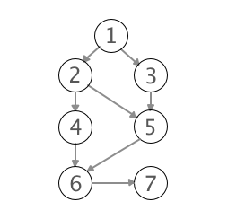
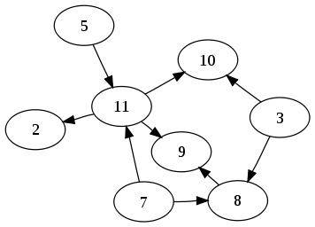
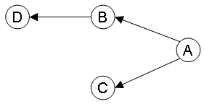
Random digraphs
Student: Luțan Elena – Ruxandra
Group: CEN 2.2.A
Coordinating teacher: Dr. Ing. Cristian Mihaescu

Slide 2
Problem Statement
Random digraphs. Write a program that takes integer values V, representing the number of vertices of a Digraph, and E, the percentage of vertices in the Digraph, and creates a Random Digraph by generating percentage E random pairs of integers, representing the vertices of the Random Digraph.

Slide 3
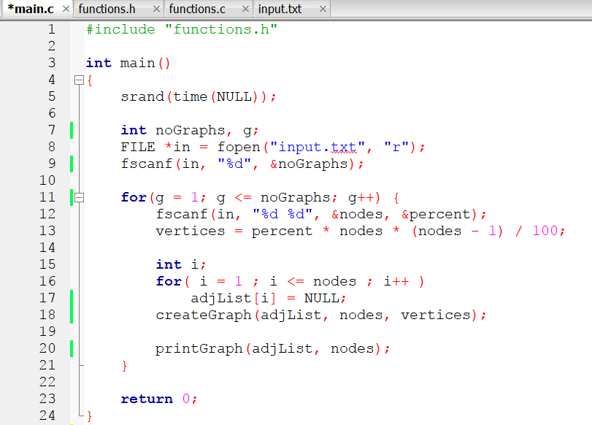
Main.c
Read number of graphs to be generated
For each graph
Read number of nodes
Read percentage of vertices
Initialize the adjacency list of the graph
Create the graph
Print created graph

Slide 4
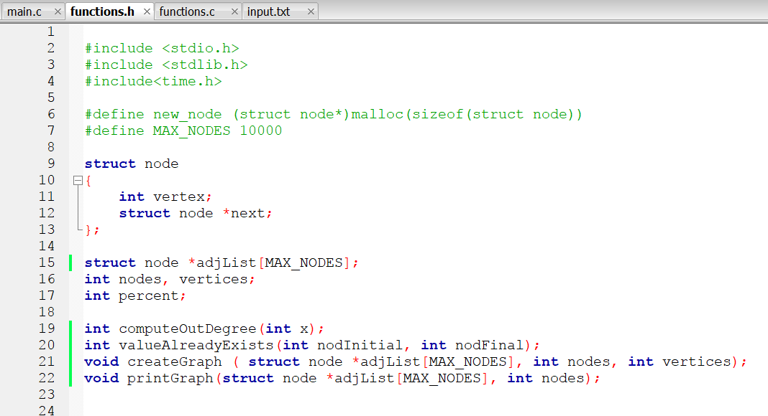
Functions.h

Slide 5
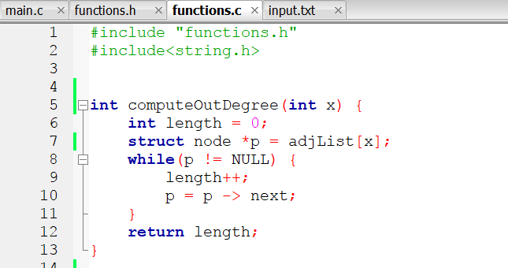
Functions.c
Function computeOutDegree – returns the number of nodes contained by the adjacency list of node x.

Slide 6
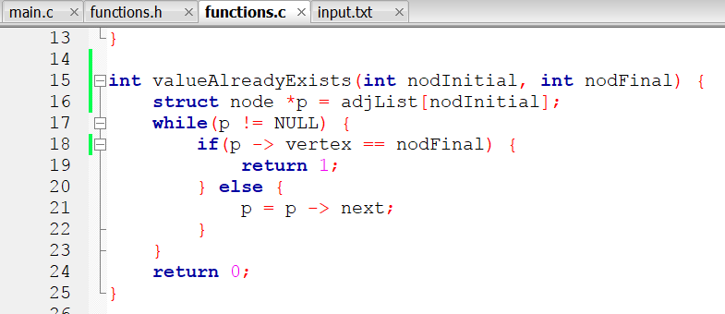
Function valueAlreadyExists – returns 1 if the node (nodFinal) exists in the adjacency list of node x (nodInitial). Otherwise it returns 0.

Slide 7
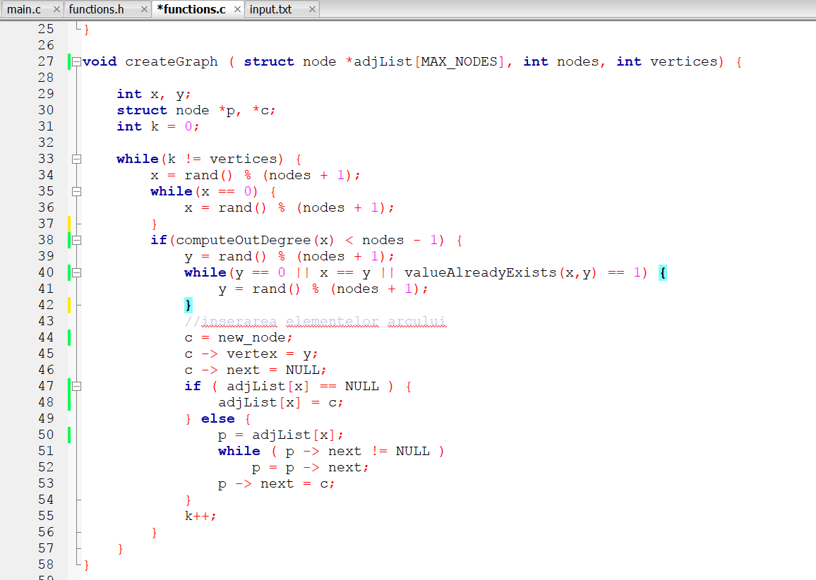
Functions.c
Function createGraph – creates the adjacency list for a graph with ‘nodes’ number of nodes and ‘vertices’ number of vertices, by generating random pairs [x – y] and testing if they can represent the vertices of the graph or not.

Slide 8
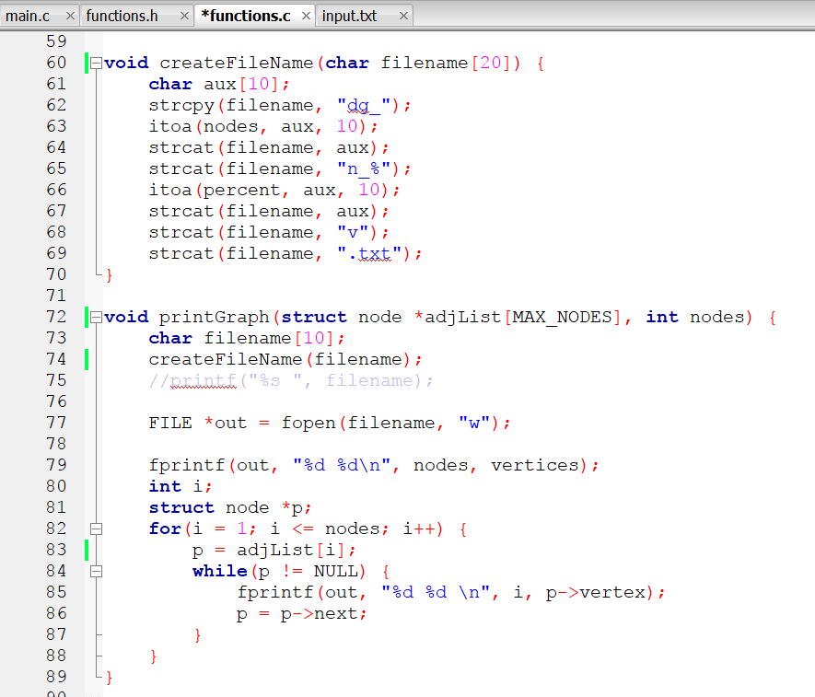
Functions.c
Function createFileName – creates a name for the current output file
Function printGraph - prints in the specific output file in the following format:
On the first line the number of nodes and vertices of the graph
On the next ‘vertices’ lines the pairs of nodes that form a vertex

Slide 9
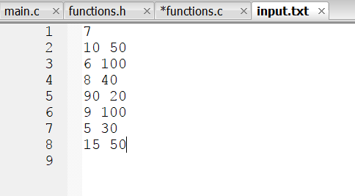
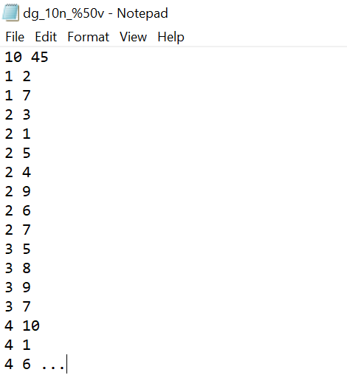
Example
Proof
N = 10 nodes
V = 50% vertices
A complete graph has:
Vertices = N*(N-1) = 10*9 = 90
So:
90 ………. 100%
X ………… 50%
=> X = 90*50/100 = 45 vertices

