Slide 1
Data Structures Project: Average search time
Gabriela-Loredana Dinu

Slide 2
PROBLEM STATEMENT
Run empirical studies to compute the average and standard deviation of the average length of a path to a random node (internal path length divided by tree size, plus 1) in a BST built by insertion of N random keys into an initially empty tree, for N from 100 to 10,000. Do 1,000 trials for each tree size. Plot the results in a Tufte plot, fit with a curve plotting the function 1.39 lg N – 1.85lgN

Slide 3
A binary search tree is a rooted binary tree, whose internal nodes each store a key (and optionally, an associated value) and each have two distinguished sub-trees, commonly denoted left and right. The tree additionally satisfies the binary search property, which states that the key in each node must be greater than or equal to any key stored in the left sub-tree, and less than or equal to any key stored in the right sub-tree. (The leaves (final nodes) of the tree contain no key and have no structure to distinguish them from one another. )

Slide 4
Project content
Core BST functions:
„Add_Node” is used to insert a new value in the BST.
Project-Related functions:
„countNodes” returns the number of nodes in a BST
„computeIPL” returns the internal path length of a BST
„ computeAveragePathLength” computes the average path length of a bst.
Testing functions:
„buildFile” is used to build a testing file.
“internalPathLength” is a second function for computing the IPL used to check the result from “computeIPL” function

Slide 5
How it works?
Implement 8 binary trees with random generated elements. The trees have 100,200,400,800,1600,3200,6400 and 12800 nodes respectively
For each tree we calculate the internal path length that is the sum of all comparisons we make in order to reach all the nodes in the tree. We can compute it recursively as following:
A)if the root is NULL, the tree/subtree is empty, thus return 0
B)else we return the sum between the IPL of the left and right subtree
We compute recursively the number of nodes in the tree as following:
a) if the tree is empty return 0
b) else the number of nodes is the sum between the number of nodes of the left and right subtree
Next we compute the average path length which is the internal path length divided by tree size, plus 1

Slide 6
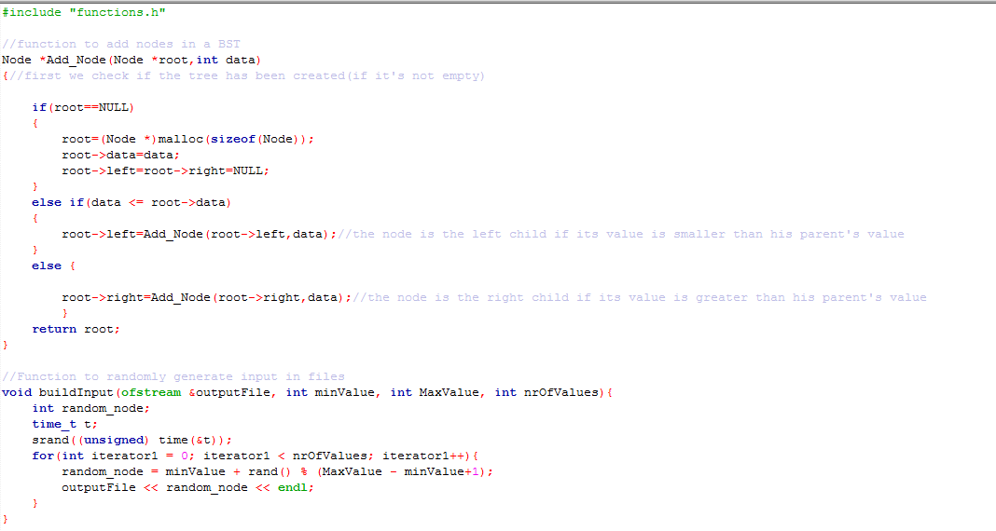
Code

Slide 7
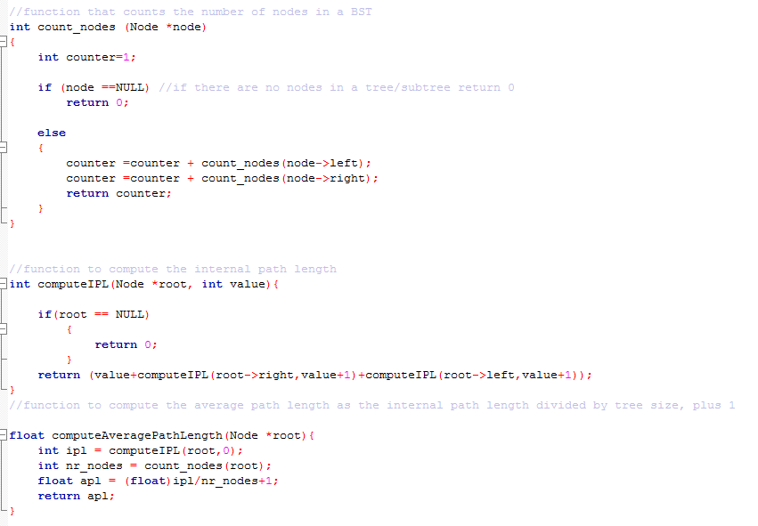

Slide 8
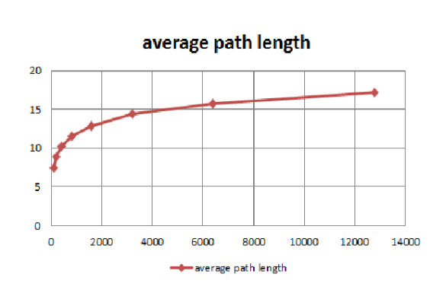
Plot of the results

Slide 9
Conclusion
The average path length is about 1.39 lg N – 1.85 lgN

Slide 10


Global coverage of code

Slide 11
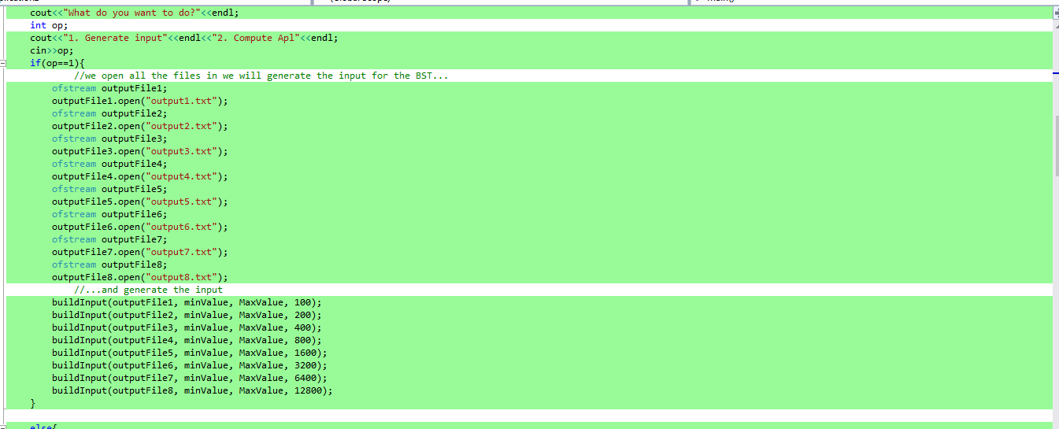
Case 1 – generate input

Slide 12
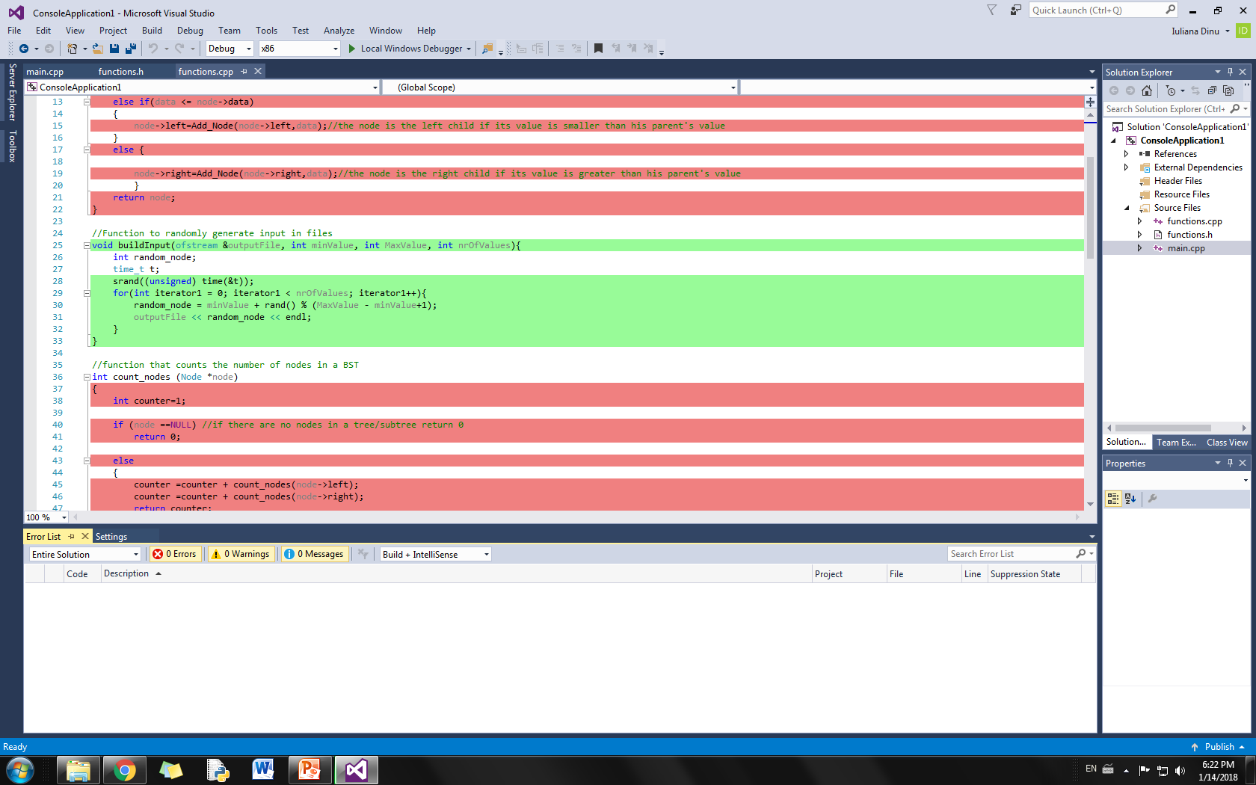

Slide 13
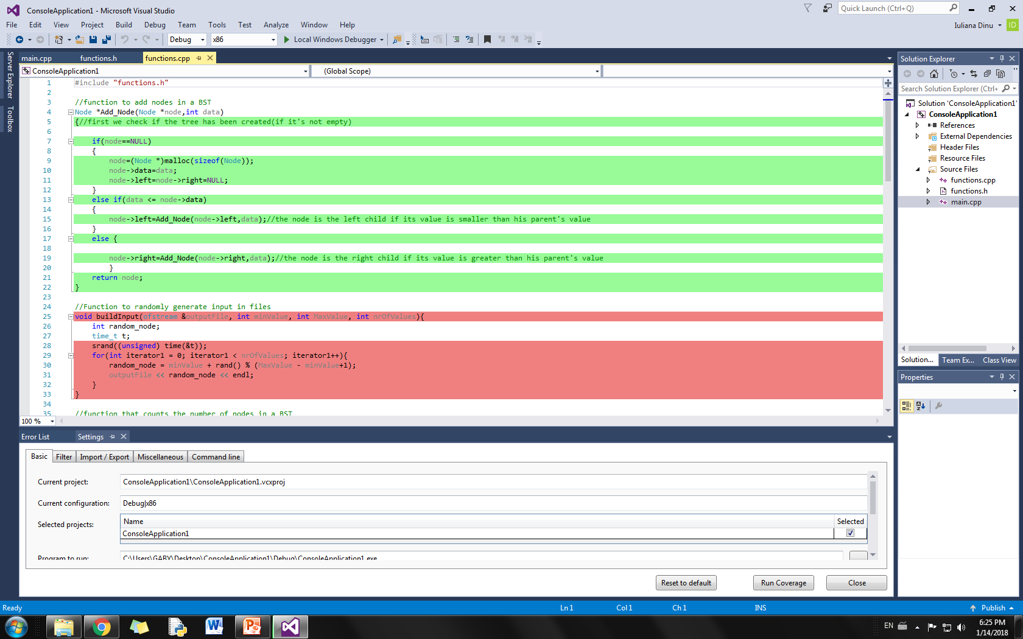
Case 2 - APL

Slide 14
