Slide 1
SECURITY · AI · REAL-TIME
WatchService Agent
Real-time Ransomware Detection System
Behavior-based AI detection · Instant alert · Gemini AI guidance
C135086 김유민 | B898061 이상혁

Slide 2
System Overview
What problem does it solve?
⚠ The Problem
✓ Our Solution
Ransomware encrypts files
Behavior-based Detection
and demands ransom — data loss is irreversible
Monitors file activity patterns — not file content. Works on any ransomware variant.
XGBoost AI Model
Traditional AV misses
9 behavioral features (read/write/delete/ entropy change) → SAFE / WARNING / DANGER
new/unknown variants (signature-based limits)
→
Instant Multi-channel Alert
Fullscreen emergency popup + email notification the moment DANGER is detected
No real-time alert
Users notice too late; damage already done
Gemini AI Guidance
LLM generates step-by-step response guide tailored to the detected threat

Slide 3
Key Features
Core capabilities of WatchService Agent
🔍 Real-time File Monitoring
🤖 AI-powered Detection
📊 Entropy Analysis
• Java NIO WatchService
• XGBoost binary classifier
• Multi-section sampling (40/40/20%)
• Recursive folder watching
• 9 behavioral feature vectors
• Encryption detection via entropy spike
• CREATE / MODIFY / DELETE events
• Trained on 30,000 samples
• Noise filter: |diff| > 0.05 threshold
• 3-second window aggregation
• SAFE / WARNING / DANGER labels
• file_encrypt_like_count feature
🚨 Instant Alert System
⚙️ Persistent Settings
📋 Reporting & Admin
• Fullscreen emergency popup
• Fixed ownerKey 'default'
• PDF report export
• Email notification (SMTP)
• Survives server restart
• CSV / JSON log download
• Gemini LLM response guidance
• Watch folders + exception rules
• Admin dashboard
• Dashboard with history & stats
• Alert email configuration
• False-positive reporting

Slide 4
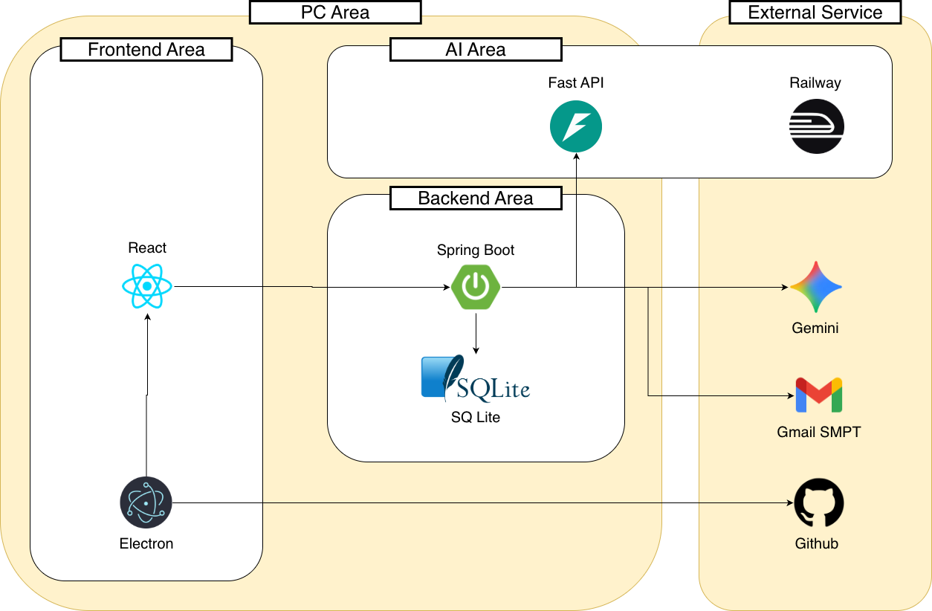
System Architecture
System components and flow

Slide 5
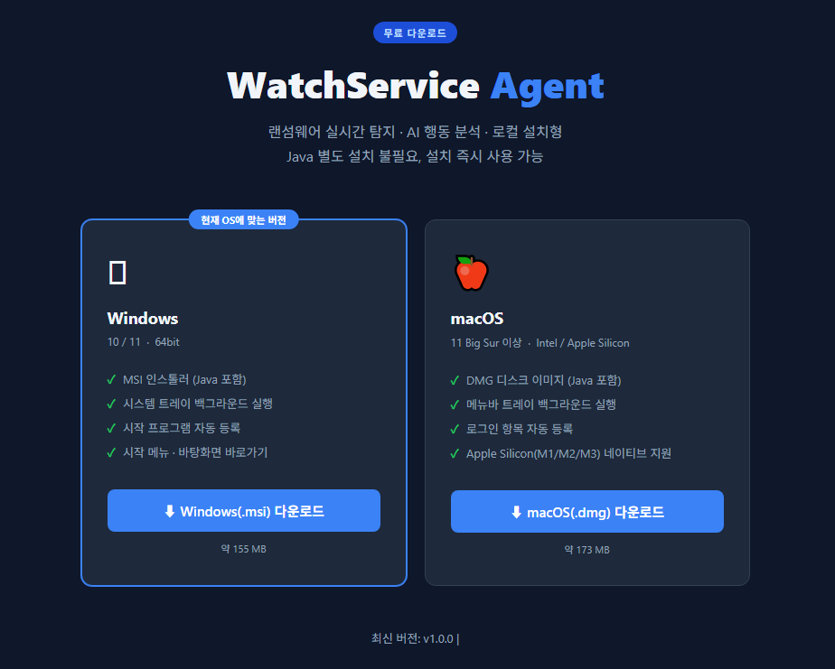
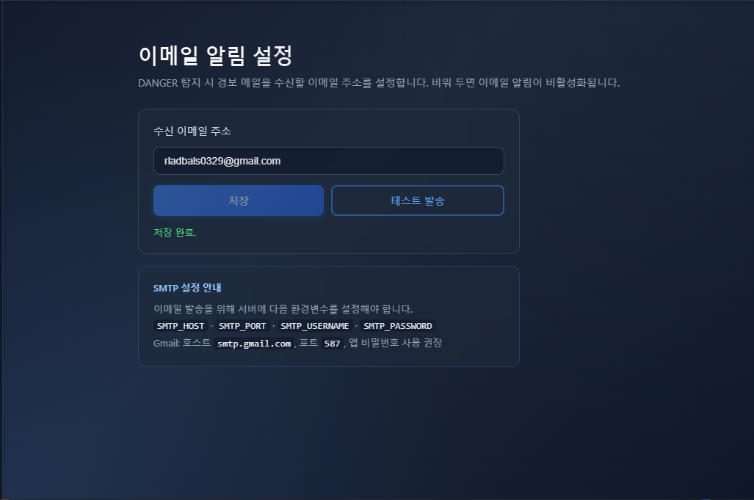
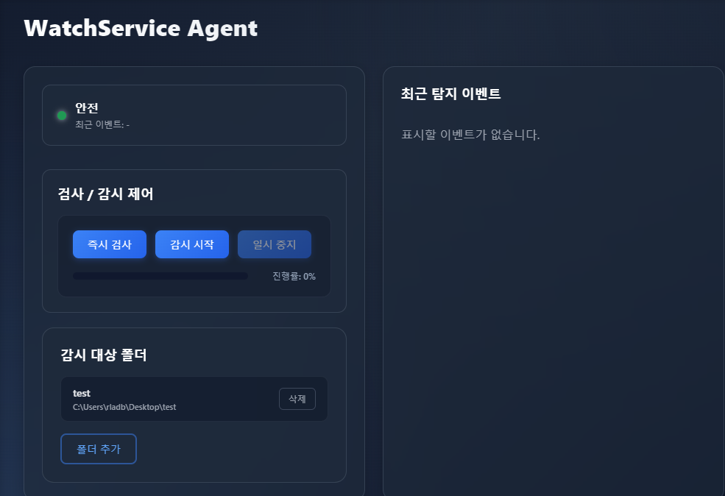
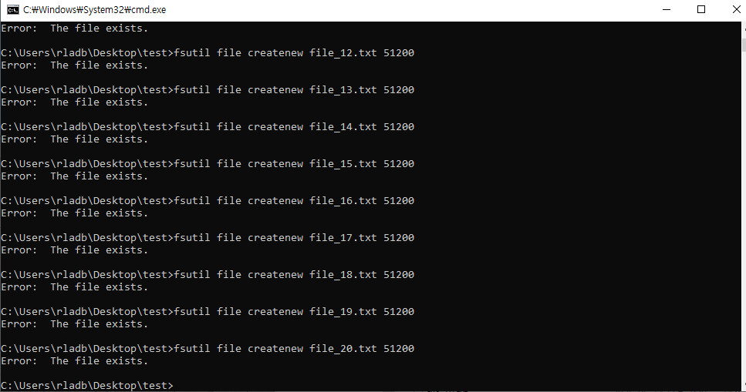
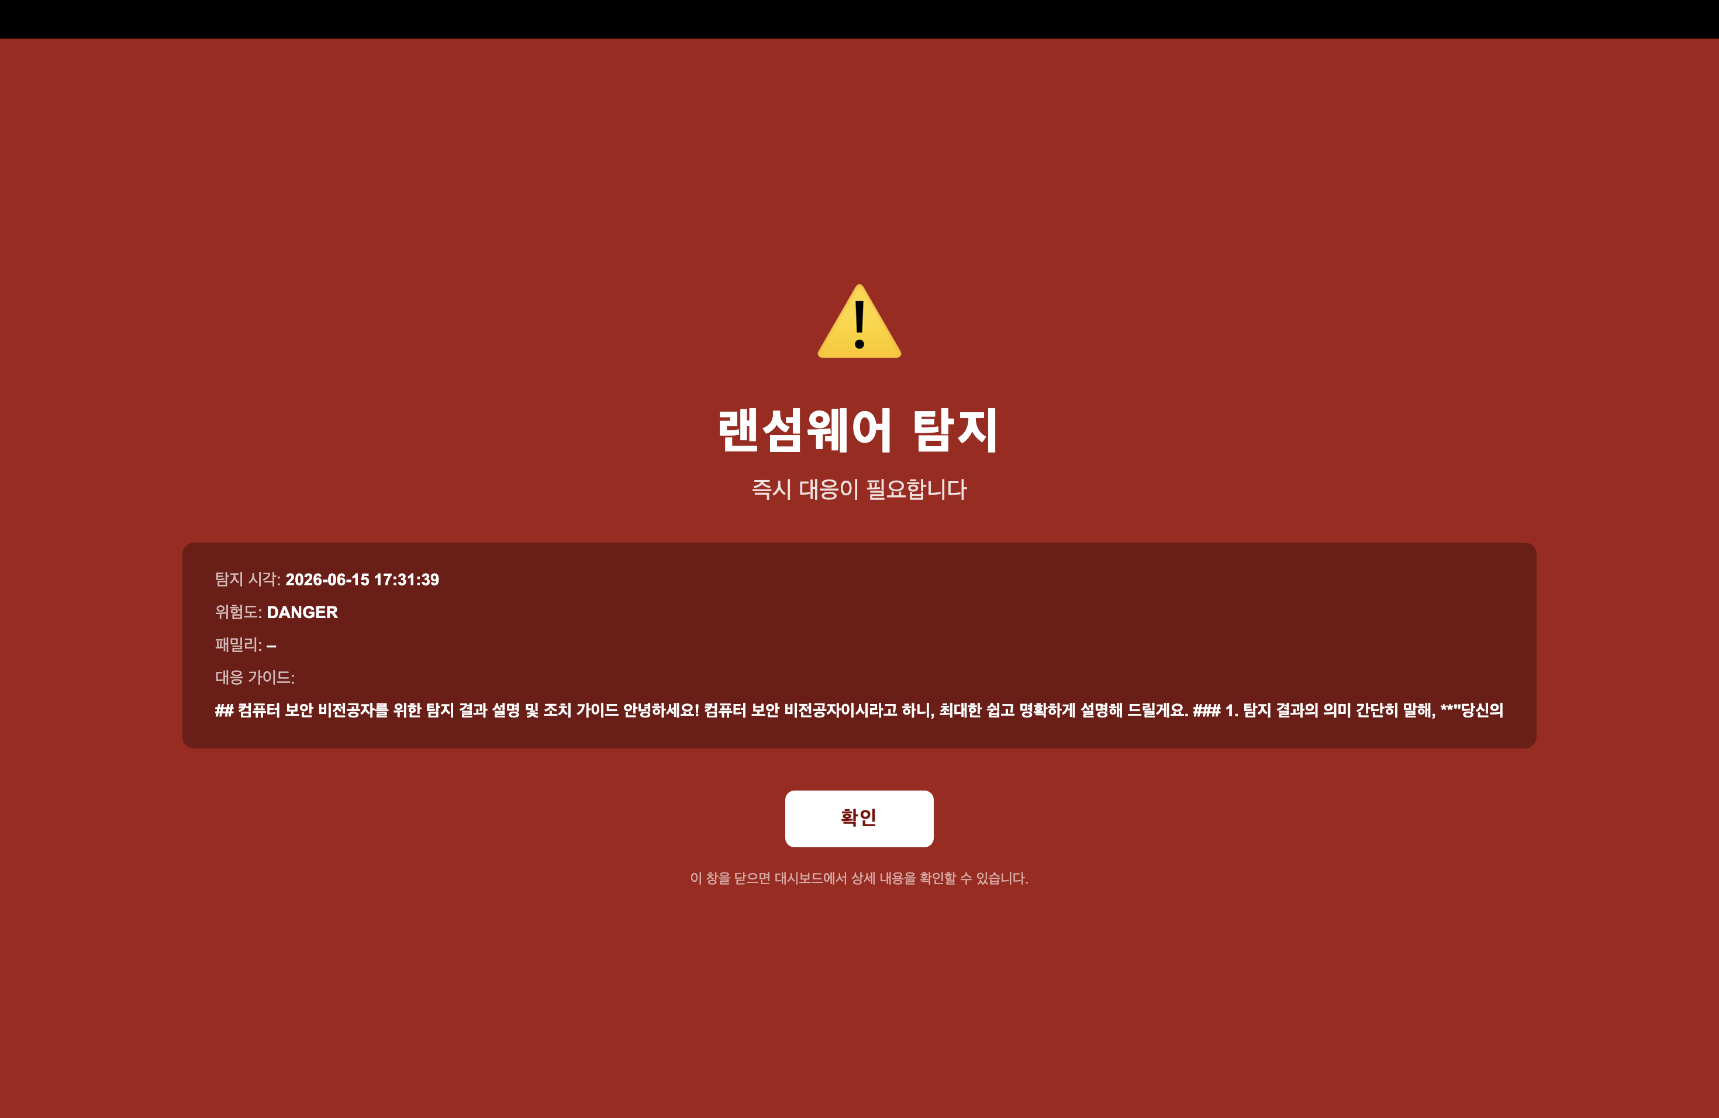
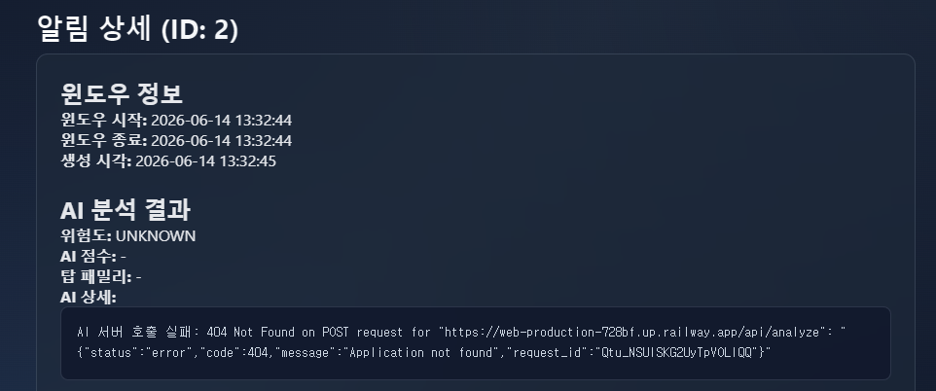
Demo
Live demonstration scenario
Step 1
Step 2
Launch & Setup
Configure Email Alert
Open WatchService Agent → Start monitoring Settings → Add watch folder (e.g. Desktop/test)
Settings → Alert Email → Enter recipient Send test email → Verify delivery in inbox
Step 3
Step 4
Simulate Normal Activity
Simulate Ransomware Behavior
Create / edit / delete a few text files Dashboard shows SAFE (green) — no alert
Run simulate script: rapid mass rename + high-entropy overwrite on 20+ files
Step 5
Step 6
DANGER Detection
Response & Review
Fullscreen emergency popup appears Email alert delivered to inbox
Gemini AI guidance displayed on screen Dashboard → Notification detail → history log

