Slide 1
CLOUD-BASED
WEATHER MONITORING
& FORECAST DASHBOARD
Using Python and Streamlit
A web-based application to view current weather, explore a 5-day forecast,
visualise weather trends and store weather history in the cloud.
Prepared by: Aikhya | Reg. No.: 25251402
PROJECT PRESENTATION

Slide 2
01 | Problem Statement & Objectives
Why a unified weather monitoring dashboard is useful
PROBLEM STATEMENT
PROJECT OBJECTIVES
Weather information is often spread across different screens and sources. Users may find it difficult to quickly compare current conditions, review upcoming forecasts and keep a record of previous weather observations.
• Provide current weather details for a searched city
• Display a 5-day forecast
• Present weather information through charts
• Allow forecast export in Excel and CSV formats
• Store and retrieve weather history using Firebase
Goal: make weather information easier to access, understand and analyse.
02 / 05

Slide 3
02 | Technology Stack & System Workflow
The dashboard combines an API, data processing, visualisation and cloud storage
USER
OPENWEATHER API
PYTHON + PANDAS
STREAMLIT + PLOTLY
FIREBASE
Searches for a city
→
Returns current conditions
and forecast data
→
Processes and organises
the weather data
→
Displays metrics, tables
and interactive charts
→
Stores and retrieves
weather history
TOOLS & LIBRARIES
Python • Streamlit • Requests • Pandas • Plotly • Firebase Admin SDK • OpenWeather API • OpenPyXL
Deployment can be hosted through Streamlit Community Cloud with secrets configured securely.
03 / 05

Slide 4
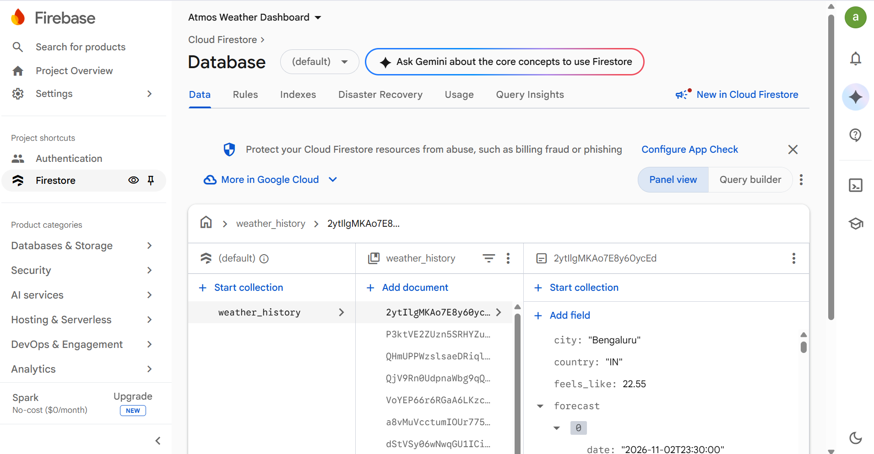
03 | Dashboard Features & Firebase Integration
Firebase Firestore stores the weather records generated by the dashboard
CURRENT WEATHER
Temperature, feels-like, min/max, humidity, pressure, wind and visibility.
5-DAY FORECAST
Date-wise temperature, humidity, wind, rainfall and weather conditions.
VISUAL ANALYTICS
Interactive charts to explore weather changes and patterns.
CITY SEARCH & COMPARISON
Search a selected city and review its weather information.
DATA EXPORT
Download forecast data in Excel (.xlsx) and CSV (.csv) formats.
FIREBASE HISTORY
Save weather records to Firestore and retrieve previously stored records.
FIREBASE CLOUD FIRESTORE | weather_history collection and saved weather records
04 / 05

Slide 5
04 | Outcome, Benefits & Future Scope
Project summary and possible enhancements
PROJECT OUTCOME
FUTURE ENHANCEMENTS
The project provides a working structure for accessing weather data through an API, presenting it in an interactive Streamlit dashboard, exporting forecast records and connecting to Firebase Firestore for cloud-based history.
• Add user login and personalised saved cities
• Add weather alerts and severe-weather notifications
• Include maps and location-based visualisation
• Add longer-term historical analysis
• Improve automated cloud deployment and monitoring
THANK YOU
Questions?
05 / 05

