Slide 1
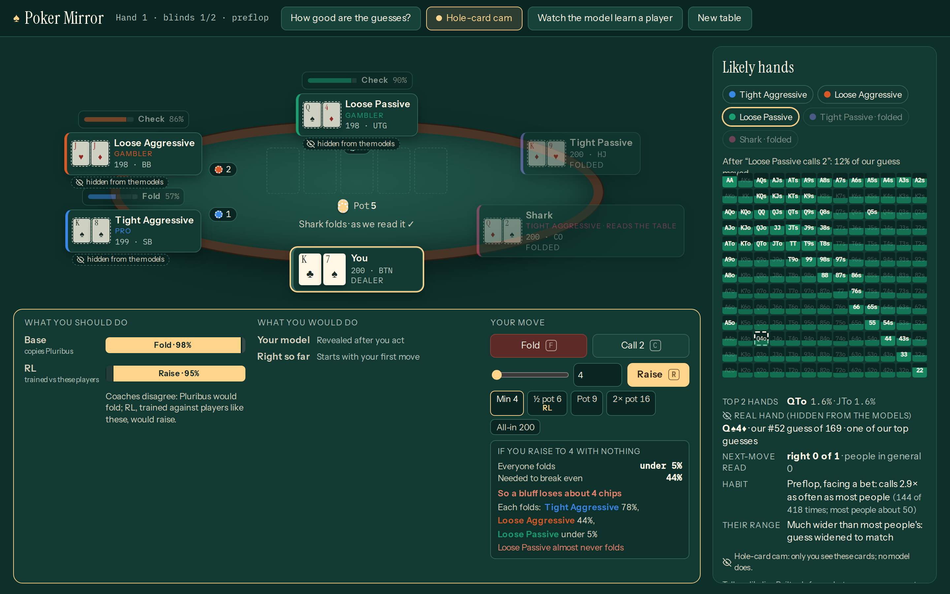
HackTheBurgh 2026 · HRT · G-Research · Make the invisible visible
Poker Mirror
Poker training that makes the hidden visible, measured on data it never saw.
HRT · predictions and decisions
Every move predicted and checked; a bluff check prices the decision.
Make the invisible visible
Hidden cards as a live range, habits in plain words, a hole-card cam.
The live table: next moves above each seat, likely hands on the right, every card shown to the audience and hidden from the models.
G-Research · real time
Every model updates as the hand is played.
Notes:
Poker is the purest problem of deciding under hidden information against people. Poker Mirror shows you what is hidden: their likely cards, their habits, what your bluff is worth, and what a coach trained by reinforcement learning would do. Every number on screen was measured on data no model saw. For HRT: predictions before every move and checked, a bluff check that prices the decision, and an RL coach tested once on sealed tables. For Make the invisible visible: ranges, habits, a hole-card cam the models never see, and a Shark whose read of you is on screen. For G-Research: it all updates live, move by move.

Slide 2
The data told us where the edge is
Our first analysis: heads-up river decisions in 21.6 million real hands
0 of 4,156
10×
+8.0 / −2.8
shown hands that were folds: the data hides every folded hand
how much more the situation predicts than the person
chips per spot exploiting a frequent folder / an average player
So we built it in four steps
1
2
3
4
Model the situation
Tilt it per person
Show what is hidden
Test on unseen data
people in general
a Bayesian update
ranges, habits, leaks
held-out and sealed
The person still adds a small, real edge (+0.0028 nats, 95% CI [+0.0002, +0.0060]), largest against players with a leak: so we built a mirror for leaks.
Notes:
Our first finding was humbling. In heads-up river decisions from 21.6 million hands, the situation (bet size, board, betting) explains about ten times more than the person's own history. Folds never reveal cards: of 4,156 hands where the defender's cards were shown, none were folds, so the data hides exactly the hands that fold. But the person adds a small, real edge, and a bot tuned to one opponent wins 8 chips per spot against a frequent folder while losing 2.8 against an average player. Player types add nothing once you know the person. So: model the situation first, tilt it per person, show what is hidden, and test everything on unseen data.

Slide 3
Real data, strict splits, four models
Each model answers one question and is tested on data it never saw
Data
Next move
Hand model
21.6M
What will they do next? Learned from every decision.
What are they holding? 169 hand types, from public actions.
real online hands, 5–6 players
Personal model
RL coach
10,000
What does this person do differently? Bayesian, live.
What should you do? PPO, millions of simulated hands.
Pluribus hands, every card known
31
The players at the table
real players kept out, to test
Named after their type: Tight Aggressive copies the Pluribus pros; Loose Aggressive, Loose Passive, Tight Passive and the Shark are mined from 10,213 real regulars.
Compute: the University of Edinburgh's Eddie cluster and one RTX 5090 PC.
Notes:
The data: 21.6 million online hands from five sites, plus the ten thousand hands Pluribus played against professionals, where every card is known, so they are the fair test for guessing hands. We split by player and keep 31 real players out of everything: 30 to test the personal model, one for the replay. Four models, each answering one question. The bots at the table are the four classic player types, mined from 10,213 real regulars (the most extreme 15% of each type) and fitted until their VPIP, PFR and AF match: Loose Passive plays 39% of hands and raises 10%, against 42% and 11% for the real players.

Slide 4
How it learns, and how we tested it
Standard methods, combined, then tested once on sealed tables
Split data by player
Train and calibrate models
Copy Pluribus first (88%)
PPO vs human-like bots
Held-out check every 50 updates
Sealed test, run once
RL coach · PPO
Personal model · Bayes
Bluff check and Shark
• 193 inputs, incl. each opponent's predicted range
• 512-512-256 network, 7 actions
• Stable on noisy rewards; a mixed strategy on CPUs
• Starts as people in general
• Pulled toward the player's own counts in each situation
• Public actions only (Bayes' Bluff, 2005)
• Each player's own model gives P(fold); multiply
• Calibrated on one session, tested on another
• The Shark asks the same about you: one level, no loops
Notes:
Left to right: split the data by player; train the supervised models and check their calibration on held-out players; start the coach as a copy of the Pluribus model (88% agreement); improve it with PPO against human-like players, rule bots and earlier copies of itself; keep each run's best version on held-out tables every 50 updates; and finally a sealed test, written down before any result and run once. PPO details: 193 inputs, a 512-512-256 network, 7 actions, clip 0.2, GAE lambda 0.95; we chose PPO because Pluribus's own method needed about 12,400 core-hours, and PPO is stable on noisy rewards and learns a mixed strategy. The personal model starts as people in general and is pulled toward the player's own fold, call and raise counts in each situation, a Dirichlet update with a prior worth 8 moves. The bluff check asks each player's own model how likely they fold and multiplies; a two-number correction is fitted on one session and scored on another. The Shark asks the same question about you and shifts its raising, one level only, so there are no loops.

Slide 5
What we found, and where it transfers
On data and opponents no model was trained on
75% → 76%
next move: said vs happened
30% vs 28%
bluff check: said vs happened
26% → 52%
the Shark's bets into a leaky player
Shipped coach +156 ± 15 · RL adds +154 ± 14
Our hand predictions add +82 ± 14
Transfers to decisions against people you cannot fully see
Trading
Negotiation
Security and fraud
Training people
Notes:
Findings, all on data or opponents no model was trained on. The next-move model is calibrated: when it says 75%, it happens 76% of the time over 670,615 decisions. The bluff check said everyone folds 30% of the time and they did 28%, over 871 real bets. The coach wins 156 big blinds per 100 hands against a maths bot on sealed tables, plus or minus 15; reinforcement learning adds 154 over the same network copying Pluribus, and our hand predictions are worth 82. The Shark doubles its bets into a leaky player within 50 hands, 26% to 52%, against 31% when it does not read. What surprised us: left alone, RL over-fits its training opponents after about 100 updates; a leash toward Pluribus stops the drift but wins less; opponent-style inputs added nothing measurable. The recipe is a population model, a Bayesian per-person tilt, a calibrated decision check and a policy started from expert imitation, tested on sealed counterparties: it transfers to market making, negotiation, security and tools that train human decisions. Caveat: the coach is tested against bots built from real players, not live people, and this is a training and review tool, not for real-money play.

