Slide 1
AI/ML-Based Prediction of 6 Ergonomic Risk Factors
By
Aila Vishnu Vardhan
23911A6702
VJIT

Slide 2
Project Objective
Analyse workload, posture, fatigue, and ergonomic exposure among delivery riders
Predict ergonomic risk severity using AI/ML techniques
Build a data-driven ergonomic exposure prediction framework

Slide 3
6 Ergonomic Risk Factors
Force
Repetition
Posture
Duration
Contact Stress
Vibration

Slide 4
Measurement Methods
Force → Borg CR10(physical demand), carrying load(carrying difficulty)
Posture → RULA & QEC
Duration→ Continuous posture duration(continuous riding position)

Slide 5
Measurement Methods
Contact Stress
Heavy shoulder bag + long duration
wrist discomfort + prolonged riding (consider age)
High Contact Stress
If:
heavy backpack
long riding hours
shoulder discomfort
no breaks
Condition | Contact Stress Risk
Low load + short duration | Low
Medium load + moderate duration | Medium
Heavy load + long duration + pain | High

Slide 6
Measurement Methods
Vibration
Exposure index= working hours x vehicle weight
Exposure Index = duration + intensity + frequency workload
Vehicle-Based Vibration Weight
Vehicle Type | Vibration Weight
Scooter | 1
Motorcycle | 2

Slide 7
Measurement Methods
Repetition
Task frequency/minute(can derive from work frequency/exposure)
Repetition Index = Deliveries Per Day​/ Work Hours
higher delivery frequency per hour leads to higher repetition exposure.
Ex:
Deliveries/Day | Work Hours | Repetition Risk
10 | 8 | Low
35 | 8 | Medium
70 | 8 | High

Slide 8
Simplified Workflow Diagram
Data Collection
↓
Data Cleaning
↓
Data Preprocessing
↓
Feature Engineering
↓
Exploratory Data Analysis
↓
Relationship Analysis
↓
AI/ML Modeling
↓
Prediction of 6 Ergonomic Risk Factors
↓
Visualization & Reporting

Slide 9
Input Variables
Work hours
Riding duration
Deliveries/day
NASA-TLX workload scores
Borg fatigue scores
Posture scores
Body pain indicators

Slide 10
Prediction Targets
Predict Force Risk
Predict Repetition Risk
Predict Posture Risk
Predict Duration Risk
Predict Contact Stress Risk
Predict Vibration Risk

Slide 11
Dataset Understanding
Identify scales and target variables
Categorize numerical and categorical data
Categorize dependent and independent variable
Category | Examples
Demographic | Age, Gender
Workload | NASA-TLX
Fatigue | Borg Scale
Exposure | Work Hours
Posture | RULA/REBA
Discomfort | Body Pain
Ergonomic Factors | Force, Vibration etc

Slide 12
Data Cleaning
Handle missing values
Remove duplicates
Standardize scales and values
Convert categorical data into structured format
Ex: Standardization High -> 3
Medium -> 2
Low -> 1

Slide 13
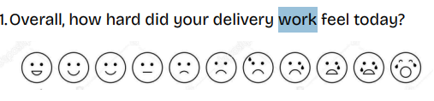
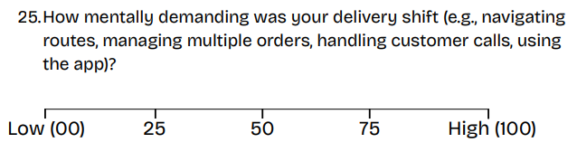
Data Cleaning
Borg Scale Standardization:
NASA-TLX Cleaning
High Workload
↓
Convert into numerical workload score
Very Low → 1
Low → 2
Medium → 3
High → 4
Very High → 5

Slide 14
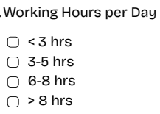
Data Cleaning
Categorical Encoding
Work Exposure Cleaning
“ 8-10 hrs ”
↓
9 hrs
Scooter → 1
Motorcycle → 2

Slide 15
Data Preprocessing
Scaling and normalization
Preparing ML-ready dataset
Categorical variables are encoded into numerical format
Yes/No variables are converted into binary values
Workload and exposure variables are normalized
Input features and target variables are separated for model training

Slide 16
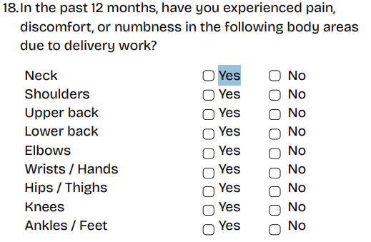
Data Preprocessing
Binary Conversion:
Yes → 1
No → 0
Ergonomic Risk Categorization
Low Risk → 0
Medium Risk → 1
High Risk → 2

Slide 17
Feature Engineering
Transform raw rider responses into meaningful ergonomic risk representations
Construct repetition, vibration, and contact stress exposure variables
Generate exposure index
Create posture risk scores
Build ergonomic severity levels
Generate feature sets for prediction of 6 ergonomic risk factors

Slide 18
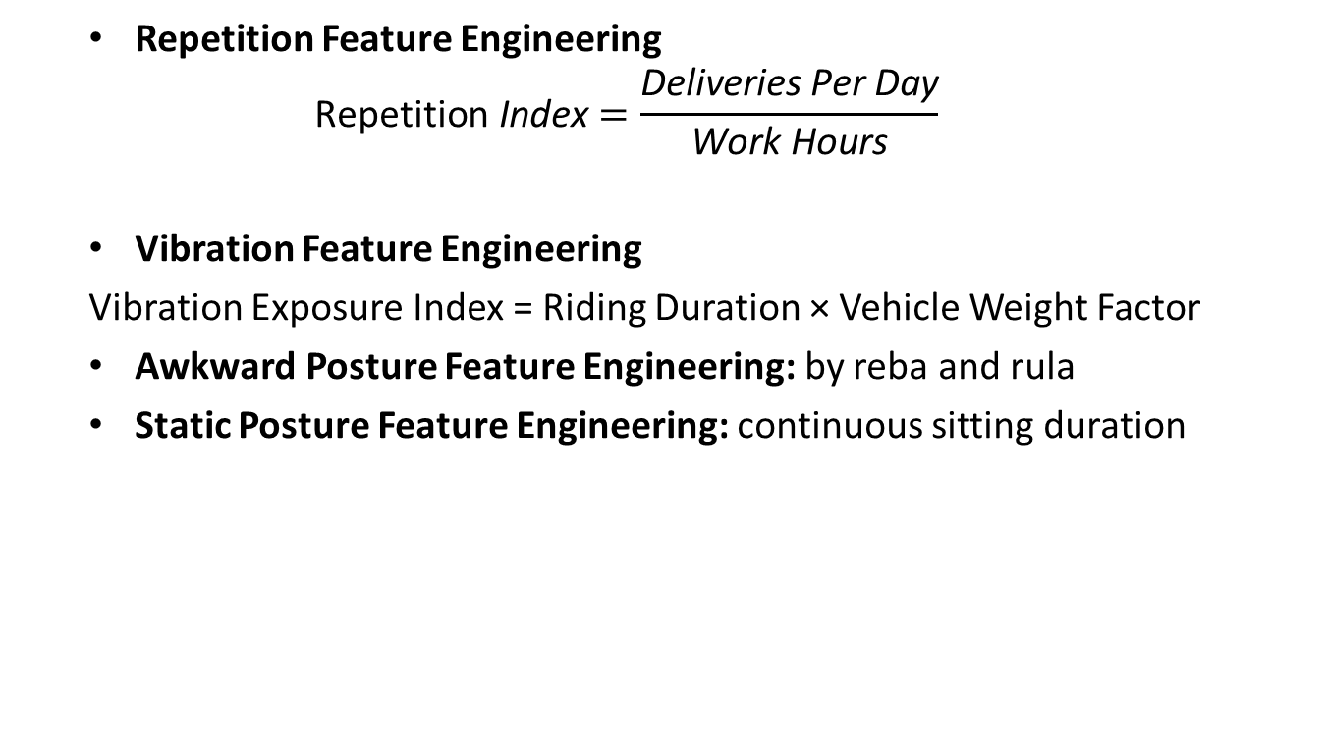
Feature Engineering
Repetition Feature Engineering
$$\text{Repetition} \text{Index}=\frac{\text{Deliveries} \text{Per} \text{Day}}{\text{Work} \text{Hours}}$$
Vibration Feature Engineering
Vibration Exposure Index = Riding Duration × Vehicle Weight Factor
Awkward Posture Feature Engineering: by REBA and RULA
Static Posture Feature Engineering: continuous sitting duration
Engineered Features Created:
- Repetition Index
- Vibration Exposure Index
- Force Exposure Score
- Static Posture Exposure
- Ergonomic Severity Level
- Overall Workload Score

Slide 19
Feature Engineering
Cumulative Exposure Modeling
Goal
Combine multiple workload and exposure variables into cumulative ergonomic exposure features.
Input Variables Considered
Work hours
Riding duration
Fatigue score
Deliveries per day
Workload score
Posture score
Example
work_hours × fatigue × riding_duration
↓
cumulative_exposure_score
Purpose
Identify riders with prolonged and combined ergonomic exposure conditions.

Slide 20
Exploratory Data Analysis
Analyze workload, fatigue, and ergonomic exposure patterns
Identify high-risk rider exposure conditions
Study fatigue and discomfort trends
Visualize body pain prevalence
Identify initial patterns and anomalies

Slide 21
Feature Engineering
Anatomical Strain Index (ASI)
Combine four localized discomfort indicators
Neck pain
Shoulder pain
Lower back pain
Wrist discomfort
↓
Single Ergonomic Strain Score

Slide 22
Exploratory Data Analysis
Workload Analysis:
Analyze:
NASA-TLX workload distribution
physical demand
stress levels
work pressure
fatigue trends
↓
Identify: high workload rider groups

Slide 23
Exploratory Data Analysis
Fatigue & Exhaustion Analysis: high fatigue exposure patterns
Repetition & Exposure Analysis : high repetition exposure groups
Static Posture Analysis : prolonged posture exposure
Contact Stress Analysis: localized contact stress patterns
Vibration Exposure Analysis: high vibration exposure conditions

Slide 24
Relationship Analysis
Analyze relationships between workload, fatigue, discomfort, and ergonomic exposure variables
Study interaction between posture, vibration, force, and fatigue variables
Work hours vs fatigue
Force vs discomfort
Repetition vs pain
Vibration vs lower back pain
Posture risk vs exhaustion

Slide 25
Relationship Analysis
Workload vs Fatigue: high workload → increased fatigue exposure
Force vs Discomfort: higher force exposure → higher discomfort risk
Repetition vs Pain: continuous repetitive work → increased pain prevalence
Vibration vs Lower Back Pain: higher riding vibration → increased lower back pain
Posture Risk vs Fatigue: awkward posture exposure → increased fatigue risk

Slide 26
Relationship Analysis
Interaction Feature Analysis
Goal
Analyze combined effects of multiple ergonomic exposure variables instead of single-variable relationships.
Interaction Variables
Workload × Fatigue
Vibration × Riding duration
Posture × Work hours
Repetition × Fatigue
Example
High vibration + long riding duration
↓
Higher lower back discomfort risk
Purpose
Identify combined ergonomic conditions contributing to high-risk exposure.

Slide 27
Relationship Analysis
Method | Purpose
Correlation Analysis | Identify variable relationships
Heatmaps | Visualize relationship strength
Scatter Plots | Study exposure patterns
Comparative Analysis | Compare rider groups
Statistical Testing | Validate significant relationships

Slide 28
Statistical Analysis
Chi-Square Test :
Bag carrying method ↔ Shoulder pain
Pearson/Spearman Correlation
Mann-Whitney U Test
Kruskal-Wallis Test
Regression Analysis
Workload + fatigue → exhaustion prediction

Slide 29
Statistical Analysis
Threshold & Risk Escalation Analysis
Goal
Identify workload and exposure thresholds where ergonomic risk rapidly increases.
Example Threshold Conditions
work_hours > 9
AND
fatigue_score > 7
↓
High exhaustion risk
Input Variables
Work hours
Fatigue score
Posture score
Workload level
Riding duration
Methods Used
Decision Trees
XGBoost
Threshold-based analysis
Purpose
Detect nonlinear ergonomic risk escalation patterns.

Slide 30
AI/ML Modeling
Train predictive models
Learn relationships from data
Predict ergonomic risk factor severity
Evaluate prediction performance
Input Features
(workload, fatigue, posture, exposure)
↓
AI/ML Model Training
↓
Prediction of Ergonomic Risk
High workload + high fatigue + long riding duration
↓
Predicted High Static Posture Risk

Slide 31
ML Algorithms
Logistic Regression(Baseline classification)
Decision Tree(Threshold-based ergonomic prediction)
Random Forest(Feature importance and robust prediction)
XGBoost (Nonlinear ergonomic risk prediction)

Slide 32
Prediction Targets
Predict Force Risk
Predict Repetition Risk
Predict Posture Risk
Predict Duration Risk
Predict Contact Stress Risk
Predict Vibration Risk

Slide 33
Model Evaluation
Validation Methods
Cross-validation is used to test model generalization and avoid overfitting.
Overfitting analysis
Purpose: Ensure the AI/ML models perform consistently across different rider data distributions.

Slide 34
Model Evaluation
Evaluation Metrics
Accuracy
Precision
Recall
F1-Score
Confusion Matrix

Slide 35
Visualizations
Heatmaps
Scatter Plots
Bar Charts
Correlation Graphs
Feature Importance Charts

Slide 36
Inputs & Outputs
Input Variables:
- workload scores = 6 NASA-TLX columns
- fatigue scores = Borg columns (overall, legs, breathing, traffic, exhaustion)
- work hours = Working Hours per Day
- riding duration
- posture scores = RULA & QEC
- delivery frequency = Number of deliveries per day
- vibration exposure = "Type of vehicle" + "Working Hours"
Prediction Outputs:
- Force Risk
- Repetition Risk
- Duration Risk
- Contact Stress Risk
- Vibration Risk
- Posture Risk

Slide 37
Expected Outputs
Analytical Outputs
EDA visualizations
relationship analysis
statistical findings
AI/ML Outputs
trained prediction models
model evaluation reports
Feature importance analysis
Threshold detection analysis

Slide 38
Technologies Used
Python
Pandas
NumPy
Scikit-learn
Matplotlib
Seaborn
Jupyter Notebook

Slide 39
Results & Findings
Phase 4-7 outputs from the 182-rider sample

Slide 40
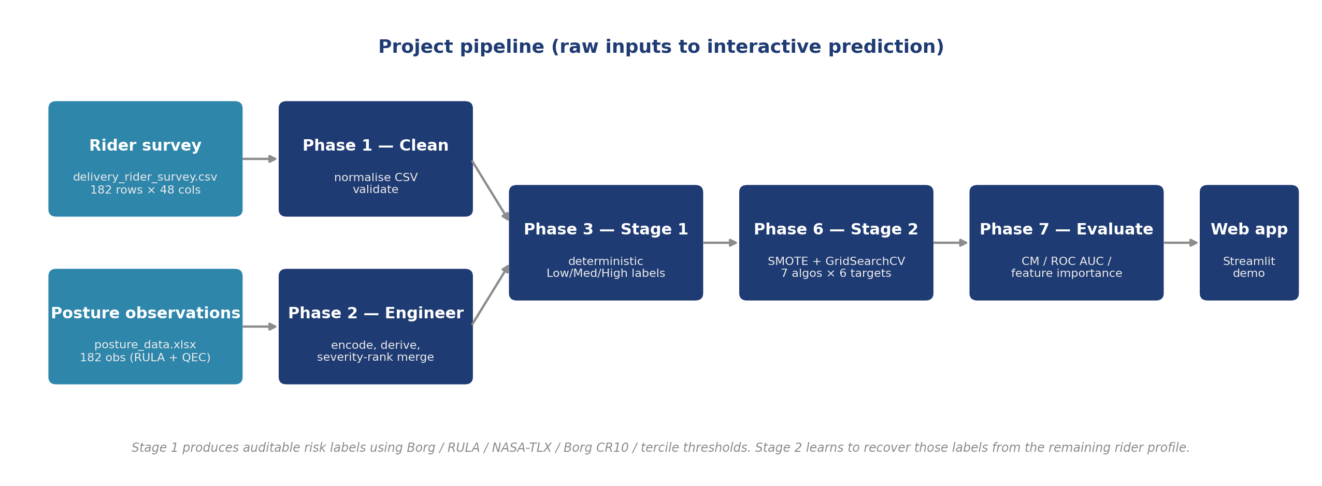
Pipeline overview
Raw inputs -> cleaning -> feature engineering -> Stage 1 labels -> Stage 2 ML -> web app

Slide 41
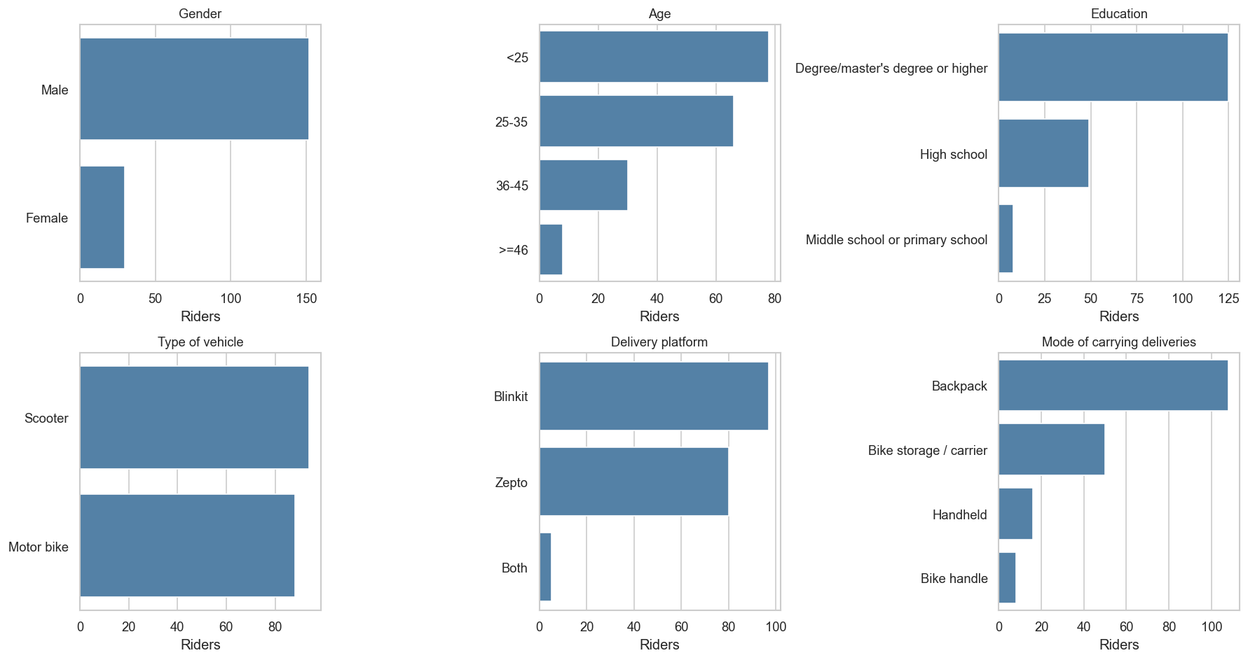
Sample demographics (n = 182)

Slide 42
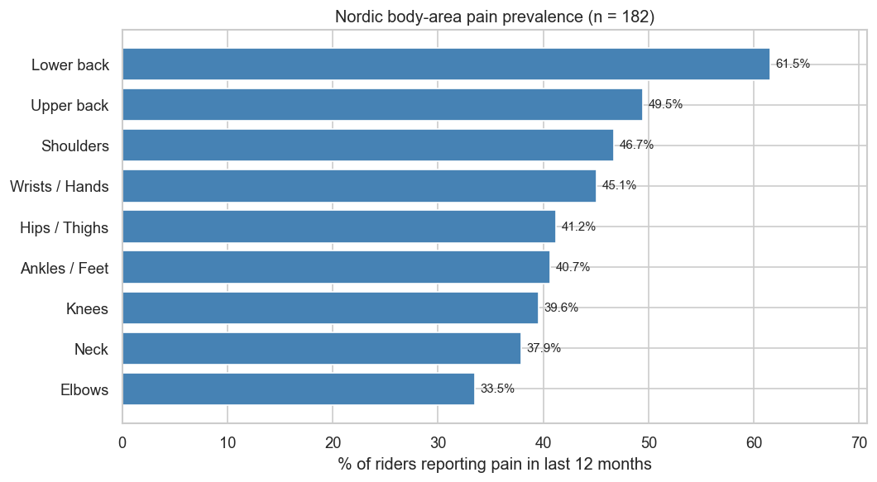
MSD prevalence by body area
84.6% of riders reported pain in at least one body area in the last 12 months

Slide 43
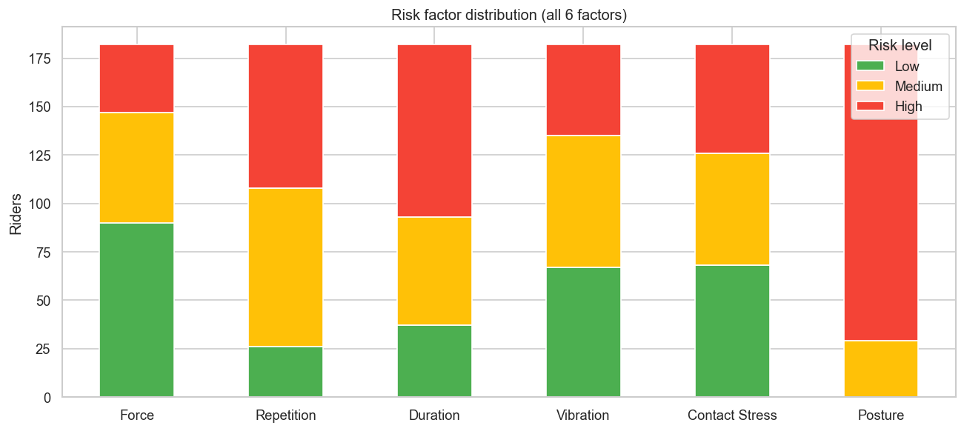
Risk factor distribution (all 6 factors)

Slide 44
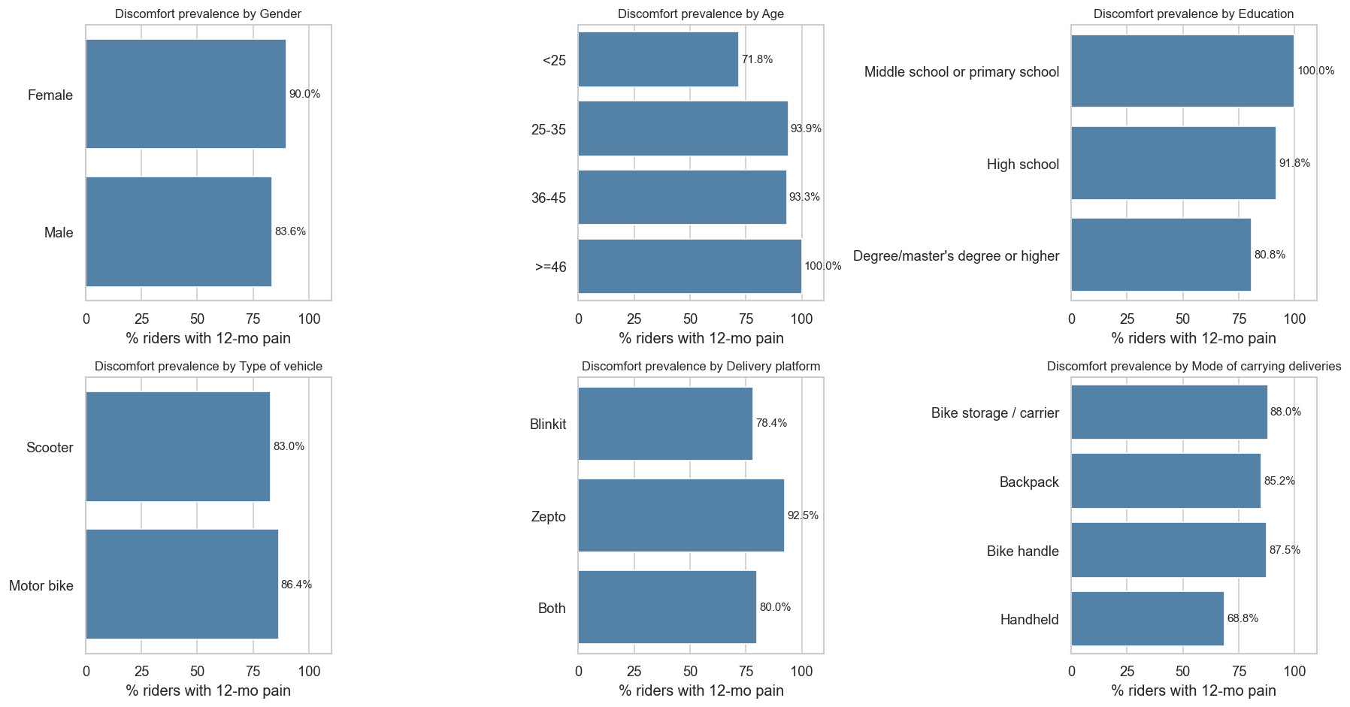
Discomfort prevalence by demographic group
Strong age gradient: 72% (under 25) up to 100% (45+)

Slide 45
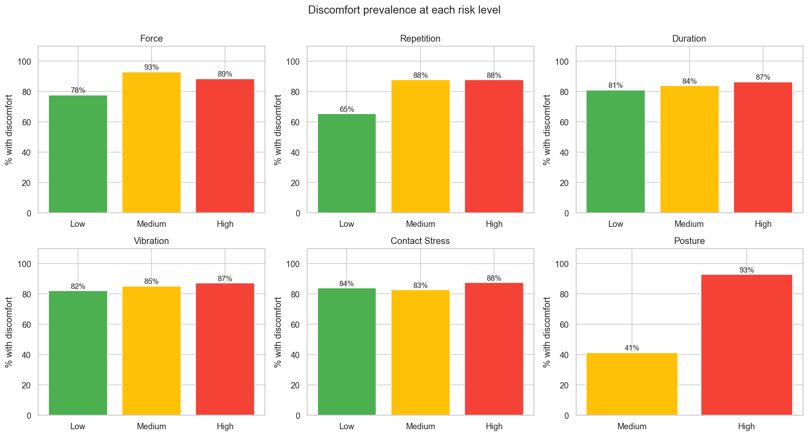
Discomfort prevalence at each risk level
Force shows the cleanest dose-response of the 5 survey-derived factors

Slide 46
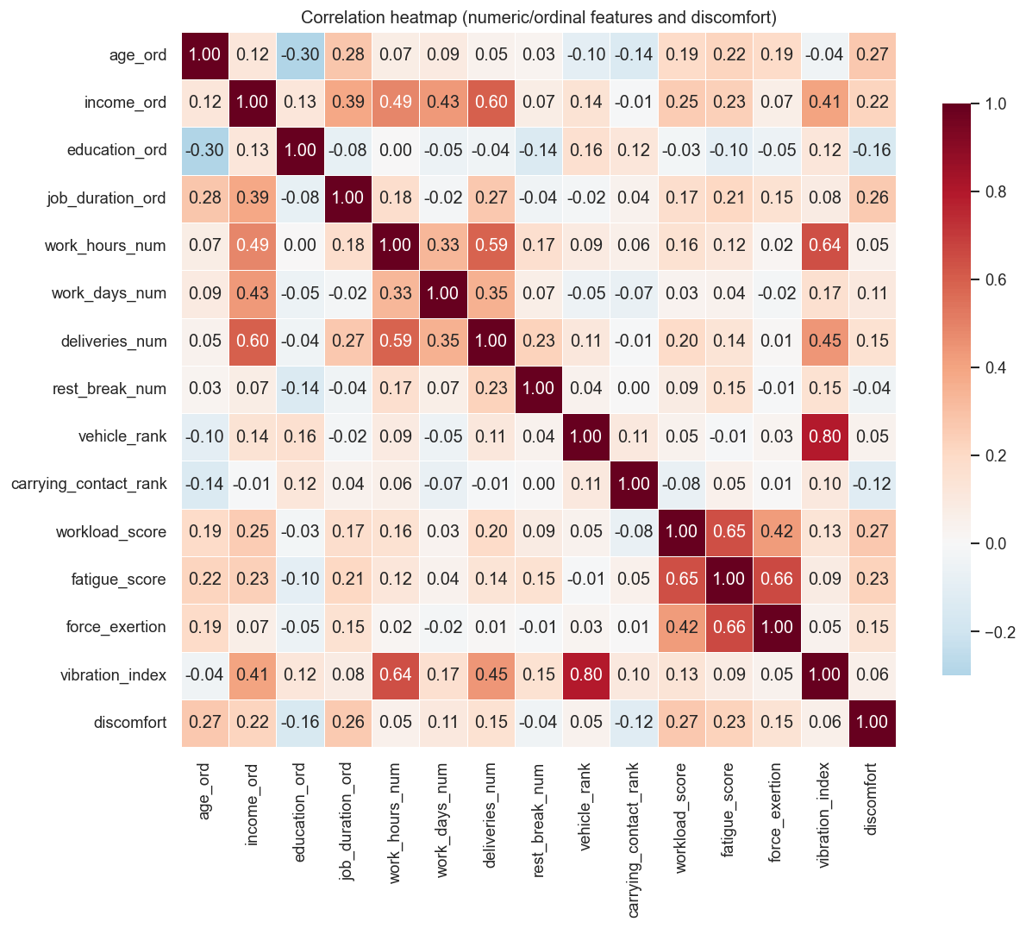
Correlation heatmap
Workload, age, and job duration are the top correlations with discomfort

Slide 47
ML model performance (Stage 2)
Best model per risk factor (5-fold CV, after GridSearchCV + SMOTE):
Force HistGradientBoosting 62% AUC 71% (42 features)
Repetition Random Forest 62% AUC 73% (41 features)
Duration Random Forest 61% AUC 76% (42 features)
Vibration Extra Trees 58% AUC 72% (41 features)
Contact Stress Random Forest 60% AUC 74% (42 features)
Posture HistGradientBoosting 97% AUC 98% (63 features)
5 survey-derived factors land at 58-62% accuracy with macro AUC 71-76%.
Posture uses real RULA + QEC observation inputs and reaches 97% / AUC 98%.

Slide 48
Winning hyperparameters (GridSearchCV)
The values each target's grid search settled on:
Force HistGradientBoosting max_depth=None, learning_rate=0.05
Repetition Random Forest n_estimators=300, max_depth=None
Duration Random Forest n_estimators=500, max_depth=5
Vibration Extra Trees n_estimators=300, max_depth=None
Contact Stress Random Forest n_estimators=500, max_depth=None
Posture HistGradientBoosting max_depth=5, learning_rate=0.05
SMOTE k_neighbors = 5 for every target.
All pipelines: imblearn.Pipeline([SMOTE, classifier]).
All CV folds: StratifiedKFold(5, shuffle=True, random_state=42).

Slide 49
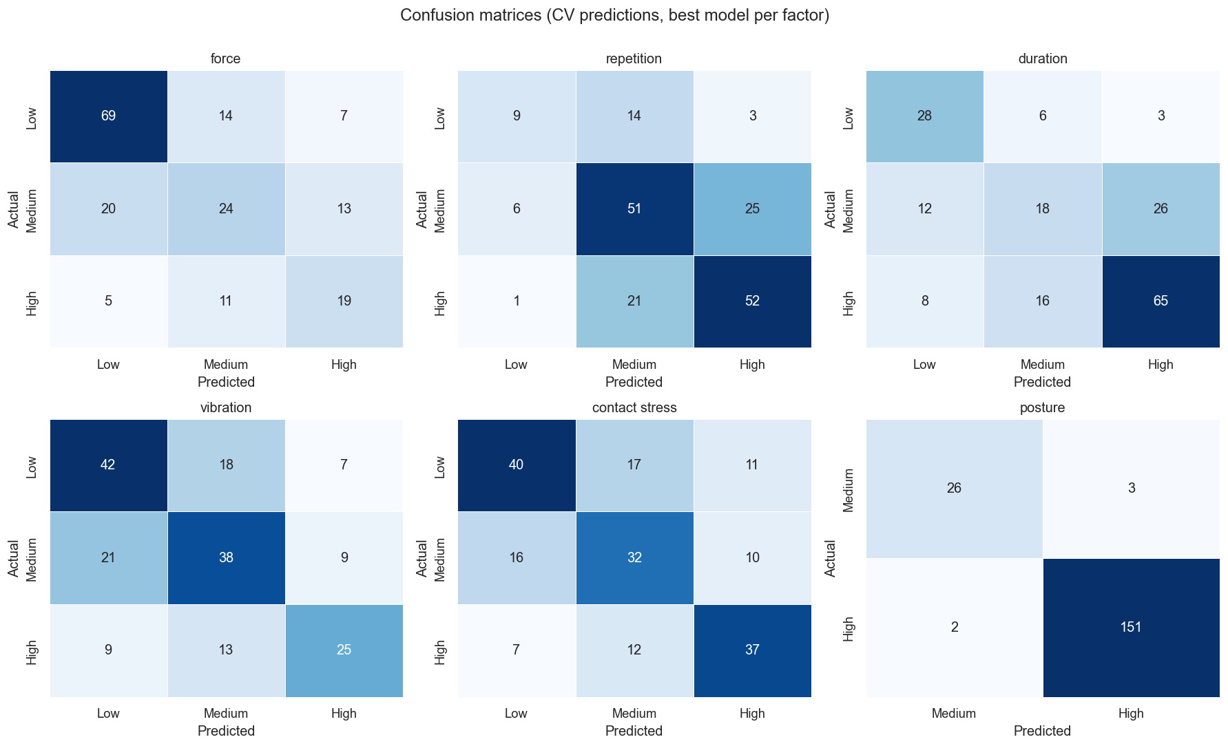
Confusion matrices (best model per factor)

Slide 50
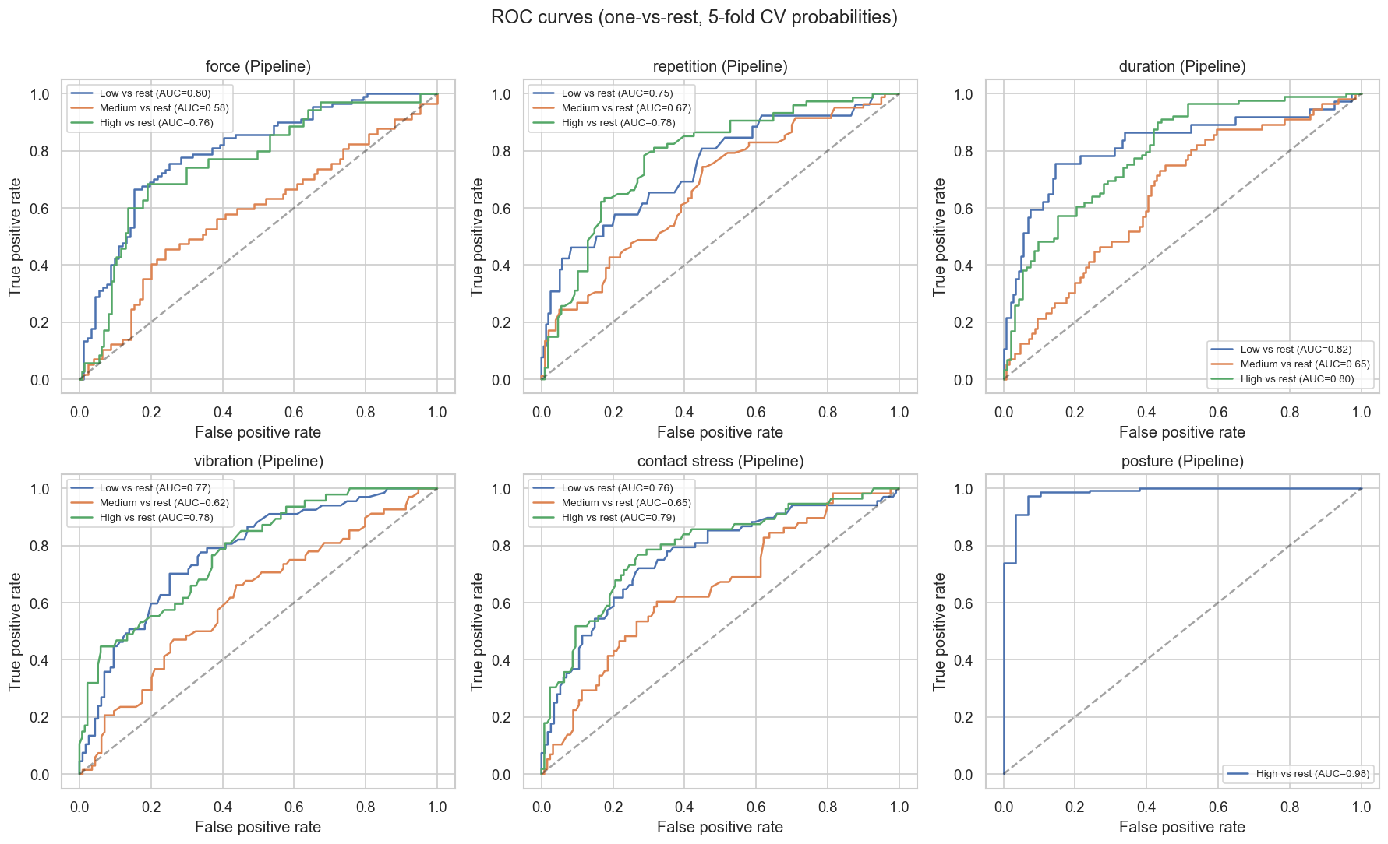
ROC curves (one-vs-rest)
AUC > 0.70 for 5 of 6 factors

Slide 51
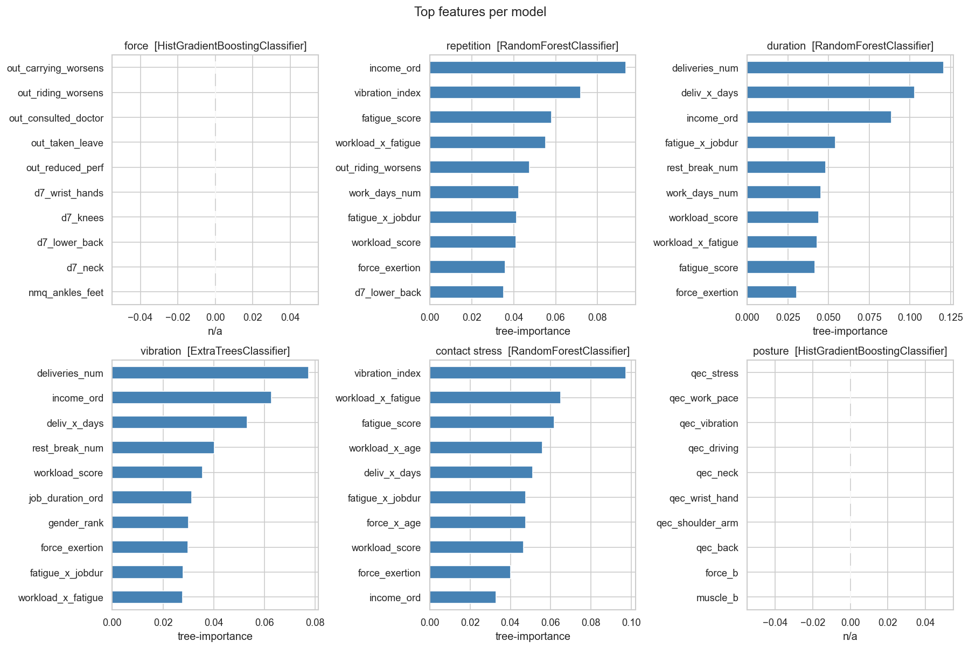
Top features per model
workload_score, fatigue_score, and age_ord recur across factors

Slide 52
Per-factor positioning
Survey-only inputs limit how high the 5 survey-derived models can go,
because each model excludes the variable that defines its own target.
The 5 survey-derived factors land at 58-62% accuracy and macro AUC 71-76%.
Macro AUC > 0.70 means the models still rank riders correctly,
even when they don't always predict the exact class.
Posture uses real RULA + QEC observation inputs (not survey proxies),
so it reaches 97% / AUC 98%.

Slide 53
Limitations
1. n = 182 self-report sample. Cross-sectional, single-region deployment.
2. Posture per-rider linkage is approximate. RULA + QEC observations shared
no rider identifier with the survey - a severity-rank merge was used.
The 97% accuracy is the upper bound the linked data permits; a
per-rider observation study would likely settle slightly lower.
3. Repetition binning was corrected (qcut -> fixed cuts [2.5, 3.75]) so
the worst real combo no longer ties on the tercile edge.
Stage-2 accuracy dropped 74% -> 62% but is now methodologically honest.
4. Vibration's 58% accuracy reflects a real signal ceiling once vehicle_rank,
work_hours_num and vibration_index are all excluded to prevent leakage.
5. Self-report biases apply to discomfort, fatigue and workload measures.

Slide 54
Recommendations for rider safety
Duration (49% of riders in High band - largest population burden):
shift-length caps and mandatory breaks every 2 hours
Force (only factor significantly associated with discomfort, p = 0.035):
limit carried-package weight; train safer lifting technique
Contact Stress (handheld carriers reported less discomfort):
encourage bike-storage box or backpack over handheld delivery
Age and job duration (strongest individual-level discomfort predictors):
workload tapering for riders over 12 months tenure or over 35 years old

Slide 55
Live web demo
Streamlit screening tool: full questionnaire to per-factor risk levels

Slide 56
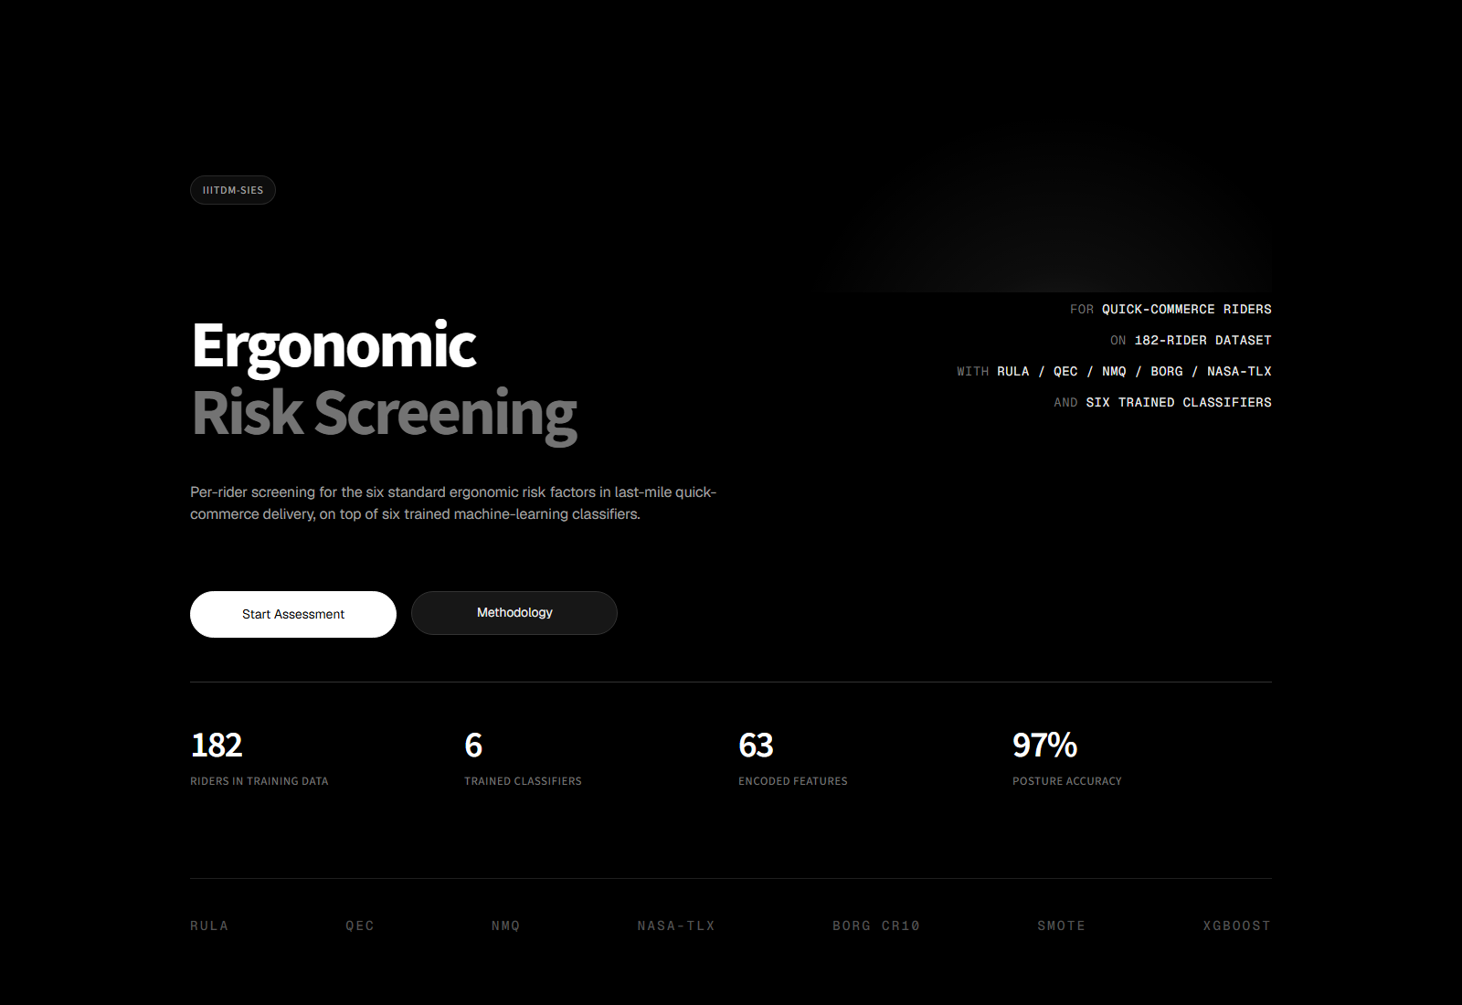
Web app: Home
Vercel-style hero on the entry page; sidebar hidden until the user starts an assessment

Slide 57
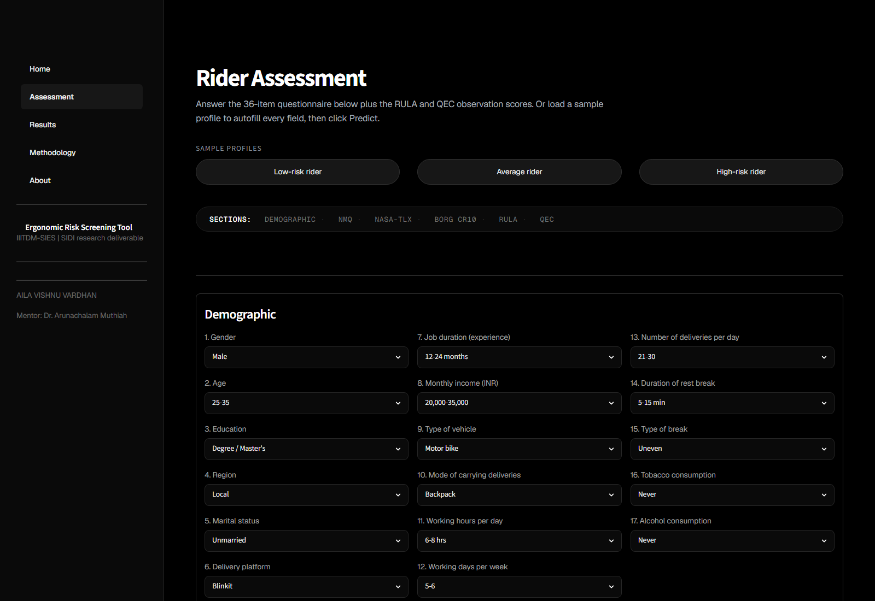
Web app: Assessment top (Q1-17)
Sample-profile shortcuts (Low / Average / High) pre-fill the entire form in one click

Slide 58
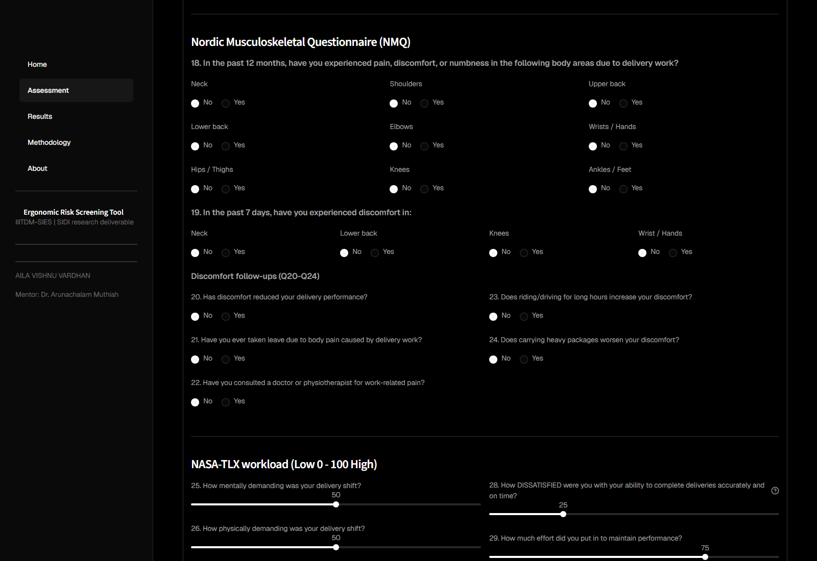
Web app: Nordic + follow-ups (Q18-24)

Slide 59
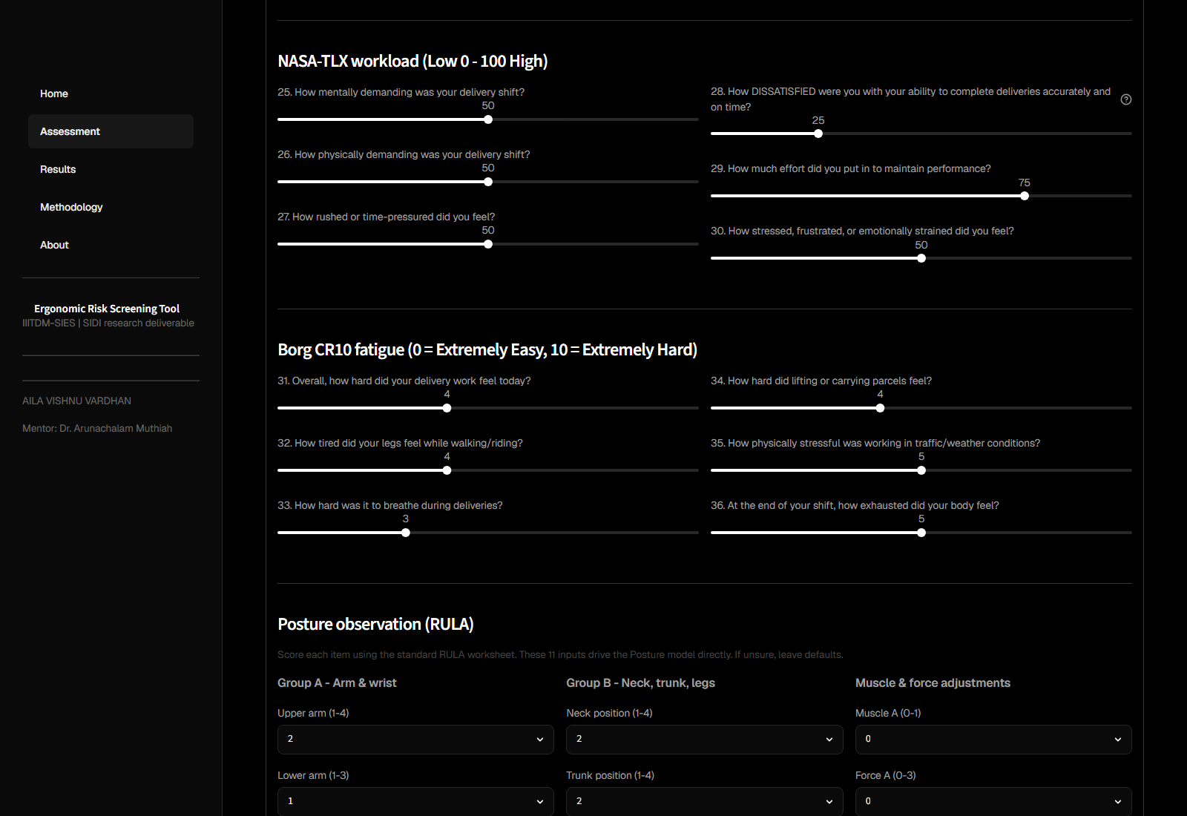
Web app: NASA-TLX + Borg CR10 (Q25-36)
Six NASA-TLX sliders point in load-direction (Q28 reworded as 'dissatisfied')

Slide 60
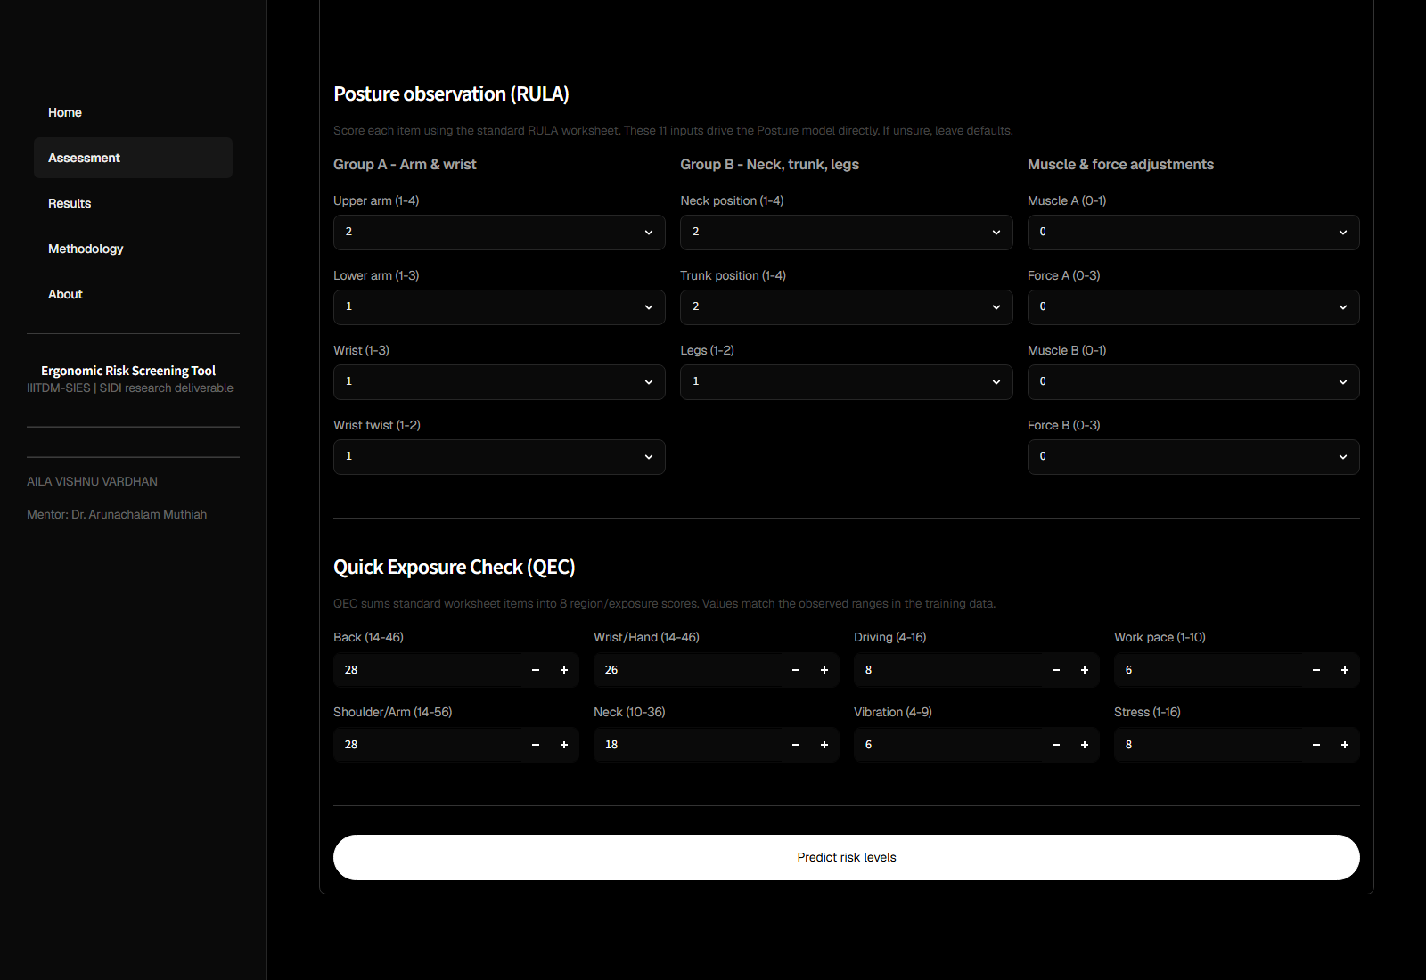
Web app: RULA + QEC + Predict
11 RULA components and 8 QEC scores drive the Posture model directly

Slide 61
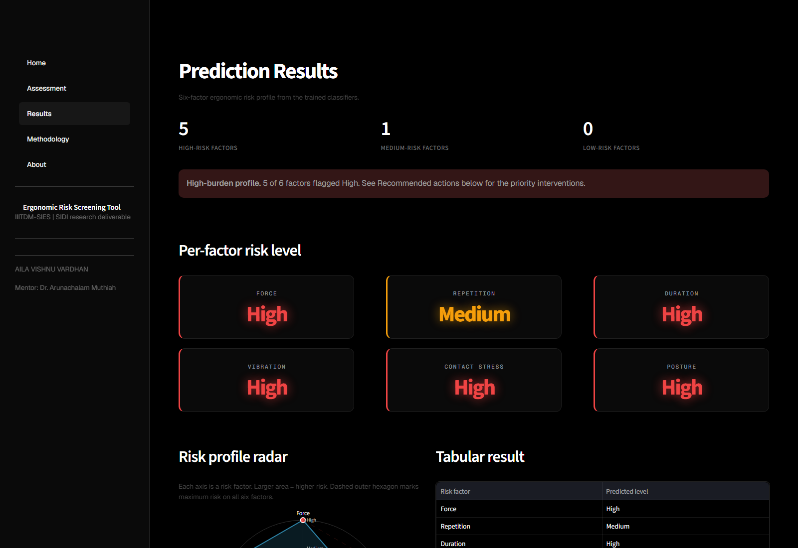
Web app: predicted risk profile
Colour-coded factor cards, radar summary, tabular view, and per-factor recommendations

Slide 62
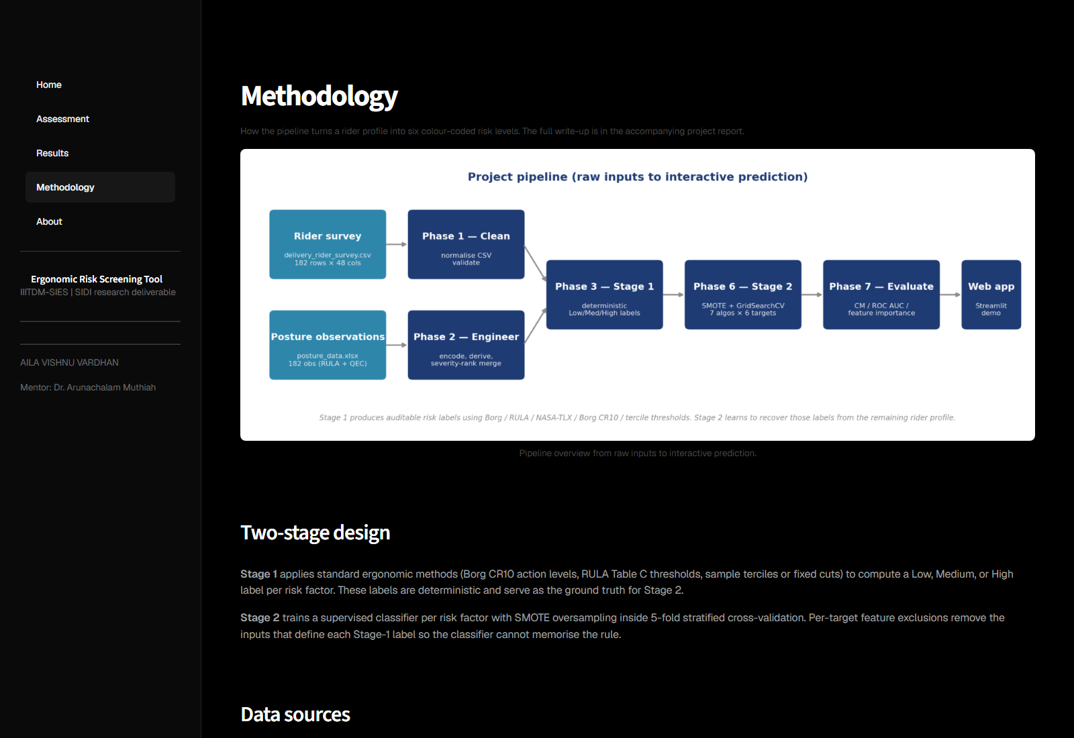
Web app: Methodology page
Pipeline flowchart, two-stage design, candidate algorithms, and model performance

Slide 63
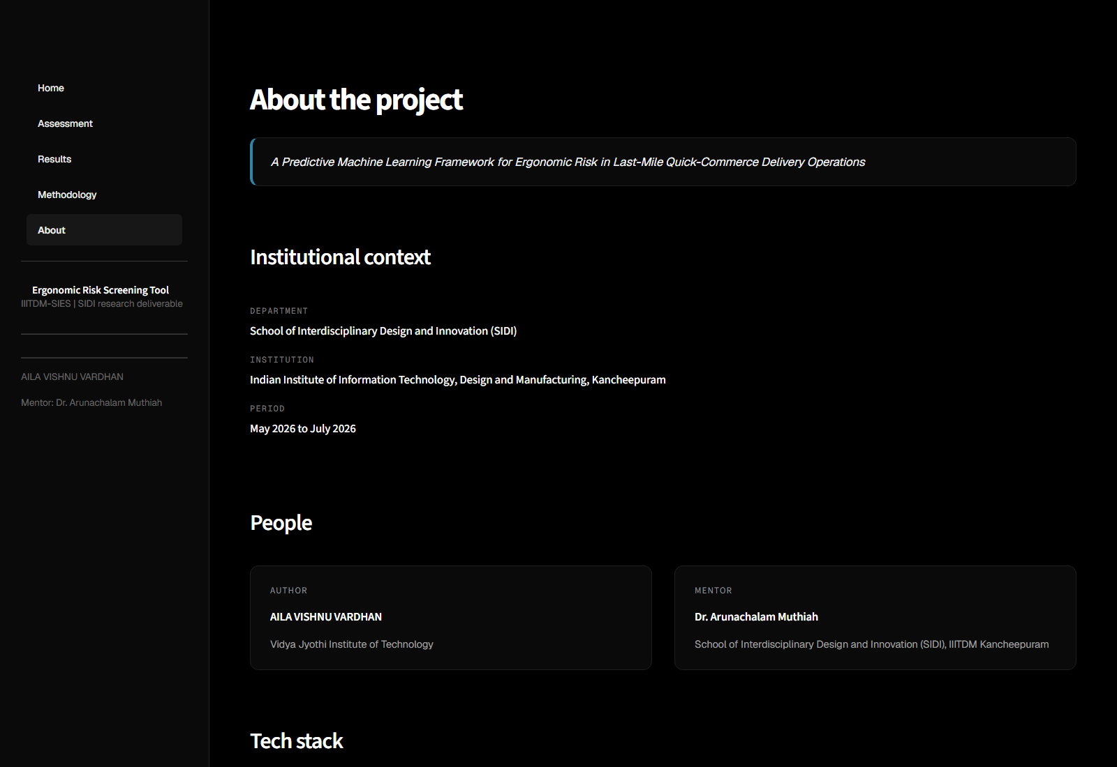
Web app: About page
Author, mentor, institutional context, and tech stack

Slide 64
Thank You

