Slide 1
IIITDM-SIES INTERNSHIP | REVIEW PRESENTATION
A Predictive Machine Learning Framework
for Ergonomic Risk in Last-Mile
Quick-Commerce Delivery Operations
PRESENTED BY AILA VISHNU VARDHAN
INSTITUTE Vidya Jyothi Institute of Technology
MENTOR Dr. Arunachalam Muthiah
PROGRAMME IIITDM-SIES Internship | School of Interdisciplinary Design and Innovation (SIDI), IIITDM Kancheepuram
July 2026

Slide 2
01 BACKGROUND
Problem and Objectives
India's 10-minute delivery boom runs on riders whose bodies quietly pay the price. Every shift is 8+ hours on the bike, heavy packages on the stairs, awkward postures in stop-and-go traffic, and constant vibration, all on the clock set by the platform's routing algorithm. Trip after trip, day after day, the exposure adds up as back pain, shoulder pain, wrist injuries, and knee problems long before the rider reports them. Yet no single screening tool measures a rider's risk across all six standard ergonomic factors (Force, Repetition, Posture, Duration, Contact Stress, Vibration) from one questionnaire.
Objectives
• Combine standard ergonomic methods (RULA, QEC, NMQ, NASA-TLX, Borg CR10) into per-rider Low / Medium / High labels for the six standard risk factors: Force, Repetition, Posture, Duration, Contact Stress, and Vibration.
• Train an ML model per factor on the 36-item rider survey plus the RULA and QEC observation set, tuned via 5-fold stratified cross-validation with SMOTE, and report per-target accuracy, macro F1, and macro AUC.
• Deploy a Streamlit web app that accepts a new rider's questionnaire (plus RULA and QEC scores) and returns colour-coded Low / Medium / High predictions across the six factors in real time.
• Translate the analysis into platform-level actions on working hours, vehicle type, carrying mode, and age-cohort screening.
A Predictive ML Framework for Ergonomic Risk in Last-Mile Quick-Commerce Delivery Operations | Slide 2/10

Slide 3
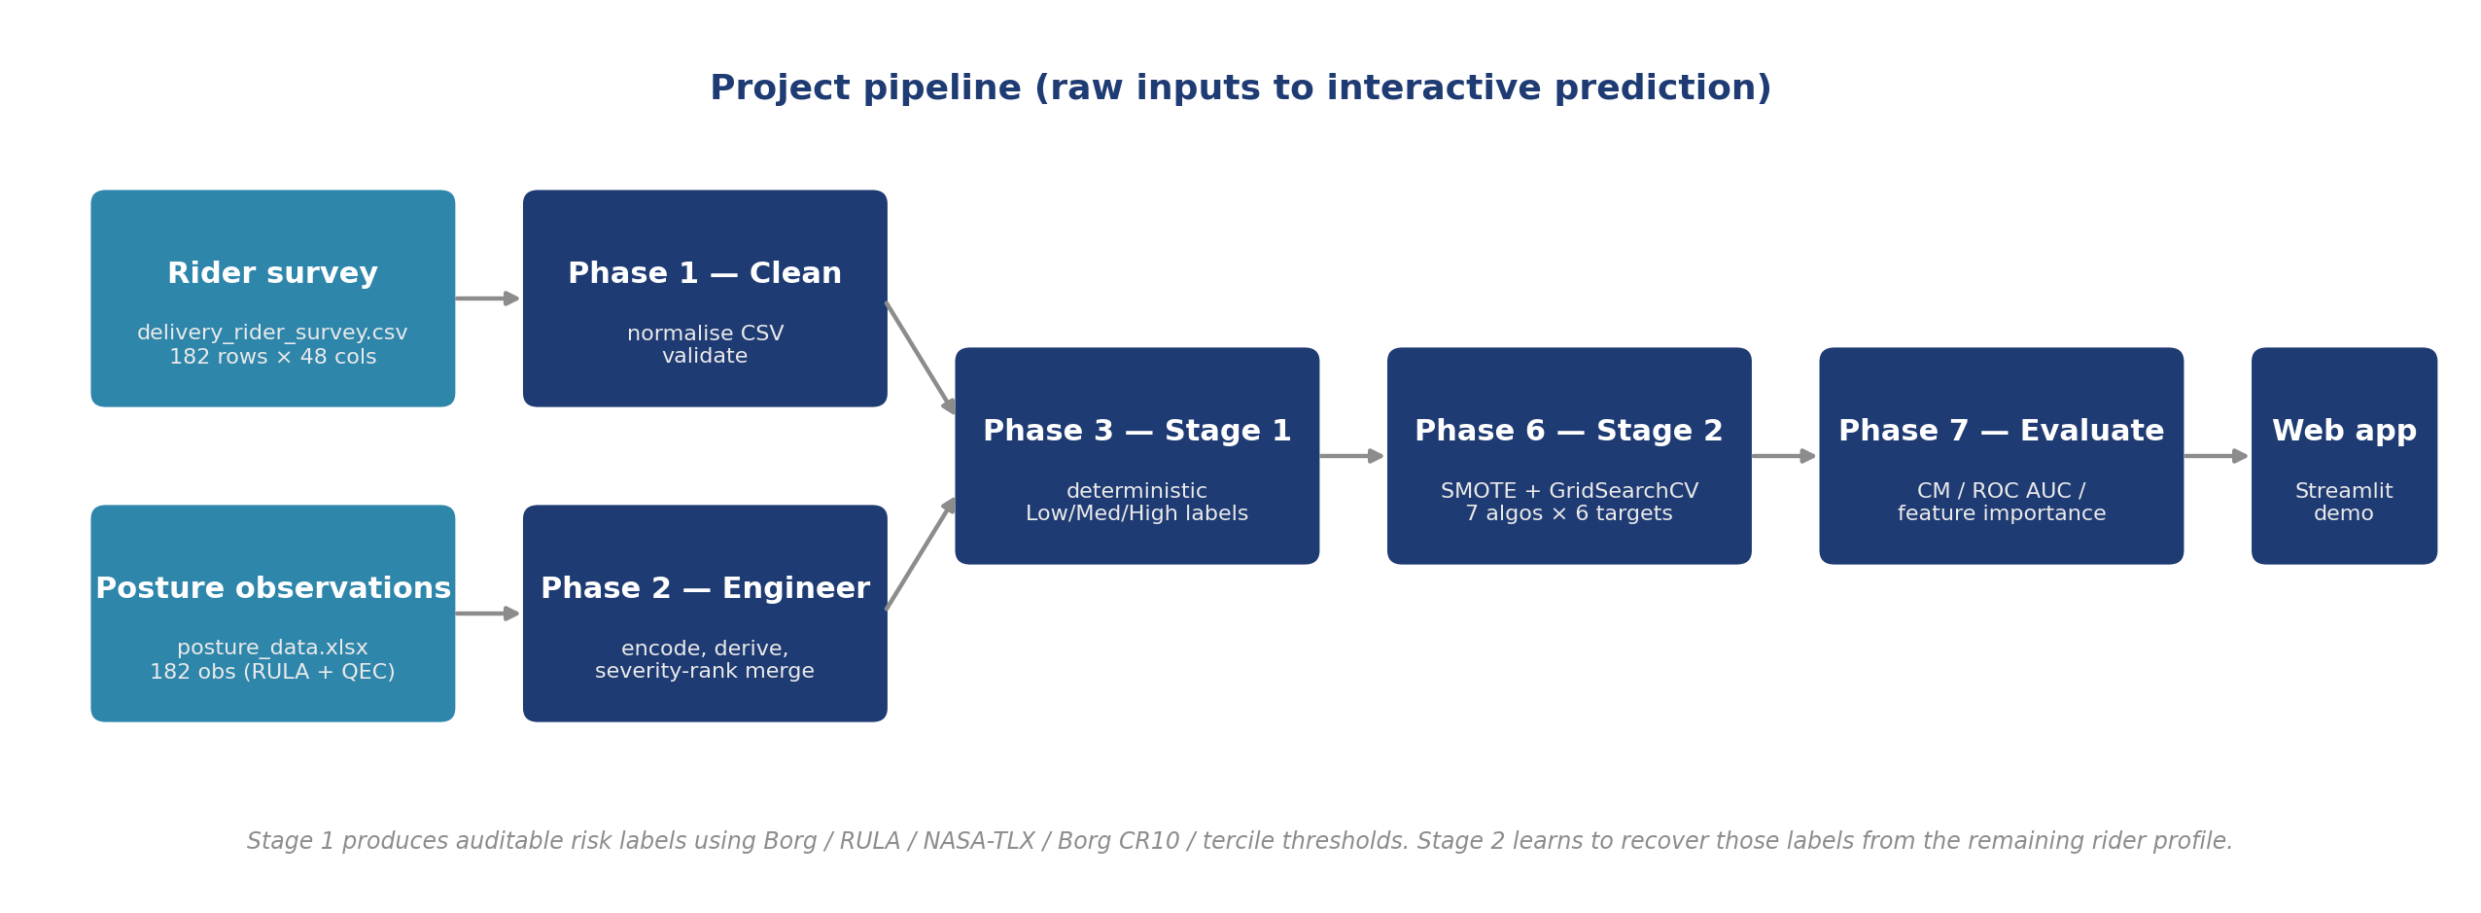
02 METHODOLOGY
Two-Stage Pipeline
• Stage 1 (deterministic). Standard ergonomic methods produce Low / Medium / High labels per factor.
– Force: Borg CR10 lifting rating (0-3 / 4-6 / 7-10).
– Posture: RULA grand-score bands (1-2 / 3-4 / 5+); the High band merges Action Levels 3 and 4.
– Duration: continuous work hours (<=5 / 6-7 / >7).
– Repetition, Vibration, and Contact Stress: fixed cuts and sample terciles.
• Stage 2 (supervised ML). One model per factor learns the Stage-1 label from the rider profile. Inputs used to define the label are excluded so the model cannot just memorise the rule.
• Trained models run behind a Streamlit form so a new rider gets predictions in seconds.
Pipeline flowchart
A Predictive ML Framework for Ergonomic Risk in Last-Mile Quick-Commerce Delivery Operations | Slide 3/10

Slide 4
03 DATA
Data Sources
N = 182
N = 182
Rider Survey (CSV)
Posture Observations (xlsx)
• 36 questionnaire items across 5 modules.
– Q1-17: demographics, work pattern, lifestyle
– Q18: NMQ 12-month pain (9 body areas)
– Q19: 7-day discomfort (neck, lower back, wrist/hands, knees)
– Q20-24: discomfort follow-ups
– Q25-30: NASA-TLX 0-100 sliders
– Q31-36: Borg CR10 0-10 sliders
• Self-administered; single time-point.
• Ergonomic observation records.
– 11 RULA components
– 3 RULA Table A/B/C scores
– 8 QEC region + exposure scores
• Merged into the survey via severity-rank pairing.
– Ranks riders by NMQ + fatigue + hours
– Ranks observations by RULA Table C
– Matches rank-to-rank one-to-one
A Predictive ML Framework for Ergonomic Risk in Last-Mile Quick-Commerce Delivery Operations | Slide 4/10

Slide 5
04 STAGE 1
Six Risk Factors & Stage-1 Distribution
Factor | Signal | Threshold rule | Low | Med | High
Force | Borg CR10 lifting rating | 0-3 / 4-6 / 7-10 (Borg) | 90 | 57 | 35
Repetition | deliveries per hour | cut at 2.5 & 3.75 dph | 26 | 82 | 74
Duration | continuous work hours | <= 5 / 6-7 / > 7 hrs | 37 | 56 | 89
Vibration | vehicle rank x work hours | sample tercile | 67 | 68 | 47
Contact Stress | carrying mode x hours x age | sample tercile | 68 | 58 | 56
Posture | RULA Table C grand score | grand score 1-2 / 3-4 / 5+ | 0 | 29 | 153
Posture (84% High), Duration (49%), and Repetition (41%) skew heavily toward High. Posture has no Low observations because the training-data minimum RULA Table C grand score is 3 (Medium); SMOTE inside every training fold handles the resulting Stage-2 class imbalance.
A Predictive ML Framework for Ergonomic Risk in Last-Mile Quick-Commerce Delivery Operations | Slide 5/10

Slide 6
05 STAGE 2
Machine-Learning Pipeline
Seven ML models tried
Per-target feature exclusions
• Logistic Regression (baseline linear model)
• Decision Tree, Random Forest, Extra Trees (tree-based)
• Histogram Gradient Boosting, XGBoost (boosted trees)
• Stacking Classifier (blends the four tree/boosted models with LR on top)
Target | Excluded features | Feats
Force | force_exertion, force_x_age | 42
Repetition | deliveries_num, hours, deliv_x_days | 41
Duration | work_hours_num, vibration_index | 42
Vibration | vibration_index, vehicle, hours | 41
Contact Stress | carry, work_hours_num | 42
Posture | (RULA Tables A/B/C only) | 63
How each model is trained
• 5-fold cross-validation: the data is split into 5 slices; each model trains on 4 and is tested on the 5th, rotating through all 5.
• SMOTE up-samples rare risk levels inside each training fold only, never on the test data, so evaluation stays honest.
• Grid search picks the best hyperparameters using macro F1 (average across Low / Medium / High).
• The winning model is re-trained on the full sample and saved as a .pkl file for the web app.
Each classifier must learn from the rest of the rider profile; it cannot memorise the Stage-1 rule.
A Predictive ML Framework for Ergonomic Risk in Last-Mile Quick-Commerce Delivery Operations | Slide 6/10

Slide 7
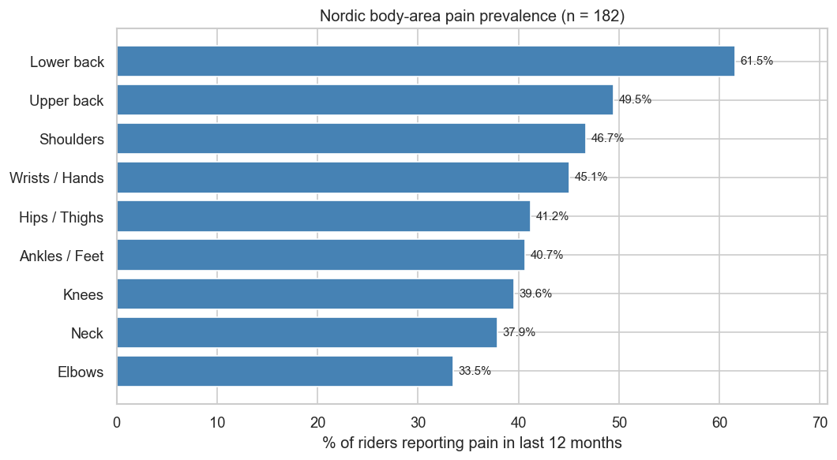
06 FINDINGS
Statistical Findings
Logistic regression | top 6 of 7 significant predictors of any 12-month pain (deliveries_num also sig., OR 1.05, p 0.045)
Predictor | OR | 95% CI | p
Age (per band) | 3.58 | 1.70 - 7.56 | 0.0008
Job duration (per band) | 2.89 | 1.54 - 5.41 | 0.001
Fatigue score | 1.43 | 1.13 - 1.80 | 0.003
Income (per band) | 2.00 | 1.25 - 3.20 | 0.004
Workload score | 1.06 | 1.02 - 1.09 | 0.0005
Education (per band) | 0.33 | 0.12 - 0.94 | 0.04
NMQ 12-month pain prevalence (n = 182)
Chi-square | Stage-1 risk factor vs 12-month pain
Mann-Whitney U | predictors of 12-month pain
Risk factor | chi2 | df | p | Sig.
Posture | 45.67 | 1 | < 0.001 | yes
Repetition | 8.62 | 2 | 0.014 | yes
Force | 6.72 | 2 | 0.035 | yes
Duration | 0.62 | 2 | 0.733 | -
Vibration | 0.60 | 2 | 0.741 | -
Contact stress | 0.54 | 2 | 0.762 | -
Feature | no pain | pain | U | p
Age (band) | 0 | 1 | 1228 | 0.0001
Tenure (band) | 0 | 1 | 1262 | 0.0002
Workload score | 42 | 50 | 1291 | 0.0007
Income (band) | 1 | 2 | 1411 | 0.0023
Fatigue score | 3.8 | 4.6 | 1474 | 0.0078
Force (Borg) | 3 | 4 | 1585 | 0.025
Posture, Repetition, and Force reach chi-square significance; age (OR 3.58) and job duration (OR 2.89) are the strongest individual predictors, alongside income, workload, and fatigue.
A Predictive ML Framework for Ergonomic Risk in Last-Mile Quick-Commerce Delivery Operations | Slide 7/10

Slide 8
07 MODEL PERFORMANCE
Best Model per Factor
Factor | Best model | Acc. | F1 macro | AUC macro | Features
Force | HistGradientBoosting | 62% | 57% | 71% | 42
Repetition | Random Forest | 62% | 57% | 73% | 41
Duration | Random Forest | 61% | 58% | 76% | 42
Vibration | Extra Trees | 58% | 57% | 72% | 41
Contact Stress | Random Forest | 60% | 59% | 74% | 42
Posture | HistGradientBoosting | 97% | 95% | 98% | 63
The five survey-derived factors land at 58-62% CV accuracy with macro AUC 71-76%, modest but honest on n = 182. Posture jumps to 97% / 98% because it is the only factor that receives real observation inputs (11 RULA components + 8 QEC scores) on top of the survey features; the observation-vs-self-report gap is the story here.
A Predictive ML Framework for Ergonomic Risk in Last-Mile Quick-Commerce Delivery Operations | Slide 8/10

Slide 9
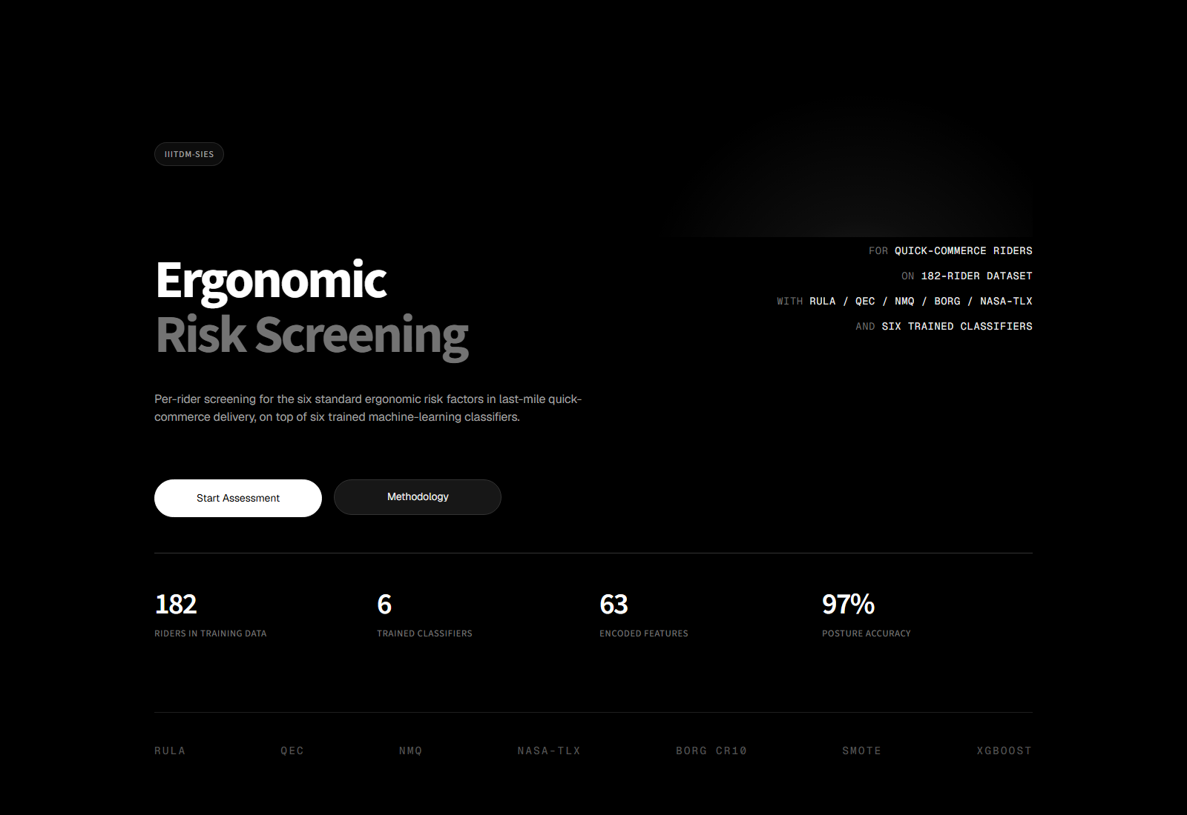
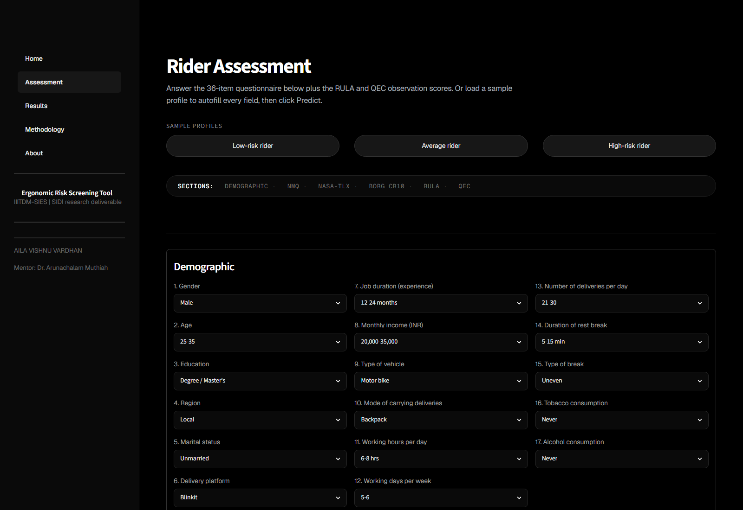
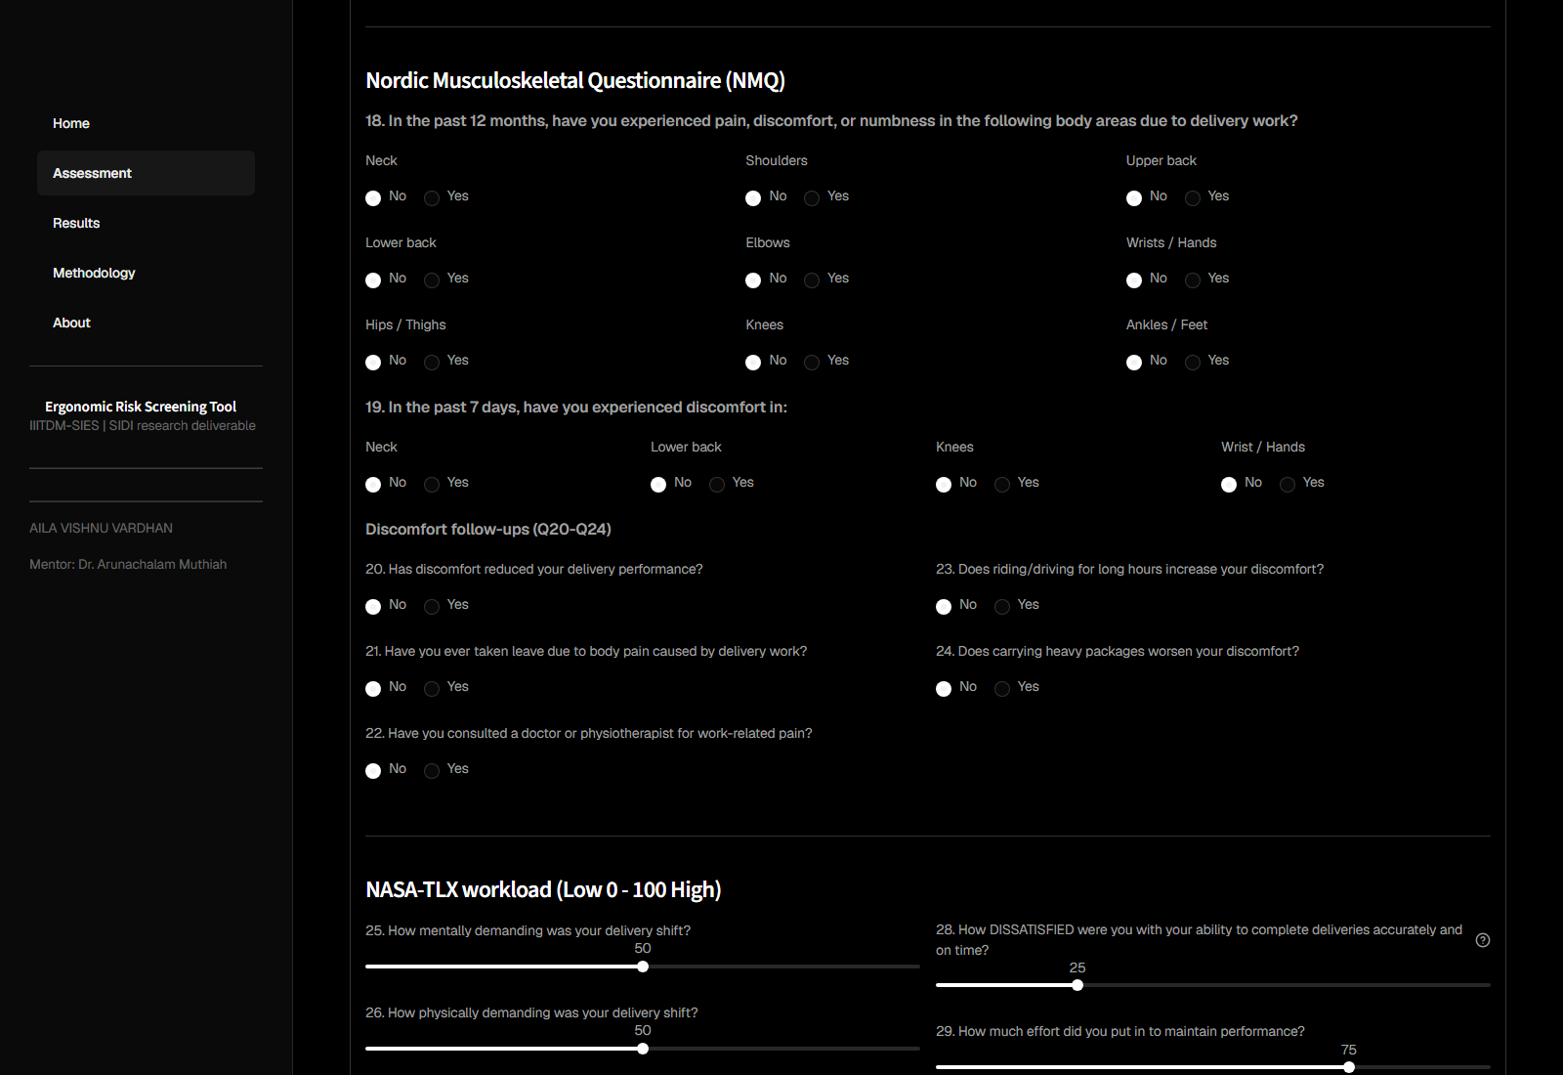
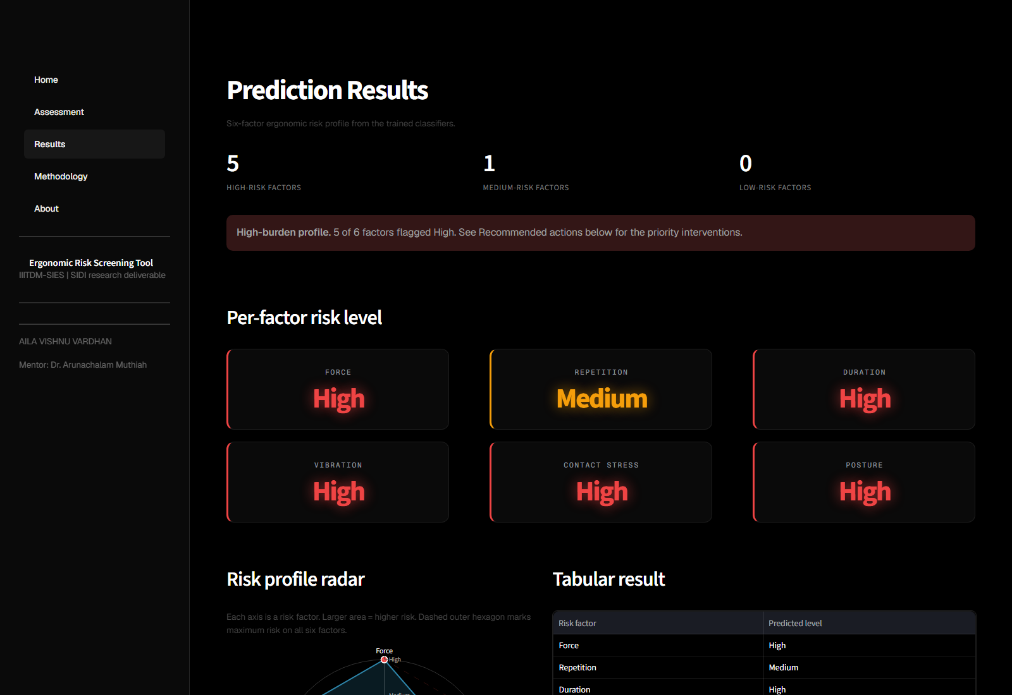
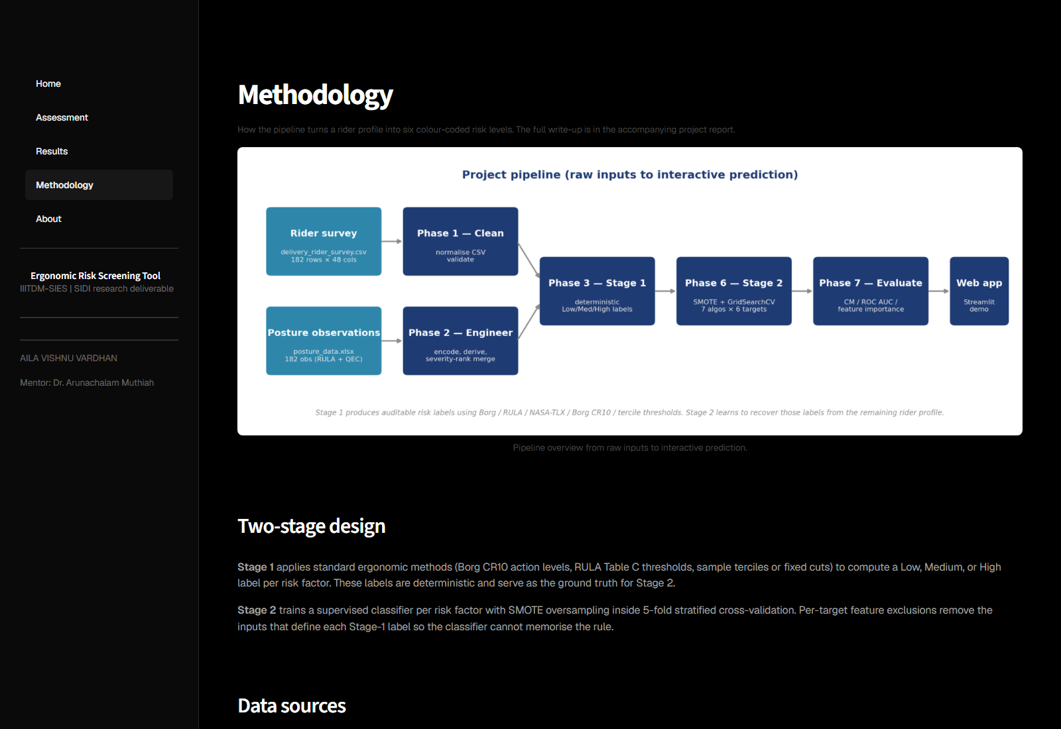
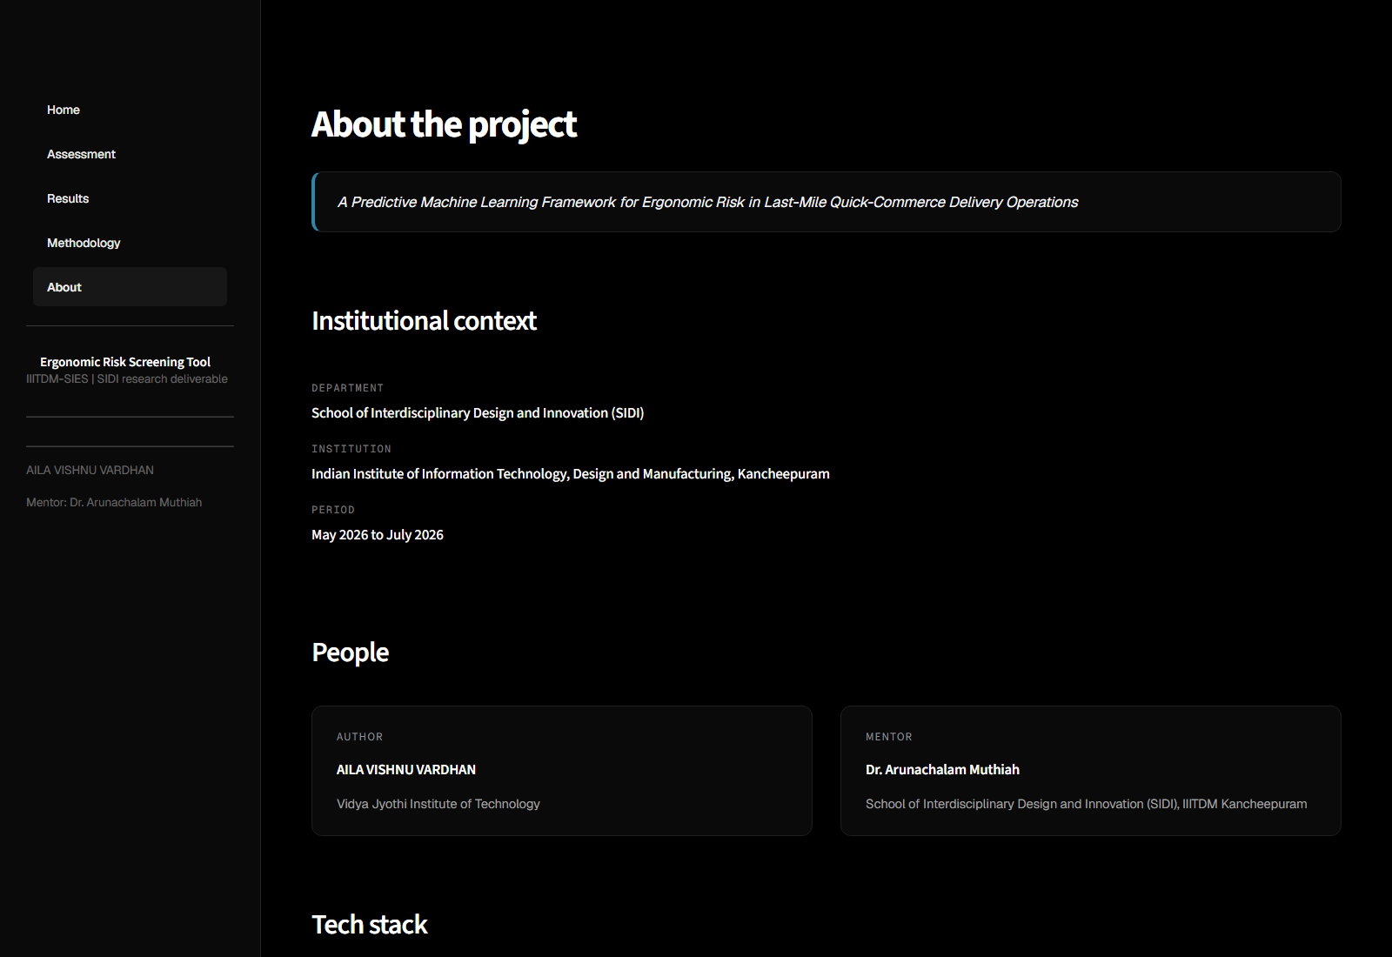
08 DELIVERABLE
Interactive Web Application
Home
Assessment | demographics
Assessment | NMQ 12-month pain
Results | per-factor risk
Methodology
About
A Predictive ML Framework for Ergonomic Risk in Last-Mile Quick-Commerce Delivery Operations | Slide 9/10

Slide 10
09 CONCLUSIONS
Conclusions & Future Work
Key contributions
Platform-level recommendations
• Two-stage pipeline auditable by ergonomists and ML reviewers independently.
• Six per-factor classifiers with honest 5-fold CV metrics.
• Two methodological corrections openly disclosed (Repetition qcut boundary, Duration leakage via vibration_index).
• Multi-page Streamlit web app for real-time screening.
• Cap daily hours (49% of sample > 8 h/day).
• Posture training and equipment review (84% at RULA grand score 5+, action level 3 or 4).
• Prefer bike-storage carriers over handheld bags.
• Age-targeted MSD screening for 36+ cohort.
• Rotate riders through high-workload shifts; watch NASA-TLX and fatigue as leading indicators.
Future work
Longitudinal follow-up study | per-rider RULA observations (eliminate the severity-rank merge) | wearable-accelerometer Vibration proxy | periodic re-training as the workforce evolves.
A Predictive ML Framework for Ergonomic Risk in Last-Mile Quick-Commerce Delivery Operations | Slide 10/10

